Slide 1
3
Jesus Reveals More about God in Three Persons
God Loves: Jesus Christ Enters the World
Notes:
Suggestions for students’ note taking:
●Require students to use a three ring binder (1/2-1 inches) full of loose leaf paper (college or wide ruled).
●Notes must be taken in pen only and hand written.
●Notebooks should contain information and notes for religion class only.
●Notebooks must have a table of contents with topic of notes, dates and page numbers.
●All notes must have a topic and page number.
●Students will be required to copy each slide unless the teacher directs students to skip certain slides or parts of slides. Notebooks will be graded based on neatness, completeness and organization. Notebooks should have a significant point value representing 20-25% of the overall grade.
The videos linked in this presentation file may contain copyright material. Such material is made available for educational purposes only. This constitutes a “fair use” of any such copyright material as provided for in Title 17 U.S.C. section106A-117 of the US Copyright Law.

Slide 2
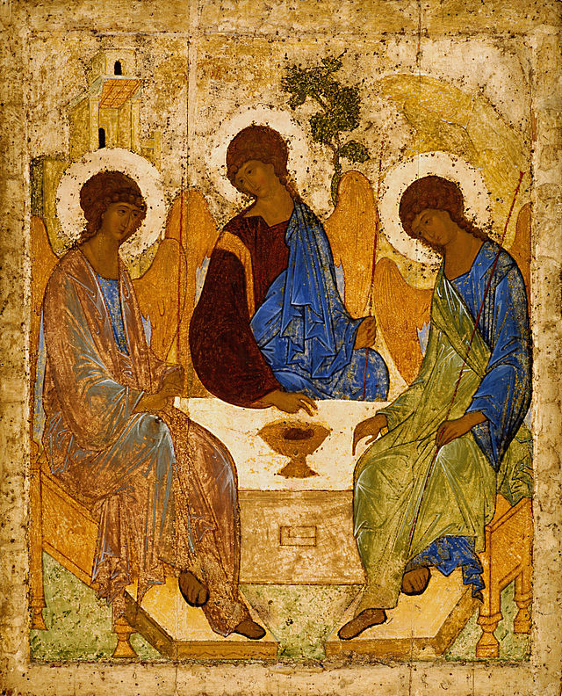
The Holy Trinity
We believe in God the Father, God the Son and God the Holy Spirit.
Notes:
Photo Credit: Holy Trinity. Andrei Rublev. Public domain.Featured picture.Andrey Rublev - Св. Троица - Google Art Project.jpg Copy. https://commons.wikimedia.org/wiki/File:Andrey_Rublev_-_%D0%A1%D0%B2._%D0%A2%D1%80%D0%BE%D0%B8%D1%86%D0%B0_-_Google_Art_Project.jpg
Directions: Have students copy the side information in their notebooks.
Teaching points: CCC 234: ‘The mystery of the Most Holy Trinity is the central mystery of Christian faith and life. It is the mystery of God in himself. It is therefore the source of all the other mysteries of faith, the light that enlightens them. It is the most fundamental and essential teaching in the "hierarchy of the truths of faith".The whole history of salvation is identical with the history of the way and the means by which the one true God, Father, Son and Holy Spirit, reveals himself to men "and reconciles and unites with himself those who turn away from sin".
Through his words and actions, Jesus revealed the central mystery of the Christian faith: that in the one God there are Three Divine Persons: Father, Son, and Holy Spirit. Whenever God acts, the common work of the Divine Persons of the Blessed Trinity is always present. In several places in the Gospels, the distinct properties of the Three Persons are manifest; for example, Three Persons are evident at both Jesus’s Baptism and his Transfiguration. Jesus’s commissioning of his Apostles recorded in Matthew 28:18–20 reveals in a single verse the names of the Divine Persons: “Then Jesus came to them and said, “All authority in heaven and on earth has been given to me. Therefore go and make disciples of all nations, baptizing them in the name of the Father and of the Son and of the Holy Spirit, and teaching them to obey everything I have commanded you. And surely I am with you always, to the very end of the age.”
Online Resources:
Have students view, The Trinity Icon. URL here: https://youtu.be/gE1az7YDA5M
View with class, 16 Beautiful Artistic Depictions of the Holy Trinity. URL here: https://www.churchpop.com/16-beautiful-artistic-depictions-of-the-blessed-trinity/
The videos linked in this presentation file may contain copyright material. Such material is made available for educational purposes only. This constitutes a “fair use” of any such copyright material as provided for in Title 17 U.S.C. section106A-117 of the US Copyright Law.

Slide 3
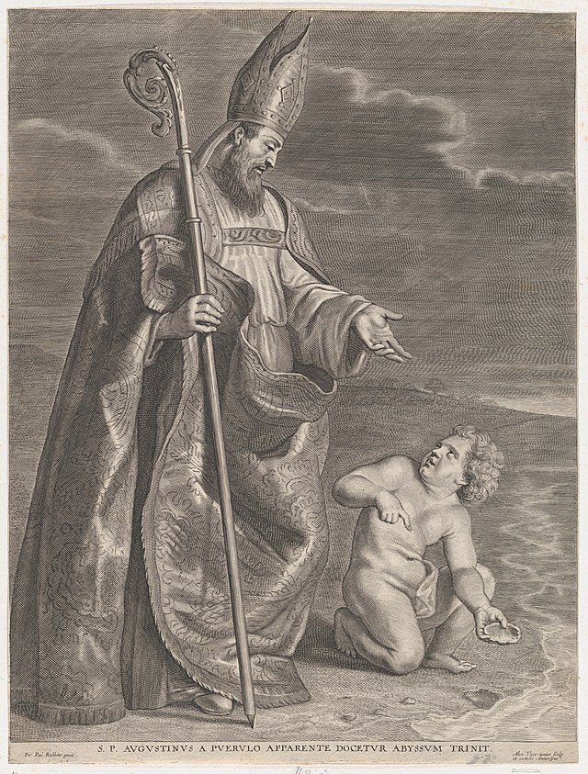
Saint Augustine and the Child
St. Augustine was walking along the seashore, deep in thought, trying to figure out the mystery of the Trinity. “How could there be one God and yet three distinct Persons?” he pondered. He was so engrossed in thought that he almost stumbled over a little boy who was pouring a pail of water into a hole he had dug in the sand. Augustine stopped to chat with the boy. “What are you doing?” he asked. “I’m going to empty the ocean into this hole,” the boy replied. Augustine laughed. “You’ll never get the whole ocean into that little hole,” he said. The boy stood up and looked directly at Augustine and said, “And you, sir, will never put the whole mystery of the Blessed Trinity into your little mind.”
Notes:
Photo Credit: Alexander Voet the Younger. Creative Commons Zero, Public Domain Dedication
Saint Augustine, appearing to a child on a beach. https://commons.wikimedia.org/wiki/File:Saint_Augustine,_appearing_to_a_child_on_a_beach_MET_DP878594.jpg
Directions: Have a student read aloud the story on the slide then ask students, What is the moral of the story?
Teaching Points: Ultimately God is a mystery and to try and explain or comprehend the Mystery of the Trinity is always going to be partial and limited. But we can grasp what has been revealed. As the Bible says, “...we declare God’s wisdom, a mystery that has been hidden and that God destined for our glory before time began. None of the rulers of this age understood it, for if they had, they would not have crucified the Lord of glory. However, as it is written: “What no eye has seen, what no ear has heard, and what no human mind has conceived”— the things God has prepared for those who love him— these are the things God has revealed to us by his Spirit.
The Spirit searches all things, even the deep things of God. For who knows a person’s thoughts except their own spirit within them? In the same way no one knows the thoughts of God except the Spirit of God. What we have received is not the spirit of the world, but the Spirit who is from God, so that we may understand what God has freely given us. This is what we speak, not in words taught us by human wisdom but in words taught by the Spirit, explaining spiritual realities with Spirit-taught words”.
The videos linked in this presentation file may contain copyright material. Such material is made available for educational purposes only. This constitutes a “fair use” of any such copyright material as provided for in Title 17 U.S.C. section106A-117 of the US Copyright Law.

Slide 4
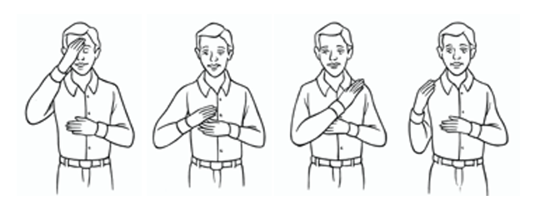
Practice: The Sign of the Cross
In the name of the Father
The Son
and the Holy Spirit
Amen
Notes:
Photo Credit: AMP textbook pg. 115
Directions: Have a students make the sign of the cross together slowly saying the words on the slide.
Teaching Points: As Catholics, we always begin and end our prayer with the Sign of the Cross. When we make the Sign of the Cross, we are telling God we believe in Him, and we are offering our prayers to Him. The Sign of the Cross is a prayer – not just an introduction. Each time that we make the Sign of the Cross and pray the words we give praise to the three Persons of the Blessed Trinity. In the name of the Father and of the Son and of the Holy Spirit.
We are praying in the name of the Father, the Son and the Holy Spirit. “Christians are baptized in the name of the Father and of the Son and of the Holy Spirit: not in their names, for there is only one God, the almighty Father, his only Son and the Holy Spirit: the Most Holy Trinity.” (CCC 233)
In the words of this prayer of the Sign of the Cross, we are calling upon the power of the name of God. The words “In the name of” are synonymous with “in the Person of”. We are placing ourselves under the power and authority of the name of the Father, Son and Holy Spirit. It is essential to know that the prayer, the Sign of the Cross, is not complete when leaving out the words “In the name of. the Father, the Son and the Holy Spirit”.
Amen. The word Amen at the end of the prayer means, “So be it.” (Catechism of the Catholic Church, Hereafter CCC, paragraph 2856) This signifies that we believe the words that we are praying.
The Sign of the Cross expresses two chief mysteries of our Faith: 1) God is a Trinity of Persons – three Persons, One God: Father, Son and Holy Spirit. 2) And Jesus died on the Cross for us.
Online Resources: Have students view video, The Sign of the Cross. URL here: https://youtu.be/9nIZJJphQr4
The videos linked in this presentation file may contain copyright material. Such material is made available for educational purposes only. This constitutes a “fair use” of any such copyright material as provided for in Title 17 U.S.C. section106A-117 of the US Copyright Law.

Slide 5
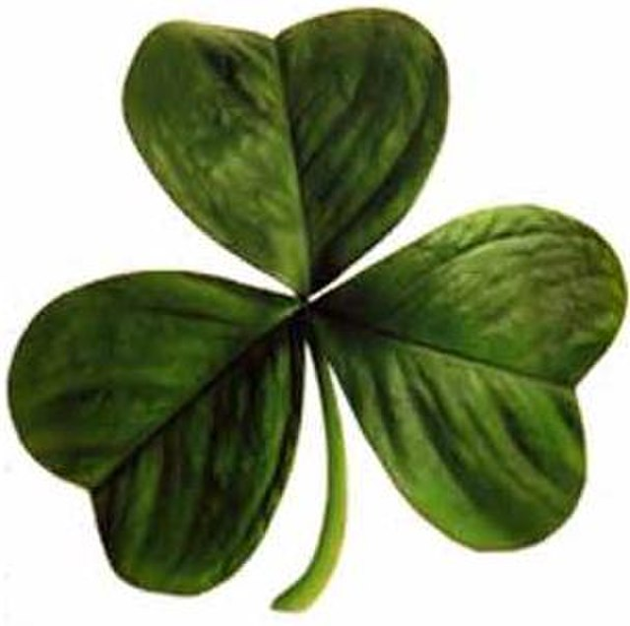
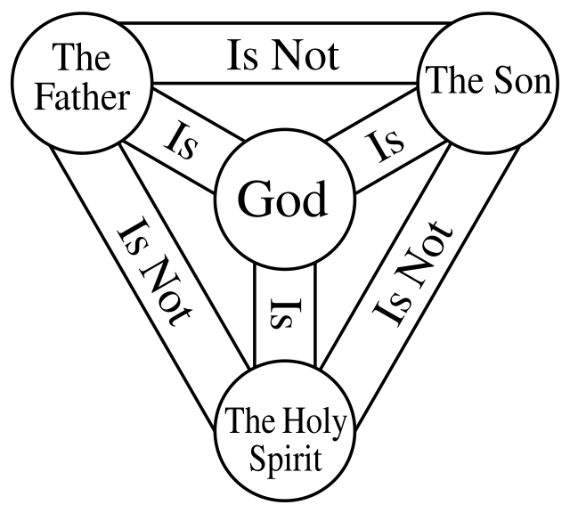
Symbols of the Holy Trinity
A picture is worth a thousand words.
Notes:
Photo Credit: Irish clover.jpg. Creative Commons Attribution-Share Alike 3.0. Irish clover.jpg
User:Anon Moos (earlier version of SVG file Sumudu Fernando). Public domain. Shield-Trinity-Scutum-Fidei-English.svg. [[File:Shield-Trinity-Scutum-Fidei-English. The Sun Clip Art.jpg. This is another bit of clip art of the sun. This work is public domain. Gaut.Chris. Creative Commons Zero, Public Domain Dedication. https://commons.wikimedia.org/. Tree. AMP Textbook pg. 120
Directions: Ask students to volunteer to explain each symbol (refer to textbook for help).
Teaching points: Consider why an equilateral triangle is used in the Shield of the Trinity. What is one way the shamrock symbol is an inaccurate description of the Trinity? How do the tree and sun images of the Trinity communicate sameness and distinction of the Three Divine Persons?
Online Resources: Assign article, Bad Analogies for the Trinity. URL here: https://www.catholic.com/magazine/print-edition/how-not-to-share-the-trinity
The videos linked in this presentation file may contain copyright material. Such material is made available for educational purposes only. This constitutes a “fair use” of any such copyright material as provided for in Title 17 U.S.C. section106A-117 of the US Copyright Law.

Slide 6
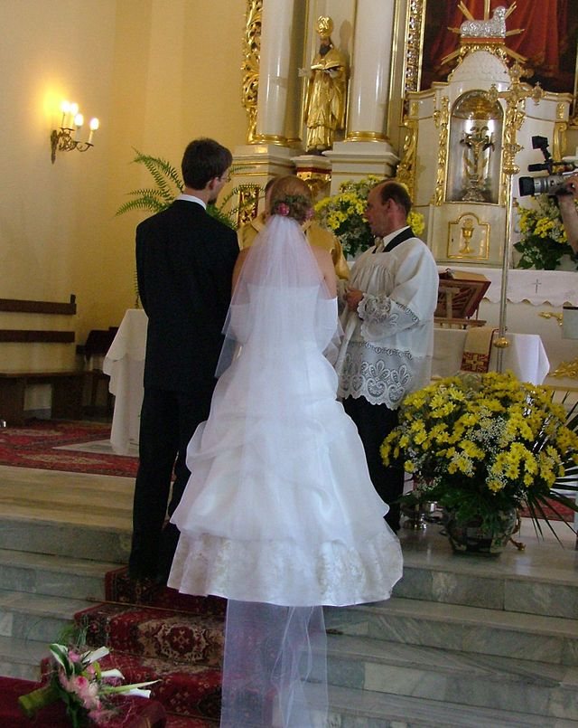
The Trinity as a Model of
Life -Giving Love
God shares the mystery of the Blessed Trinity to help us to understand how he gives his life and his love.
Humans are made in his image as male and female, also participate in life-giving, family love.
Notes:
Photo Credit: Wedding portraits. Międzyrzec Podlaski. Alina Zienowicz Ala z. Creative Commons Attribution-Share Alike 3.0. https://commons.wikimedia.org/wiki/File:Wedding_portraits_(1).jpg
Directions: Have students copy information from the slide into their notes.
Teaching points: “We are created for the sake of love. When we experience love in family life, it is heavenly, but it is still only an image of the greater glory we hope to behold in heaven.” ― Scott Hahn. Human families are called to image the Trinity in concrete ways. A hu band loves a wife and receives her love; a wife loves a husband and receives his love; and their love is so great that it actually pours forth another person— that is, their child.
If God is not a Trinity, God is not love. For love requires three things: a lover, a beloved, and a relationship between them. If God were only one person, he could be a lover, but not love itself. The Father loves the Son and the Son loves the Father, and the Spirit is the love proceeding from both, from all eternity. If that were not so, then God would need us, would be incomplete without us, without someone to love. Then his creating us would not be wholly unselfish, but selfish, from his own need.
We are made in the image of God, which means there is something Trinitarian about us, as well. No, we don’t exist as three persons in one being. But we are made to be in relationship. This is why Christ commands us to love God and our neighbors (Mk 12:31), and why He teaches that we will be judged according to how we treat our neighbors (Mt 25:31-46). We are made for community. We are made for communion. Marriage and Family life exemplify this reality.
“Marriage is the icon of God’s love for us. Indeed, God is also communion: the three Persons of the Father, the Son and the Holy Spirit live eternally in perfect unity. And this is precisely the mystery of marriage: God makes of the two spouses one single existence…” -Pope Francis
The videos linked in this presentation file may contain copyright material. Such material is made available for educational purposes only. This constitutes a “fair use” of any such copyright material as provided for in Title 17 U.S.C. section106A-117 of the US Copyright Law.

Slide 7
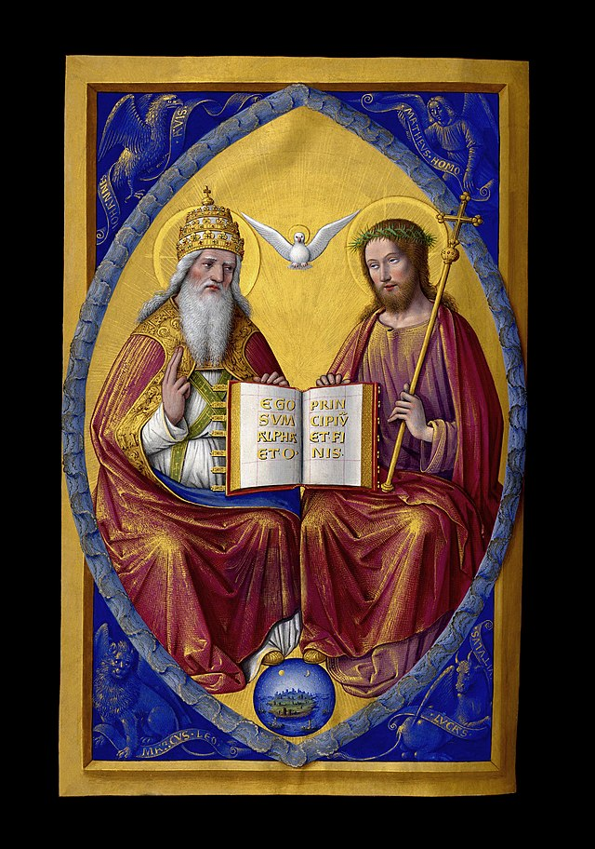
God the Father and God the Son
Jesus called God ‘Abba’ which translates to ‘daddy’ or ‘papa’.
Jesus loved to do the will of his Father.
Jesus spent alone time conversing with the Father.
Jesus used parables like the Tenants and the Prodigal Son to reveal the Person of the Father.
Notes:
Photo Credit: Trinité Grandes Heures Anne de Bretagne.jpg. Jean Bourdichon. Public domain. https://commons.wikimedia.org/wiki/File:Trinit%C3%A9_Grandes_Heures_Anne_de_Bretagne.jpg
Directions: Have students copy information down in their notes. Teaching point:
Teaching Points: During his earthly ministry, Jesus taught that the God he called Abba, or “Father,” was the same God who had made covenants with the Chosen People in the Old Testament. To highlight his unique relationship as God’s only Son, Jesus referred to God as “my heavenly Father” (Mt 15:13).
The videos linked in this presentation file may contain copyright material. Such material is made available for educational purposes only. This constitutes a “fair use” of any such copyright material as provided for in Title 17 U.S.C. section106A-117 of the US Copyright Law.

Slide 8
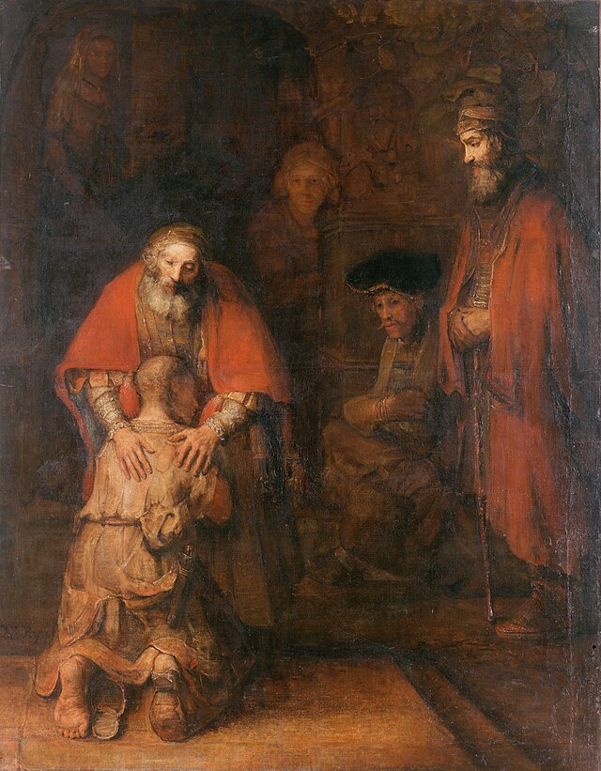
Jesus Reveals His Father’s Mercy
But while he was still a long way off, his father saw him and was filled with compassion for him; he ran to his son, threw his arms around him and kissed him. -Luke 15:20
Notes:
Photo Credit: The Return of The Prodigal Son. Rembrandt. Public Domain. https://commons.wikimedia.org/wiki/File:Rembrandt_Harmensz._van_Rijn_-_The_Return_of_the_Prodigal_Son.jpg
Directions: Have students copy the side information in their notebooks. Read The Prodigal Son parable aloud…Luke 15:11-31.
Teaching points: Jesus’s teachings reveal the Father’s unconditional and total love for humanity. God is like the Good Shepherd who went out of his way to find a lost sheep (see Matthew 18:10–14). (Jesus is the Good Shepherd.) God is like the father in the parable of the lost son who welcomed back his wayward child with open arms—no questions asked.
Online Resources: Have students view video, Rembrandt’s Prodigal Son. URL here: https://youtu.be/IIEILdxeyvc
The videos linked in this presentation file may contain copyright material. Such material is made available for educational purposes only. This constitutes a “fair use” of any such copyright material as provided for in Title 17 U.S.C. section106A-117 of the US Copyright Law.

Slide 9
Jesus and the Holy Spirit Partnership
The Holy Spirit descended on Jesus at his baptism.
Jesus was filled with the Holy Spirit and led into the desert
Jesus was conceived by the power of the Holy Spirit
The
Holy Spirit
helped Simeon recognize Jesus
Jesus began his public ministry “in the power of the Spirit”
Jesus gradually taught about the Holy Spirit
Jesus asked the Father to pour out the Holy Spirit on the Church
Notes:
Directions:. Have students copy the side information in their notebooks.
Teaching points: The Holy Spirit is eternally in union with Jesus. Since their wills are perfectly aligned, they work together to accomplish the plan of the Father to accomplish our redemption and sanctification.
The videos linked in this presentation file may contain copyright material. Such material is made available for educational purposes only. This constitutes a “fair use” of any such copyright material as provided for in Title 17 U.S.C. section106A-117 of the US Copyright Law.

Slide 10
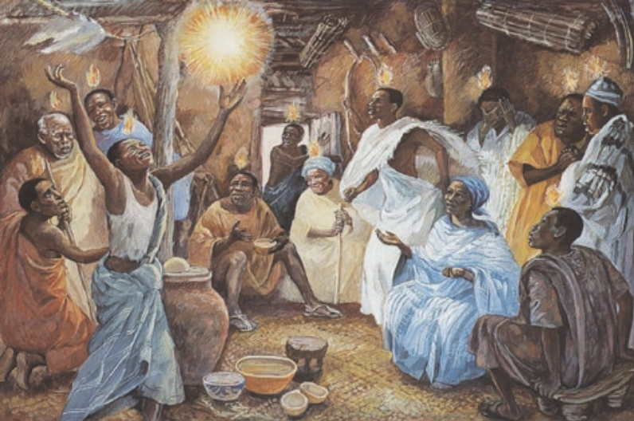
The Church and The Trinity
By the power of love in the Son’s redemption of the Church and by the Holy Spirit animating and sanctifying the Church, God the Father fulfills the "plan of his loving goodness" of creation, redemption and sanctification.
Notes:
Photo Credit: AMP textbook, p.134.
Directions: Have students copy the side information in their notebooks.
Teaching Points: Each Person of the Trinity has a role to play in our salvation. The Father has a plan of salvation, the Son gives his life to save us from sin and to carry out the Father’s plan and the Holy Spirit completes the plan by giving divine life and sanctification in and through the Church.
Online Resources: View video, ‘Redemption and Salvation’ (Economy of Salvation). URL here: https://youtu.be/d-GOVQOoN5c
View video, Bishop Barron on the meaning of The Holy Trinity. URL here: https://youtu.be/5l-Lv9tGQwI
See website, Trinity in the New Testament. URL here: https://catholic-resources.org/Bible/Trinity.htm
The videos linked in this presentation file may contain copyright material. Such material is made available for educational purposes only. This constitutes a “fair use” of any such copyright material as provided for in Title 17 U.S.C. section106A-117 of the US Copyright Law.

Slide 11
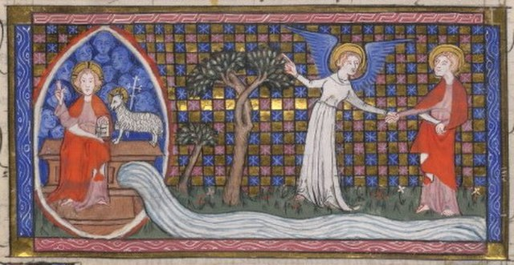
Proceeds
Key
Vocab
Protestants who interpret each word or phrase in the
Bible from a literalist point of view.
In the Creed we say, ‘The Holy Spirit proceeds from the Father and the Son’…This means ‘to come from or to be sent’. "I will send the Holy Spirit from the Father" said Jesus in John 14:26
Notes:
Photo Credit: Yates Thompson. The angel shows St John the throne of God and the Lamb, the river of the water of life flowing from the throne, and the tree of life (Revelation 22: 1-2). Anonymous. Public domain. https://commons.wikimedia.org/wiki/File:Yates_Thompson_MS_10_-_f38r._River_of_Life.jpg
Directions: Have students add this vocabulary term to their notes.
Teaching Points: As the Father begets his Son in the love of the Holy Spirit, so the Son, in turn, loves the Father in the same Holy Spirit. Thus, the Holy Spirit proceeds or ensues from the Father as the paternal love of the Father for the Son, and proceeds or ensues from the Son as the filial love of the Son for the Father.
Online Resources: View video, ‘Does the Holy Spirit Proceed from the Father and the Son?’. URL here: https://youtu.be/mOxD0dA1C8k
Have students view, ‘Comments on the Filioque Controversy’. URL here: https://youtu.be/kKA5PzAhsYw
The videos linked in this presentation file may contain copyright material. Such material is made available for educational purposes only. This constitutes a “fair use” of any such copyright material as provided for in Title 17 U.S.C. section106A-117 of the US Copyright Law.

Slide 12
“How can there be one God but we refer to three names: Father, Son and Holy Spirit?”
The key is to distinguish between person and nature. God exists as three distinct Persons who are all eternal and equally divine in nature and therefore one God.
Notes:
Directions: Begin by asking the question on the screen. After calling on students to respond, have the answer fly in using the animation feature.
The videos linked in this presentation file may contain copyright material. Such material is made available for educational purposes only. This constitutes a “fair use” of any such copyright material as provided for in Title 17 U.S.C. section106A-117 of the US Copyright Law.

Slide 13
Person and Nature
Key
Vocab
God is three Persons in one Divine Nature. To have a Divine Nature is to possess all the attributes that make God who He is. To be a Person is to have intelligence, affection, a specific role and to take action. Each Person of the Trinity is co-equal and united in their divine will.
Protestants who interpret each word or phrase in the
Bible from a literalist point of view.
Notes:
Photo Credit: Shield-Trinity-Scutum-Fidei-English.svg. [[File:Shield-Trinity-Scutum-Fidei-English. The Sun Clip Art.jpg. This is another bit of clip art of the sun. This work is public domain. Gaut.Chris. Creative Commons Zero, Public Domain Dedication. https://commons.wikimedia.org/.
Directions: Have students add this vocabulary term to their notes.
Online Resources: View video, The Trinity’s Biblical Basis.URL here: https://youtu.be/wmNt9iu0fH8
The videos linked in this presentation file may contain copyright material. Such material is made available for educational purposes only. This constitutes a “fair use” of any such copyright material as provided for in Title 17 U.S.C. section106A-117 of the US Copyright Law.

Slide 14
Turn and Talk
To which Person of the Blessed Trinity do you usually address your prayer? Father, Son or Holy Spirit. Why do you think this is so?
When at the Last Supper Jesus said about the Eucharist, “This is my Body” why do you think most Protestants do not interpret that as literal and Catholics do?
Notes:
Directions: Have students write down the question and then write down their answer….Then have students share their answers with one person close by. Call on volunteers to share with the whole class.
The videos linked in this presentation file may contain copyright material. Such material is made available for educational purposes only. This constitutes a “fair use” of any such copyright material as provided for in Title 17 U.S.C. section106A-117 of the US Copyright Law.

Slide 15
Memorize It
Key
Verse
“Go, thereforeand make disciples of all nations, baptizing them in the name of the Father, and of the Son, and of the Holy Spirit…”
-Mt 28:19
Notes:
Directions: Have students copy the quote. Add bonus points to the assessment if they can copy it down demonstrating that they memorized it.
The videos linked in this presentation file may contain copyright material. Such material is made available for educational purposes only. This constitutes a “fair use” of any such copyright material as provided for in Title 17 U.S.C. section106A-117 of the US Copyright Law.

