Slide 1
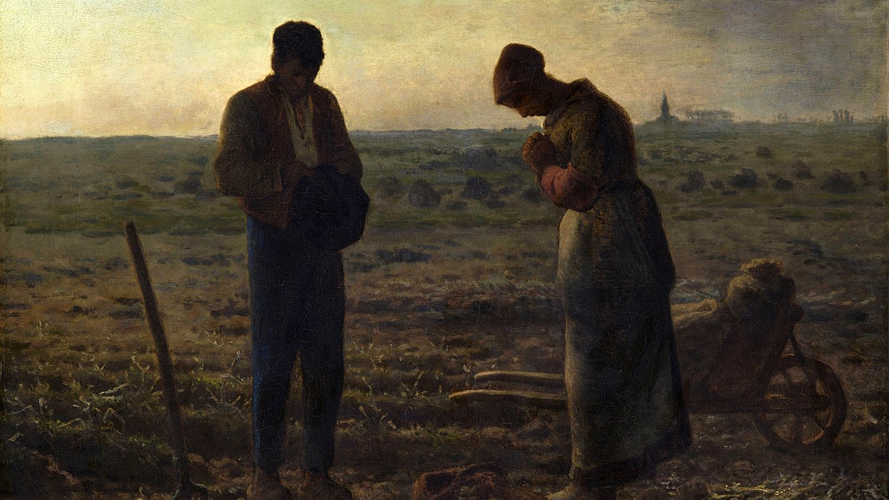
5
Jesus’s Own Mother Leads Us to Him
God Loves: Jesus Christ Enters the World
Notes:
Photo Credit: The Angelus. Jean-François Millet. Public Domain.
Suggestions for students’ note taking:
●Require students to use a three ring binder (1/2-1 inches) full of loose leaf paper (college or wide ruled).
●Notes must be taken in pen only and hand written.
●Notebooks should contain information and notes for religion class only.
●Notebooks must have a table of contents with topic of notes, dates and page numbers.
●All notes must have a topic and page number.
●Students will be required to copy each slide unless the teacher directs students to skip certain slides or parts of slides. Notebooks will be graded based on neatness, completeness and organization. Notebooks should have a significant point value representing 20-25% of the overall grade.
The videos linked in this presentation file may contain copyright material. Such material is made available for educational purposes only. This constitutes a “fair use” of any such copyright material as provided for in Title 17 U.S.C. section106A-117 of the US Copyright Law.

Slide 2
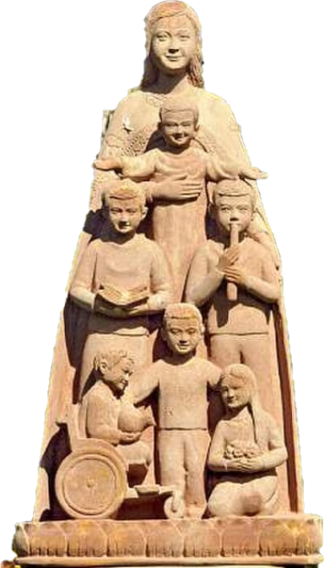
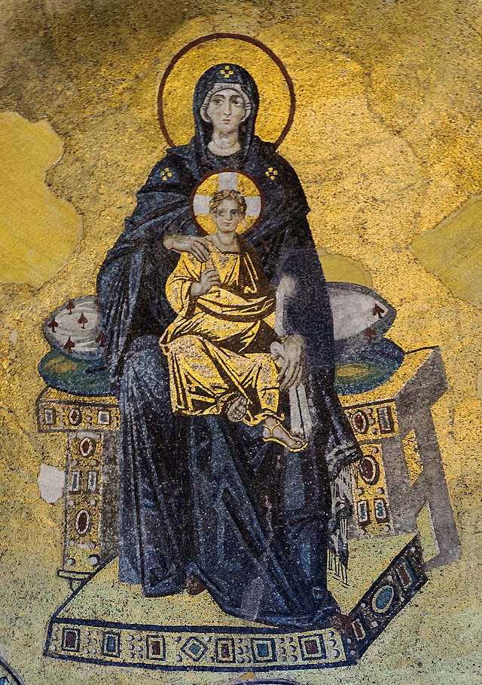
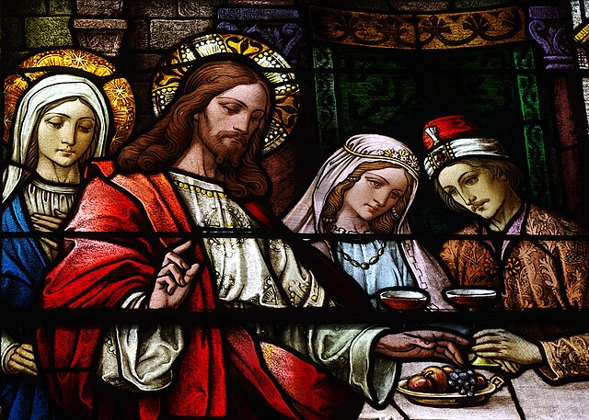
Special Titles for Mary
Advocate
Mother of all Christians
Mother of God
Spouse of the Holy Spirit
Notes:
Photo Credit: Kike Figaredo. Public domain. Mary Mother of Inclusive Love. Cropped.https://commons.wikimedia.org/wiki/File:Mary_Mother_of_Inclusive_Love.jpg . the Wedding at Cana, detail
Nheyob.Creative Commons Attribution-Share Alike 3.0. The Virgin and Child (Theotokos) mosaic, in the apse of Hagia Sophia (Istanbul, Turkey).Photograph: Myrabella.Public domain. Hans Memling. Public domain. Annunciation Memling cropped. https://commons.wikimedia.org
Directions: Have students copy down information from the slide into their notes.
Teaching Points:
An advocate is someone who “argues for a cause” or “pleads on another’s behalf.” When they were on earth, Mary and all the saints cooperated with God to do good work on behalf of others. From heaven, Mary continues to take on Jesus’s Own Life Reveals More about the Nature of God. Mary’s role is to plead on behalf of humankind to her Son through the Holy Spirit and, ultimately, to God the Father for others who are in need on earth and those in Purgatory. At the wedding at Cana (see John 2:1–12) Mary saw the need for more wine and asked Jesus to do something about it.
Mother of Christians: The Virgin Mary is considered the Mother of Christians because she is the mother of Jesus Christ, who is considered the Head of the Church. As such, Mary is also considered the mother of the Church."When Jesus saw his mother, and the disciple whom he loved standing near, he said to his mother, 'Woman, behold, your son!'. Then he said to the disciple, 'Behold, your mother!’" (Jn 19:26-27).
Mother of God: The title “Mother of God” is a Roman Catholic way of saying the Greek ‘Theotokos’, which means “God-bearer”. Mary was chosen by God, the Father, to bring Jesus Christ into this world. Since Jesus is God, Mary is called the mother of God. She freely accepted the Father’s plan and she was given grace to carry it out.
Spouse of the Holy Spirit: Pope Leo XIII mentioned the spousal relationship between the Holy Spirit and the Blessed Virgin in an 1897 encyclical: “Let all Christian peoples add their prayers also, invoking the powerful and ever-acceptable intercession of the Blessed Virgin. You know well the intimate and wonderful relationship existing between her and the Holy Spirit, so that she is justly called His Spouse. May she continue to strengthen our prayers with her prayers” (Divinum Illud Munus/That Divine Gift, n.14). “And the angel answered her, “The Holy Spirit will come upon you, and the power of the Most High will overshadow you; therefore the child to be born will be called holy—the Son of God” (Lk 1:35).
Online Resources: View as a class, The LItany of the Blessed Virgin Mary. URL here: https://www.nashvilledominican.org/prayer/litanies/litany-of-the-blessed-virgin-mary/
View video: Litany of the Blessed virgin Sung in Latin. URL here:
https://youtu.be/oKsh2EDNt-E
The videos linked in this presentation file may contain copyright material. Such material is made available for educational purposes only. This constitutes a “fair use” of any such copyright material as provided for in Title 17 U.S.C. section106A-117 of the US Copyright Law.

Slide 3
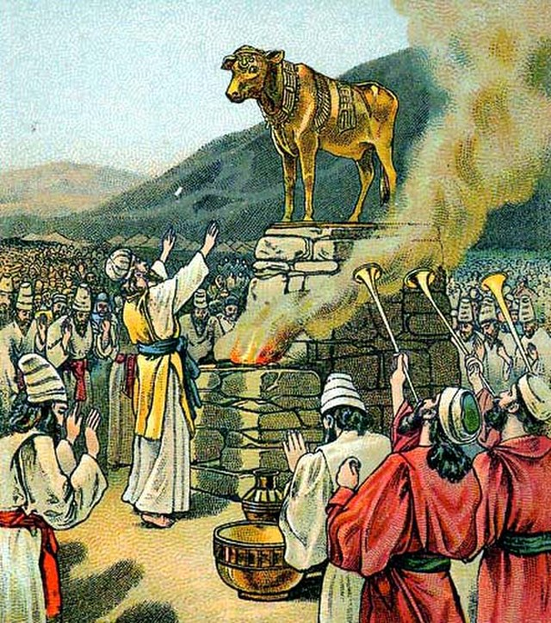
Idolatry
Key
Vocab
The worship of idols. Idolatry is an offense against the First Commandment, in which God says that we are to have “no other gods besides me.” Idolatry is always a grave sin.
Notes:
Photo Credit: Providence Lithograph Company.Public domain. Worshiping the golden calf. https://commons.wikimedia.org/wiki/File:Worshiping_the_golden_calf.jpg
Directions: Have students copy the term and the definition in the vocabulary section of their notes.
Teaching Points: Biblical idolatry is the worship of physical statues, images or icons connected to false gods. In the New testament, Colossians 3:5 says, "Put to death therefore what is earthly in you: sexual immorality, impurity, passion, evil desire, and covetousness, which is idolatry".
In modern society, idolatry can take many forms. Some common examples include prioritizing material possessions, wealth, fame, relationships, pleasure, power or even social media popularity above God and religious faith.
Online Resources: Have students view video, Bishop Barron on Idolatry. URL here: https://youtu.be/fWiEoZhyrQc
The videos linked in this presentation file may contain copyright material. Such material is made available for educational purposes only. This constitutes a “fair use” of any such copyright material as provided for in Title 17 U.S.C. section106A-117 of the US Copyright Law.

Slide 4
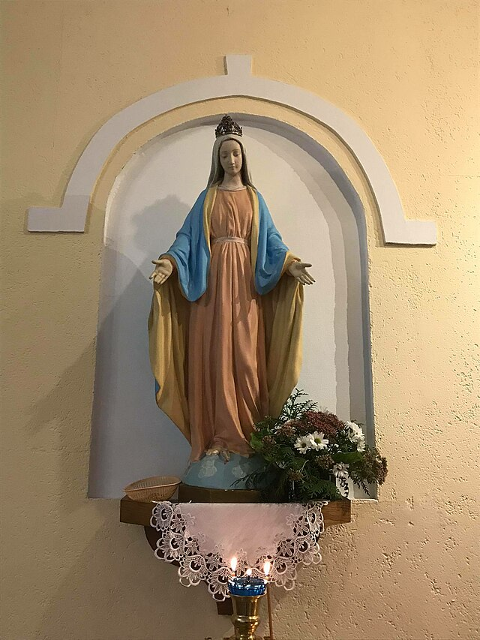
Veneration
Key
Vocab
To venerate is way of showing respect or reverence to people, such as saints or relics. It's different from worship, which is a type of respect that's reserved for God alone.
Notes:
Photo Credit: Nizhny Novgorod. Mapatxea. Creative Commons Attribution-Share Alike 4.0
Statue of the Virgin Mary. https://commons.wikimedia.org/wiki/File:Statue_of_the_Virgin_Mary_(Catholic_Assumption_Church,_Nizhny_Novgorod).jpg
Directions: Have students copy the term and the definition in the vocabulary section of their notes.
Teaching Point: How to venerate relics: In general the Church recommends an exterior gesture that fits the occasion and corresponds to a person’s interior disposition. Someone venerating a saint’s relic can kiss or touch the glass case that houses the relic, or simply stand near the relic in a prayerful attitude, raising one’s heart and mind to God and invoking the intercession of the saint.
Other acceptable gestures include signing oneself with the sign of the cross or kneeling in front of the relic in prayer. However, a person should not genuflect before the relic in a way similar to genuflecting before the Blessed Sacrament. Christ alone is reserved that type of veneration.
Online Resources: Have students view video, The Difference Between Veneration and Worship Explained. URL here: https://youtu.be/i8raYi6JsGE
The videos linked in this presentation file may contain copyright material. Such material is made available for educational purposes only. This constitutes a “fair use” of any such copyright material as provided for in Title 17 U.S.C. section106A-117 of the US Copyright Law.

Slide 5
Challenge
Question
The word ‘pray’ primarily means ‘to ask’. So when we pray to Mary or any Saint, we are simply asking her/them to intercede on our behalf. The Bible says, “The prayers of the righteous are very powerful” (James 5:16). Mary’s prayers are efficacious (powerful) because Jesus honors her request as she is his holy mother.
Why do Catholics pray to Mary? Isn’t that idolatry?
Notes:
Directions: Use the animation feature to have the yellow answer box appear after you ask the students to respond out loud to the question on the left.
Online Resources: View video, Why do Catholics Pray to Mary?. URL here: https://youtu.be/J9IFJ7mBo7M
Assign article, Bible Christians should pray to Mary Too. URL here: https://www.catholic365.com/article/30190/why-bible-christians-should-pray-to-mary.html
The videos linked in this presentation file may contain copyright material. Such material is made available for educational purposes only. This constitutes a “fair use” of any such copyright material as provided for in Title 17 U.S.C. section106A-117 of the US Copyright Law.

Slide 6
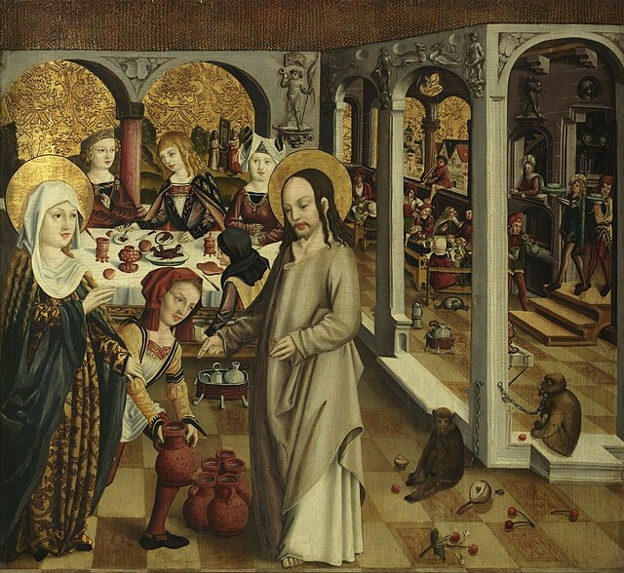
The Wedding at Cana
Mary showed that she was a concerned mother.
She noticed the small problems.
She knew Jesus was the answer to the problems.
She interceded and asked Jesus to help.
She told the people to listen to whatever Jesus says.
Jesus honored her request.
Notes:
Photo Credit: Oil on panel painting by an anonymous artist from Swabia. Anonymous early 16th-century artist. Public domain. The Wedding at Cana. https://commons.wikimedia.org/wiki/File:The_Wedding_at_Cana_(Unterlinden_Museum).jpg
Directions: Have students copy information from the slide into their notes.
Online Resources: Have students view video, The Wedding at Cana and Jesus’ Response to Mary. URL here: https://youtu.be/DkhSlFYLgXg
The videos linked in this presentation file may contain copyright material. Such material is made available for educational purposes only. This constitutes a “fair use” of any such copyright material as provided for in Title 17 U.S.C. section106A-117 of the US Copyright Law.

Slide 7
Turn and Talk
What are some small problems in your life that Mary might be able to intercede on your behalf as your heavenly mother?
Notes:
Directions: Have students write down the question and then write down their answer….Then have students share their answers with one person close by.
The videos linked in this presentation file may contain copyright material. Such material is made available for educational purposes only. This constitutes a “fair use” of any such copyright material as provided for in Title 17 U.S.C. section106A-117 of the US Copyright Law.

Slide 8
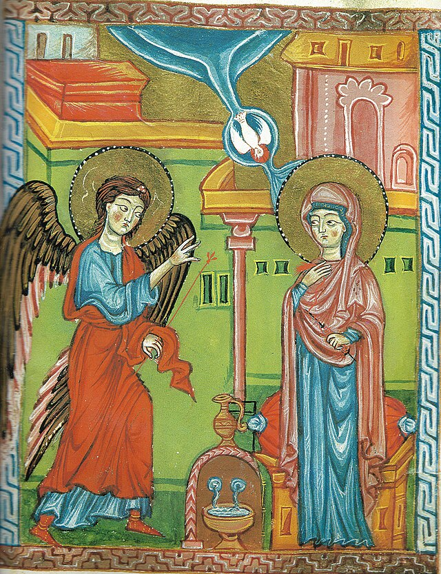
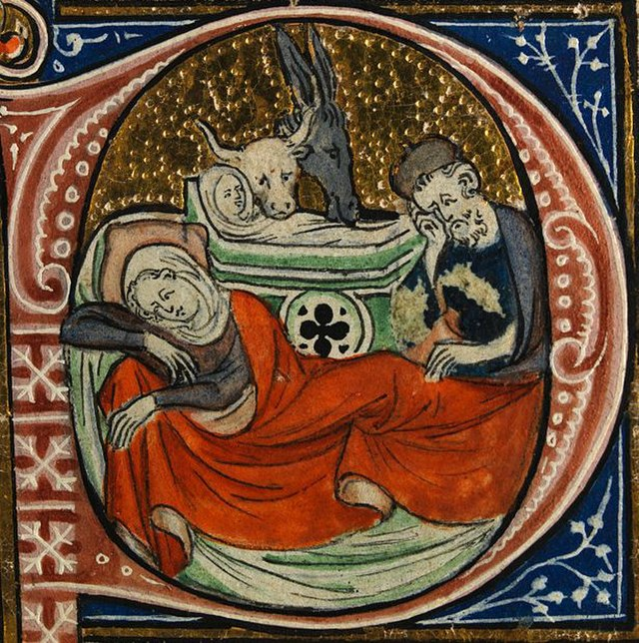
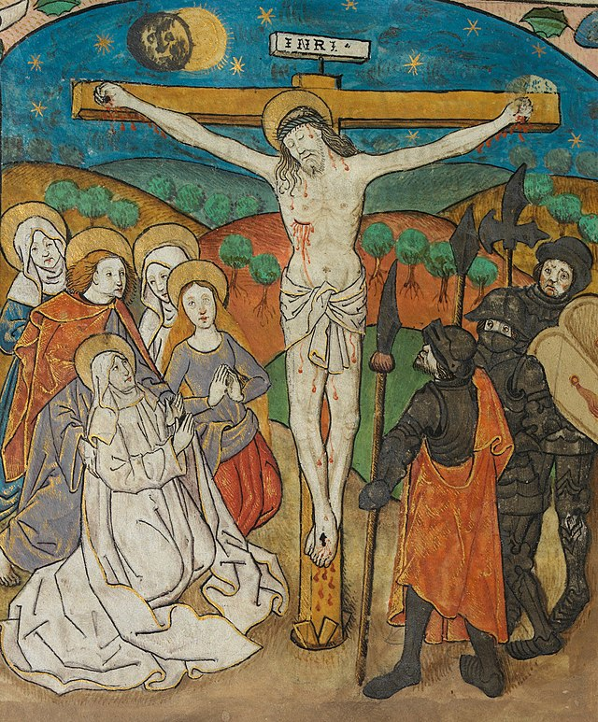
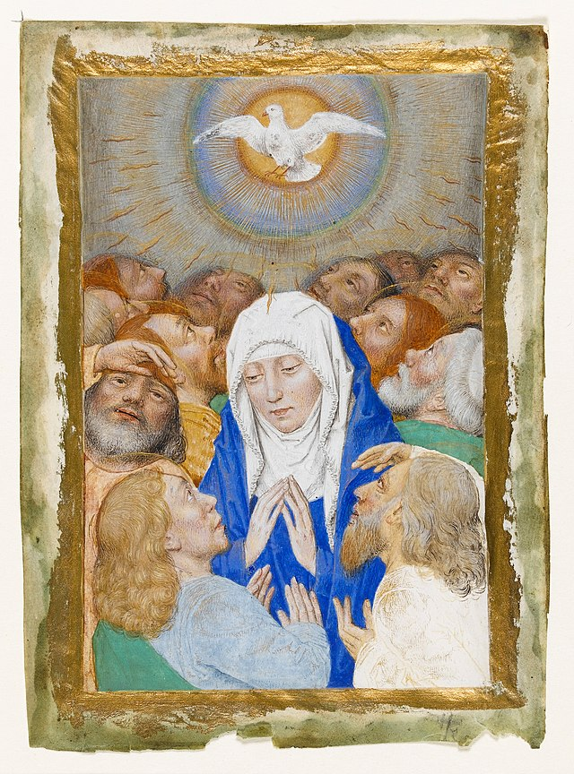
Four Other Biblical Events & Mary
Annunciation
Birth of Jesus
At the Foot of the Cross
Pentecost
Notes:
Photo Credit: The annunciation, University of Gladzor. Toros Taronasi. Nativity from Sherbrooke Missal.
Public domain. Unknown author. Creative Commons Zero, Public Domain Dedication. The Crucifixion. Christ dead on the Cross, with the Virgin Mary, John and the Three Maries mourning. Unknown author. Creative Commons Zero, Public Domain Dedication. Miniature: Pentecost showing the Virgin surrounded by 12 apostles, Hainaut, Valenciennes (c 1480-1490) by follower or Simon Marmion. Follower of Simon Marmion. Public domain. https://commons.wikimedia.org/
Directions: Have students copy information from the slide into their notes.
Teaching Points: Mary in the New Testament
The Gospel of Luke mentions Mary the most often, identifying her by name twelve times, all of these in the infancy narrative (Luke 1:27–2:34).
The Gospel of Matthew mentions her by name five times, four of these (1:16, 18, 20: 2:12) in the infancy narrative and only once (Matthew 13:55) outside the infancy narrative.
The Gospel of Mark names her once (Mark 6:3) and mentions Jesus' mother without naming her in Mark 3:31–32.
The Gospel of John refers to the mother of Jesus twice, but never mentions her name. She is first seen at the wedding at Cana (John 2:1–12).The second reference has her standing near the cross of Jesus together with Mary Magdalene, Mary of Clopas (or Cleophas), and her own sister (possibly the same as Mary of Clopas; the wording is semantically ambiguous), along with the "disciple whom Jesus loved" (John 19:25–26).John 2:1–12 is the only text in the canonical gospels in which the adult Jesus has a conversation with Mary. He does not address her as "Mother" but as "Woman". In Koine Greek (the language that the Gospel of John was composed in), calling one's mother "Woman" was not disrespectful, and could even be tender.Accordingly, some versions of the Bible translate it as "Dear woman"
In the Acts of the Apostles, Mary and the brothers of Jesus are mentioned in the company of the eleven apostles who are gathered in the upper room after the Ascension of Jesus (Acts 1:14).
In the Book of Revelation, the "woman clothed with the sun" (Revelation 12:1, 12:5–6) is identified as Mary.
Online Resources: Assign article, Scripture on the Life of Mary. URL here: https://udayton.edu/imri/mary/s/scripture-on-the-life-of-mary.php
Assign article, Mary in the New Testament. URL here: https://www.motherofallpeoples.com/mary-in-the-new-testament
The videos linked in this presentation file may contain copyright material. Such material is made available for educational purposes only. This constitutes a “fair use” of any such copyright material as provided for in Title 17 U.S.C. section106A-117 of the US Copyright Law.

Slide 9
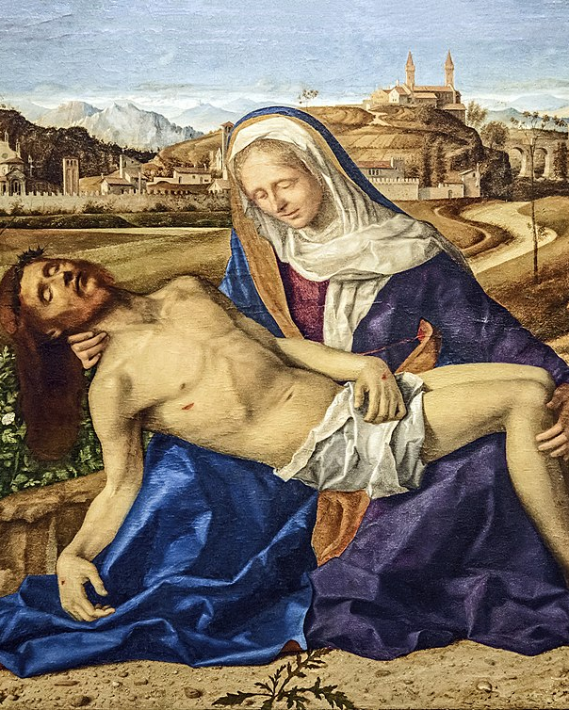
The Suffering of Mary
“Simeon blessed them and said to Mary his mother, “Behold, this child is destined for the fall and rise of many in Israel, and to be a sign that will be contradicted and you yourself a sword will pierce so that the thoughts of many hearts may be revealed.”
-Lk 2:34-35
Notes:
Photo Credit: Pietà Martinengo. Giovanni Bellini. Public Domain.
Directions: Have students copy information from the slide into their notes.
Teaching Point: The feast day of Our Lady of Sorrows is observed on September 15. The occasion is a time for reflection on Mary’s sorrows as the Mother of Christ and her example of perseverance through suffering.
The Seven Sorrows
Mary experienced many trials throughout her life, beginning with the prophecy of Simeon shortly after the birth of Jesus. The Holy Family then had to flee to Egypt to escape Herod’s clutches. The most significant of her sorrows, however, was undoubtedly the crucifixion of her son.
Altogether, there are seven traditional sorrows of Mary:
The prophecy of Simeon (Luke 2:25-35)
The flight into Egypt (Matthew 2:13-15)
Loss of the Child Jesus for three days (Luke 2:41-50)
Mary meets Jesus on his way to Calvary (Luke 23:27-31; John 19:17)
Crucifixion and death of Jesus (John 19:25-30)
The body of Jesus being taken from the Cross (Luke 23:50-54; John 19:31-37)
The burial of Jesus (Luke 23:50-56; John 19:38-42; Mark 15:40-47)
Online Resources: Have students view, The Seven Sorrows of Mary. URL here: https://youtu.be/QF1Ak_vNPZ0
The videos linked in this presentation file may contain copyright material. Such material is made available for educational purposes only. This constitutes a “fair use” of any such copyright material as provided for in Title 17 U.S.C. section106A-117 of the US Copyright Law.

Slide 10
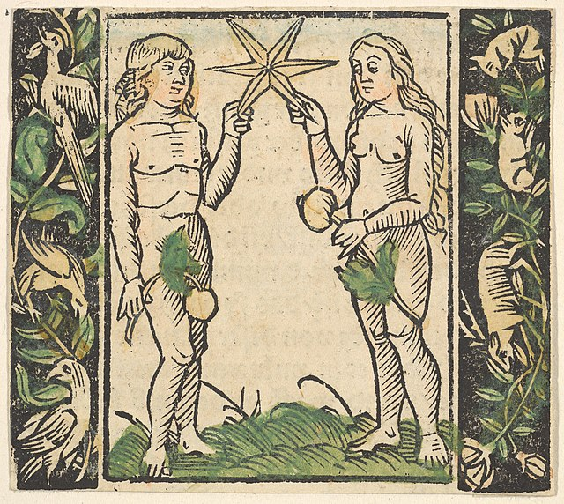
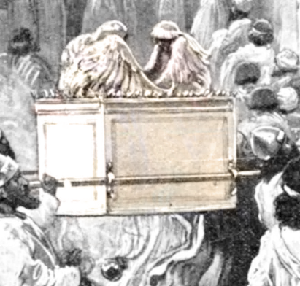
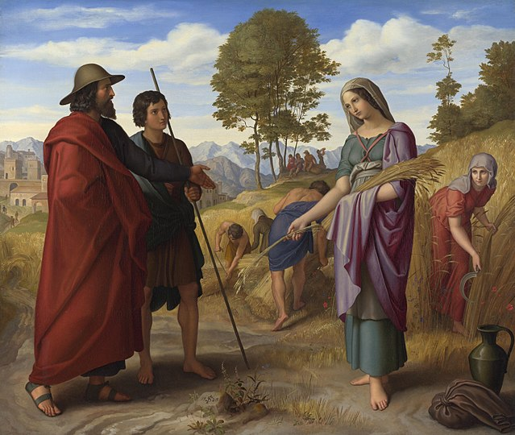
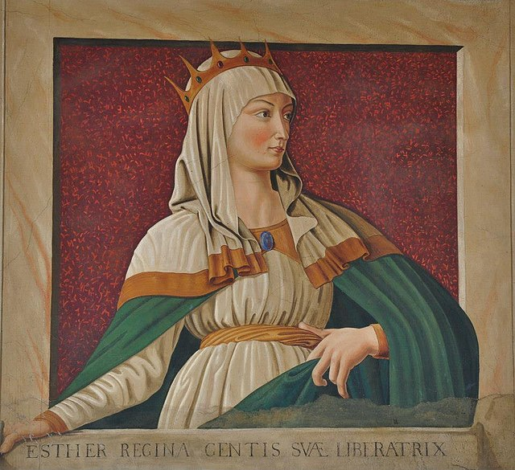
Four O.T. Types of Mary
Eve
The Ark of the Covenant
Ruth
Queen Esther
Notes:
Photo Credit: Hans Baldung Grien. Creative Commons Zero, Public Domain Dedication.Adam and Eve Holding a Star. Paul Hardy. Public domain. Ark of the Covenant . Ruth in the field. Julius Schnorr von Carolsfeld. Public domain. Cropped. Copy of the picture. Queen Esther by Andrea del Castagno.jpg
Nicolas Lokhoff. Copy of the picture: Queen Esther by Andrea del Castagno. Nicholas Lokhoff. Public domain. https://commons.wikimedia.org/
Directions: Have students copy information from the slide into their notes.
Teaching Points: Many people think Mary is only briefly mentioned in the Bible but that is not true. We are going to see that Mary is present in Sacred Scripture before she was even born through people, places and things that prepared for her role in this world. After all, "Early Christian catechesis made constant use of the Old Testament. As an old saying put it, the New Testament lies hidden in the Old and the Old Testament is unveiled in the New” (CCC 129). Mary is indeed hidden in many people, places and things in the Old Testament. We can find several examples of where God made people and things that remind us of Mary…
Eve: Saint Irenaeus wrote that “the knot of Eve’s disobedience was untied by the obedience of Mary; what the virgin Eve bound by her unbelief, the Virgin Mary loosened by her faith”
The Ark of the Covenant: “Mary, in whom the Lord himself has just made his dwelling, is the daughter of Zion in person, the Ark of the covenant, the place where the glory of the Lord dwells. She is “the dwelling of God . . . with men.” (CCC 2676)
Ruth: Ruth's faithfulness to God is rewarded with the birth of a child, Obed, who is the father of Jesse and David. Mary is also a model of faith throughout her life, as recorded in the New Testament.
Queen Esther: Both Mary and Esther queens known for their prayers and their ability to intercede with God. As Queen Mother, Mary also works to advocate for those in need.
Online Resources: Assign article, Discovering Mary in the Old Testament. URL here: https://www.catholic365.com/article/30184/discovering-mary-in-the-old-testament.html
View video, Mary, the Ark of the New Covenant. URL here: https://youtu.be/jmNWqLSJcJI
View video, Where is Mary in the Bible?, Scott Hahn. URL here: https://youtu.be/qkU016FDSng
The videos linked in this presentation file may contain copyright material. Such material is made available for educational purposes only. This constitutes a “fair use” of any such copyright material as provided for in Title 17 U.S.C. section106A-117 of the US Copyright Law.

Slide 11
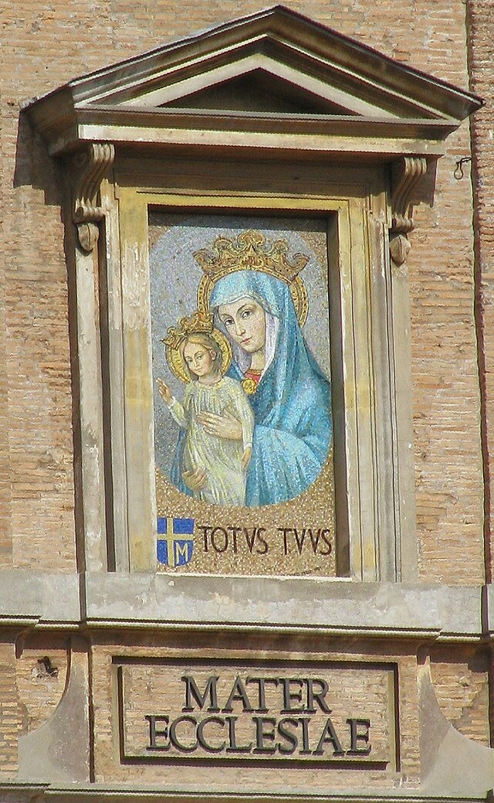
The Church and Mary
When Catholics consecrate themselves to Jesus through Mary, they make a promise to her that they will allow her to fulfill her motherly task and conform them Christ. St. John Paul II expressed this by adopting the motto...
'TOTUS TUUS'
Notes:
Photo Credit: Johannes Joas; cropped & shifted by Rabanus Flavus. Public domain. Vaticano Mater Ecclesiae.https://commons.wikimedia.org/wiki/File:Vaticano_Mater_Ecclesiae.jpg
Directions: Have students copy information from the slide into their notes.
Teaching Point: ‘Totus Tuus’ is Latin for “All Yours”. ‘Mater Ecclesia’ is Latin for “Mother of the Church”. Consecration to Mary means surrendering your will to hers and giving her permission to take your prayers and actions and distribute them where they are most needed and in ways that bring you closer to her Son. Many saints have suggested consecration to Jesus through Mary, most famously St. Louis Marie de Montfort but also more recently St. Maximilian Kolbe, St. Teresa of Calcutta, and St. John Paul II.
Online Resources: Have students view, John Paul II’s Homily on Mary. URL here: https://youtu.be/uer34lKMQd0
The videos linked in this presentation file may contain copyright material. Such material is made available for educational purposes only. This constitutes a “fair use” of any such copyright material as provided for in Title 17 U.S.C. section106A-117 of the US Copyright Law.

Slide 12
Four Key Teachings About Mary
Immaculate Conception
Perpetual Virginity
Mother of God
Assumption
Mary, the mother of Jesus, was preserved free from the effects of the sin of Adam (usually referred to as “original sin”) from the first instant of her conception.
Mary, the mother of Jesus, was a virgin "before, during and after" the birth of Christ. When the Bible speaks of Jesus’ brothers and sisters it is referring to kinsmen.
Mary is the Theotokos (Greek for Christ Bearer or Mother of God). Jesus is God and Mary is his mother, therefore Mary is the mother of God.
Mary was "assumed"or taken into heaven instead of going through the natural process of physical decay upon death.
Notes:
Directions: Have students copy information from the slide into their notes.
Teaching Points:
A dogma proposes truths contained in Divine Revelation or having a necessary connection with it.
These truths are immediately or mediately grounded in Scripture.
They reflect not only the full authority of the Church received from Christ but also the Church's tradition, liturgical practice and the faith of the people (sensus fidelium).
Dogmas are lights on our path of faith. They have binding character, and intellect and heart to a deeper understanding of God's mystery. Read CCC 88-89 (85-95).
There are four dogmas stating important aspects of Mary's role in salvation and her personal relationship with God. Each of these teachings are rooted in Scripture, some are explicitly stated others are implicitly stated. Their names are:
Divine Motherhood
Perpetual Virginity
Immaculate Conception
Assumption
Online Resources: Have students view video, Four Dogmas Catholics Believe About Mary. URL here: https://youtu.be/l-FNNjQS2xk
Have students view video, The Four Marian Dogmas. URL here: https://youtu.be/D4hnSR2zkWs
View video, The Assumption of Mary. URL here: https://youtu.be/4vOPWJBjAPg
Assign article, The Four Marian Dogmas. URL here: https://www.catholicnewsagency.com/resource/55423/the-four-marian-dogmas
The videos linked in this presentation file may contain copyright material. Such material is made available for educational purposes only. This constitutes a “fair use” of any such copyright material as provided for in Title 17 U.S.C. section106A-117 of the US Copyright Law.

Slide 13
Apparition
Key
Vocab
An apparition is a gift of grace—an extraordinary, miraculous and supernatural appearance on earth of Jesus, the saints, or angels. These special manifestations are necessary to turn the world around from its indifference to the Lord and to bring the Good News of Jesus.
Notes:
Photo Credit: Advance poster for the 1943 film The Song of Bernadette. Norman Rockwell. Public domain. Cropped. https://commons.wikimedia.org/wiki/File:The_Song_of_Bernadette_(1946_advance_poster).jpg
Directions: Have students copy the term and the definition in the vocabulary section of their notes.
Teaching Point: Marian apparitions give rise to new titles for Mary and can help the Church live more fully by Christ’s Revelation in a certain period of history. This intercession is sometimes sought through a pilgrimage to the apparition site. In addition to the approved apparition of Our Lady to St. Bernadette at Lourdes (pictured in the slide) there are many others.
The videos linked in this presentation file may contain copyright material. Such material is made available for educational purposes only. This constitutes a “fair use” of any such copyright material as provided for in Title 17 U.S.C. section106A-117 of the US Copyright Law.

Slide 14
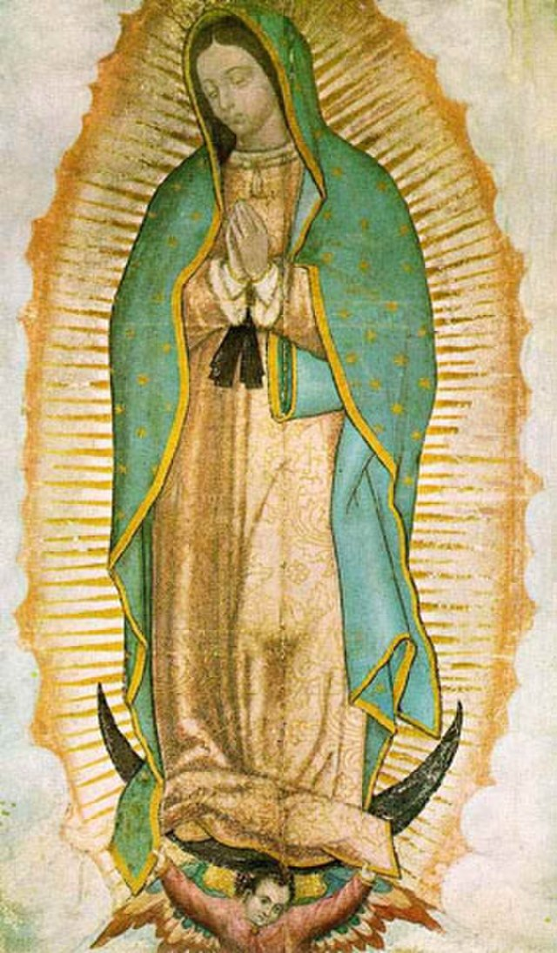
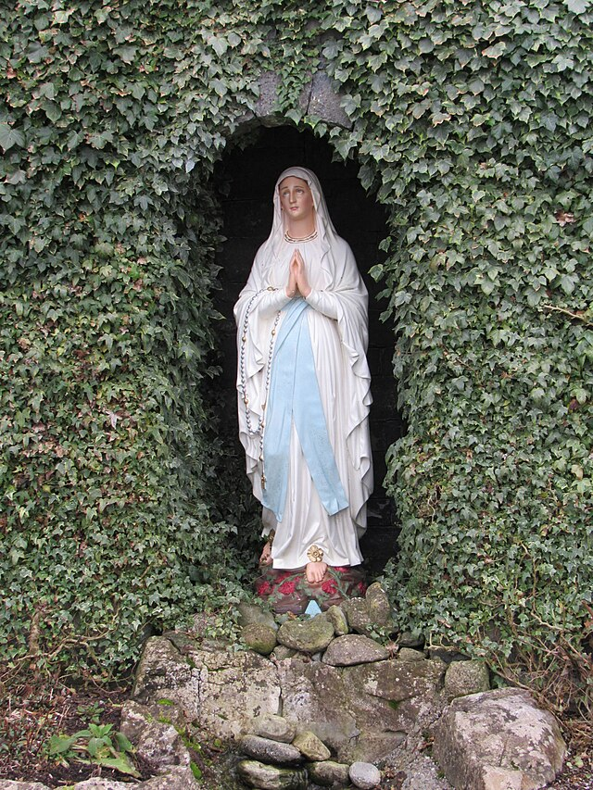
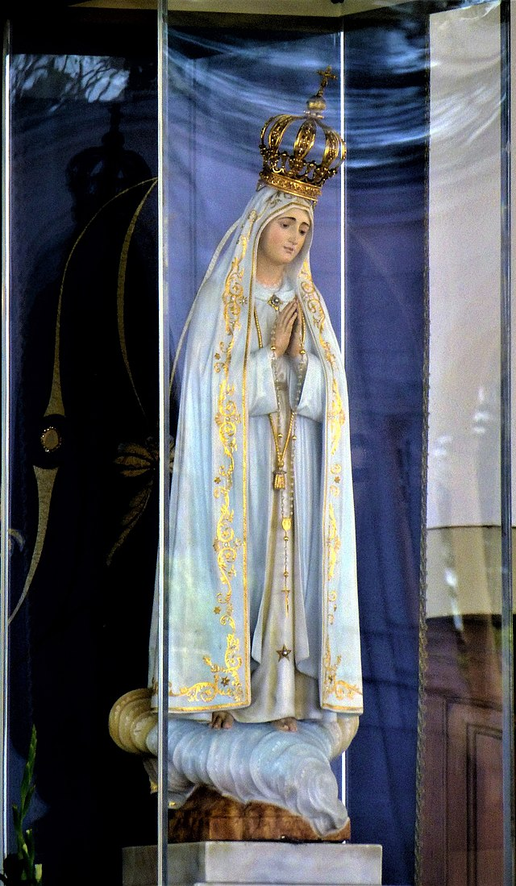
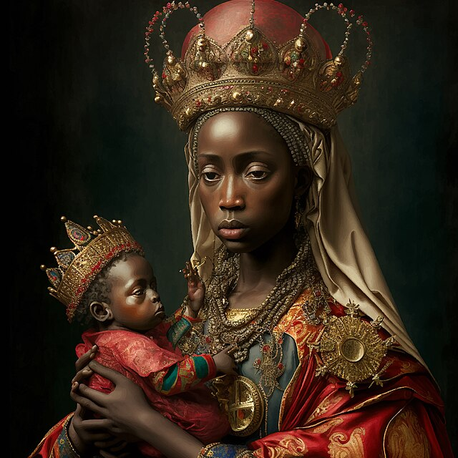
Four Key Apparitions of Mary
Our Lady of Guadalupe
Our Lady of Lourdes
Our Lady of Fatima
Our Lady of Kibeho
Notes:
Photo Credit: Our Lady of Guadalupe. Unknown author. Public domain. FredSeiller. Creative Commons Zero, Public Domain Dedication. Lourdes grotto. First Sculpture of Our Lady of Fatima.jpg. Fatima. Bingar1234.Our Lady of Sorrows, title under which the Virgin Mary presented herself at Kibeho. Rosary Team. Public domain. Our Lady of Kibeho. https://commons.wikimedia.org/
Directions: Have students copy down information from the slide into their notes.
Teaching Points: Mary appeared in 1531 to a Mexican peasant named Saint Juan Diego in modern day Mexico city. Mary appeared in 1858 in the grotto at Lourdes, France to Saint Bernadette Soubirous, a fourteen-year-old peasant girl. Mary appeared in 1917 to three shepherd children, Lúcia dos Santos and her cousins Francisco and Jacinta Marto, at the Cova da Iria in Fátima, Portugal. Mary appeared in 1981, to young girls in Kibeho, Rwanda under the name “Nyina wa Jambo” or “Mother of the Word”. It’s the only approved apparition in Africa.
Online Resources: Have students view video, Our Lady’s Wardrobe. URL here: https://youtu.be/rv1UsMzxIOY
View Video, Mysteries of the Church: Marian Episode. URL here: https://youtu.be/_Dl1aGN_nJI
The videos linked in this presentation file may contain copyright material. Such material is made available for educational purposes only. This constitutes a “fair use” of any such copyright material as provided for in Title 17 U.S.C. section106A-117 of the US Copyright Law.

Slide 15
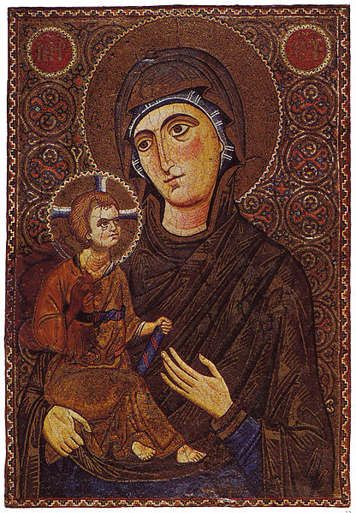
The Angelus
The name of the Angelus is Latin for “the angel,” the first words of the opening verse. The Angelus consists of three recitations of the Hail Mary accompanied by three introductory verses, a concluding verse, and prayer.
Notes:
Photo Credit: Mary and the child depicted as a hodegetria. Unknown. Public Domain.
Directions: Have students copy information from the slide into their notes.
Teaching Point: For much of the twentieth century, Catholic church bells would ring at dawn, noon, and dusk to remind Catholics that it was time to stop and pray. The form of the Angelus is simple. Lead students through the prayer.
V. The Angel of the Lord declared unto Mary.
R. And she conceived of the Holy Spirit. Hail Mary . . .
V. Behold the handmaid of the Lord.
R. Be it done unto me according to your word. Hail Mary . . .
V. And the Word was made flesh.
R. And dwelt among us. Hail Mary . . .
V. Pray for us, O holy Mother of God.
R. That we may be made worthy of the promises of Christ. Let us pray: Pour forth, we beseech you, O Lord, thy grace into our hearts; that we, to whom the Incarnation of Christ, thy Son, was made known by the message of an angel, may by his Passion and Cross be brought to the glory of his Resurrection. Through the same Christ, our Lord. Amen.
Online Resources: View video, The Angelus Prayer Explained. URL here: https://youtu.be/BehBMHuiOD0
The videos linked in this presentation file may contain copyright material. Such material is made available for educational purposes only. This constitutes a “fair use” of any such copyright material as provided for in Title 17 U.S.C. section106A-117 of the US Copyright Law.

Slide 16
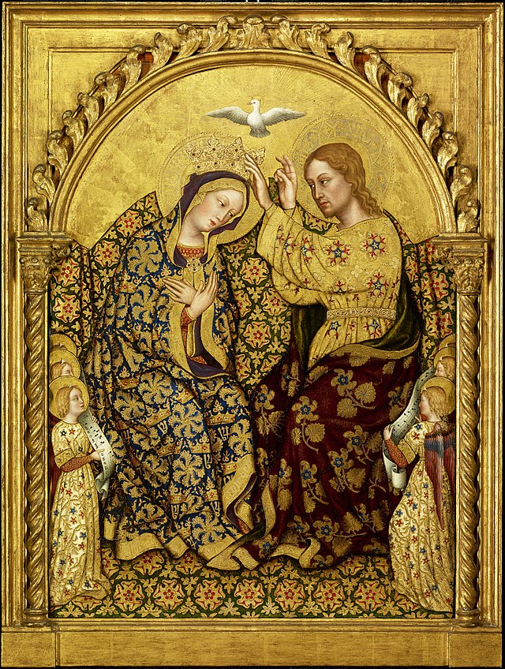
The Queen Mother
“ A great sign appeared in the sky, a woman clothed with the sun, with the moon under her feet, and on her head a crown of
twelve stars.”
-Rev 12:1
Notes:
Photo Credit: Coronation of The Virgin. Gentile de Fabriano. Public Domain. https://commons.wikimedia.org/wiki/File:Gentile_da_Fabriano_-_Coronation_of_the_Virgin.jpg
Directions: Have students copy information from the slide into their notes.
Teaching Points: The feast of the Queenship of Mary was established in 1954 by Pope Pius XII, but the tradition pf celebrating Mary as queen of heaven goes back much earlier, with various saints and Church fathers referring to Mary as “lady” and “queen” as early as the fourth century. The basic idea is that if Jesus is “king,” then it is fitting that Mary, his mother, would share in his reign as queen.
This way of understanding the honor due Mary as the Mother of God became especially popular in the Middle Ages, with its emphasis on courtly manners, but it also has a biblical basis. The Book of Revelation describes a woman clothed with the sun and crowned with twelve stars, traditionally understood to be Mary. When the angel Gabriel appears to Mary, he says that her son, Jesus, will inherit the throne of David (Luke 1:32). Later, Mary proclaims her Magnificat (Luke 1:46-56), in which she says, “Surely, from now on all generations will call me blessed; for the Mighty One has done great things for me….”
Online Resources: View video, The Queen Mother. URL here: https://youtu.be/8TpjIoec7zQ
View video, A Woman Clothed With The Sun. URL here: https://youtu.be/I1GdAQ21zzQ
Have students view video, Bishop Barron on the Queenship of Mary. URL here: https://youtu.be/i0dk8F0KYxY
Assign Article, Amazing Image of Mary as Queen. URL here: https://www.catholic365.com/article/30620/the-most-amazing-image-of-mary-as-queen-van-eycks-mary.html
Listen to Marian Hymn, Salve Regina (Hail Holy Queen). URL here: https://en.wikipedia.org/wiki/Salve_Regina
The videos linked in this presentation file may contain copyright material. Such material is made available for educational purposes only. This constitutes a “fair use” of any such copyright material as provided for in Title 17 U.S.C. section106A-117 of the US Copyright Law.

Slide 17
Apparition
Key
Verse
“And Mary said, ‘My soul proclaims the greatness of the Lord, my spirit rejoices in God my Savior,...From this day all generations will call me blessed”
- Luke 1: 46-48
Notes:
Directions: Have students copy the quote. Add bonus points to the assessment if they can copy it down demonstrating that they memorized it.
Online Resources: Assign article, The Magnificat, Mary’s Own Prayer. URL here: https://www.catholicculture.org/culture/library/view.cfm?recnum=7340
The videos linked in this presentation file may contain copyright material. Such material is made available for educational purposes only. This constitutes a “fair use” of any such copyright material as provided for in Title 17 U.S.C. section106A-117 of the US Copyright Law.

