Slide 1
Chapter 7 PowerPoint

Slide 3
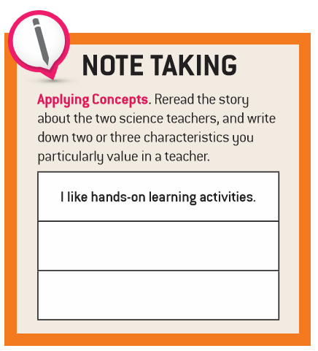
Good Teachers

Slide 4
Mission Statement of the
National Catholic Educational Association
Rooted in the Gospel of Jesus Christ, the National Catholic Educational Association (NCEA) is a professional membership organization that provides leadership, direction, and service to fulfill the
evangelizing, catechizing,
and teaching mission
of the Church.
Good Teachers

Slide 5
The Scripture Jesus holds in his left hand symbolizes that he is the Word made flesh as well as his teaching ministry.
Jesus the Teacher
Facial features:
● the eyes are gazing into the distance
● his forehead is high and convex because it is identified as the seat of wisdom
● the elongated nose contributes to his look of nobility
● the large ears symbolize that he hears everything
● the mouth is closed in the silence of contemplation
● the flowing hair suggests the endless flow of time
Jesus’ right hand is raised in a gesture of blessing.
The red tunic symbolizes both the blood of his suffering as well as his Resurrection and the victory of life over death.
The halo indicates his sanctity and is inscribed with Greek letters that translate to “Who Am” in English.
Symbolism of the Icon
The “IC XC” is a shortened form of Christ’s name in Greek.
The dark blue cloak indicates the infiniteness of the sky and represents his Divine nature.
Good Teachers

Slide 6
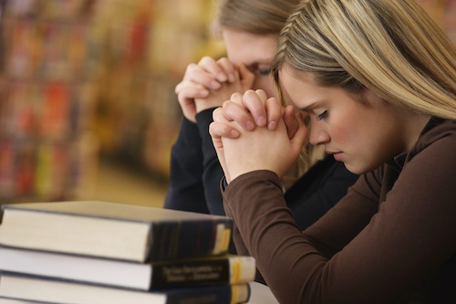
Prayer to Christ the Teacher
O source of all Wisdom, Christ the Teacher You are the Way, the Truth, and the Life. Teach me to embrace the truths You have revealed to Your Church. Fill my soul with Your Grace that I may love God above all and my neighbor as myself. Christ Jesus, friend and Teacher most patient, bless me and teach me. O Light of the world, teach me always to follow You that I should not walk in darkness, but have forever the Light of Life.
Good Teachers

Slide 7
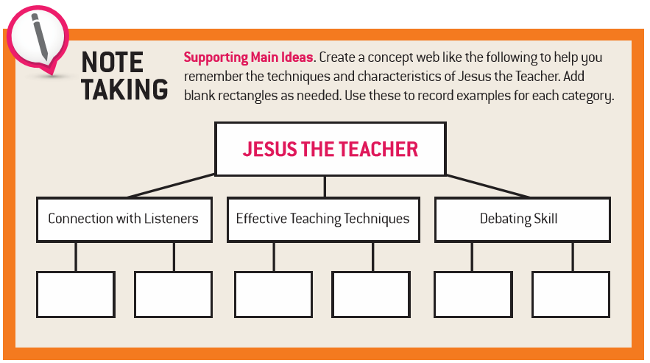
Jesus the Teacher

Slide 8
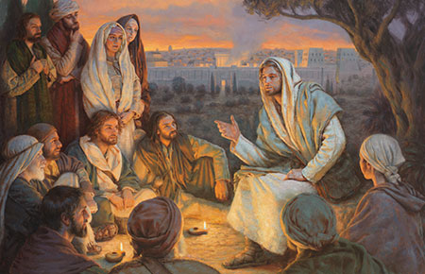
And He got into one of the boats, which was Simon's, and asked him to put out a little way from the land. And He sat down and began teaching the people from the boat. Lk 5:3)
Jesus was going throughout all Galilee, teaching in their synagogues and proclaiming the gospel of the kingdom, and healing every kind of disease and every kind of sickness among the people. (Mt 4:23)
… for He was teaching them as one having authority, and not as their scribes. (Mt 7:29)
He opened His mouth and began to teach them … (Mt. 5:2)
But when it was now the midst of the feast Jesus went up into the temple, and began to teach. (Jn 7:14)
… this man came to Jesus by night and said to Him, "Rabbi, we know that You have come from God as a teacher; for no one can do these signs that You do unless God is with him.“ Jn 3:2
And He began teaching in their synagogues and was praised by all. (Lk 4:15)
Early in the morning He came again into the temple, and all the people were coming to Him; and He sat down and began to teach them. (Jn 8:2)
When Jesus went ashore, He saw a large crowd, and He felt compassion for them because they were like sheep without a shepherd; and He began to teach them many things. Mk 6:34
Jesus the Teacher

Slide 9
Methods of Preaching Used by Jesus | Examples
Jesus told stories | The Good Samaritan (Lk 10:25-37), The Dishonest Steward (Lk 16:1-12)
Jesus shocked people through the use of hyperbole | If your right eye causes you to sin, tear it out and throw it away (Mt 5:29), If any one comes to me without hating his father and mother … he cannot be my disciple. (Lk 14:26)
Jesus Crafted Memorable Sayings | Do to others whatever you would have them do to you. (Mt 7:12), Stop judging and you will not be judged. (Lk 6:37)
Jesus Asked Questions | What good will it be for someone to gain the whole world, yet forfeit their soul? (Mt. 16:26) Can any of you by worrying add a single moment to your lifespan? (Mt 6:27)
Jesus Used Object Lessons | He washed the feet of his disciples (Jn 13:1-17), He said we must become like a little child (Mt 18:2-3)
Jesus Used Repetition | The Son of Man must suffer (Mk 8:31, 9:12, 10:32-34)

Slide 10
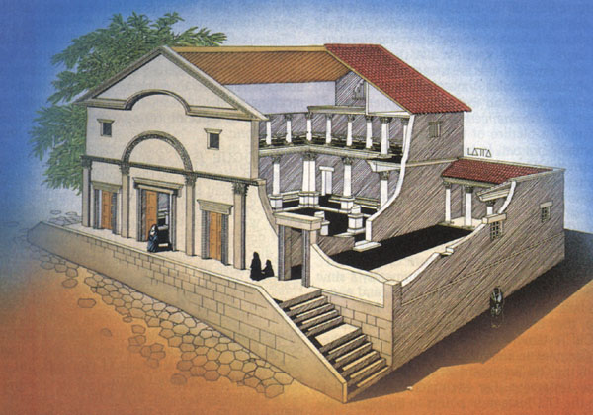
He [Jesus] went around all of Galilee, teaching in their synagogues, proclaiming the gospel of the kingdom, and curing every disease and illness among the people. Mt 4:23
Typical synagogue of the first century A.D. The men met in the inner room and the balcony was the place for the women.
Jesus the Teacher

Slide 11
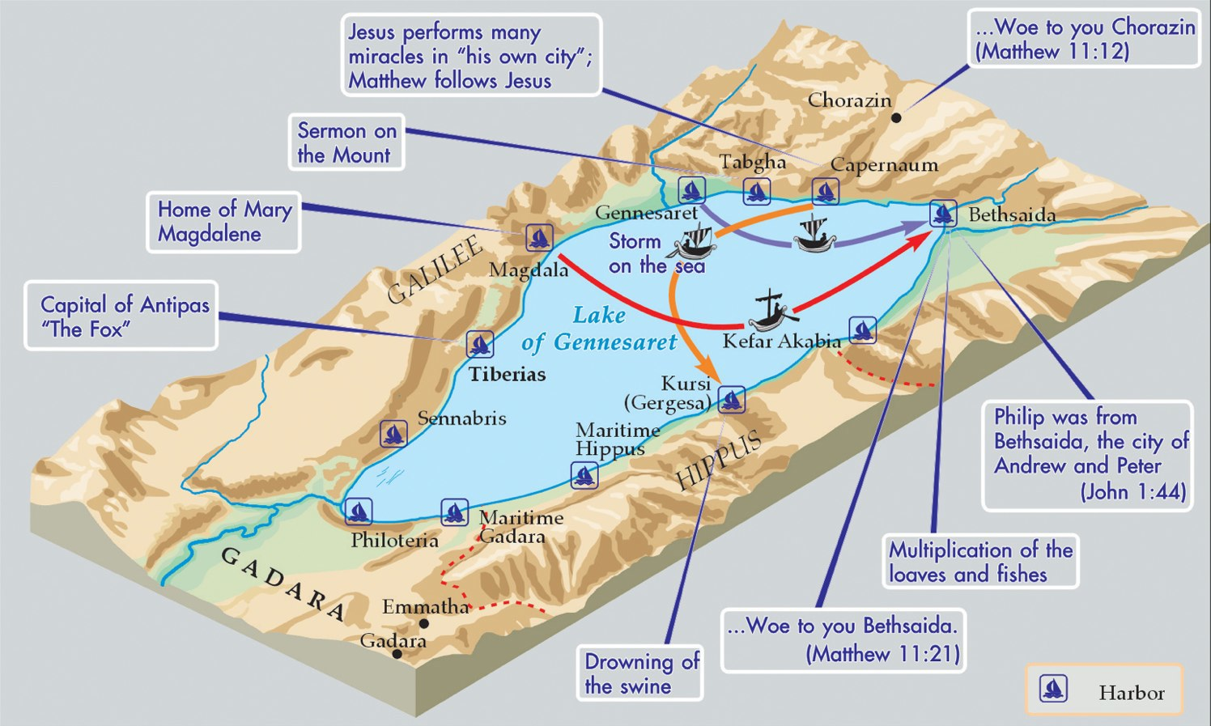
Jesus’ Ministry Around the Sea of Galilee
Jesus the Teacher

Slide 12
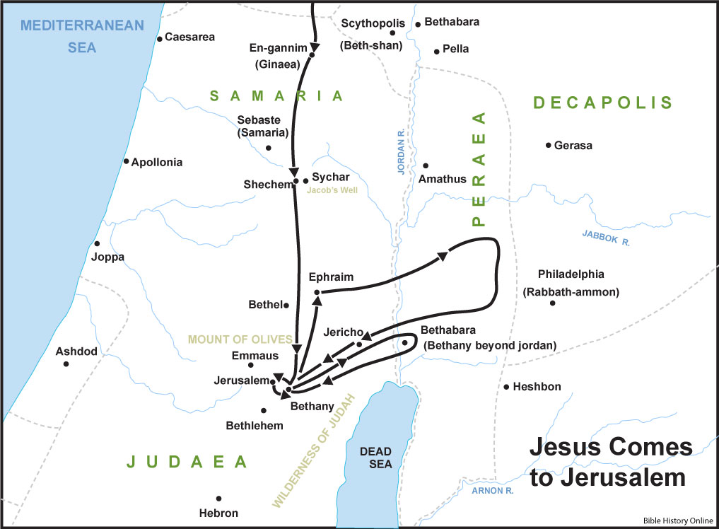
Jesus the Teacher

Slide 13
Jesus and the Kingdom of God

Slide 14
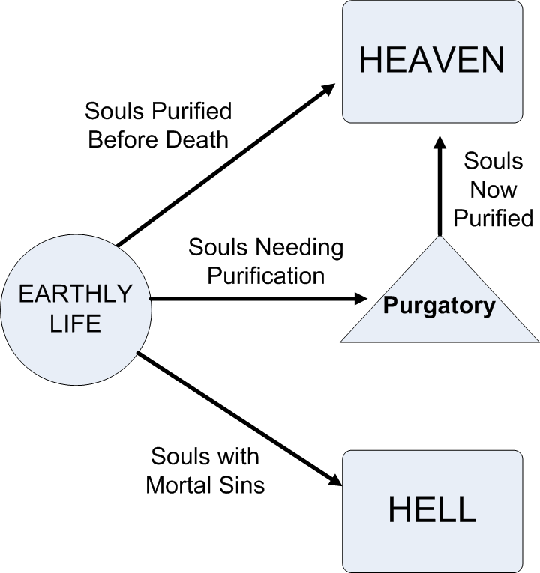
Hell The eternal separation from God that occurs when a person dies after freely and deliberately acting against God’s will, not repenting of a mortal sin.
Jesus and the Kingdom of God

Slide 15
The Kingdom of God
Promised Fulfillment
Promised
Perfect Fulfillment
Genesis 3, 12
Protoevangelium, Abraham
Genesis 12 – 2 Chronicles
Abraham – Solomon
Mark 1:15
Jesus Christ
This is the time of fulfillment. The kingdom of God is at hand. Repent, and believe in the gospel.
Jesus and the Kingdom of God

Slide 16
… seek first the kingdom [of God] and his righteousness (Mt 6:32)
"Henceforward the Church, endowed with the gifts of her founder and faithfully observing his precepts of charity, humility and self-denial, receives the mission of proclaiming and establishing among all peoples the Kingdom of Christ and of God, and she is on earth the seed and the beginning of that kingdom.” CCC 768
Jesus and the Kingdom of God

Slide 17
Jesus’ Sermon on the Mount

Slide 18
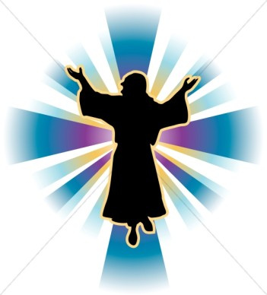
Steps to becoming a disciple of Jesus
Persecuted for Jesus’ sake
Persecuted for righteousness sake
Peacemakers
Pure of heart
Merciful
Hunger and thirst for righteousness
Meek
Mourn
Poor of Spirit
Jesus’ Sermon on the Mount

Slide 19
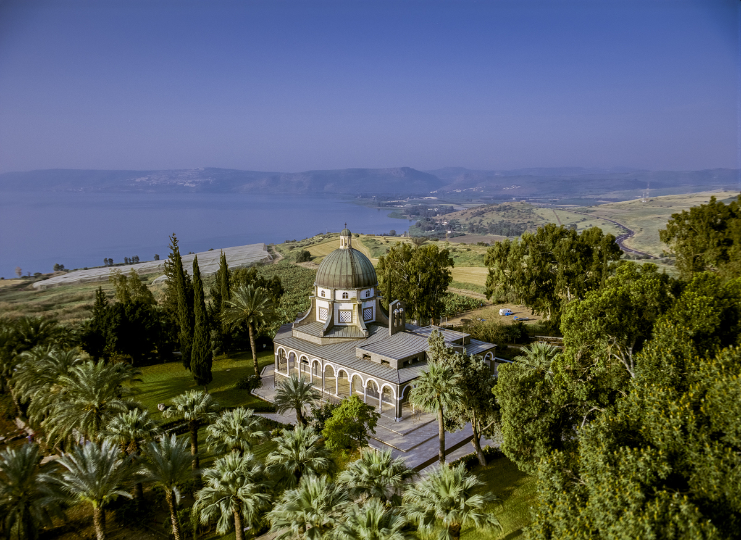
The Church of the Beatitudes located by the Sea of Galilee near Tabgha and Capernaum in Israel.
Jesus’ Sermon on the Mount

Slide 20
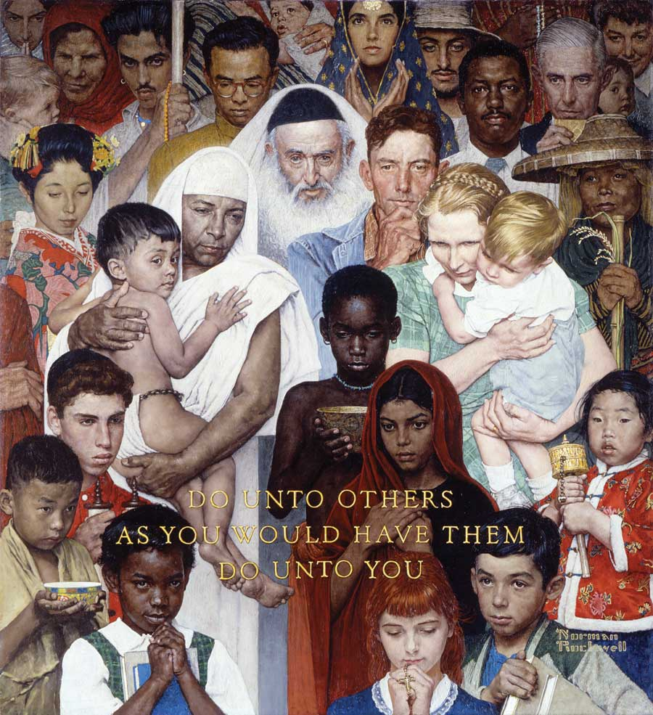
Saturday Evening Post, April 1,1961
"Golden Rule" (Do unto others)
by
Norman Rockwell
Jesus’ Sermon on the Mount

Slide 21
The Beatitudes in Matthew (5:3–12) | The Beatitudes in Luke (6:21–26)
Blessed are the poor in spirit, for theirs is the kingdom of heaven. | Blessed are you who are poor, for the kingdom of God is yours. (vs 20) But woe to you who are rich, for you have received your consolation. (vs. 24)
Blessed are they who mourn, for they will be comforted. | Blessed are you who are now weeping, for you will laugh. (vs. 21) Woe to you who laugh now, for you will grieve and weep. (vs 25)
Blessed are the meek, for they will inherit the land.
Blessed are they who hunger and thirst for righteousness, for they will be satisfied. | Blessed are you who are now hungry, for you will be satisfied. (vs. 21) But woe to you who are filled now, for you will be hungry. (vs. 25)
Blessed are the merciful, for they will be shown mercy.
Blessed are the clean of heart, for they will see God.
Blessed are the peacemakers, for they will be called children of God.
Blessed are they who are persecuted for the sake of righteousness, for theirs is the kingdom of heaven. Blessed are you when they insult you and persecute you and utter every kind of evil against you [falsely] because of me. Rejoice and be glad, for your reward will be great in heaven. Thus they persecuted the prophets who were before you. | Blessed are you when people hate you, and when they exclude and insult you, and denounce your name as evil on account of the Son of Man. (vs 22) Rejoice and leap for joy on that day! Behold, your reward will be great in heaven. For their ancestors treated the prophets in the same way. (vs. 23) Woe to you when all speak well of you, for their ancestors treated the false prophets in this way. (vs 26)
Jesus’ Sermon on the Mount

Slide 22
Endnotes
Quotations from Sacred Scripture come from the New American Bible, Revised Edition (NABRE) http://wwwmigrate.usccb.org/bible/
Quotations from the Catechism of the Catholic Church http://www.vatican.va/archive/ENG0015/_INDEX.HTM
Quotations from Documents of the Second Vatican Council http://www.vatican.va/archive/hist_councils/ii_vatican_council/index.htm

