Slide 1

4. THE CHURCH RISES
TO PROMINENCE
Notes:
Suggestions for students’ note taking:
●Require students to use a three ring binder (1/2-1 inches) full of loose leaf paper (college or wide ruled).
●Notes must be taken in pen only and hand written.
●Notebooks should contain information and notes for religion class only.
●Notebooks must have a table of contents with topic of notes, dates and page numbers.
●All notes must have a topic and page number.
●Students will be required to copy each slide unless the teacher directs students to skip certain slides or parts of slides. Notebooks will be graded based on neatness, completeness and organization. Notebooks should have a significant point value representing 20-25% of the overall grade.
The resources linked in this presentation file may contain copyright material. Such material is made available for educational purposes only. This constitutes a “fair use” of any such copyright material as provided for in Title 17 U.S.C. section106A-117 of the US Copyright Law.

Slide 2
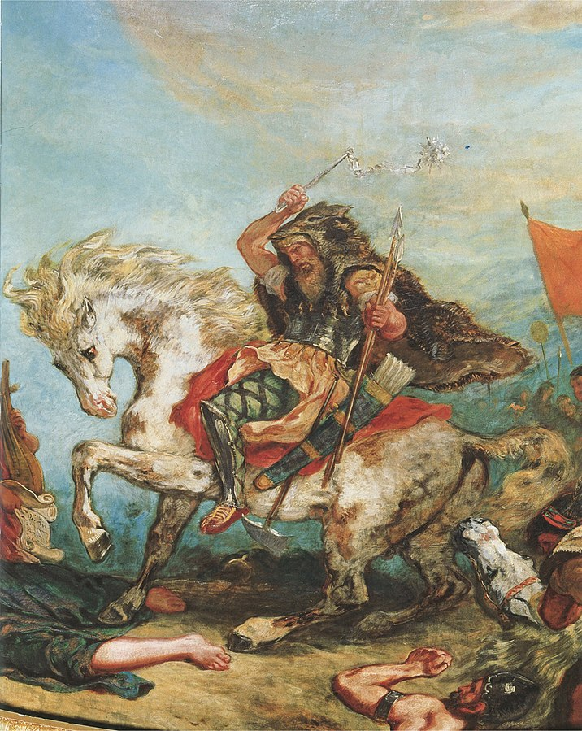
The Fall of Rome
Attila the Hun
‘Attila, the leader of the Huns, who was called the scourge of God, came into Italy, inflamed with fury, after he had laid waste with most savage frenzy Thrace and Illyricum, Macedonia and Moesia, Achaia and Greece, Pannonia and Germany. He was utterly cruel in inflicting torture, greedy in plundering, insolent in abuse. . .’ -Historian, James Robinson
Notes:
Photo Credit: Attila Frament. Eugène Delacroix. Public domain. Eugene Ferdinand Victor Delacroix Attila fragment.jpg/
Directions: Have students copy the side information in their notebooks.
Teaching Points:
As the Roman Empire faltered in the fifth century, bands of people from the east (sometimes called barbarians) moved in to occupy its domains.
This was a centuries-long process, sometimes peaceful and sometimes brutally violent.
Prominent among the leaders of the barbarian tribes was Attila, king of the Huns, a people from Central Asia who conquered formerly Roman domains in western Asia and eastern and central Europe. In the 450s, Attila’s forces ravaged what is now northern Italy and threatened the capital city Rome itself in 452.
A weakened Rome was incapable of defending itself, so the citizens elected to beg for mercy, hoping to avoid the death and destruction that Attila usually left in his wake. Pope St. Leo I led a delegation to negotiate with Attila. To their surprise, the Hun leader agreed to spare Rome. The city was saved temporarily.
Although Pope Leo’s efforts won Rome a temporary reprieve, the empire’s days were numbered. Historians generally date the end of the empire in the West to 476, the year that the barbarian king Odoacer took control of the city of Rome and deposed Emperor Romulus Augustus. This is also the approximate beginning of the so-called Middle Ages, or medieval period.
When the Roman Empire in the West collapsed, Christians found themselves in a new situation. Without a strong government to organize social and educational institutions, it fell to the Church to provide the structure of society. In the process, the Church rose to prominence, attaining a more concrete and elaborate structure.
Online Resources: Assign article, Pope Leo the Great Stares Down Attila the Hun. URL here: https://www.catholic365.com/article/36856/st-leo-i-when-popes-were-great.html
Assign article, Attila the Hun, leo the Great and a Battle of Wills. URL here: https://www.wordonfire.org/articles/fellows/attila-the-hun-leo-the-great-and-the-battle-of-wills/
Have students view video, How St. Leo the Great Beat Arianism, Attila the Hun, and More
URL here: https://youtu.be/LOdSL6P5KXE
The resources linked in this presentation file may contain copyright material. Such material is made available for educational purposes only. This constitutes a “fair use” of any such copyright material as provided for in Title 17 U.S.C. section106A-117 of the US Copyright Law.

Slide 3

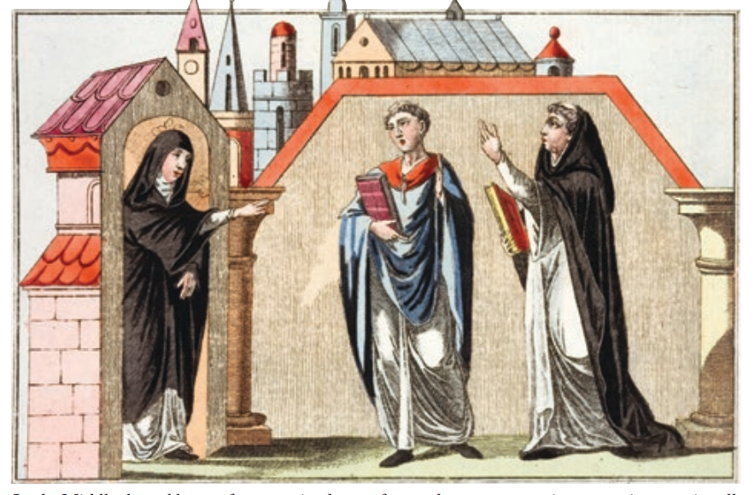
Monasticism
Key
Vocab
A religious way of life where members live in seclusion from the world, take vows, and follow a set rule. Monasticism is characterized by asceticism, simplicity, and chastity, and members are often called monks, friars, or nuns.
Notes:
Photo Credit: AMP Textbook pg. 168
Directions: Have students copy the key vocabulary in their notes.
Online Resources: Read article, Why God Loves Monasticism So much. URL here: https://www.ncregister.com/blog/why-god-loves-monasticism-so-much
The resources linked in this presentation file may contain copyright material. Such material is made available for educational purposes only. This constitutes a “fair use” of any such copyright material as provided for in Title 17 U.S.C. section106A-117 of the US Copyright Law.

Slide 4
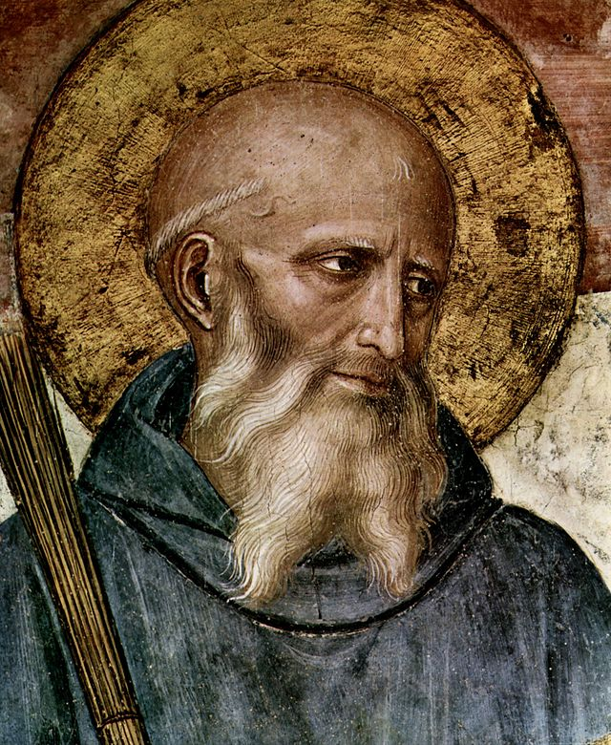
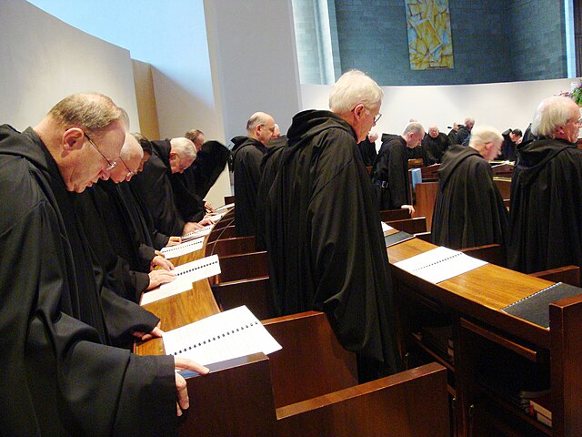
St. Benedict and The Rule
Notes:
Photo Credit: Detail: head of S. Benedict. Fra Angelico. Public domain. Roman Catholic monks of the Order of Saint Benedict singing Vespers on Holy Saturday at St. Mary's Abbey in Morristown, New Jersey. John Stephen Dwyer (Boston). Creative Commons Attribution-Share Alike 3.0. https://commons.wikimedia.org/.
Teaching Points:
St. Benedict of Nursia (480–547) was born just after the Roman Empire in the West fell.
Like the Desert Fathers in the East, Benedict initially fled the world by himself, seeking the life of a hermit in the hills of Italy, but others were attracted to his holiness, and he eventually helped to organize many monasteries.
His sister St. Scholastica organized a convent for women. Communities of Benedictine monks and nuns around the world today.
To give order and direction to the monks’ lives, Benedict composed his rule.
He drew on the previous Rules of Augustine and Basil but also added his own elements to craft a guide that would be practical and flexible and could be used for centuries to come by many different people in many different places.
The rule would serve as the basis for the constitutions of most of the religious orders, including non-monastic orders like the Jesuits, Franciscans, and Dominicans, that have been founded in the centuries since.In the rule, Benedict stressed the virtues of poverty, chastity, and obedience, which have been the vows taken by members of most religious orders ever since. He also encouraged hospitality in the monasteries, the welcoming of travelers and others in need. From this foundation, monasteries and convents became houses of charity, especially care for the sick.
Part of the rule regulates the prayer life of the monks. In the picture on the screen, still today, Roman Catholic monks of the Order of Saint Benedict singing Vespers on Holy Saturday at St. Mary's Abbey in Morristown, New Jersey. John Stephen Dwyer (Boston) as part of the Rule.
Online Resource: Have students view video, The Rule of Saint Benedict. URL here: https://youtu.be/e3C39BqPJGU
Assign article, How Benedict’s Rule Can Guide Your Spiritual Practice. URL here: https://uscatholic.org/articles/201908/how-benedicts-rule-can-guide-your-spiritual-practice/
The resources linked in this presentation file may contain copyright material. Such material is made available for educational purposes only. This constitutes a “fair use” of any such copyright material as provided for in Title 17 U.S.C. section106A-117 of the US Copyright Law.

Slide 5

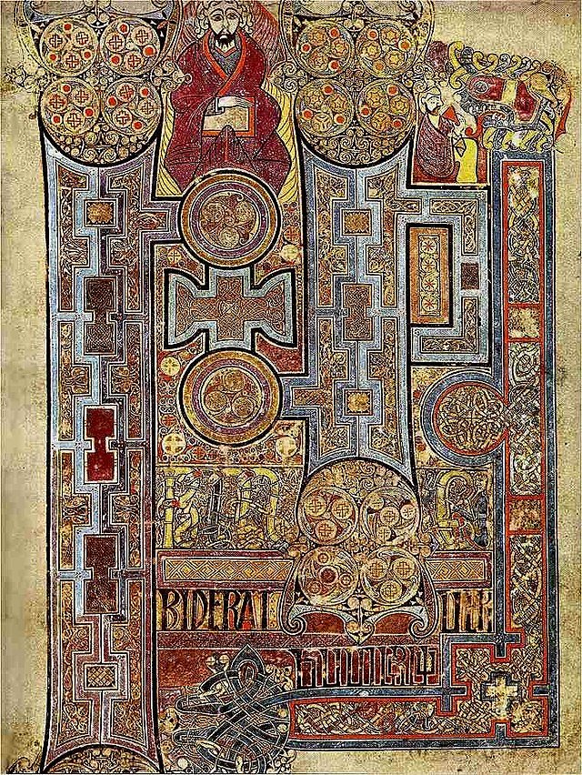
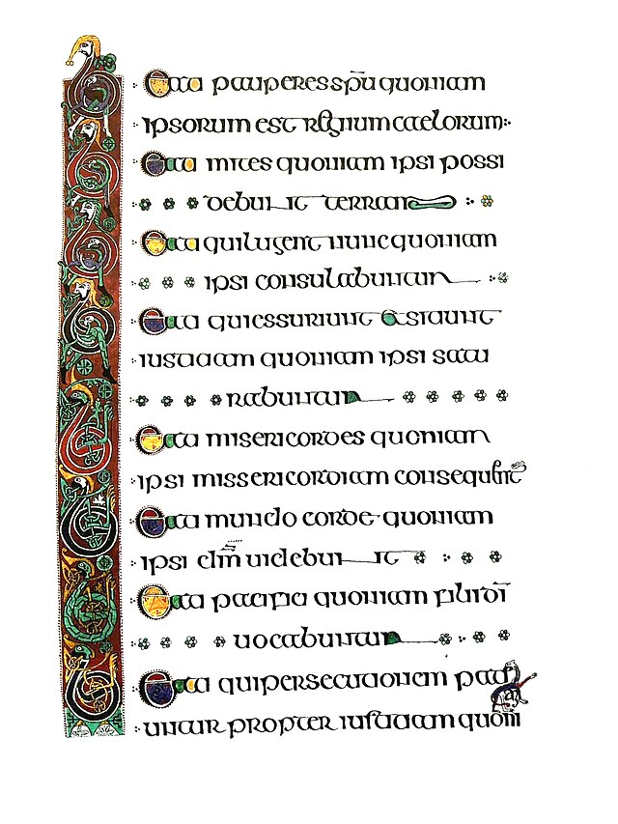
The Book of Kells and other manuscripts
Day by day, year after year, monks and nuns would persevere in their holy labors, copying with loving care every letter of the sacred text from some old manuscript of
the Bible.
Notes:
Photo Credit: Book of Kells, Folio 292r, Incipit to John. In principio erat verbum. Unknown author. Public domain
Designer Mario Kleff. Creative Commons Attribution-Share Alike 4.0. Book Of Kells Detail By Mario Kleff In Early 90s 07.jpg
Directions: Have students copy the side information in their notebooks.
Teaching Points:
Many monks toiling diligently, monasteries became centers of industry, growing agricultural products, raising livestock, producing cloth from wool, mining and manufacturing metal goods, and publishing written materials. Another kind of work was scholarship. Some monks taught reading, writing, math, and other subjects to fellow monks and other students. Others were tasked with copying manuscripts, including the Sacred Scriptures.
Book of Kells: An illuminated manuscript of the four Gospels that was produced by the monks of St. Columba in Iona, Scotland, before being brought to Kells, Ireland, in about 795 to keep it safe from Viking marauders. It is believed that the priests who read from the Book of Kells had the passages memorized and would hold the images facing the congregation so that they could learn from the beauty of the work.
Online Resources: View video, Ten Most Asked Questions About The Book of Kells. URL here: https://youtu.be/CnhelGcEOLc
The resources linked in this presentation file may contain copyright material. Such material is made available for educational purposes only. This constitutes a “fair use” of any such copyright material as provided for in Title 17 U.S.C. section106A-117 of the US Copyright Law.

Slide 6
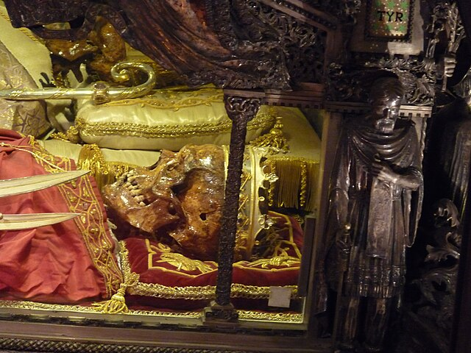
Saints and Relics
“Behind a grille, just under the main altar, lie the skeletal remains of Ambrose… With the aid of some pretty high-powered camera lenses, I was able to see the skull of the great bishop of Milan in extraordinary detail. What struck me especially was the size and solidity of his teeth, still formidable after 1,600 years. I’ll confess that when I examined those ancient teeth, I couldn’t help but think of the lips that once covered them, for Augustine, in his Confessions, famously reported his amazement at seeing Ambrose read without moving his lips—something quite unusual at the time.” -Bishop Robert Barron
Notes:
Photo Credit: Luc..Creative Commons Attribution-Share Alike 3.0.Milan Basilica Sant'Ambrogio Skull of Saint Ambrose.JPG. https://commons.wikimedia.org/wiki/File:Milan_Basilica_Sant%27Ambrogio_Skull_of_Saint_Ambrose.JPG
Directions: Have a students read aloud the quote on the slide.
Teaching points:
There have been saints in every age of the Church, but the Middle Ages saw the proliferation of devotions to them and the creation of a formal process for recognizing people of extraordinary sanctity in the Church called canonization.
Devotion to the saints gave rise to important practices in the Church’s spiritual life, such as feast days and pilgrimages. Saints represent a wildly diverse array of models of holiness for Catholics to admire and emulate.
Relics are physical things associated with a Saint, such as their bodies or body parts, their possessions such as clothing or any object that they possessed.
They are holy because Jesus came to make the material world holy especially our bodies.
Relics of martyrs and other saints were divided and shared with many local churches, and these relics were venerated by Christians. Soon Christians beyond the local area traveled to venerate the relics of these martyrs which were usually kept in church buildings such as the cathedral of Milan.
Online Resource: Have students view video, Bishop Barron on the Teeth of Saint Ambrose. URL here: https://youtu.be/9aHqa43Piik
Assign article, Musing on the Teeth of Saint Ambrose. URL here: https://www.wordonfire.org/articles/barron/musing-on-the-teeth-of-st-ambrose/
The resources linked in this presentation file may contain copyright material. Such material is made available for educational purposes only. This constitutes a “fair use” of any such copyright material as provided for in Title 17 U.S.C. section106A-117 of the US Copyright Law.

Slide 7
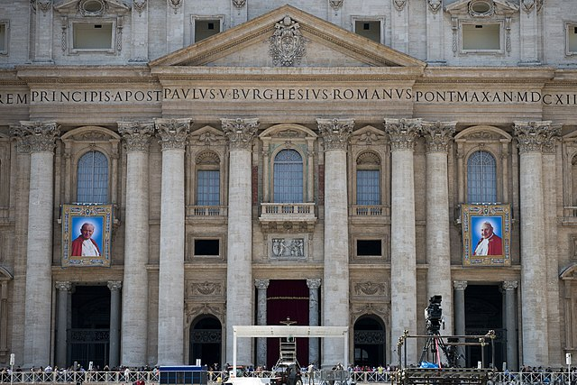
Canonization
Key
Vocab
The formal process carried out by the Catholic Church of declaring a deceased person a saint and worthy of universal veneration.
Notes:
Photo Credit: Aleteia Image Department.Creative Commons Attribution-Share Alike 2.0.In anticipation of the Canonization of John XXIII and John Paul II. https://commons.wikimedia.org/wiki/File:In_anticipation_of_the_Canonization_II_(14005415332).jpg
Directions: Have students copy the key vocabulary in their notes.
Online Resources: Have students view video, How to become a saint: Canonization explained. URL here: https://www.britannica.com/video/how-does-a-person-become-a-saint-canonization/-308642
The resources linked in this presentation file may contain copyright material. Such material is made available for educational purposes only. This constitutes a “fair use” of any such copyright material as provided for in Title 17 U.S.C. section106A-117 of the US Copyright Law.

Slide 8
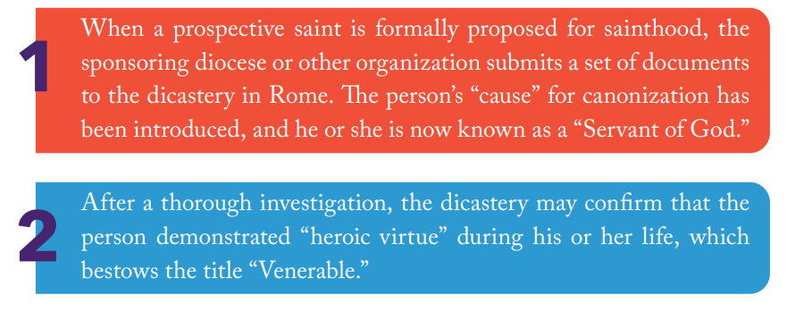
Four Steps to Becoming a Saint
Notes:
Photo Credit: AMP textbook pg. 191
Directions: Have students copy down the information from the slide in their notes.
Teaching Points:The canonization process can be long and tedious. This is because the Church recognizes that she has duty to be careful about determining who she presents as worthy of emulation, but the pope can also dispense with certain requirements and expedite the process when he believes the situation demands it. This was the case for Mother Teresa, for example, for whom Pope John Paul II waived the normal five-year waiting period after death before a cause can begin.
The resources linked in this presentation file may contain copyright material. Such material is made available for educational purposes only. This constitutes a “fair use” of any such copyright material as provided for in Title 17 U.S.C. section106A-117 of the US Copyright Law.

Slide 9
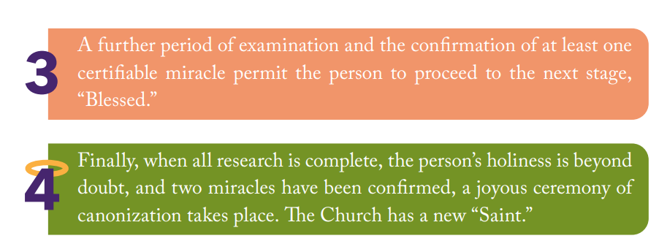
Four Steps to Becoming a Saint
Notes:
Photo Credit: AMP textbook pg. 192
Directions: Have students copy down the information from the slide in their notes.
Teaching Points: It is important to understand that the Church does not “make” saints in the sense of “deciding” who gets the title. The process of canonization is intended to identify at least some holy people who have lived in extraordinary union with God. God has already made them saints; the Church is simply recognizing the fact and recommending their example to her members. The purpose of this system is to assist and encourage Catholics now and in the future to pursue holiness themselves: “By canonizing some of the faithful, i.e., by solemnly proclaiming that they practiced heroic virtue and lived in fidelity to God’s grace, the Church recognizes the power of the Spirit of holiness within her and sustains the hope of believers by proposing the saints to them as models and intercessors” (CCC, 828).
The resources linked in this presentation file may contain copyright material. Such material is made available for educational purposes only. This constitutes a “fair use” of any such copyright material as provided for in Title 17 U.S.C. section106A-117 of the US Copyright Law.

Slide 10
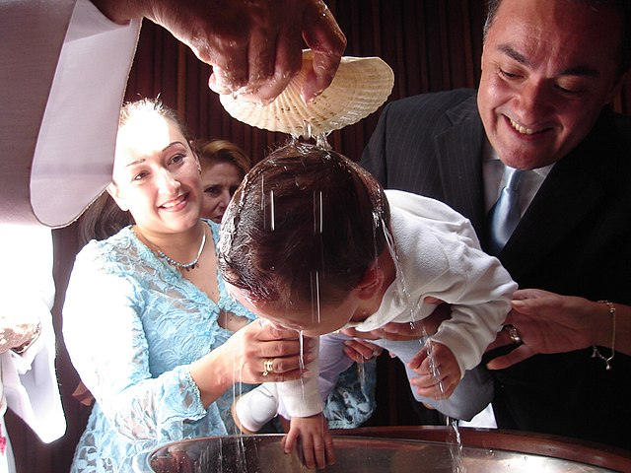
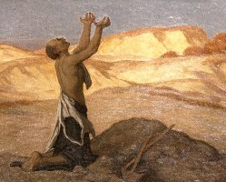
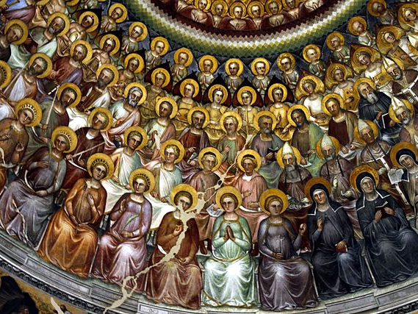
Sanctification
Comes to the Church in three stages…
In the Sacraments
In our Response of Faith
In Heaven
Notes:
Photo Credit: Alberto Poggioli. Creative Commons Attribution-Share Alike 3.0. Bautizo (68227747).jpeg/ Elihu Vedder.Public domain.Brooklyn Museum - Prayer for Death in the Desert - Elihu Vedder (Cropped). José Luiz. Creative Commons Attribution-Share Alike 4.0. Communion of saints - Baptistry - Padua 2016.
Directions: Have students copy down the information from the slide in their notes.
Teaching Points:
Sanctification Means “being made holy.” The first sanctification of a person takes place at Baptism. The second sanctification takes place from how the person lives his or her life in growing in the likeness of God. The third sanctification takes place when the person enters heaven and is fully united with God for all eternity.
We also grow in holiness through: • charity (loving God and our neighbor); • prayer (talking with God); and • service (meeting the needs of the poor and vulnerable)
The best way to understand the process of sanctification is by studying the lives of the Saints or holy people such as Sister Clare Crockett.
Online Resource: Have students view video, Sister Clare Crockett, All or Nothing. URL here: https://youtu.be/xSKiESB1Pfs
Assign article, Sister Clare Crockett All or Nothing, A Case Study in Spiritual Transformation. URL here: https://www.catholic365.com/article/30460/sister-clare-crockett-all-or-nothing.html
The resources linked in this presentation file may contain copyright material. Such material is made available for educational purposes only. This constitutes a “fair use” of any such copyright material as provided for in Title 17 U.S.C. section106A-117 of the US Copyright Law.

Slide 11
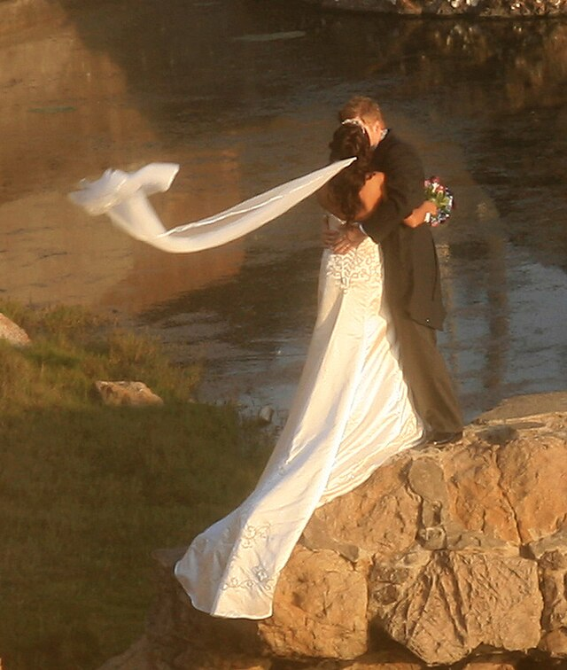
The Church is Holy
One of the images of the Church used by Jesus himself is the Bride of Christ. John the Baptist spoke of Jesus as “the bridegroom” and Saint Paul calls the Church his bride.
Notes:
Photo Credit: Bride and groom at the ruins of w:Sutro bath. Brocken Inaglory. Creative Commons Attribution-Share Alike 3.0. https://commons.wikimedia.org/wiki/File:Bride_and_groom_cropped.jpg
Directions: Have a students copy down information from their slides into their notes.
Teaching Points:
The Church has always been, in the words of St. Augustine, a corpus permixtum—a “mixed body” of saints and sinners. This understanding comes straight from Jesus, who told a parable about the Kingdom of Heaven where sinners (weeds) intermingled among the righteous (wheat). Jesus explained that “if you pull up the weeds you might uproot the wheat along with them” (Mt 13:29). It is incorrect, then, to think that the holiness of the Church depends on the holiness of her members.
The holiness of the church is based on her union with Jesus. Regarding this union, one of the images of the Church used by Jesus himself is the Bride of Christ. John the Baptist spoke of Jesus as “the bridegroom” (Jn 3:29), and Jesus referred to himself the same way (Mk 2:19). St. Paul reinforces the image in his Letters to the Corinthians, referring to the Christian community as “betrothed” to Christ (2 Cor 11:2).
The story, Cinderella is actually a Christian allegory about the Church as the Holy Bride of Christ.
Online Resources: Have students view video, Bishop Barron Comments on Cinderella. URL here: https://youtu.be/qwCl_xcF4nA
Assign article, Cinderella and the Church. URL here: https://www.catholic365.com/article/38483/cinderella-a-christian-allegory.html
The resources linked in this presentation file may contain copyright material. Such material is made available for educational purposes only. This constitutes a “fair use” of any such copyright material as provided for in Title 17 U.S.C. section106A-117 of the US Copyright Law.

Slide 12

Turn and Talk
Describe a time when you experienced the holiness of the church and a time when you experienced the sinful human side.
Notes:
Directions: Have students write down the question and then write down their answer….Then have students share their answers with one person close by.
The resources linked in this presentation file may contain copyright material. Such material is made available for educational purposes only. This constitutes a “fair use” of any such copyright material as provided for in Title 17 U.S.C. section106A-117 of the US Copyright Law.

Slide 13
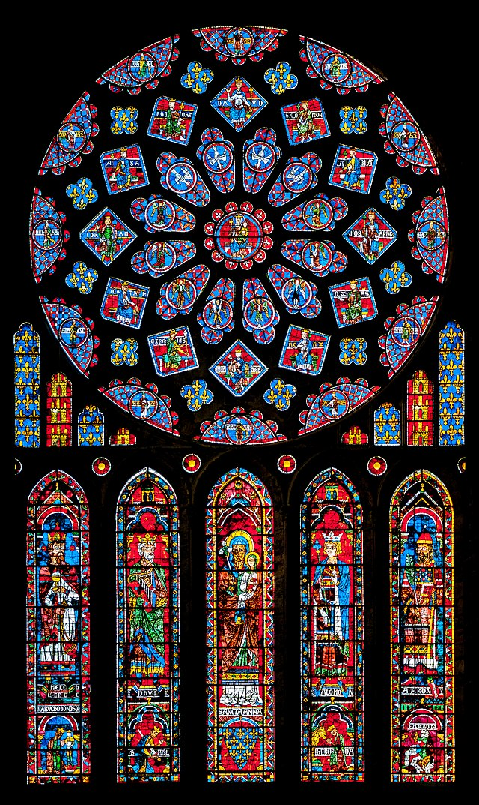
Rise of Cathedrals and Universities
The Medieval period was unique in its extraordinary production of awe-inspiring, spiritually uplifting, and enduring church structures.
Medieval European schools were run by cathedral clergy. Originally the function of such schools was to train priests, but later they taught lay students as well.
Great theologians, scientists, mathematicians, artists and architects were the fruits of the university system established by the Catholic Church.
Notes:
Photo Credit: Chartres Cathedral Rose Window. PtrQs.Creative Commons Attribution-Share Alike 4.0. Chartres RosetteNord 121 DSC08241.jpg. https://commons.wikimedia.org/wiki/File:Chartres_RosetteNord_121_DSC08241.jpg
Directions: Have students copy the side information in their notebooks.
Teaching Points:
The University of Paris, located south of the Cathedral of Notre Dame, just across a bridge connecting her island to the “Left Bank” of the Seine River, is an example of an institution that grew up during the Middle Ages and the years following. It remains today one of the world’s most prestigious universities. Some of the most brilliant minds of the medieval period, including St. Thomas Aquinas, were associated with the University of Paris.
Other early universities emerged in Oxford, England; Salamanca, Spain; and Bologna, Italy. Bologna in particular became known for its courses in canon law. Canon law gradually developed over hundreds of years in order to aid the Magisterium in articulating the life and structure of the Church to Catholics and non-Catholics alike.
Online Resources: Have students view video, The Catholic Church Builder of Civilization: The University System. URL here: https://youtu.be/0ElbBq3-5q8
The resources linked in this presentation file may contain copyright material. Such material is made available for educational purposes only. This constitutes a “fair use” of any such copyright material as provided for in Title 17 U.S.C. section106A-117 of the US Copyright Law.

Slide 14
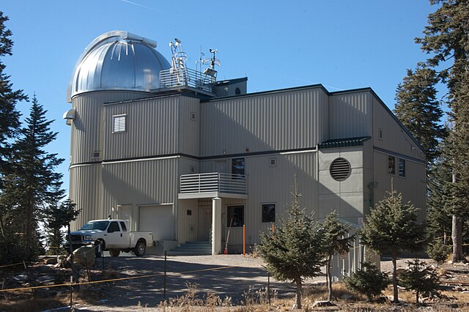
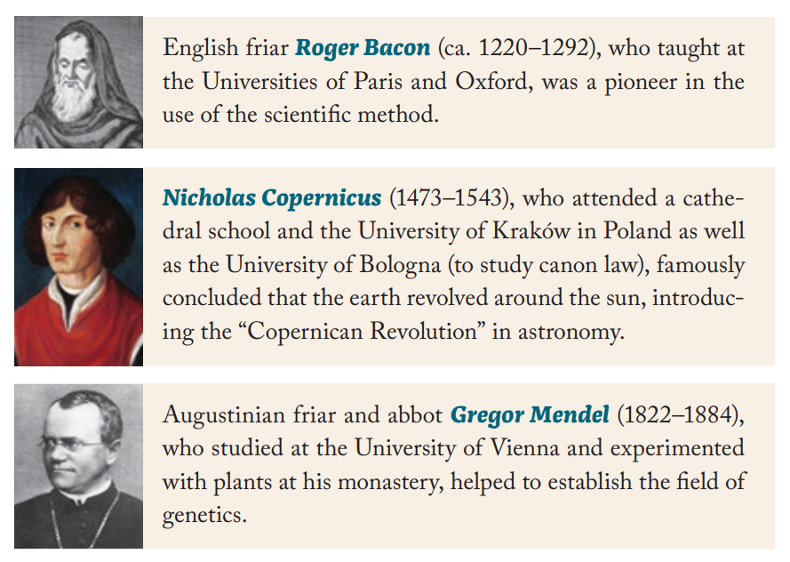
The Catholic Church gave us both Churchmen and Scholars
The Vatican Advanced Technology Telescope (VATT), the main telescope of the Vatican Observatory. The dome to the left houses the telescope itself; the space to the right are the control room and the living space for the observers.
Notes:
Photo Credit: Jjstott. Creative Commons Attribution-Share Alike 3.0. Vatican Observatory VATT.https://commons.wikimedia.org/wiki/File:VaticanObservatory_VATT.jpg
AMP Textbook pg. 226.
Directions: Have students copy the side information in their notebooks.
Teaching Points:
The University of Paris, located south of the Cathedral of Notre Dame, just across a bridge connecting her island to the “Left Bank” of the Seine River, is an example of an institution that grew up during the Middle Ages and the years following. It remains today one of the world’s most prestigious universities. Some of the most brilliant minds of the medieval period, including St. Thomas Aquinas, were associated with the University of Paris.
Other early universities emerged in Oxford, England; Salamanca, Spain; and Bologna, Italy. Bologna in particular became known for its courses in canon law. Canon law gradually developed over hundreds of years in order to aid the Magisterium in articulating the life and structure of the Church to Catholics and non-Catholics alike.
Online Resources: Have students view video, Groundbreaking Achievements of Catholic Scientists. URL here: https://youtu.be/w8iRWSgnxWQ
The resources linked in this presentation file may contain copyright material. Such material is made available for educational purposes only. This constitutes a “fair use” of any such copyright material as provided for in Title 17 U.S.C. section106A-117 of the US Copyright Law.

Slide 15
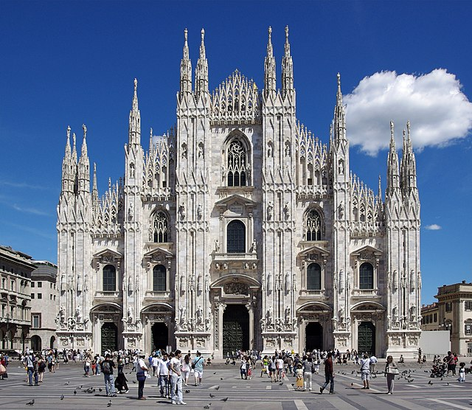
“So Grand, So Solemn, So Vast!’
"I cannot understand how it can be second to anything made by human hands. A wonder it is! So grand, so solemn, so vast! And yet so delicate, so airy, so graceful!" -American writer Mark Twain on the Cathedral of Milan upon seeing the Milan Cathedral.
Notes:
Photo Credit: Milan Cathedral. Jakub Hałun.Creative Commons Attribution-Share Alike 4.0. https://commons.wikimedia.org/wiki/File:20110724_Milan_Cathedral_5260.jpg
Directions: Have students copy the information from the slide into their notes.
Teaching points:
The ways that historians have written about the Middle Ages have dismissed the many Catholic Church achievements of the period, roughly from 500 to 1500.
The Catholic Church became the driving force of art, architecture and culture in the Western World peaking in the middle ages.
One example is the Duomo of Milan in its entire scope is a magnificent work of art. Built in a Gothic style that had reached its peak around the beginning of construction in 1386, the cathedral took over six centuries to complete. This long history makes it difficult to connect the cathedral with any one architect. At the end of the fifteenth century, Leonardo da Vinci, one of the greatest architects and artists of all time, was commissioned to design the cathedral’s tiburium, or tower. Da Vinci designed a buttress that would hold the tower and strengthen the infrastructure of the entire cathedral. The style of the tower is Gothic like the rest of the cathedral, but he used Renaissance methods in its design, including a more octagonal layout for its base.
Online Resources: Have students view video, Building the Great Cathedrals. URL here: https://youtu.be/D40JhGKVUVM
Have students view video, 14 Most Beautiful Cathedrals and Churches. URL here: https://youtu.be/XVEc00qqN4A
The resources linked in this presentation file may contain copyright material. Such material is made available for educational purposes only. This constitutes a “fair use” of any such copyright material as provided for in Title 17 U.S.C. section106A-117 of the US Copyright Law.

Slide 16
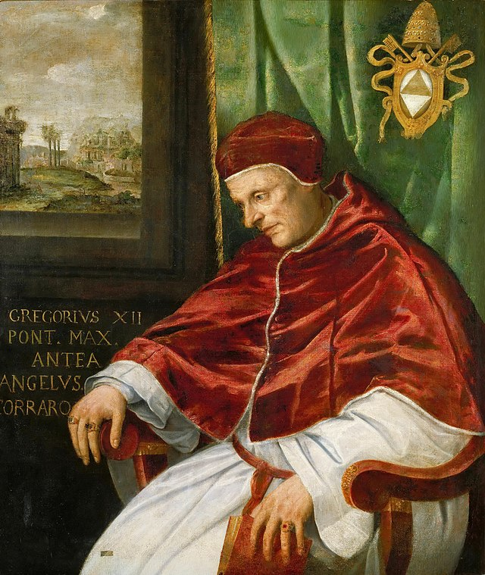
Pope
Key
Vocab
Successor of Peter, bishop of Rome. Keeper of the Keys. All bishops are subject to the pope, just as the Apostles deferred to Peter. He is the head of the Universal Church and he is the Vicar of Christ.
Notes:
Photo Credit: Portrait of pope Gregory XII by Girolamo Muziano, found in the collection of the Vatican Museums at Viale Vaticano, Rome.Girolamo Muziano. Public domain. https://commons.wikimedia.org/wiki/File:Girolamo_Muziano_%E2%80%93_Portrait_of_Pope_Gregory_XII_(Musei_Vaticani).jpg
Directions: Have students copy down the key Vocabulary in their notes.
Teaching Points: As the successor of St. Peter and the head of the college of bishops, the pope is the pastor who watches over the whole Church and each of her members throughout the world.
The resources linked in this presentation file may contain copyright material. Such material is made available for educational purposes only. This constitutes a “fair use” of any such copyright material as provided for in Title 17 U.S.C. section106A-117 of the US Copyright Law.

Slide 17
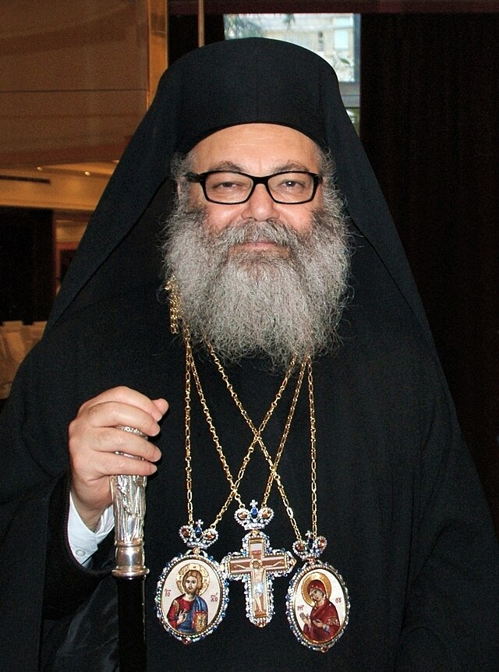
Patriarch
Key
Vocab
Bishops of one of five episcopal sees…. Jerusalem, Antioch, Constantinople, Alexandria and the Latin patriarchate of Rome. The Pope, bishop of Rome, is acknowledged as the principal patriarch.
Notes:
Photo Credit: Patriarch John X of Antioch.Υπουργείο Εξωτερικών (Ministry of Foreign Affairs, Greece). Creative Commons Attribution-Share Alike 2.0. https://commons.wikimedia.org/wiki/File:Patriarch_John_X_of_Antioch_2.jpg
Directions: Have students copy down the key Vocabulary in their notes.
The resources linked in this presentation file may contain copyright material. Such material is made available for educational purposes only. This constitutes a “fair use” of any such copyright material as provided for in Title 17 U.S.C. section106A-117 of the US Copyright Law.

Slide 18
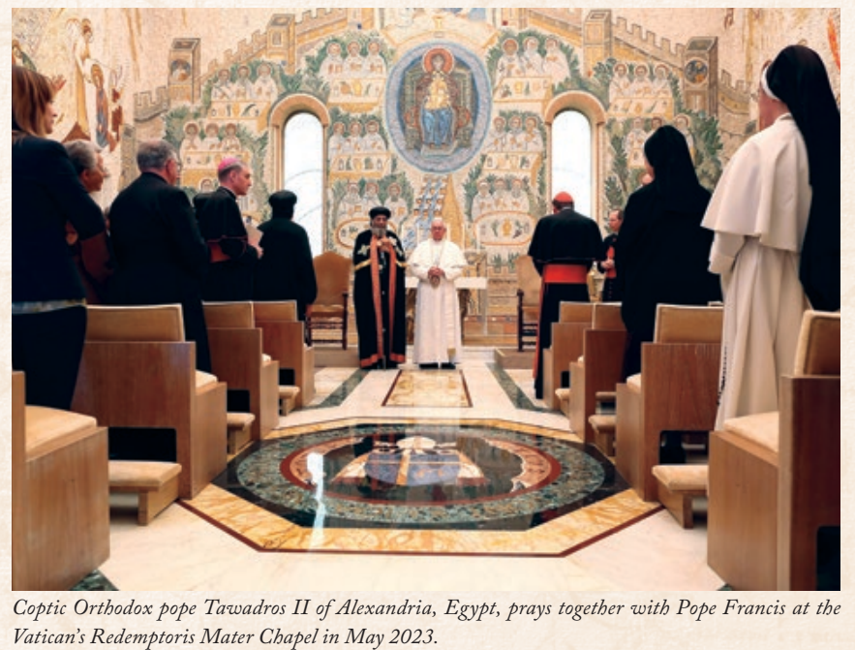
The Church is Catholic
Today there are twenty-one Eastern Catholic Churches in full communion with Roman Catholicism.
These churches retain the customs and liturgical practices of their own traditions.
Notes:
Photo Credit: Bride and groom at the ruins of w:Sutro bath. Brocken Inaglory. Creative Commons Attribution-Share Alike 3.0. https://commons.wikimedia.org/wiki/File:Bride_and_groom_cropped.jpg
Directions: Have a students copy down information from their slides into their notes.
Teaching Points:
Jesus commanded the apostles to go out into the whole world baptizing ALL Nations
The Church spread throughout the world over time
There are many types of Catholics (27 Rites) with the Roman Rite being the largest.
The Church is also universal in time. It was prefigured by Israel and it will be eternal as the Bride at the Wedding Feast of the Lamb (Heaven).
Online Resources: Have students view video, What Does the Word Catholic Mean?. URL here: https://youtu.be/m_XuzsDEWHQ
Have students view video, The Meaning of Catholic. URL here: https://youtu.be/3NBYfYTOeJI
The resources linked in this presentation file may contain copyright material. Such material is made available for educational purposes only. This constitutes a “fair use” of any such copyright material as provided for in Title 17 U.S.C. section106A-117 of the US Copyright Law.

Slide 19
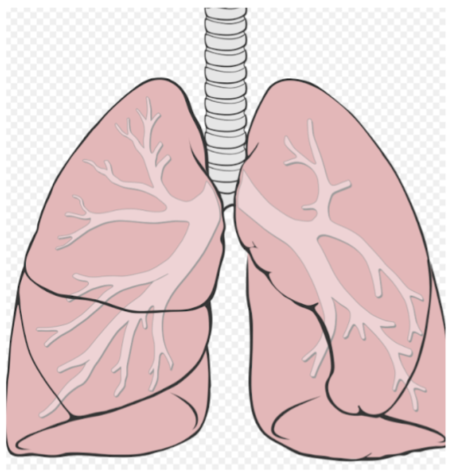
The Church is both East and West
"The Church must breathe with her two lungs”
-Pope John Paul II
Notes:
Photo Credit: Lungs. Patrick J. Lynch. Creative Commons Attribution-Share Alike 2.5. Birikak. https://commons.wikimedia.org/wiki/File:Birikak.png
Directions: Have a students copy down information from their slides into their notes. Ask why they think the pope used this analogy (the church is an organic, living body).
Teaching Points: In his 1995 encyclical Ut Unum Sint, Pope St. John Paul II describes the unity of the Church, saying, “The Church must breathe with her two lungs!” Here, he speaks of the mutual interdependence and healthy tension that should exist between the East and West so that the Church, as a whole, fully can benefit and her mission become more effective.
Online Resources: View video, Eastern Catholic Churches by Catholic Central. URL here:https://youtu.be/aZTNQ6jpzT8
The resources linked in this presentation file may contain copyright material. Such material is made available for educational purposes only. This constitutes a “fair use” of any such copyright material as provided for in Title 17 U.S.C. section106A-117 of the US Copyright Law.

Slide 20
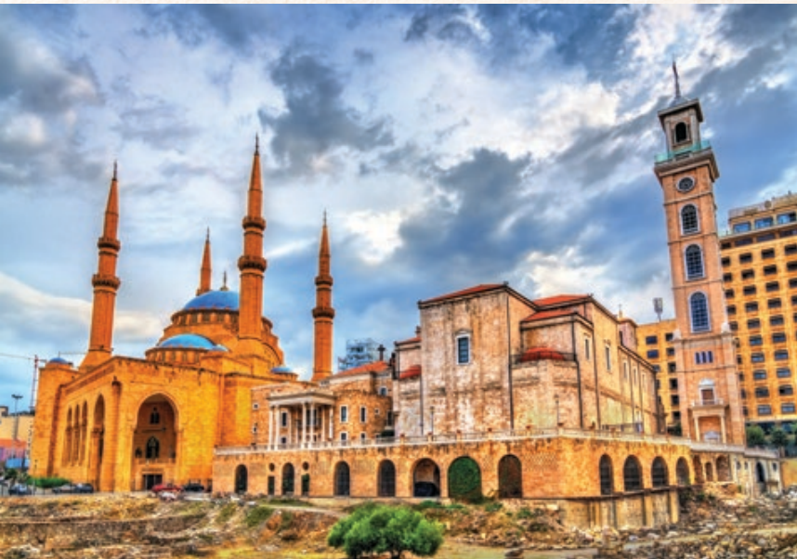
Notes:
Photo Credit: AMP Textbook pg. 211.
Directions: Have a students copy down information from their slides into their notes.
Teaching Points: The architecture of the Maronite Catholic Cathedral (next to the mosque) in Beirut resembles many of the other Catholic rite churches.
Who are the Maronites?
Origin: The Maronites are named after St. Maron, a Syriac monk from the 4th century. They trace their origins to the monastery of Bet Moroon, or the House of Maron, which was built in 452 on the Orontes River.
Church: The Maronites are part of the Maronite Church, one of the largest Eastern ritechurches. The Maronite Church is in communion with the Roman Catholic Church, but has its own liturgical and spiritual traditions.
Location: The Maronites are concentrated in Lebanon, but there are also smaller communities in Syria, Israel, and Jordan.
History: The Maronites' history is intertwined with Lebanon. The Maronite political leaders and their Church played a key role in the changes that led to Lebanon electing a Christian Maronite president.
Online Resources: View video, The Maronite History and Liturgy. URL here: https://youtu.be/YdRAGziWB08
The resources linked in this presentation file may contain copyright material. Such material is made available for educational purposes only. This constitutes a “fair use” of any such copyright material as provided for in Title 17 U.S.C. section106A-117 of the US Copyright Law.

Slide 21

Memorize It
Key
Verse
“You are Peter and upon this rock I will build my church... I will give you the keys of the kingdom”
-Mt 16:18-19
Notes:
Directions: Have students copy the quote. Add bonus points to the assessment if they can copy it down demonstrating that they memorized it.
The resources linked in this presentation file may contain copyright material. Such material is made available for educational purposes only. This constitutes a “fair use” of any such copyright material as provided for in Title 17 U.S.C. section106A-117 of the US Copyright Law.

