Slide 1
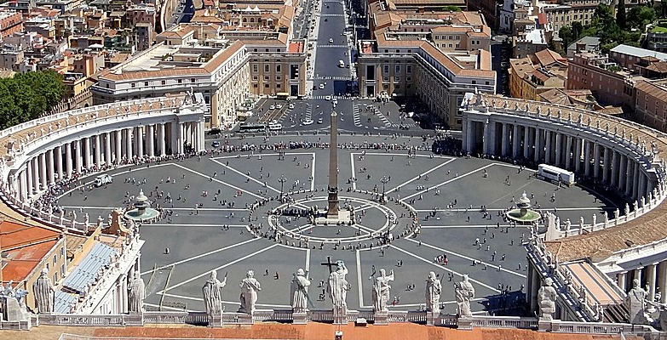
8
The Bible in the Life
of the Church
God Reveals: An Introduction to the Bible
Notes:
*Photo Credit: https://commons.wikimedia.org/wiki/File:Vatican_City_dotm_banner_1.jpg
Suggestions for students’ note-taking:
●Require students to use a three-ring binder (1/2-1 inches) full of loose-leaf paper (college or wide ruled).
●Notes must be taken in pen only and handwritten.
●Notebooks should contain information and notes for religion class only.
●Notebooks must have a table of contents with topic of notes, dates, and page numbers.
●All notes must have a topic and page number.
●Students will be required to copy each slide unless the teacher directs students to skip certain slides or parts of slides. Notebooks will be graded based on neatness, completeness, and organization. Notebooks should have a significant point value representing 20-25% of the overall grade.

Slide 2
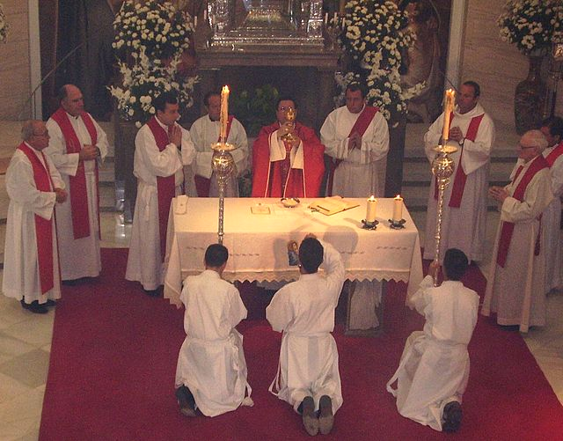
Liturgy
Key
Vocab
“The work of the people.” The people of God participating in the work of God. The coming together of the Church for official prayer and worship to participate in our salvation.
Notes:
*Photo Credit: Almicar, Public domain, Seminario mayor de Asidonia-Jerez 2005. https://commons.wikimedia.org/wiki/File:SeminarioAsidoniaJerez2.jpg
Directions: Have students copy down key vocabulary in their notes.

Slide 3
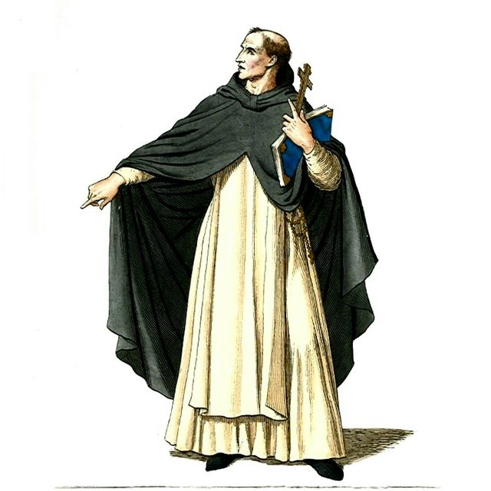
Homily
Key
Vocab
At Mass, during the Liturgy of the Word, the homily is a reflection given by a bishop, priest or deacon in order to expound from the biblical readings the mysteries of the faith and the guiding principles of the Christian life.
Notes:
*Photo Credit: Paul Mercuri, Public domain, Medieval priest/monk. https://commons.wikimedia.org/wiki/File:Medieval_Priest,_Friar,_or_Monk_(1).JPG
Directions: Have students copy down key vocabulary in their notes.

Slide 4
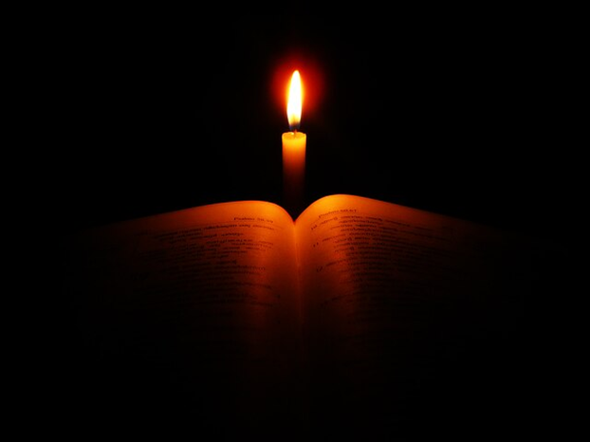
Biblical Prayers
Old Testament
The Shema
The Psalms
New Testament
The Lord’s Prayer (Our Father)
The Hail Mary
Notes:
*Photo Credit: Vishnu gs, Creative Commons Attribution 3.0, Bible in Candlelight. https://commons.wikimedia.org/wiki/File:Holy_bible.jpg
Directions: Share the following extra information about biblical prayers:
Old Testament
The Sh’ma: comes from the first word of the prayer which means “hear” or “listen.” It is located in the book of Deuteronomy. It reads, “Hear, O Israel! The LORD is our God, the LORD alone! Therefore, you shall love the LORD, your God, with your whole heart, and with your whole being, and with your whole strength.”
The Psalms: the 150 Psalms make up what we call the book of Psalms. They were prayed or chanted at the Temple worship liturgy of the Hebrew people. Catholics pray or chant the Psalms during the Liturgy of the Word at Mass. The Psalms also make up a large portion of the Divine Office which is prayed by certain religious orders.
New Testament
The Our Father: the shorter version is in the Gospel of Luke (see Luke 11:2–4) and the longer version is in the Gospel of Matthew (see Matthew 6:9–13). Jesus gave the prayer to his disciples when he was asked how they should pray.
The Hail Mary: located in the Gospel of Luke. The prayer begins with the angelic salutation, “Hail, favored one” or “Hail, full of grace, the Lord is with you” spoken by the angel Gabriel to Mary (see Luke 1:28). The next part comes from the words Elizabeth spoke: “Most blessed are you among women, and blessed is the fruit of your womb” (Lk 1:42). The last part is supported by the Letter of James which says the prayers of the righteous are very powerful. We ask Mary to pray for us because she is our holy mother with God in heaven.

Slide 5
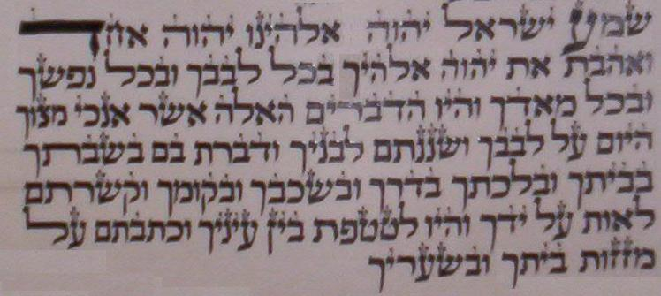
Sh’ma
Key
Vocab
The Sh’ma Israel or Shema Yisrael is considered the most important part of Jewish prayer. It is recited twice daily by observant Jews as a mitzva—that is, a religious commandment. In the Catholic Liturgy of the Hours, the Sh’ma is recited as part of Night Prayer (Compline) every Saturday.
Notes:
Photo Credit: BuickCenturyDriver, Public domain. 1st Paragraph of Shema. https://commons.wikimedia.org/wiki/File:1st_paragraph_of_Shema.JPG
Directions: Have students copy down key vocabulary in their notes.

Slide 6

Turn and Talk
Why do you think it is important to use prayers that are in the Bible when we come together to worship God?
Notes:
Directions: Have students write down the question and then write down their answer. Then have students share their answers with one person close by.

Slide 7

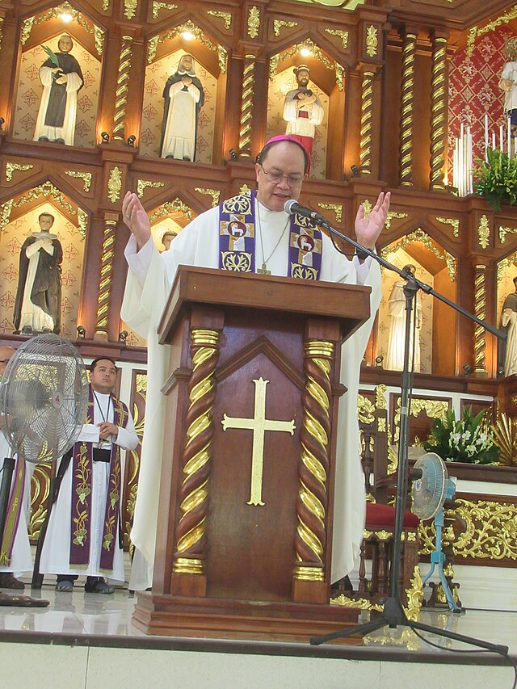
Scripture at Mass
The Catholic Mass has two main parts:
Liturgy of the Word
Liturgy of the Eucharist
The Liturgy of the Word
Scripture is read aloud
First Reading from the Old Testament
Responsorial Psalm (Book of Psalms, Old Testament)
Second Reading usually from a letter of St. Paul (New Testament)
The Gospel Reading from Matthew, Mark, Luke, or John
Notes:
Photo Credit: E911a, Creative Commons Attribution-Share Alike 4.0. https://commons.wikimedia.org/wiki/File:Northbay_Boulevard_South_City_of_Navotas_(Metro_Manila;_2023-08-16)_E911a_32.jpg
Directions: Have students copy information from the slide into their notes.
Online Resources: Catholic-resourses.org has a webpage dedicated to the use of scripture in liturgy. URL here:
https://catholic-resources.org/Bible/Biblical-Mass-Texts.htm
Also have students listen to the readings of the day at the USCCB website. URL here: https://bible.usccb.org/daily-bible-reading

Slide 8
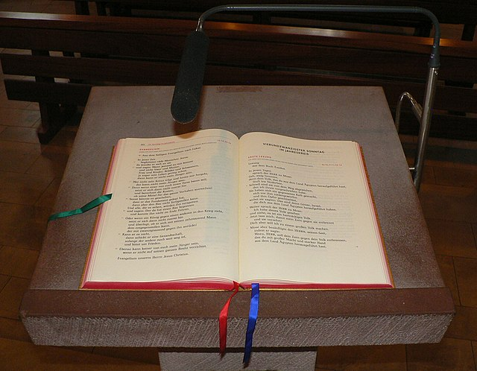
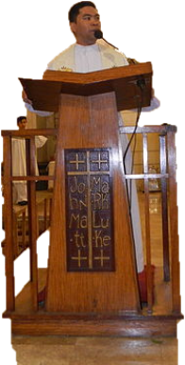
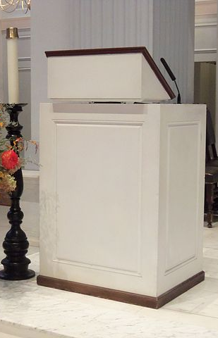
The Sunday cycle is divided into three years, labeled A, B, and C:
  In Year A, we read mostly from the Gospel of Matthew.
  In Year B, we read the Gospel of Mark and chapter 6 of the Gospel of John.
  In Year C, we read the Gospel of Luke.
  The Gospel of John is read during the Easter season in all three years.
Lector:
One who reads at the lectern at Mass.
Lectionary:
The book which contains the readings for Mass based on a three year cycle and ordered to the liturgical year.
The weekday cycle is divided into two years:
  Year I is read in odd-numbered years (2023, 2025, etc.)
  Year II is used in even-numbered years (2022, 2024, etc.)
The Gospels for both years are read semi-continuously, beginning with Mark, then moving on to Matthew and Luke. The Gospel of John is read during the Easter season.
Lectern:
The stand on which is placed the lectionary or book of the Gospels to be read at Mass.
Notes:
*Photo Credits (from top to bottom):
1. https://commons.wikimedia.org/wiki/File:St._Nikolaus_Germete_Ambo_mit_aufgeschlagenem_Lektionar_Lesejahr_C.jpg
2. https://commons.wikimedia.org/wiki/File:HolyRosaryParishChurchjf3929_04.JPG
3. https://commons.wikimedia.org/wiki/File:Holy_Trinity_Georgetown_DC_06.JPG
Directions: Have students add the vocabulary terms to their notes. Explain that each item in the slide begins with the root word lectio, which is Latin for “read.” The purpose of the reading cycles is to ensure that as Catholics we hear almost the whole Bible read aloud over the course of three years if we include weekday readings.

Slide 9


Challenge
Question
It has been reported by Fr. Felix Just, SJ, that the Sunday and weekday Lectionaries contain:
13.5 percent of the Old Testament (not counting the Psalms)
54.9 percent of the non-Gospel New Testament
89.8 percent of the Gospels
71.5 percent of the entire New Testament
“How much of the Bible do Catholics read and hear aloud if they attend Mass each day over the course of three years?”
Notes:
Directions: Use the animation feature to have the blue answer box appear after you ask the students to respond out loud to the question on the left.

Slide 10
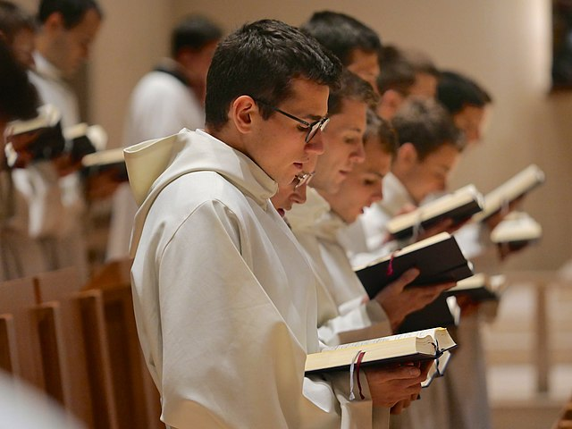
Liturgy of the Hours
Key
Vocab
The official prayer of the church consisting of psalms, readings, and hymns that are recited at stated hours of the day. Also called the Divine Office.
Notes:
Photo Credit: Octave 444, Creative Commons Attribution-Share Alike 4.0, Liturgie des Heures. https://commons.wikimedia.org/wiki/File:Communaut%C3%A9_Saint-Martin_office.jpg
Directions: Have students copy down key vocabulary in their notes.

Slide 11

Liturgy of the Hours
“The celebration of the Liturgy of the Hours demands not only harmonizing the voice with the praying heart, but also a deeper ‘understanding of the liturgy and of the Bible, especially of the Psalms.’”
(CCC, 1176)
Notes:
Photo Credit: Octave 444, Creative Commons Attribution-Share Alike 4.0, Liturgie des Heures. https://commons.wikimedia.org/wiki/File:Communaut%C3%A9_Saint-Martin_office.jpg
Directions: Explain that it is a requirement for most Catholic religious communities to pray daily with set readings and prayers found in a book called a breviary.
Share the following Catechism quote about the Liturgy of the Hours:
“The hymns and litanies of the Liturgy of the Hours integrate the prayer of the psalms into the age of the Church, expressing the symbolism of the time of day, the liturgical season, or the feast being celebrated. Moreover, the reading from the Word of God at each Hour (with the subsequent responses or troparia) and readings from the Fathers and spiritual masters at certain Hours, reveal more deeply the meaning of the mystery being celebrated, assist in understanding the psalms, and prepare for silent prayer” (CCC, 1177).
Online Resources: To listen to daily Liturgy of the Hours readings and prayers, see the website divineoffice.org. URL here: https://divineoffice.org/

Slide 12
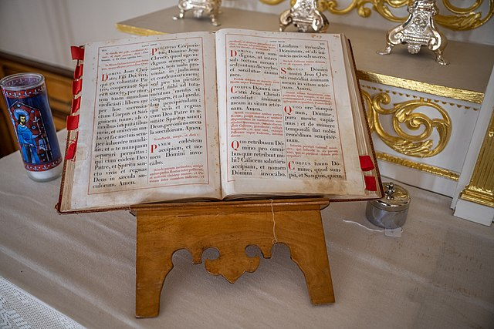
Breviary
Key
Vocab
A liturgical book in the Roman Catholic Church that contains the daily service, readings, and prayers for the Liturgy of the Hours or Divine Office.
Notes:
Photo Credit: Wilfredo Rafael Rodriguez Hernandez,Creative Commons Zero, Public Domain Dedication. https://commons.wikimedia.org/wiki/File:Saint-Charles-Borrom%C3%A9e_Church,_Charlesbourg,_Quebec_05.jpg
Directions: Have students copy down key vocabulary in their notes.

Slide 13
Five Reasons to Pray the Liturgy of the Hours
It is the public prayer of the Church which praises God and sanctifies time.
It helps us to be thankful to God.
It keeps us in a state of ongoing prayer in the morning, at midday, and in the evening.
It teaches us Scripture, prayers of Church Fathers, and seasonal themes in the liturgical calendar.
It extends the mysteries of Christ’s Incarnation and Paschal Mystery into our daily life.
Notes:
Directions: Have students summarize these reasons in their notes.

Slide 14
Challenge
Question
No. Catholics use the Bible regularly. The Bible or Scripture is an integral part of Catholic prayer life, forming part of every Mass, every sacramental celebration, and the official daily prayer of the Church—the Liturgy of the Hours.
(CCC, 141, 1190)
“Is it true that Catholics do not use or read the Bible?”
Notes:
Directions: Use the animation feature to have the yellow answer box appear after you ask the students to respond out loud to the question on the left.

Slide 15
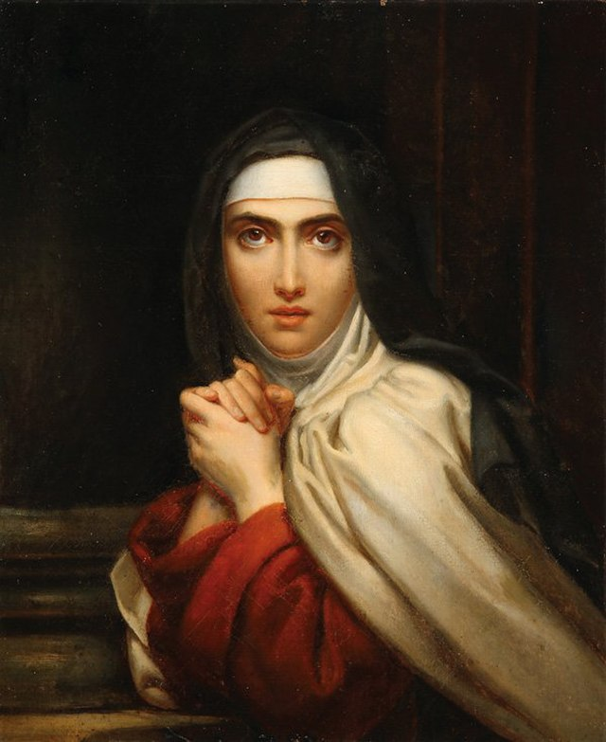
Meditation
Key
Vocab
A quest where the mind seeks to understand the why and how of the Christian life in order to adhere and respond to what the Lord is asking.
Notes:
Photo Credit: François Gérard, Public domain. https://commons.wikimedia.org/wiki/File:Fran%C3%A7ois_G%C3%A9rard_-_St_Theresa_(detail).jpg
Directions: Have students copy down key vocabulary in their notes.
Online Resources: Have students view the video “The Ecstasy of St. Teresa of Avila.” URL here: https://youtu.be/whU0UxlRmGA

Slide 16
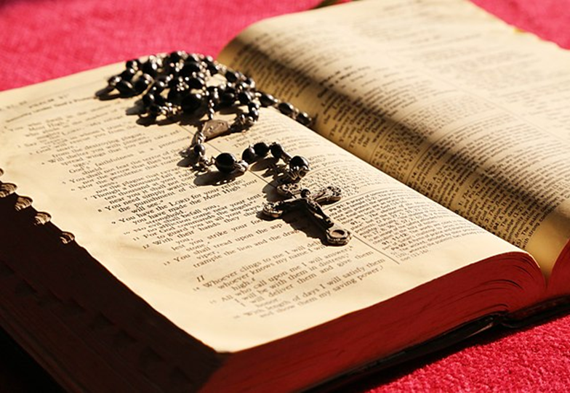
How to Use Scripture for Meditation
Two Examples:
Lectio Divina
Scriptural Rosary
Notes:
Photo Credit: James Chan, Creative Commons Zero, Public Domain Dedication. https://commons.wikimedia.org/wiki/File:Bible-706658.jpg
Directions: Explain Lectio Divina and Scriptural Rosary using the definitions below:
Lectio Divina: means “sacred reading.” The practice of prayerfully reading Scripture. The method of lectio divina follows five steps:
Reading (lectio) – hearing God’s Word in the Sacred Scriptures as we read a short text aloud
What does this biblical text itself really say?
Meditation (meditatio) – reflecting on the meaning and relevance of the text that I/we have read
What is God saying to me/us through this text?
Prayer (oratio) – speaking with God in praise, thanksgiving, contrition, petition, intercession
What do I/we say to God in response to this text?
Contemplation (contemplatio) – listening to God more quietly in the silence of our hearts
How does this text make me/us feel in my/our relationship with God?
Action (actio) – letting the encounter concretely affect our daily life and work in the world
How will we change what I/we do today in response to hearing this text?
Flexibly adapt the above steps, as needed, for individuals or groups, youths or adults, etc.
Scriptural Rosary: The use of short Scripture verses or passages that highlight the mystery that one calls to mind during the prayer. The method of praying a Scriptural Rosary follows the same steps as lectio divina:
1. Read a Scripture verse (lectio)
2. Meditate on its connection to the overall mystery (meditatio)
3. Pray the Hail Mary aloud (oratio) and
4. Contemplate how the mystery and the Scripture verse reveals God’s plan for our life and our salvation (contemplatio).
Online Resources: Have students view the video “What is Lectio Divina?” URL here: https://youtu.be/gKYEOc3ik9k

Slide 17

Memorize It
Key
Verse
“Hear, O Israel! The Lord is our God, the Lord alone! Therefore, you shall love the Lord, your God, with your whole heart, and with your whole being, and with your whole strength.”
Deuteronomy 6:4–5
Notes:
Directions: Have students copy the quote. Add bonus points to the assessment if they can write it down, demonstrating that they memorized it.

