Slide 1
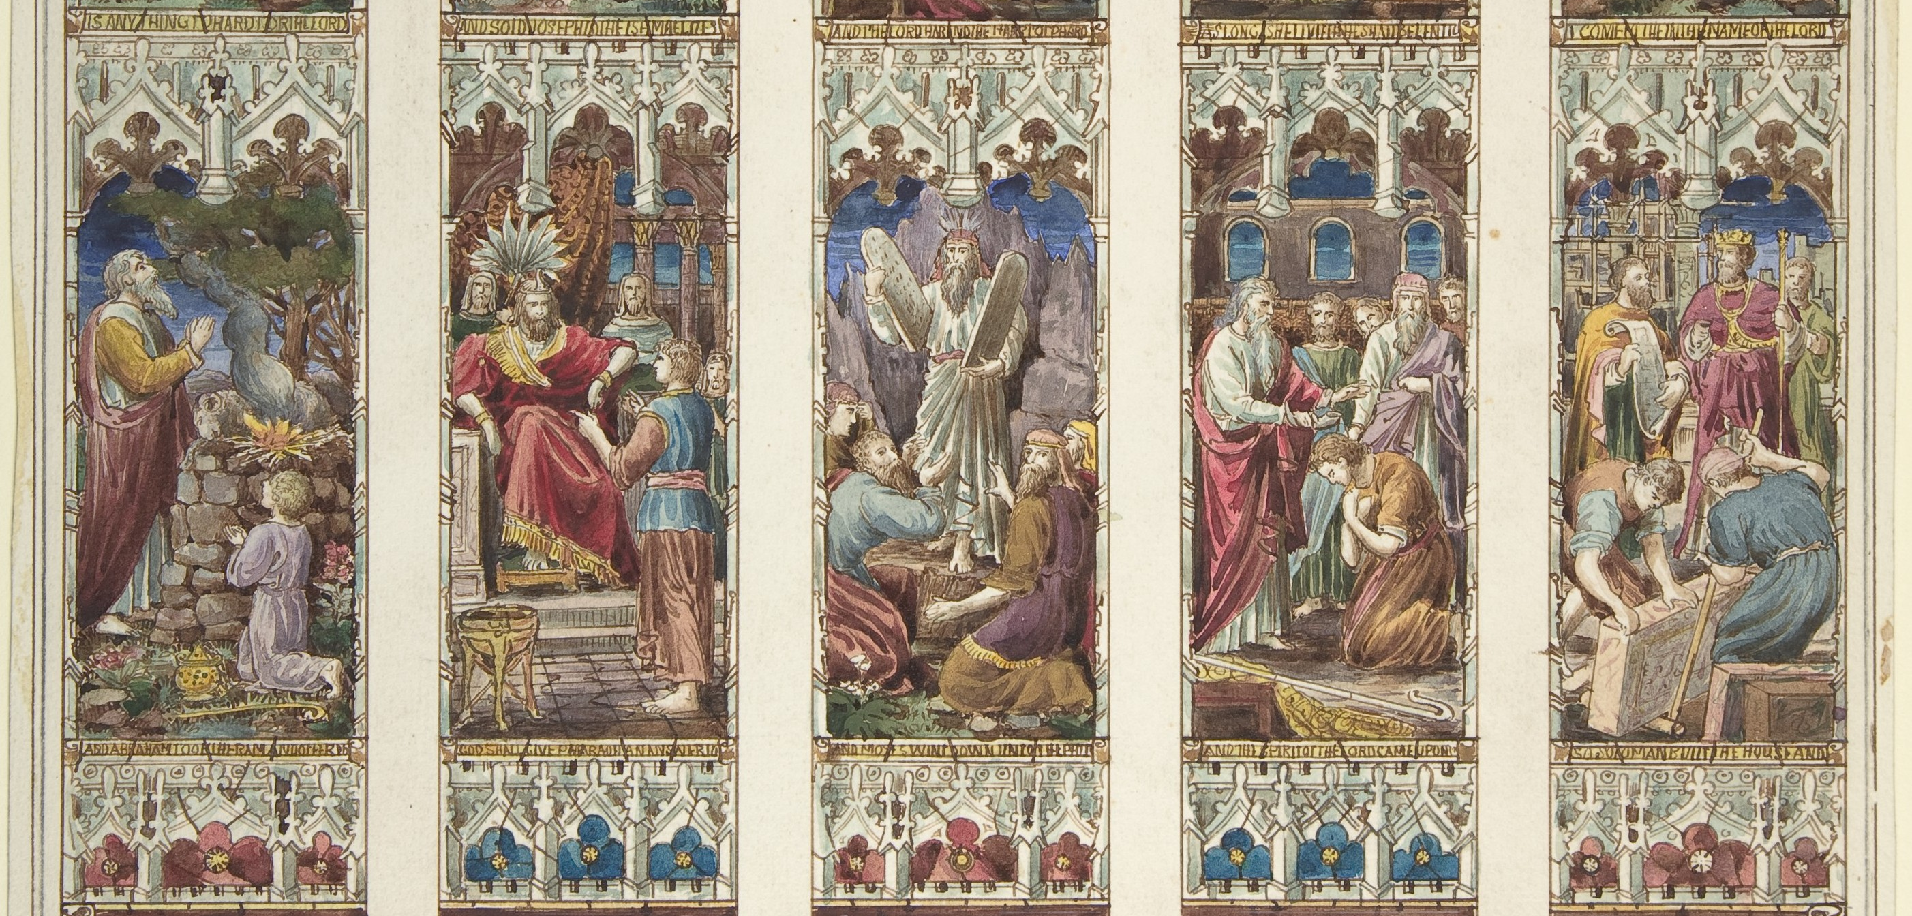
3
How to Understand the Bible
God Reveals: An Introduction to the Bible
Notes:
*Photo Credit: https://commons.wikimedia.org/wiki/File:Design_for_Old_Testament_Window_MET_DP805903.jpg
Suggestions for students’ note taking:
Require students to use a three-ring binder (1/2-1 inches) full of loose-leaf paper (college or wide ruled).
Notes must be taken in pen only and handwritten.
Notebooks should contain information and notes for religion class only.
Notebooks must have a table of contents with topic of notes, dates, and page numbers.
All notes must have a topic and page number.
Students will be required to copy each slide unless the teacher directs students to skip certain slides or parts of slides. Notebooks will be graded based on neatness, completeness, and organization. Notebooks should have a significant point value representing 20-25% of the overall grade.

Slide 2

Seven Beliefs About the Bible
The Bible Is Not Always Literal
The Bible is Supernatural
The Bible Is Infallible
The Bible Is Inspired
The Bible and the Church Are Sufficient
The Bible Is Authoritative
The Bible Is Practical
Notes:
Directions: Ask students to read pp.114–116 of the student text. After they read, go ever each of the seven beliefs that Catholics have regarding the Bible (below).
1. The Bible Is Supernatural
The Bible is the Word of God, which means that God is the author of Scripture. The great miracle
of the almighty God is that he authored the Bible with the aid of flawed human authors.
2. The Bible Is Inspired
Catholics and Protestants both accept that the Bible is inspired. However, fundamentalists and Catholics disagree about how the inspiration took place. Fundamentalists often hold that God dictated the books of the Bible word for word and the human authors were secretaries recording his words. This argument breaks down with the fact that we don’t have the original manuscripts of any of the books of the Bible. Any version of the Bible is a reproduction or copy from an earlier version. Yet, even without the original manuscripts, there is ninety-nine percent verbal agreement among the different manuscripts, which is far more than for any other ancient writings. God’s inspiration involves his working with human authors and editors.
3. The Bible Is Infallible
Catholics understand that the Bible is infallible (without error), but not necessarily in areas like grammatical, mathematical, or scientific truth. The Bible is primarily a source of symbolic, relational, moral, and religious truth.
4. The Bible and the Church Are Sufficient
For most Protestants, the Scriptures, especially the New Testament, are the only sources of faith and practice. The problem is that Scripture can’t interpret itself. The belief in sola scriptura has led to, conservatively, thousands of different Protestant denominations. Most clearly, the infallible Church is needed to guarantee an infallible Bible because it was the Church (the early disciples) who wrote the Bible and the early Church councils that determined the canon of the Bible.
5. The Bible Is Authoritative
Catholics and fundamentalists agree that the Bible’s authority is absolute and without fault. The difference is that Catholics understand that the Bible’s proper authority can only be preserved and interpreted by the Church.
6. The Bible Is Not Always Literal
Fundamentalists insist on a literal interpretation of almost everything in the Bible. The accounts of creation are an example of this. Also, fundamentalists are known for using biblical passages to predict when the world will end, though Jesus himself said that even he does not know “the day and hour” and that “the Father alone” knows (see Matthew 24:36). Interestingly, one passage fundamentalists do not interpret literally is Jesus’s words at the Last Supper: “This is my body” (Mt 26:26). Catholics and most Protestants have a completely different understanding of Jesus’s presence in the Eucharist.
7. The Bible Is Practical
Here, fundamentalists, at least in the past, have had an advantage over Catholics. Fundamentalists are known for reading, studying, believing, and being devoted to Scripture. Catholics in other generations have been less familiar with using the Bible in these ways. From a negative point of view, fundamentalists, while proficient in using and citing the Bible, have done so in faulty ways as the other six points address.

Slide 3
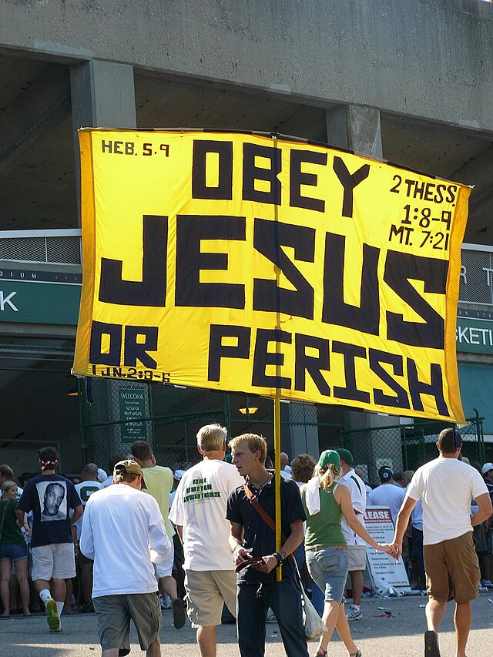
Fundamentalist
Key
Vocab
Protestants who interpret each word or phrase in the
Bible from a literalist point of view.
Notes:
*Photo Credit: Saraware, Creative Commons Attribution 3.0, https://commons.wikimedia.org/wiki/File:DavidWoronieckiWithSign.jpg
Directions: Have students write down the term and definition as part of a Key Vocab section in their notes. Assign the article below to reinforce understanding.
Online Resources: See Peter Kreeft’s article “Fundamentalists.” URL here: https://www.catholiceducation.org/en/religion-and-philosophy/apologetics/fundamentalists.html

Slide 4
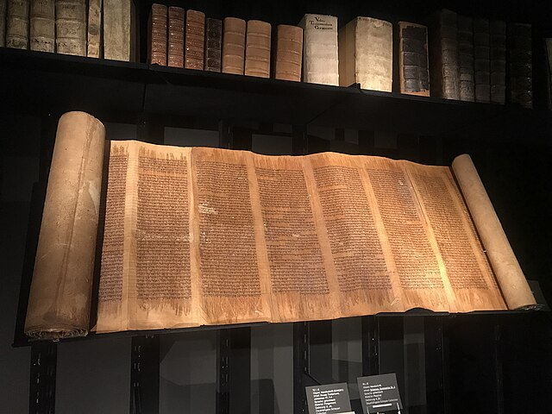
Contextualist
Key
Vocab
The Catholic approach to the Bible which takes into account language, culture, time period, science and human contribution. Open to layers of meaning.
Notes:
*Photo Credit: Marsupium, Creative Commons Attribution 4.0, https://commons.wikimedia.org/wiki/File:Bible_Museum_M%C3%BCnster_02.jpg
Directions: Have students write down the term and definition as part of a Key Vocab section in their notes. Assign the article below to reinforce understanding.
Online Resources: See Tim Gray’s article “Do You Read the Bible Literally?” URL here: https://www.catholiceducation.org/en/religion-and-philosophy/apologetics/do-you-read-the-bible-literally.html

Slide 5

Scientism
Key
Vocab
The belief that only knowledge obtained from scientific research is valid
Notes:
*Photo Credit: Reaper35, Creative Commons Zero, Public Domain Dedication, https://commons.wikimedia.org/wiki/File:Darwin_Fish_01.svg
Directions: Have students write down the term and definition as part of a Key Vocab section in their notes. Assign the article below to reinforce understanding.
Online Resources: See Bishop Michael J. Sheridan’s article, “The Lies of Scientism.” URL here: https://www.catholicculture.org/culture/library/view.cfm?recnum=8753

Slide 6
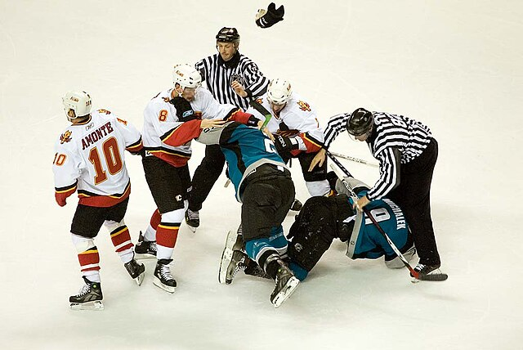
Catholicism
Fundamentalism
“Fellas, calm down! Faith does not fear reason. Truth cannot contradict truth!”
“Scripture cannot be in error in faith, salvation, science or history!”
“Science has disproved the Bible! Miracles are impossible. Scripture is fantasy and myth.”
Scientism
Notes:
*Photo Credit: Elliot, Creative Commons Attribution 2.0, https://commons.wikimedia.org/wiki/File:Steve_Bernier_vs_Brad_Ference_fight.jpg
Directions:
Ask students why the Catholic Faith is represented as the referee in this infographic.
Have students view the video below and take notes on three viewpoints on Scripture. Set up notes with three columns. One for Ralph Reed (Fundamentalism), another for Bill Maher (Scientism/atheism) and a third for Bishop Barron (Catholicism). The goal is to capture the three viewpoints as discussed by Bishop Barron.
View the video “Bishop Robert Barron on Bill Maher and Biblical Interpretation.” URL here: https://youtu.be/ZGDDKlXl488?list=TLPQMTYwMjIwMjRaQUXa8gQouA

Slide 7

Scripture has Four Layers of Meaning…
Literal
Allegorical
Moral
Anagogical
Notes:
*Photo Credit: Annie Spratt anniespratt, Creative Commons Zero, Public Domain Dedication, https://commons.wikimedia.org/wiki/File:Colorful_Cake_(Unsplash).jpg
Directions: Review each of the four senses below. Assign article below to reinforce understanding.
The literal sense looks at how the words were understood at the time they were
written and how they were used to describe things that actually happened. For example, the
description of Jesus’ arrest, trial, Passion, and Death are written from a literal sense.
The spiritual sense has three subdivisions:
The allegorical sense. An allegory is a metaphor or a sustained comparison. In
an allegorical work of literature, you can see that the storyline conveys more than
one level of meaning. The allegorical sense is similar to typology in that it looks
at the entire Bible, especially the Old Testament, in light of its fulfillment in Christ.
Knowing of Christ’s victory over sin, for example, it is possible to recognize that
the Exodus crossing of the Red Sea prefigures this victory. Because the Exodus
was an escape from slavery into freedom, an allegorical reading of this event
also connects it to the waters of Baptism that free us from our slavery to sin.
The moral sense. The Bible provides instruction on proper ways to live and
behave and to act justly on behalf of God and other people. For example,
Abraham teaches us to have faith and to trust in God. A common message of the
prophets, up to the time of John the Baptist, was to turn away from sin, to repent,
and to reform one’s life. When we read these biblical examples from a moral
sense, we, too, are to respond to the same call.
The anagogical sense. This sense helps us to view earthly events and other
realities in the context of our journey to heaven. Your ultimate goal is to get to
heaven, and the Bible is a handbook of sorts to lead you on the way. The word
anagogical comes from a Greek word for “leading.” How does the anagogical
sense work in the Bible? For example, when you read about a person who finds
treasure buried in the field and then goes out and sells everything he has in order
to buy that field, you come to understand that to achieve eternal life you must too
put everything else aside in order to put God first (see Matthew 13:44). The
anagogical sense also helps us to recognize the Church as the “heavenly
Jerusalem” and the “Body of Christ” which leads us to heaven.
Online Resources: See article by Ed Sri, “Making Sense out of Scripture,” URL here: https://www.catholiceducation.org/en/culture/catholic-contributions/making-sense-out-of-scriptArticle ure.html

Slide 8

Leo the L.L.A.M.A. teaches about the Four Layers of meaning
Catholic Bible Interpretation
Looks for
1. The Literal sense: the meaning conveyed by the words of Scripture as written.
2. The spiritual sense:
a. Allegorical sense: recognizing the significance of events in the Bible as they relate to Christ through prophecy, typology and symbolism.
b. Moral sense: Scripture teaches us and encourages us how to live and act.
c. Anagogical sense: Scripture speaks to us of eternal realities.
Notes:
*Photo Credit: Midjourney AI, prompted by Netha Hussain, Creative Commons Zero, Public Domain Dedication, https://commons.wikimedia.org/wiki/File:Llama_in_watercolour.png
Directions: Have students read the following article, “The Prodigal Llama.” URL here: https://www.catholic365.com/article/30494/the-prodigal-llama.html
Follow up with a discussion on how the senses were applied to the Prodigal Son parable (Luke 15:11-32).

Slide 9

Six Criteria for Bible Interpretation
1. Read and interpret Sacred Scripture within the tradition and teaching of the Church.
2. Give attention both to what the human authors intended to say and to what God reveals to us by their words.
3. Take into account the conditions of the time when it was written and the culture where it was written.
4. Read and interpret Sacred Scripture in the light of the same Holy Spirit by whom it was written.
5. Read and interpret each part of Sacred Scripture with an awareness and understanding of the unity of the content and teaching of the entire Bible.
6. Be attentive to the analogy of faith, that is, the unity that exists in all Church teaching.
Notes:
Directions: Have students copy the six criteria for Bible interpretation in their notes.
Online Resources: See Philip Kosloski’s article “How do Catholic Interpret the Bible?” URL here: https://aleteia.org/2020/06/28/how-do-catholics-interpret-the-bible/

Slide 10


The Church does not always propose a literalist or fundamentalist approach to Scripture but rather a contextualist approach. The Church teaches that all of Scripture is true on matters pertaining to religious and salvific teaching because it is inspired by God for that purpose (CCC, 107, 116).
The Church does not claim that the Bible’s purpose is to present scientific or historical facts (CCC, 107).
“Is the Bible always literally true?”
Notes:
Directions: Use the animation feature to have the yellow answer box appear after you ask the students to respond out loud to the question on the left.
Online Resources: View video on misunderstanding the Bible, URL here: https://youtu.be/htxOjJHB5-8

Slide 11
No. While Scripture contains various types of literary forms and genres, it is more than just literature. It is the inspired Word of God (CCC, 135).
“Isn’t the Bible just another piece of literature?”
Notes:
Directions: Use the animation feature to have the yellow answer box appear after you ask the students to respond out loud to the question on the left.

Slide 12
How Recent Magisterial Documents Guide Interpretation
Divino Afflante Spiritu
(Pius XII, 1943)
Dei Verbum (DV) (Vatican II, 1965)
Interpretation of the Bible in the Church, (Pontifical Biblical Commission 1993)
In this document the Church permitted limited use of modern methods of biblical criticism
One of four Constitutions from Vatican II. It covers what the Church teaches about Divine Revelation.
In this Church document ( nos. 5-19) a thorough examination of Catholic interpretation is examined.
1
2
3
Authentic interpretation of the Bible is the responsibility of the teaching office of the Church
Notes:
Directions: Have students view webpage discussing Catholic Bible interpretation. URL here: https://catholic-resources.org/Bible/Catholic-Interpretation.htm
Ask them to create a list of Church documents (see below) at the end of the page which cover interpretation of the Bible.
Pope Pius XII: Encyclical Divino Afflante Spiritu (1943)
Second Vatican Council: “Constitution on the Sacred Liturgy”: Sacrosanctum Concilium (1963)
Second Vatican Council: “Dogmatic Constitution on Divine Revelation”: Dei Verbum (1965)
Pontifical Biblical Commission: “The Interpretation of the Bible in the Church” (1993)
Catechism of the Catholic Church: Part One, Section One, Chapter Two - §§51-141 (1994, 1997)
Online Resourcea: View Video on Vatican II Constitution Dei Verbum, URL here: https://youtu.be/MsQqcn1XGiE?list=TLPQMTYwMjIwMjRaQUXa8gQouA

Slide 13
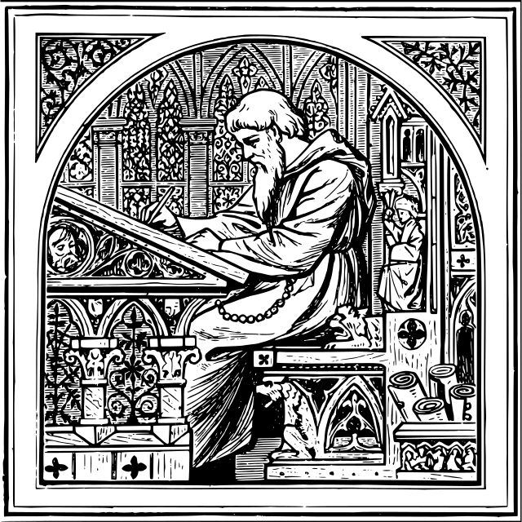
Exegesis
Key
Vocab
The process of careful, analytical study of biblical passages undertaken in order to produce useful interpretations of those passages.
Notes:
*Photo Credit: Grufo after Medieval writing desk.jpg, GNU General Public License v3, https://commons.wikimedia.org/wiki/File:Medieval_writing_desk.svg
Directions: Have students write down this key vocabulary term and definition in their notes.
Online Resources: Show students the following webpage with a chart that scholars use to “do exegesis.” URL here: https://catholic-resources.org/Bible/Exegesis.htm

Slide 14

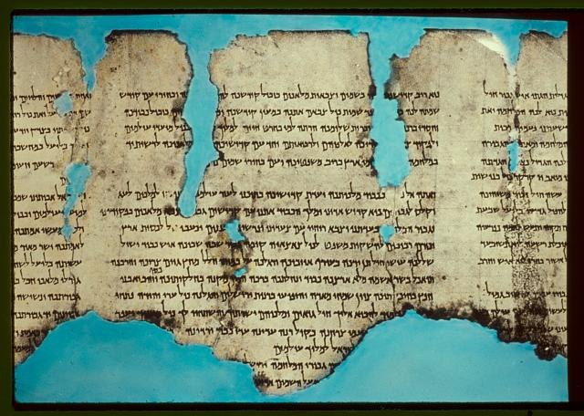
Exegesis requires that you ask questions
Notes:
*Photo Credit: Matson Photo Service - American Colony Jerusalem, Creative Commons Zero, Public Domain Dedication, https://commons.wikimedia.org/wiki/File:The_War_Scroll_-_Dead_Sea_Scroll.jpg
Directions: Share the questions below.
What is the type, or literary genre, of writing?
What occurred historically at the time this was written that might shed light on what this passage means?
Who first wrote this material?
How did these texts come to be part of the canon of the Bible?
How was the material gathered and edited?
If any changes were made, why were they made?

Slide 15
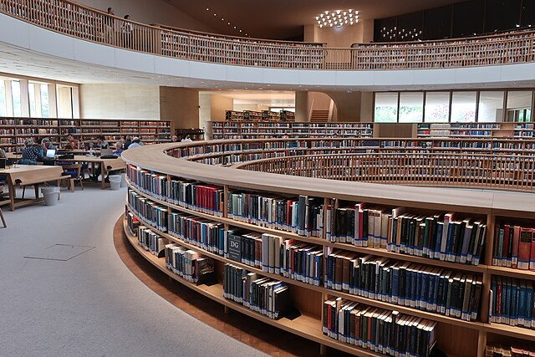
Biblical Criticism
Key
Vocab
A general term that describes several ways to understand biblical texts in their original setting, for discovering the intention of the original author, and for examining their literary style. It includes form criticism, historical criticism, source criticism, and redaction criticism.
Notes:
*Photo Credit: Davidbena, Creative Commons Attribution 4.0, https://commons.wikimedia.org/wiki/File:The_National_Library_of_Israel.jpg
Directions: Have students write down this key vocabulary term and definition in their notes.

Slide 16
Four Types of Biblical Criticism
01
Form Criticism
Determines how each biblical book took shape in the period of oral tradition before the authors put it into writing. Identifies the literary genres used in the Bible.
02
Historical Criticism
Determines the historical and cultural context of the biblical text. Historical criticism uses archaeological and historical research to discover the time period of a text.
03
Source Criticism
Determines where biblical material came from and which sources may have been used.
04
Redaction Criticism
Focuses on the editor or editors who collected and arranged sources used. Determines how a given biblical author’s theology influenced the way that he organized the material.
Notes:
Directions: Share examples below of each type of criticism.
Form Criticism Example: Because Psalm 150 is a hymn, it is very probable that it
was used in the context of ancient Israel's worship.
Historical Criticism Example: You may be familiar with the Ark of the Covenant from the Old Testament.
Why do you think that people do not know where the Ark is today? Historical research reveals
that the Ark of the Covenant was a wooden chest, built by the Chosen People after Moses
received the Ten Commandments. (Exodus 25:10–22 describes its design. Exodus 37:1–9
describes its construction.) It would have measured approximately four feet by two-and-a-half
feet. The original tablets of the Ten Commandments—and nothing else—were in the Ark. The
Ark traveled with the Israelites in the desert until King David brought it to Jerusalem around
1000 BC. The last time the Old Testament mentions the Ark is when the Babylonians demolished the
Jerusalem Temple in 587 BC. There was no mention of the Ark when the Jews rebuilt the
Temple about seventy years later. The scholarly consensus is that the Babylonians destroyed
the Ark and melted it down for its gold.
Source Criticism Example: In the study of the Pentateuch (the term Christians give to the first five books of the Bible), scholars have discovered four strands of tradition in the composition. These strands of tradition are named the Jahwist (J), the Elohist (E), the Priestly (P) and the Deuteronomist (D). Characteristic vocabulary, concerns, themes, biases, and theological perspectives distinguish each tradition.
Redaction Criticism Example: Consider the genealogy of Jesus. When the Evangelist Luke recorded Jesus’s
family tree, he traced his lineage back to Adam, the common ancestor of all people, to show
that his Gospel was written for Gentile Christians. The author of Matthew’s Gospel, on the other
hand, traced Jesus’s ancestry to Abraham, the father of Judaism, and so displayed a different but
not conflicting theology. Because he was writing for a predominantly Jewish-Christian
community, Matthew included material showing that Jesus Christ fulfilled the prophecies made
to the Chosen People.

Slide 17

Turn and Talk
At the Last Supper Jesus said about the Eucharist, “This is my Body.” Why do you think most Protestants do not interpret that as literal and Catholics do?
Notes:
Directions: Have students write down the question and then write down their answer. Then have students share their answers with one person close by.

Slide 18

Memorize It
Key
Verse
“But if I should be delayed, you should know how to behave in the household of God, which is the church of the living God, the pillar and foundation of truth.”
1 Tim 3:15
Notes:
Directions: Have students copy the quote. Add bonus points to the assessment if they can write it down, demonstrating that they memorized it.

