Slide 1
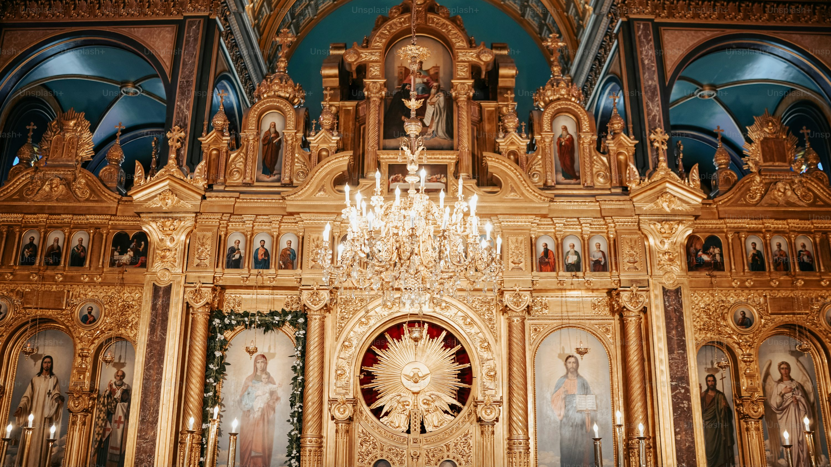
8
Living the Paschal Mystery
God Saves: We Are Redeemed through the Paschal Mystery
Notes:
Image Source: https://unsplash.com/photos/a-church-with-a-chandelier-and-paintings-on-the-wall-sKFi5S2QTWg
Suggestions for students’ note taking:
●Require students to use a three ring binder (1/2-1 inches) full of loose leaf paper (college or wide ruled).
●Notes must be taken in pen only and hand written.
●Notebooks should contain information and notes for religion class only.
●Notebooks must have a table of contents with topic of notes, dates and page numbers.
●All notes must have a topic and page number.
●Students will be required to copy each slide unless the teacher directs students to skip certain slides or parts of slides. Notebooks will be graded based on neatness, completeness and organization. Notebooks should have a significant point value representing 20-25% of the overall grade.
The videos linked in this presentation file may contain copyright material. Such material is made available for educational purposes only. This constitutes a “fair use” of any such copyright material as provided for in Title 17 U.S.C. section106A-117 of the US Copyright Law.

Slide 2


This is the Time
“This is the time of fulfillment.
The kingdom of God is at hand.
Repent, and believe in the gospel.”
(Mark 1:15)
What’s holding you back from being all in?
Notes:
Photo Credit: https://unsplash.com/photos/selective-focus-photo-of-brown-and-blue-hourglass-on-stones-BXOXnQ26B7o
Directions: Have students copy information from the slide into their notes. Ask students why are some people afraid of commitment in general? What holds people back from being an outwardly committed Catholic-Christian? What are the first two steps that Jesus tells us to do in order to be ‘all-in”? (Repent and Believe)
Teaching Points:Openness to God and his Kingdom requires everyone to make a dedicated effort to explore any reasons, questions, or concerns that may be holding them back from making a commitment to Christ and the Gospel. If Jesus is who he says he is then we have to make a choice today.
Are you all in or not? How can Christ fit into every aspect of your life, from schoolwork to activities to future plans to your relationships with others?
Jesus is not meant to be an extra appendage who only comes into your mind at certain times.
Jesus’s directions from Mark 1:15 are for you to repent and believe. What could that look like?
Repentance means a change of mind and heart, a turning away from sin so that you can be more open to Christ and his message. This means that you must give up what is keeping you from God: fighting and complaining, senseless com petition against others, making gods out of pleasure or material possessions, ignoring others and their needs, and so forth.
Believe: Instead, you can take practical steps to believe more deeply in God and his Kingdom by doing things like following the two Great Commandments (loving God above everything and your neighbor as yourself), increasing your efforts at prayer, and participating in the sacraments of the Church
Online Resources: Assign article, ‘Being Set on Fire, Not Lukewarm’. URL here: https://www.corpuschristiphx.org/blog?month=201906&id=1329178282&cat=All&pg=1&title=Being+set+on+fire%2C+not+lukewarm#:~:text=We%20are%20made%20to%20be%20on%20fire%2C%20not%20lukewarm.,either%20being%20Hot%20or%20Cold.
The videos linked in this presentation file may contain copyright material. Such material is made available for educational purposes only. This constitutes a “fair use” of any such copyright material as provided for in Title 17 U.S.C. section106A-117 of the US Copyright Law.

Slide 3

I’m spiritual but not religious. I don’t need organized religion.
You say, “I’m spiritual but not religious,” but is that all that Jesus asked for?
It’s illogical to believe in Jesus and not believe in the Gospel message.
Jesus said he was building a Church and that we must be born anew in Baptism.
He also said, we must drink his blood and eat his flesh to have life within us.
Notes:
Directions: Use the animation feature to have the yellow answer box appear after you ask the students to respond out loud to the question on the left.
Online Resources: Assign article, ‘Why Be Religious? Isn’t Being Spiritual Enough?’. URL here:
https://www.catholic.com/magazine/online-edition/why-be-religious-isnt-being-spiritual-enough
Assign article, ‘Spiritual but not Religious’. URL here:
https://www.catholic365.com/article/5953/spiritual-but-not-religious-how-spirituality-devoid-of-the-christian-religion-is-not-in-conformity-with-gods-plan.html
The videos linked in this presentation file may contain copyright material. Such material is made available for educational purposes only. This constitutes a “fair use” of any such copyright material as provided for in Title 17 U.S.C. section106A-117 of the US Copyright Law.

Slide 4

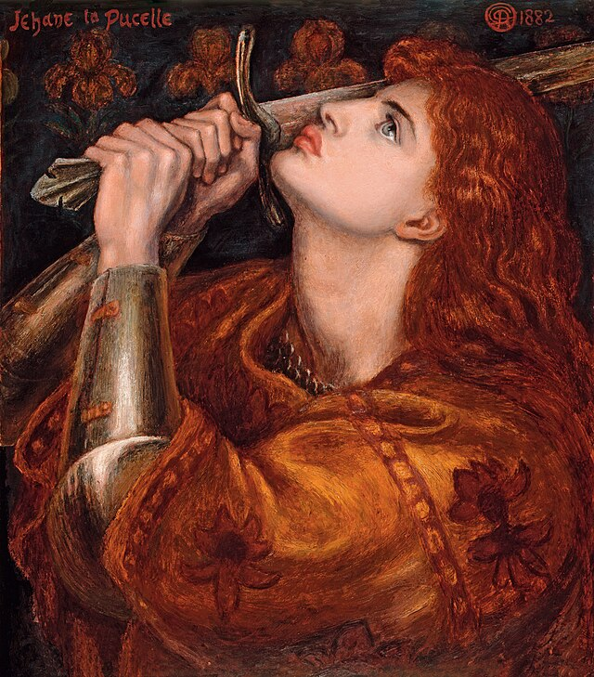
Why We Need the Church
“About Jesus Christ and the Church, I simply know they are one thing and we shouldn’t complicate the matter.”
-St. Joan of Arc
Notes:
Photo Credit: Joan of Arc (1882) by Dante Gabriel Rossetti (1828–1882).Dante Gabriel Rossetti.Public domain. https://commons.wikimedia.org/wiki/File:Dante_Gabriel_Rossetti_-_Joan_of_Arc_(1882).jpg
Directions: Have students copy information from the slide into their notes.
Teaching Points: On the day of Pentecost “Then there appeared to them tongues as of fire , which parted and came to rest on each of them. And they were filled with the Holy Spirit…”(Acts 2: 1-4). This is when the Church realized that it was the continuation of Christ on earth as His living Body. The two became one. Christ is the head and the Church is his body. From Pentecost on, the Holy Spirit dwells in the Church as the animating soul. Referring to Pentecost , Jesus said, ““In a little while the world will no longer see me, but you will see me, because I live and you will live. On that day you will realize that I am in my Father and you are in me and I in you” -Jn 14:19-20
Jesus himself affirmed the truth of this union with himself and the Church as one body when he said:
-‘I am in you and you are in me’
-‘Whoever listens to you listens to me’.
-‘Saul, Saul, why do you persecute me?’
-’I am the Vine you are the branches’.
We need the Church because we need to become one with Christ and become animated by the life that the Holy Spirit gives.
Jesus continues his work of salvation through the Church.
Present to the world through the Church.
Actions of Church = Actions of Christ
These are called ‘Liturgical Actions’
The Seven most important Liturgical Actions are called Sacraments.
The videos linked in this presentation file may contain copyright material. Such material is made available for educational purposes only. This constitutes a “fair use” of any such copyright material as provided for in Title 17 U.S.C. section106A-117 of the US Copyright Law.

Slide 5
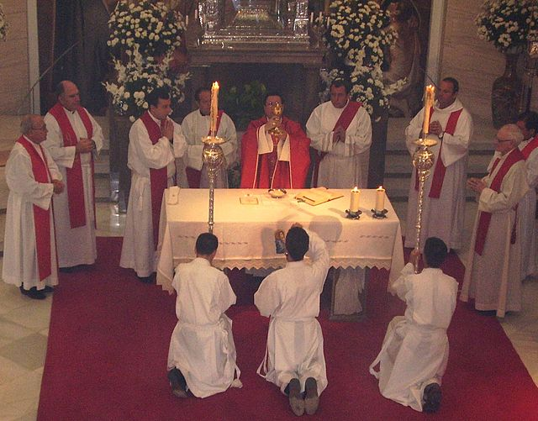
Sacraments
Key
Vocab!
It is in the sacraments, seven holy rituals— that God’s love and compassion are celebrated. They are outwards signs of God’s invisible grace. They give us a new life in Christ and they give us the supernatural grace to live it well.
Notes:
Photo Credit: Almicar, Public domain, Seminario mayor de Asidonia-Jerez 2005. https://commons.wikimedia.org/wiki/File:SeminarioAsidoniaJerez2.jpg
Directions: Have students copy vocabulary term and definition from the slide into their notes.
Teaching Points: “By the sacraments of rebirth, Christians have become ‘children of God,’ ‘partakers of the divine nature.’ Coming to see in the faith their new dignity, Christians are called to lead henceforth a life ‘worthy of the gospel of Christ.’ They are made capable of doing so by the grace of Christ and the gifts of his Spirit, which they receive through the sacraments and through prayer” (CCC, 1692, quoting 2 Peter 1:4 and Philippians 1:27).
Online Resources:Have students view video, ‘Intro to Sacraments’. URL here: https://youtu.be/qmfSwi3ZKH4
The videos linked in this presentation file may contain copyright material. Such material is made available for educational purposes only. This constitutes a “fair use” of any such copyright material as provided for in Title 17 U.S.C. section106A-117 of the US Copyright Law.

Slide 6

Turn and Talk
How can the sacraments impact a person’s reconnection with Jesus and the Church?
Notes:
Directions: Have students write down the question and then write down their answer….Then have students share their answers with one person close by.
The videos linked in this presentation file may contain copyright material. Such material is made available for educational purposes only. This constitutes a “fair use” of any such copyright material as provided for in Title 17 U.S.C. section106A-117 of the US Copyright Law.

Slide 7

Paschal Mystery and Time
We can participate in the Paschal Mystery event (the main Salvation event) because it is not stuck in the past. It remains always in the present because it is in God’s time not ours.
Notes:
Photo Credit: Spiral GIF, Google Slides Images
Directions: Have students copy information from the slide into their notes. Share this quote: “You have made all times, and you are before all times, and not at any time was there no time” -St. Augustine. Ask students, ‘What does it mean to say time and eternity are different?’
Teaching Points: Time has no effect on God. He is infinite and eternal. His actions bringing about our salvation exist outside of time. Because the events of the Paschal Mystery accomplish the end to sinfulness and death and are for everyone who ever lived and will live, they must not be a one-time event. The Paschal Mystery—the Passion, Death, and Resurrection of Christ—continues to happen now and to stretch into eternity.
Because the Paschal Mystery is timeless or transcends time, when you are at Mass, it is as if you are truly present at the actual events of the Last Supper, Good Friday, and the Resurrection. Jesus’ Body and Blood are not just ‘represented’ (symbolic) but they are ‘re-presented’ (Real Presence) on the altar.
The CCC explains this in a poetic way… "When the Church celebrates the mystery of Christ, there is a word that marks her prayer: Today! -a word echoing the prayer her Lord taught her and the call of the Holy Spirit.”
This "today" of the living God which man is called to enter is "the hour" of Jesus' Passover, which reaches across and underlies all history: Life extends over all beings and fills them with unlimited light; the Orient of orients pervades the universe, and he who was "before the daystar" and before the heavenly bodies, immortal and vast, the great Christ, shines over all beings more brightly than the sun.Therefore a day of long, eternal light is ushered in for us who believe in him, a day which is never blotted out: the mystical Passover" (CCC 1165).
Online Resources: Assign article, ‘Catholic Time Travel: The Paschal Mystery Time Machine’. URL here: https://www.catholic365.com/article/30129/the-paschal-mystery-time-machine.html
The videos linked in this presentation file may contain copyright material. Such material is made available for educational purposes only. This constitutes a “fair use” of any such copyright material as provided for in Title 17 U.S.C. section106A-117 of the US Copyright Law.

Slide 8
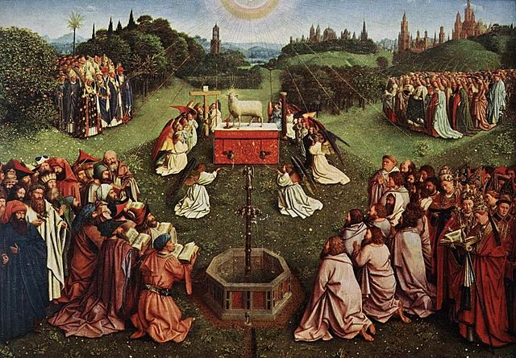
Heavenly Liturgy
Key
Vocab!
The Mass is a participation in what Jesus celebrates unceasingly in the heavenly liturgy, with Mary, the apostles, all the saints, and those who have entered the kingdom.
Notes:
Photo Credit: Jan van Eyck - The Ghent Altarpiece - Adoration of the Lamb (detail) - WGA07654.jpg
Jan van Eyck. Public domain. https://commons.wikimedia.org/wiki/File:Jan_van_Eyck_-_The_Ghent_Altarpiece_-_Adoration_of_the_Lamb_(detail)_-_WGA07654.jpg
Directions: Have students copy vocabulary term and definition from the slide into their notes.
Teaching Points: The Catechism of the Catholic Church defines liturgy as an action of the whole Christ. On earth we celebrate the liturgy using signs of form and matter (see the subsection "Experiencing God’s Love and Compassion in the Church" in Chapter 8 Introduction). The earthly liturgy reminds us of the heavenly 388 God Saves liturgy in several ways. For example, the Book of Revelation describes a writ ten scroll to be used in the heavenly liturgy, resembling the readings from the Scriptures at Mass and in the other sacraments. Revelation also mentions candles (Rev 1:12–13; 4:6), an altar (Rev 8:3; 9:13), hymns (Rev 5:8; 14:1; 15:3), golden vessels (Rev 1:12; 1:13; 5:8; 8:3; 15:6; 15:7), and stained glass (Rev 21:10), which are all familiar aspects of the earthly liturgy. The heavenly liturgy will be celebrated by all of creation—angels and saints—“where celebration is wholly communion and feast” (CCC, 1136).
Online Resources: Assign article, ‘The Apocalyptic Mass’. URL here: https://www.catholic.com/magazine/print-edition/the-apocalyptic-mass
The videos linked in this presentation file may contain copyright material. Such material is made available for educational purposes only. This constitutes a “fair use” of any such copyright material as provided for in Title 17 U.S.C. section106A-117 of the US Copyright Law.

Slide 9
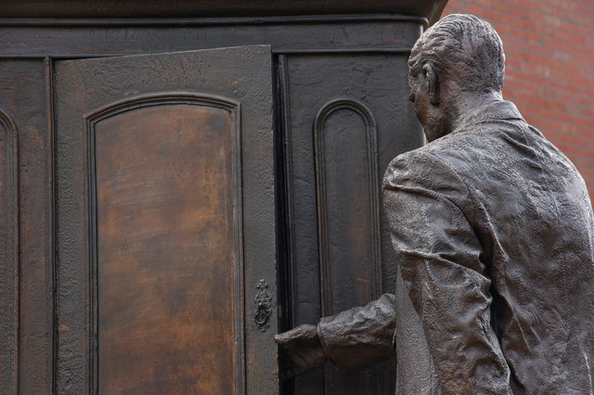

Baptism as a Door to the Supernatural
“Narnia lies just on the other side of the mysterious wardrobe. The Christian imagination is that the mystical and the supernatural lie just on the other side of the ordinary, the mundane, and the natural.”
-Fr. Raymond de Souza
Notes:
Photo Credit: This statue depicts Lewis stepping into a wardrobe. Albert Bridge. Creative Commons Attribution-Share Alike 2.0 https://commons.wikimedia.org/wiki/File:The_Lion,_the_Witch_._._._-_geograph.org.uk_-_317441.jpg. The Chronicles of Narnia: The Lion, the Witch and the Wardrobe logo.Unknown. Public domain. https://commons.wikimedia.org/wiki/File:Chronicles_narnia_lion_witch_logo.png
Directions: Have students copy quote from the slide into their notes.
Online Resources: Assign article, ‘Baptism in Narnia’. URL here: https://www.catholic365.com/article/30228/baptism-in-narnia.html
Teaching Points: Baptism is the “door” that gives access to the other sacraments and to your participation in the Paschal Mystery itself:“By virtue of our Baptism, the first sacrament of the faith, the Holy Spirit in the Church communicates to us, intimately and personally, the life that originates in the Father and is offered to us in the Son” (CCC, 683).
Holy Baptism is the basis of the whole Christian life, the gateway to life in the Spirit (vitae spiritualis ianua), and the door which gives access to the other sacraments. Through Baptism we are freed from sin and reborn as sons of God; we become members of Christ, are incorporated into the Church and made sharers in her mission: "Baptism is the sacrament of regeneration through water in the word." (CCC 1213).
To further teach the concept of the Sacrament of Baptism as a door to another world (of grace), the Disney version of The Lion The Witch and the Wardrobe by C.S. Lewis may be shown. Reflection questions below:
Handout Narnia: The Lion,The Witch, and the Wardrobe Reflection Questions…
1.The movie starts out with a Nazi bombing raid on London. What does this say about the world we live in?
2. In this scene, evil is portrayed as dark(happening at night, not in the clear of day), but in Narnia evil is more clear and it presses in all around. Why?
3. If Narnia represents the spiritual life what would the wardrobe be?
4. Which Sacrament is like a doorway into the spiritual life?
5. If Narnia represents the spiritual life, why is it a perpetual winter?
6. What does the falling snow represent?
7. What might the lamp post represent?
8. Why did no time pass when Lucy returns from the wardrobe? What does that say about Narnia?
9. When he protects Lucy the umbrella and asks if she's alright, what role might the fawn be playing?
10. When the Fawn describes Narnia before winter—what does he say about it? What does this relate to in the spiritual life?
11. How does the Witch's encounter with Edmond relate to Jesus encounter with the devil in the desert? 12. What does this say about the White Witch?
13. How do the other kids react when the Lucy tells about what she experienced?
14.How does their skepticism reflect the way modern people look at the Sacraments?
15. The wise professor reacts differently, what does he say?
16. What protection does the wardrobe offer against the cold?
17. What might the fur coats represent in the sacramental life?
18. Why are the humans called to wage war on the white witch?
19. Why does the witch fear the 4 humans?
20. Once Edward fell into the lure of the White witch they said, “Only Aslan can help him now”. How does this relate to Christ's power over the devil and sin?
21.The animals that were frozen seem to be dead but their life is restored . How does this relate to the spiritual life and the sacrament of confession?
22. Why does the witch need to use Edward to bring the others down? What does this say about the nature of evil?
23.What do you think the pack of wolves represent?
24.What kind of 'wolves' exist in the spiritual world?
25.In what way does the Santa Clause figure represent the holy Spirit in the sacrament of Confirmation? How many gifts did he give? What were the gifts to be used for?
26.How does the change in weather signify the reversal of original sin?
27.Why are the children addressed as Magesty and as royalty? Does this relate to the sacraments?
28.What did Aslan's tent remind you of? The Veil? The elevated step? All the other tents surrounding it?
29.Why do you think the hero's name is Peter?
30. How does the stone table relate to the Eucharist, the Mass?
The videos linked in this presentation file may contain copyright material. Such material is made available for educational purposes only. This constitutes a “fair use” of any such copyright material as provided for in Title 17 U.S.C. section106A-117 of the US Copyright Law.

Slide 10
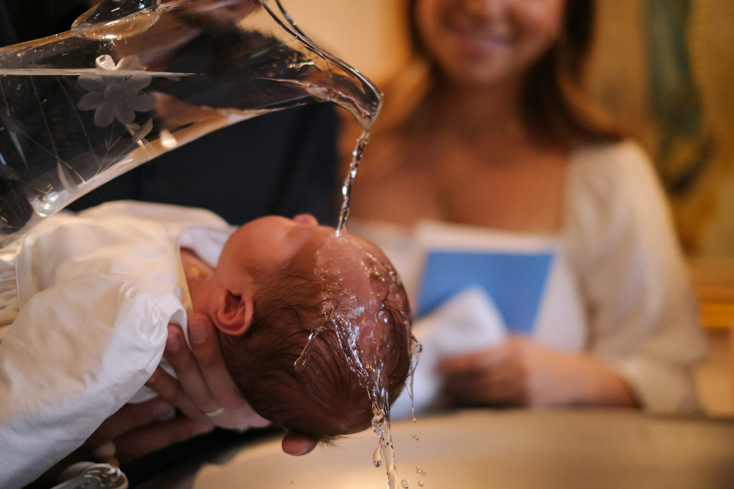
Saved in the Waters of Baptism
“Happy is our sacrament of water,
in that, by washing away the sins of our
early blindness, we are set free
and admitted into eternal life.”
- Tertullian, AD 203
Notes:
Photo Credit: https://unsplash.com/photos/a-baby-being-washed-in-a-kitchen-sink-LQEk8okbEOw
Directions: Have students copy quote from the slide into their notes.
Teaching Points: THE NECESSITY OF BAPTISM in the CCC
1257 The Lord himself affirms that Baptism is necessary for salvation.⁶⁰ He also commands his disciples to proclaim the Gospel to all nations and to baptize them.⁶¹ Baptism is necessary for salvation for those to whom the Gospel has been proclaimed and who have had the possibility of asking for this sacrament.⁶² The Church does not know of any means other than Baptism that assures entry into eternal beatitude; this is why she takes care not to neglect the mission she has received from the Lord to see that all who can be baptized are "reborn of water and the Spirit." God has bound salvation to the sacrament of Baptism, but he himself is not bound by his sacraments.
1258 The Church has always held the firm conviction that those who suffer death for the sake of the faith without having received Baptism are baptized by their death for and with Christ. This Baptism of blood, like the desire for Baptism, brings about the fruits of Baptism without being a sacrament.
1259 For catechumens who die before their Baptism, their explicit desire to receive it, together with repentance for their sins, and charity, assures them the salvation that they were not able to receive through the sacrament.
1260 "Since Christ died for all, and since all men are in fact called to one and the same destiny, which is divine, we must hold that the Holy Spirit offers to all the possibility of being made partakers, in a way known to God, of the Paschal mystery."⁶³ Every man who is ignorant of the Gospel of Christ and of his Church, but seeks the truth and does the will of God in accordance with his understanding of it, can be saved. It may be supposed that such persons would have desired Baptism explicitly if they had known its necessity.
1261 As regards children who have died without Baptism, the Church can only entrust them to the mercy of God, as she does in her funeral rites for them. Indeed, the great mercy of God who desires that all men should be saved, and Jesus' tenderness toward children which caused him to say: "Let the children come to me, do not hinder them,"⁶⁴ allow us to hope that there is a way of salvation for children who have died without Baptism. All the more urgent is the Church's call not to prevent little children coming to Christ through the gift of holy Baptism.
_____________________________________
Christ was very clear in JN 3:5, “Truly, truly, I say to you, unless one is born of water and the Spirit he cannot enter into the kingdom of God”. The Church has always proclaimed the necessity of Baptism. The early Church Fathers illuminated this belief…
The Letter of Barnabas 70-132 AD
"the washing which confers the remission of sins." As he explains, "We descend into the water full of sins and defilement, but come up bearing fruit in our heart."
The Shepherd of Hermas 150 AD
"I have heard, sir" said I, "from some teacher, that there is no other repentance except that which took place when we went down into the water and obtained the remission of our former sins." He said to me, "You have heard rightly, for so it is."
Justin Martyr 100-130 AD
As many as are persuaded and believe that what we teach and say is true, and undertake to be able to live accordingly, are instructed to pray and entreat God with fasting for the remission of their sins that are past, while we pray and fast with them. Then they are brought by us where there is water and are regenerated in the same manner in which we were ourselves regenerated. For in the name of God the Father and Lord of the Universe, and of our Savior Jesus Christ, and of the Holy Spirit, they then receive the washing with water. For Christ also said, "Unless you be born again, you shall not enter into the kingdom of heaven."
Clement of Alexandria 150-215 AD
When we are baptized, we are enlightened. Being enlightened we are adopted as sons. Adopted as sons, we are made perfect …. It is a washing by which we are cleansed of sins, a gift of grace by which the punishments due our sins are remitted, an illumination by which we behold that holy light of salvation.
Tertullian 160-240 AD
Happy is our sacrament of water, in that, by washing away the sins of our early blindness, we are set free and admitted into eternal life … Baptism itself is a corporeal act by which we are plunged into the water, while its effect is spiritual, in that we are freed from our sins.
St. Gregory of Nazianzus 329-390 AD
"Baptism is God's most beautiful and magnificent gift … We call it gift, grace, anointing, enlightenment, garment of immortality, bath of rebirth."
Augustine 354-430 AD
"Baptism washes away all, absolutely all, our sins …. This is the meaning of the great sacrament of Baptism, which is celebrated among us."
.
Online Resources: Assign article, ‘Baptism Saves You’. URL here: https://www.catholic.com/magazine/print-edition/baptism-saves-you
Assign article, ‘What the early church believed: Necessity of Baptism’. URL here: https://www.catholic.com/tract/the-necessity-of-baptism
The videos linked in this presentation file may contain copyright material. Such material is made available for educational purposes only. This constitutes a “fair use” of any such copyright material as provided for in Title 17 U.S.C. section106A-117 of the US Copyright Law.

Slide 11
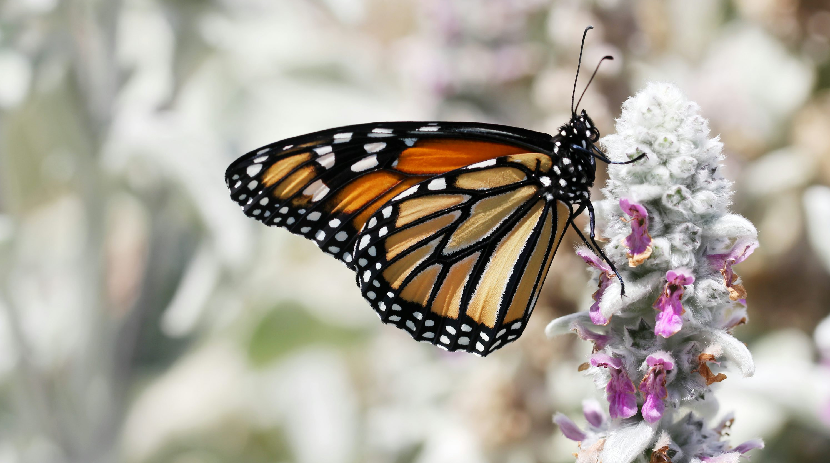
Life, Death, and New Life in Baptism
Notes:
Photo Credit: https://unsplash.com/photos/monarch-butterfly-perched-on-purple-flower-in-close-up-photography-during-daytime-pNGJpcrbfM4
Directions: Have students sketch the image in their notebook and add the title. Write ‘Before Baptism’ under the caterpillar, ‘Baptism’ under the cocoon and ‘New Life after Baptism’ under the Butterfly.
Teaching Points:
The natural cycle of the life of a butterfly reveals the Paschal Mystery aspect of Baptism. Before Baptism we have a soul that is cut off from God’s grace and stained by Original Sin and our life is limited, temporary and biological. In the waters of Baptism we die to our old self and when we emerge we are rising to a new kind of life- a life that is participating in God’s own life- divine life, eternal life. This pattern of suffering, death and resurrection continues throughout the Christian life. When we answer the call to holiness, when we live our lives according to the Beatitudes, when we receive the Sacraments, we are living as Jesus commanded. In a spiritual sense, whenever we personally die to sin, to our personal desires and to ourselves, and rise to a life centered on Christ, we are living the Paschal Mystery.
The Paschal Mystery isn’t only about Jesus’ life, death, and resurrection. It is also about our own. As a caterpillar must die to the way things were in order to become a butterfly, so we, too, often find ourselves losing one thing in order to gain another. But like Jesus on the cross, that losing isn’t easy, and there is pain involved. The Paschal Mystery promises us that if we allow the pain of loss to happen, and we open ourselves to it, then in time, something new can happen.
St. Paul and other New Testament letter writers emphasized the importance of Baptism profusely. In this excerpt from the Letter to the Romans, St. Paul is explaining that Baptism is putting us in touch with the death and resurrection of Jesus therefore with the very power of salvation. Baptism is an entrance into the Paschal Mystery.
“What shall we say, then? Shall we go on sinning so that grace may increase? By no means! We are those who have died to sin; how can we live in it any longer? Or don’t you know that all of us who were baptized into Christ Jesus were baptized into his death? We were therefore buried with him through baptism into death in order that, just as Christ was raised from the dead through the glory of the Father, we too may live a new life. For we know that our old self was crucified with him so that the body ruled by sin might be done away with, that we should no longer be slaves to sin— because anyone who has died has been set free from sin. Now if we died with Christ, we believe that we will also live with him”. -Romans 6:1-8
Online Resources: View video, ‘Baptism in Romans 6’. URL here: https://youtu.be/oeleRcPP0iY
View video,‘Baptism in the Bible’. URL here: https://youtu.be/3nDmpDKZjgo
The videos linked in this presentation file may contain copyright material. Such material is made available for educational purposes only. This constitutes a “fair use” of any such copyright material as provided for in Title 17 U.S.C. section106A-117 of the US Copyright Law.

Slide 12
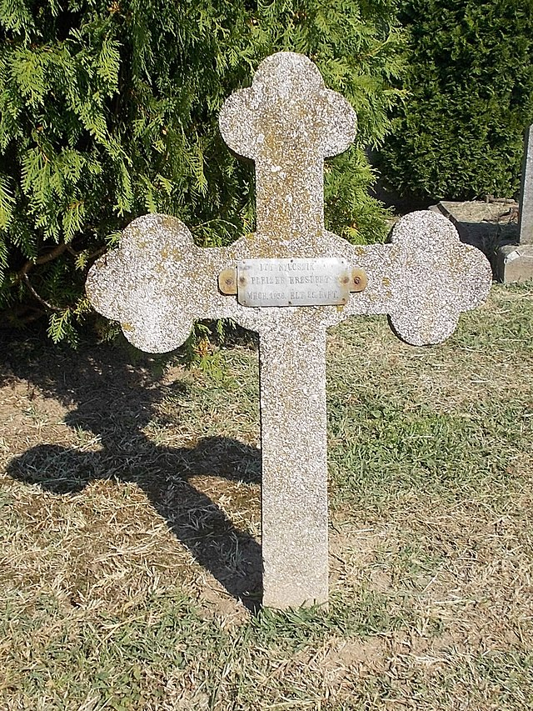
Death
Death is a participation in the Paschal Mystery
Death is the end of earthly life
Death is a consequence of sin
Death is transformed by Christ
Notes:
Photo Credit: Roman Catholic Cemetery. - Rákóczi and Hetényi streets corner, Dombóvár, Tolna County, Hungary.
Globetrotter19. Creative Commons Attribution-Share Alike 3.0. https://commons.wikimedia.org/wiki/File:Cemetery,_stone_cross_(%E2%80%A01936),_2018_Domb%C3%B3v%C3%A1r.jpg
Directions: Have students copy information from the slide into their notes.
Teaching Points: Because Jesus, though innocent, took on death for all of humanity, your own death has a positive meaning and is the path to eternal life. It is important to be ready for death at all times, because we are not guaranteed a long life.
Death in CCC
1006 Death is a participation in the Paschal Mystery. "It is in regard to death that man's condition is most shrouded in doubt." In a sense bodily death is natural, but for faith it is in fact "the wages of sin."For those who die in Christ's grace it is a participation in the death of the Lord, so that they can also share his Resurrection.
1007 Death is the end of earthly life. Our lives are measured by time, in the course of which we change, grow old and, as with all living beings on earth, death seems like the normal end of life. That aspect of death lends urgency to our lives: remembering our mortality helps us realize that we have only a limited time in which to bring our lives to fulfillment:
Remember also your Creator in the days of your youth, . . . before the dust returns to the earth as it was, and the spirit returns to God who gave it.
1008 Death is a consequence of sin. The Church's Magisterium, as authentic interpreter of the affirmations of Scripture and Tradition, teaches that death entered the world on account of man's sin. Even though man's nature is mortal God had destined him not to die. Death was therefore contrary to the plans of God the Creator and entered the world as a consequence of sin. "Bodily death, from which man would have been immune had he not sinned" is thus "the last enemy" of man left to be conquered.
1009 Death is transformed by Christ. Jesus, the Son of God, also himself suffered the death that is part of the human condition. Yet, despite his anguish as he faced death, he accepted it in an act of complete and free submission to his Father's will. The obedience of Jesus has transformed the curse of death into a blessing.
Online Resources: View video, ‘What happens when we die?’. URL here: https://youtu.be/hkMemGGsNkc
The videos linked in this presentation file may contain copyright material. Such material is made available for educational purposes only. This constitutes a “fair use” of any such copyright material as provided for in Title 17 U.S.C. section106A-117 of the US Copyright Law.

Slide 13
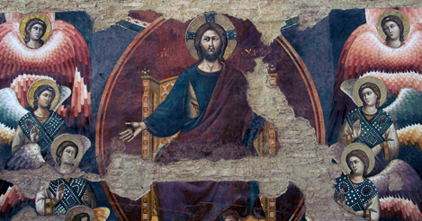
Particular Judgment
Key
Vocab!
The divine judgment that a deceased person undergoes immediately after death.
Notes:
Photo Credit: AMP textbook pg. 398
Directions: Have students copy information from the slide into their notes.
The videos linked in this presentation file may contain copyright material. Such material is made available for educational purposes only. This constitutes a “fair use” of any such copyright material as provided for in Title 17 U.S.C. section106A-117 of the US Copyright Law.

Slide 14

Afterlife
Heaven
Purgatory
Hell
Notes:
Photo Credit: https://unsplash.com/photos/persons-left-hand-raising-up-j-Jn_xKbjxg
Directions: Have students copy information from the slide into their notes.
Teaching Points:
Death marks a transition into the after-life. Whether one is holy or wicked, death will one day call. At the moment of death, time is over. There is no more chance to change your mind, repent or amend your life. All of that must happen before death. Death is not just part of nature, it is a result of the Fall and Original sin. In that sin humanity lost the gift of immortality. Death is not caused by God but by sin in general. Both sin and death have been conquered by Christ.
The supernatural virtue of hope guards us from both despair and presumption of salvation. We hope and pray that we will see the light of heaven but we do not take it for granted. We pray for the dead because of our belief in judgment and purgatory. For Catholics that prayer is structured through a rosary, a funeral Mass, and burial rite.
In Catholic eschatology, there are two kinds of judgment, Immediate Judgment and Final Judgment. Immediately at death the soul leaves the body and meets Christ, the Just Judge. We Catholics believe that Mary and our Guardian Angel are our advocates before Jesus the Judge. Prayers from others may be helpful and efficacious as well. Satan's role is to make the case that you are not worthy of heaven due to your sins. In the great courtroom of the afterlife, he is truly ‘the Accuser’.
As St. John of the Cross said, “At the evening of our life we shall be judged on our love.” In the Final Judgment, at the end of time, all the good and all the bad that we have done will be shown to all. We will know why we are either saved or not. No one goes to hell by accident. We will know that Jesus does not send us to hell but that through our choices in life we ultimately chose hell especially because we refused to repent and amend our life.
Heaven
Jesus promised his disciples eternal life. On the night before he died, Jesus told his Apostles that he was going to prepare a place for them in the afterlife. He said, “My Father’s house has many rooms; if that were not so, would I have told you that I am going there to prepare a place for you? And if I go and prepare a place for you, I will come back and take you to be with me that you also may be where I am. You know the way to the place where I am going.” (Jn 14:2-4)
Heaven
In the Bible, heaven is described as a kingdom, a mansion, a banquet, a new creation, a celestial paradise and our true home. In heaven we will be joined to the company of the holy angels and the communion of Saints such as Mary, Joseph, the Apostles as well as holy people we have known.
Our deepest desire for union with God, who is the source of love, beauty and truth will be finally satiated. We will see God face to face. In a state of total happiness, we will realize that we have been perfected by him and are now like him forever (CCC 1023). We should set our sights on heaven, hope for it and think about it often.
Purgatory
Purgatory is a state of spiritual purification as a preparation for heaven. While purgatory is a powerful sign of Jesus’ mercy, it is not a second chance for those who have seriously rejected his mercy in this life.
All who die in God's grace and friendship, but still imperfectly purified, are indeed assured of their eternal salvation; but after death they undergo purification, so as to achieve the holiness necessary to enter the joy of heaven (CCC 1030).
This is why the book of Revelation says about Heaven, “Nothing unclean can enter it” (Rev 21:27). When we attend someone's funeral or hear that someone has died, because we have hope, we pray for the dead. Because the Church is a supernatural family, our prayers and small sacrifices can benefit those in purgatory.
Hell
For those who choose against God through serious sin and fail to repent for that sin have ultimately chosen eternal separation from God. Although God is all merciful he respects our free will to reject that gift that he earned for us on the cross. This state of eternal separation from God is called hell. Jesus warned that the road to hell was wide and many have chosen to take that path. “Enter through the narrow gate. For wide is the gate and broad is the way that leads to destruction, and many enter through it” (Mt 7:13).
It’s important to realize that those who end up in hell have sent themselves there through their own choices. God desires that all people be saved from hell but he does to force salvation on anyone. By rejecting grace in this life, one already judges oneself, receives according to one's works, and can even condemn oneself for all eternity by rejecting the Spirit of love. CCC 679.
Online Resources: Assign article, ‘Did Jesus teach that Purgatory is real?’. URL here: https://www.catholic.com/magazine/online-edition/did-jesus-believe-in-purgatory . Assign article, ‘Where is Hell Mentioned in the Bible?’. URL here: https://www.catholic.com/qa/where-is-hell-mentioned-in-the-bible . Assign article, ‘But Heaven Sounds So Boring’. URL here: https://www.catholic.com/magazine/online-edition/but-heaven-sounds-so-boring
The videos linked in this presentation file may contain copyright material. Such material is made available for educational purposes only. This constitutes a “fair use” of any such copyright material as provided for in Title 17 U.S.C. section106A-117 of the US Copyright Law.

Slide 15
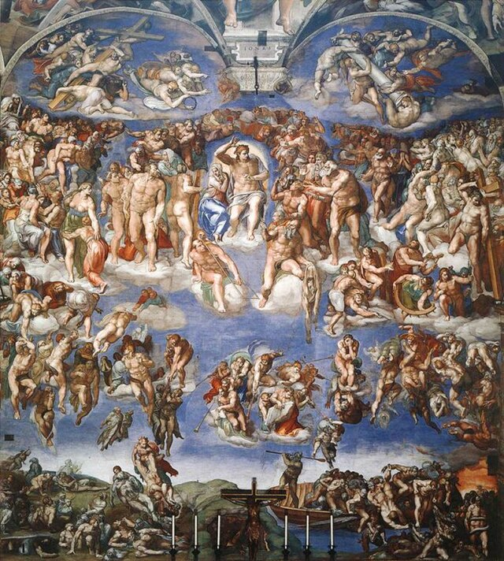
Last Judgment
Key
Vocab!
All of humanity will be raised and each person's body and soul will be reunited. Everyone will be judged by Christ The truth of each one's deeds will be laid bare.
Notes:
Photo Credit: Michelangelo Buonarroti - Jugement dernier.jpg. Michelangelo.Public domain. https://commons.wikimedia.org/wiki/File:Michelangelo_Buonarroti_-_Jugement_dernier.jpg
Directions: Have students copy down key vocabulary in their notes.
Online Resources: Have students view, ‘The Last Judgment’. URL here: https://youtu.be/c2MuTvQM61Y
The videos linked in this presentation file may contain copyright material. Such material is made available for educational purposes only. This constitutes a “fair use” of any such copyright material as provided for in Title 17 U.S.C. section106A-117 of the US Copyright Law.

Slide 16

Memorize It
Key
Verse!
“What eye has not seen, and ear has not heard, and what has not entered the human heart, what God has prepared for those who love him,” this God has revealed to us through the Spirit.
1 Corinthians 2:9–10
Notes:
Directions: Have students copy the quote. Add bonus points to the assessment if they can copy it down demonstrating that they memorized it.
The videos linked in this presentation file may contain copyright material. Such material is made available for educational purposes only. This constitutes a “fair use” of any such copyright material as provided for in Title 17 U.S.C. section106A-117 of the US Copyright Law.

Slide 17


How will you bring others to Christ?
Pray the Chaplet of Divine Mercy!
Consecrate Yourself to Mary!
Radically Commit to Christ and His Church!
Commit to Serve!
Become a Missionary!
Notes:
Directions: Ask students if they can add another way they could be intentional about bringing others to Christ.
Share with the class any way that you have been intentional about bringing others to Christ.
Online Resources: Have students view video, ‘A Conversation With FOCUS Missionaries’. URL here: https://youtu.be/TL-WkdetkSI
The videos linked in this presentation file may contain copyright material. Such material is made available for educational purposes only. This constitutes a “fair use” of any such copyright material as provided for in Title 17 U.S.C. section106A-117 of the US Copyright Law.

