Slide 1

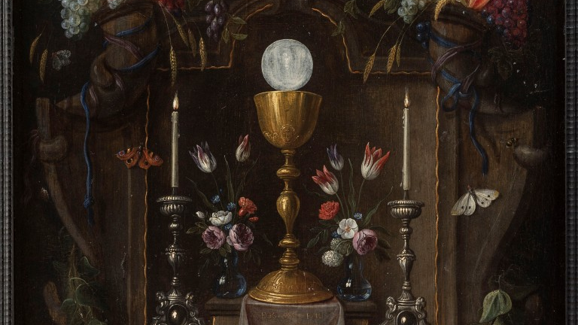
4. THE SACRAMENT OF THE EUCHARIST
4
The Sacrament of the Eucharist
The Seven Sacraments: Signs of God’s Grace
Notes:
Suggestions for taking notes on the slides:
Require students to use a three ring binder (1/2-1 inches) full of loose leaf paper (college or wide ruled).
Notes must be taken in pen only and hand written.
Notebooks should contain information and notes for religion class only.
Notebooks must have a table of contents with topic of notes, dates and page numbers.
All notes must have a topic and page number.
Students will be required to copy each slide unless the teacher directs students to skip certain slides or parts of slides. Notebooks will be graded based on neatness, completeness and organization.

Slide 2
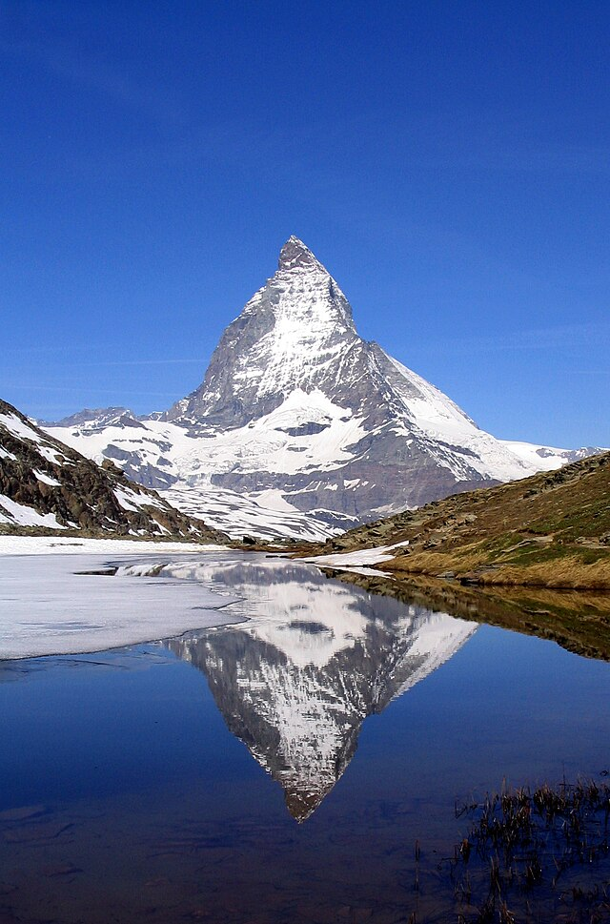
Source and Summit
“The Eucharist is ‘the source and summit of the Christian life.’ . . . For in the blessed Eucharist is contained the whole spiritual good of the Church, namely Christ himself . . .” –CCC, 1324
Notes:
Photo Credit: Dirk Beyer.Creative Commons Attribution-Share Alike 3.0.Featured picture, Picture of the day. Matterhorn Riffelsee 2005-06-11. https://commons.wikimedia.org/wiki/File:Matterhorn_Riffelsee_2005-06-11.jpg.
License: https://en.wikipedia.org/wiki/GNU_Free_Documentation_License, https://creativecommons.org/licenses/by-sa/3.0/deed.en.
Directions: Have students copy information from the slide into their notes. Ask students to define, in their own words, source and summit.
Teaching Points:
Source defined: a place, person, or thing from which something comes or can be obtained.
Summit defined: the highest point, part, or elevation, especially of a mountain.
The Eucharist is called the source and summit of the Christian life. To be a source of life emphasizes that the Eucharist gives us spiritual nourishment. To be a summit of life emphasizes that the Eucharist is the best way we can be close (the highest degree of unity) to God while in this world.
Online Resources: Assign article, The Eucharist: Source and Summit of Christian Spirituality. URL here: https://www.ewtn.com/catholicism/library/eucharist-source-and-summit-of-christian-spirituality-10380

Slide 3

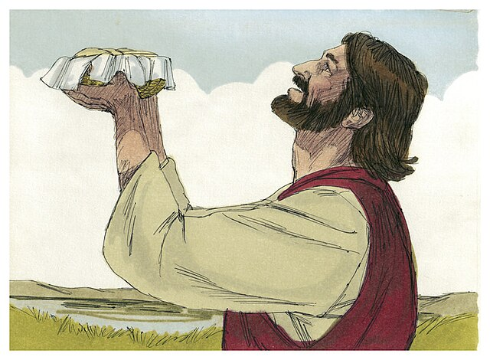
Eucharist
Key
Vocab
Definition: A Greek word that means “thanksgiving.” To give thanks to God in the form of a sacrificial offering. The Church’s central act of divine worship.
Notes:
Photo Credit: Bible Illustrations by Sweet Media. Gospel of John ch 6. Jim Padgett. Creative Commons Attribution-Share Alike 3.0. https://commons.wikimedia.org/wiki/File:Gospel_of_John_Chapter_6-8_(Bible_Illustrations_by_Sweet_Media).jpg
Directions: Have students write down the term and definition as part of a Key Vocab section in their notes.
Online Resources: Assign article, The Eucharist as Thanksgiving. URL here: https://www.wordonfire.org/articles/the-eucharist-as-thanksgiving/

Slide 4
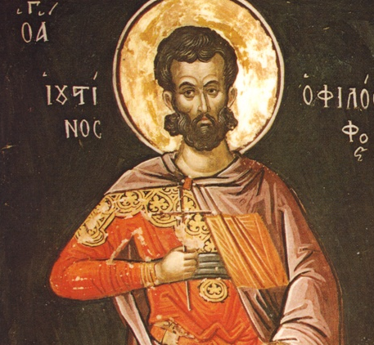
“And this food is called among us Eucharistia . . .”
Notes:
Photo Credit: Saint Justin Martyr, Theopanes the Cretan. Public Domain.
Teaching Points:
As early as the second century, we have the witness of St. Justin Martyr for the basic lines of the order of the Eucharistic celebration. They have stayed the same until our own day for all the great liturgical families. St. Justin wrote to the pagan emperor Antoninus Pius (AD 86–161) around the year 155, explaining what Christians did:
On the day we call the day of the sun, all who dwell in the city or country gather in the same place. The memoirs of the apostles and the writings of the prophets are read, as much as time permits. When the reader has finished, he who presides over those gathered admonishes and challenges them to imitate these beautiful things. Then we all rise together and offer prayers for ourselves . . . and for all others, wherever they may be, so that we may be found righteous by our life and actions, and faithful to the commandments, so as to obtain eternal salvation.
When the prayers are concluded we exchange the kiss. Then someone brings bread and a cup of water and wine mixed together to him who presides over the brethren. He takes them and offers praise and glory to the Father of the universe, through the name of the Son and of the Holy Spirit and for a considerable time he gives thanks (in Greek: eucharistian) that we have been judged worthy of these gifts. When he has concluded the prayers and thanksgivings, all present give voice to an acclamation by saying: “Amen.” When he who presides has given thanks and the people have responded, those whom we call deacons give to those present the "eucharisted" bread, wine and water and take them to those who are absent.
Online Resource: Have students view video, June 1: St. Justin Martyr. URL here: https://youtu.be/ksy0VKUS9oQ
The videos linked in this presentation file may contain copyrighted material. Such material is made available for educational purposes only. This constitutes a “fair use” of any such copyrighted material as provided for in Title 17 U.S.C. section 106A-117 of the US Copyright Law.

Slide 5

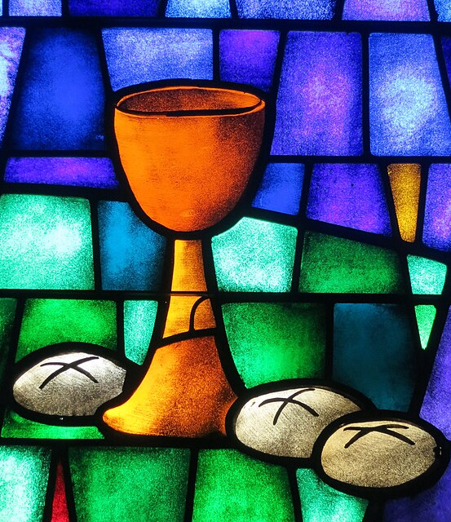
Names for the Eucharist
The Lord’s Supper
Breaking of the Bread
Holy Communion
The Holy Sacrifice
Memorial of the Lord’s Passion
Divine Liturgy
Mass
Notes:
Photo Credit: “Saint James the Greater Catholic Church (Concord, North Carolina) - stained glass, chalice & loaves.JPG.” Nheyob. Creative Commons Attribution-Share Alike 4.0. https://commons.wikimedia.org/wiki/File:Saint_James_the_Greater_Catholic_Church_(Concord,_North_Carolina)_-_stained_glass,_chalice_%26_loaves.JPG
License: https://creativecommons.org/licenses/by-sa/4.0/deed.en
Directions: Have students copy information from the slide into their notes.
Teaching Points:
The Lord’s Supper because of its connection with the meal Jesus shared with his disciples on the night before his Passion;
The Breaking of Bread, by which the communion of the faithful with Christ and others is indicated;
Holy Communion because the Eucharist unites Catholics in one Body after receiving the Body and Blood of Christ;
The Holy Sacrifice because it makes present the one sacrifice of Christ the Savior and includes the Church’s offering;
Memorial of the Lord’s Passion because it represents the events of Calvary;
The Eucharistic assembly because the Mass is celebrated with faithful Catholics and is a visible expression of the Church;
Divine Liturgy because the Church’s whole liturgy centers on the celebration of this sacrament;
Mass because it concludes with a “sending forth” (missio) of the faithful so that they may fulfill God’s will in their daily lives.

Slide 6
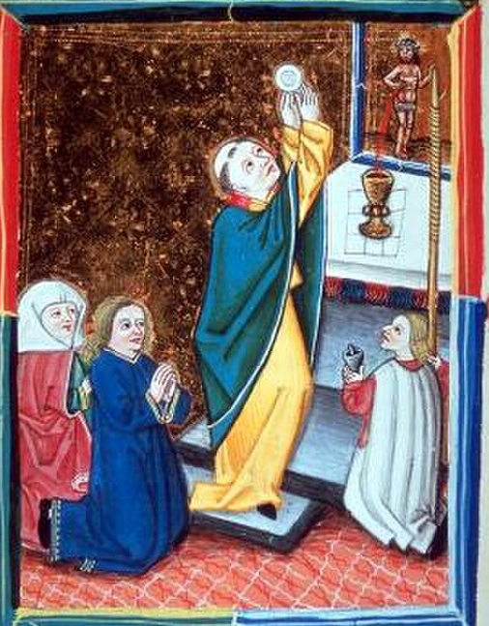
Transubstantiation
Key
Vocab
Definition: Used to express how the bread and wine at Mass changes into the reality of Jesus—his risen, glorified Body and Blood.
Notes:
Photo Credit: Messdarstellung Wien um 1470, mit Wandlungskerze als um einen Stab gewickelter Wachsstock. unbekannter Künstler.Cropped. Public domain. https://commons.wikimedia.org/wiki/File:Wandlungskerze_3.jpg.
Directions: Have students write down the term and definition as part of a Key Vocab section in their notes.
Online Resources: View video, Transubstantiation (Aquinas 101). URL here: https://youtu.be/93lauv161ks
The videos linked in this presentation file may contain copyrighted material. Such material is made available for educational purposes only. This constitutes a “fair use” of any such copyrighted material as provided for in Title 17 U.S.C. section 106A-117 of the US Copyright Law.

Slide 7
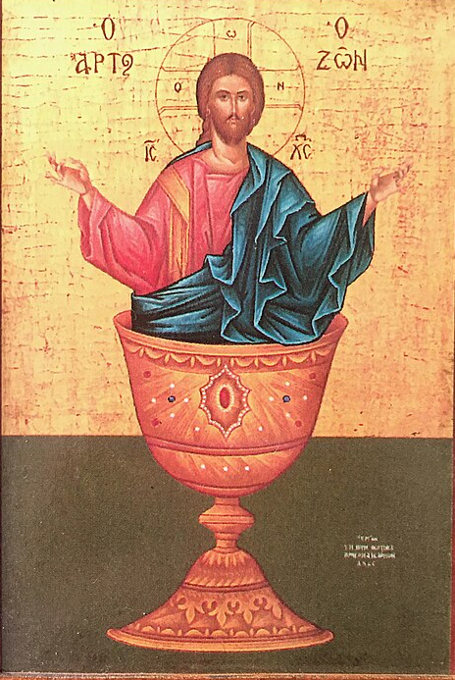
Real Presence
“[After Jesus told his disciples that they must eat the flesh of the Son of Man and drink his blood] . . . Then many of his disciples who were listening, said, ‘This saying is hard; who can accept it?’ . . . Many of them returned to their former way of life and no longer accompanied him.” —Jn 6:48–66
Misunderstandings of this teaching persists through today.
Notes:
Photo Credit: Uriel1022. Creative Commons Attribution-Share Alike 4.0. Jesus Christ, "The Bread of Life” icon.jpg. Cropped. https://commons.wikimedia.org/wiki/File:Jesus_Christ_%22The_Bread_of_Life%22_icon.jpg
License: https://creativecommons.org/licenses/by-sa/4.0/deed.en
Directions: Have a student read aloud the information on the slide.
Teaching Points:
The image is Greek Orthodox icon of Jesus Christ called “The Bread of Life” that was inspired by John 6:48-55.
Real Presence refers to the change that happens to the bread and wine at Mass. Jesus becomes fully present body, blood, soul, and divinity under the (accidents) appearance and taste of bread and wine.
A 2019, Pew Research study revealed that just one-third of U.S. Catholics (31%) say they believe that “during Catholic Mass, the bread and wine actually become the Body and Blood of Jesus.”
Online Resource: Have students view video, The Holy Eucharist - Source and Summit of our Faith!. URL here: https://youtu.be/gLmta376WlQ
The videos linked in this presentation file may contain copyrighted material. Such material is made available for educational purposes only. This constitutes a “fair use” of any such copyrighted material as provided for in Title 17 U.S.C. section 106A-117 of the US Copyright Law.

Slide 8

Eucharist Prefigured in the Old Testament
Gn 14:18–20: Melchizedek and his offering
Ex 16:3–4: The Manna and Flesh
Ex 12:1–10: The Passover Lamb
Ex 24:8: The Blood of the Covenant
Notes:
Photo Credit: Creative Commons Zero, Public Domain Dedication. Open bible. wikicommons.org.
Directions: Have students copy down the information from the slide in their notes.
Teaching Points:
Melchizedek : Referenced in Genesis14:18-20, he was a mysterious priest-king, called ‘king of peace’ who offered bread and wine. Abraham gave him a tenth of his wealth thus recognizing him as a “priest of God most high”. Melchizedek is a Christ-like figure, witnessed by Abraham bowing to him. The Letter to the Hebrews makes typological connections to this incident in Genesis. Melchizedek’s offering stands out because every other offering has been an animal sacrifice. The problem with the Jews seeing Jesus as a priest was that he was not a Levite. He was a Judahite. So Melchizedek’s priesthood, which is greater than the Levitical priesthood, is where Jesus’ priestly credentials stems. It was more great and more mysterious and very Eucharistic.
Passover: More than any other Old Testament passage, Exodus 12:21-23 this one is eucharistic through and through. The blood of the lamb saved the people from death. They had to sacrifice the lamb. It had to have its blood spread on the wood. Then they had to eat the lamb. Jesus is our passover Lamb.”
Manna: Moses gave them manna, bread from heaven to sustain them until they reached the Promised Land. Jesus gives the Church true bread from heaven, his flesh and blood to sustain us until we reach heaven. Give us this day our daily bread. The Eucharist is the new manna given after the Exodus from slavery into freedom, after we cross from from death to life in Baptism.
Blood: Moses stood above the people on the foot of the Mountain and he dipped a branch into the bowl of bull’s blood. As he splashed it on the people below him he said, ‘This is the blood of the covenant’. This came after the people verbally assenting to the terms of the covenant. This was how Moses ratified the covenant. The blood was a reminder of two very important things. It told the people that this was deathly serious and that breaking the covenant warranted death. It was also a sign of family unity. The blood is what binds a family and makes one a member of the family. So the covenant was a family bond as the people of God the Father. Jesus, as the new Moses, did the same thing at the Last Supper. He held up the cup and said, “This is the blood of the New covenant
Online Resources: Assign article, Discovering the Eucharist in the Old Testament. URL here: https://www.catholic365.com/article/30208/discovering-the-eucharist-in-10-old-testament-stories.html

Slide 9
Eucharist in the New Testament
Jn 6:53–56: The Bread
of Life Discourse
Mt 26:26–28: Institution of the Eucharist at the Last Supper
Lk 24:30–32: The Eucharist at Emmaus
Acts 2:42: The Early Church Breaking Bread
Notes:
Photo Credit: Creative Commons Zero, Public Domain Dedication. Open bible. wikicommons.org.
Directions: Have students copy down the information from the slide in their notes.
Teaching Points:
Bread of Life Discourse: Nowhere in Scripture is the Real Presence of Jesus in the Eucharist so explicitly taught than here in John 6. Jesus promises the Eucharist, but the people are are caught off guard and lack the eyes of faith to see that he intends to give them his actual body and blood under the signs of bread and wine. When some of the crowd abandons him, he does not stop them because he knows that they heard what he said but that they lacked faith. He reiterates and strengthens his eucharistic language. When he asks Peter and the Apostles if they too will leave, Peter responds, "To whom shall we go? You have the words of everlasting life." At the Last Supper their fidelity is rewarded as they receive the Holy Eucharist and the priesthood.
Last Supper: Jesus, as the New Moses, uses the Mosaic formula for ratifying a covenant with the blood of sacrifice. When he says this is the blood of the covenant, the Apostles who were with him at the Last Supper would have known what he was really doing. He was sealing or ratifying a new covenant in his own blood which is eternal and perfect. Instead of being splashed externally by finite animal blood, the Church receives his infinite, resurrected body and blood internally as a fulfillment of the Old Covenant and as a remedy to the problem of sin.
Emmaus: The disciples of Jesus recognize his real presence as Jesus breaks the bread in Luke 24. This is eucharistic because it is a meal following a long homily that Jesus gave on the way and the bread is miraculous in its effects.
Early Church: The Apostles, as priests, presided over the Agape Meal and they already had the structure in place that followed the pattern of worship that they knew. There was a synagogue component,—reading the written words of Scripture, a teaching—homily, and then a sacrificial offering and communion meal—the Eucharist. This ritual meal brought about a bond of charity and service between members of the early Church.
Online Resources: Assign article, The Hidden Eucharist in the New Testament. URL here: https://www.catholic365.com/article/30287/the-eucharist-hidden-throughout-the-new-testament.html

Slide 10
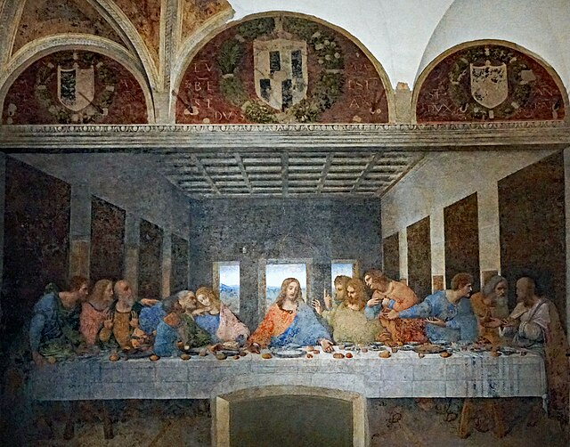
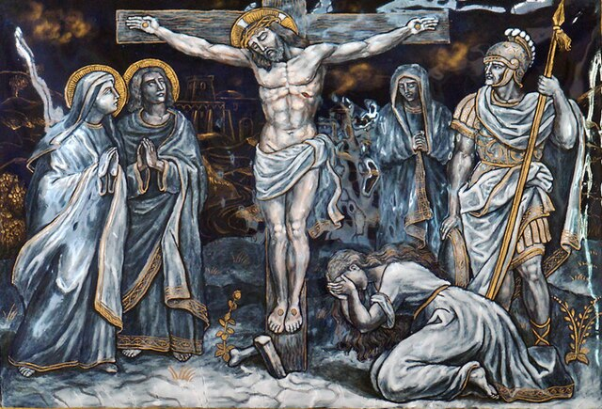
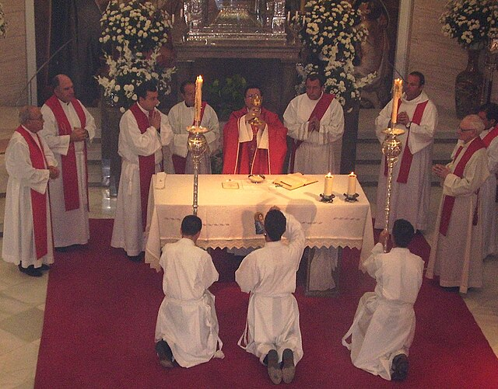
A Once and For All Sacrifice
At the Last Supper, the once and for all sacrifice is “Pre-Presented”
At Calvary, the once and for all sacrifice is “Presented”
At Holy Mass, the once and for all sacrifice is “Re-Presented”
Notes:
Photo Credit: The Last Supper by Leonardo Da Vinci, Santa Maria delle Grazie. Milan, Italy. Mariordo. Creative Commons Attribution-Share Alike 4.0. https://commons.wikimedia.org/wiki/File:Da_Vinci_Last_Supper_Milan_04_2024_7011.jpg Derived from File:TWELFTH STATION Jesus dies on the Cross.jpg. https://commons.wikimedia.org/wiki/File:TWELFTH_STATION_Jesus_dies_on_the_Cross.jpg Soerfm. Creative Commons Attribution-Share Alike 3.0. José Luiz. Seminario mayor de Asidonia-Jerez 2005 Almicar. Public domain. https://commons.wikimedia.org.
Licenses: https://creativecommons.org/licenses/by-sa/4.0/deed.en, https://creativecommons.org/licenses/by-sa/3.0/deed.en.
Directions: Have students copy down the information from the slide in their notes.
Teaching Point:
The Eucharist is really the sacrament of the sacrifice of Christ. There is only one sacrifice—that of Christ. For this reason, the Catechism of the Catholic Church teaches that “the sacrifice of Christ and the sacrifice of the Eucharist are one single sacrifice” (CCC, 1367). The Eucharist “re-presents” and perpetuates “the sacrifice of the cross throughout the ages until [Christ] should come again.” At every Mass, then, we are joined to Christ himself, who is present, offering his Body and Blood to God for our salvation. The Eucharist doesn’t just recall or memorialize the sacrifice of Christ; rather, it makes his sacrifice present.
Online Resource: Have students view video Why Does Jesus Need Priests to Offer His Body Repeatedly? URL here: https://youtu.be/vpOV2kYPGbs
The videos linked in this presentation file may contain copyrighted material. Such material is made available for educational purposes only. This constitutes a “fair use” of any such copyrighted material as provided for in Title 17 U.S.C. section 106A-117 of the US Copyright Law.

Slide 11
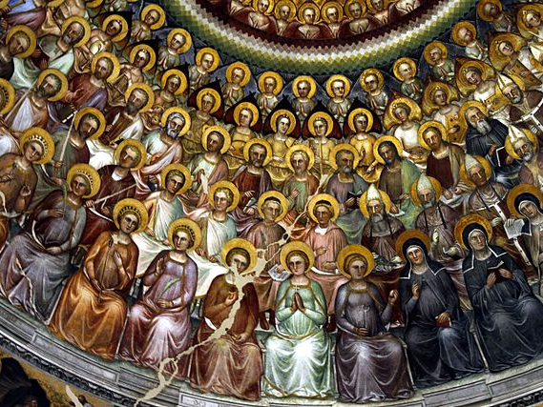
Past – Present – Future
At the Last Supper, Jesus instituted the Eucharist
At Holy Mass, experience the Eucharist as a sacrifice and meal
The Eucharist is also an anticipation of our heavenly glory
Notes:
Photo Credit: The Last Supper by Leonardo Da Vinci, Santa Maria delle Grazie. Milan, Italy. Mariordo. https://commons.wikimedia.org/wiki/File:Da_Vinci_Last_Supper_Milan_04_2024_7011.jpg. Creative Commons Attribution-Share Alike 4.0. José Luiz. Seminario mayor de Asidonia-Jerez 2005 Almicar. Public domain. Creative Commons Attribution-Share Alike 4.0. José Luiz. Communion of saints - Baptistry - Padua 2016. https://commons.wikimedia.org/wiki/File:Communion_of_saints_-_Baptistry_-_Padua_2016.jpg
Licenses: https://creativecommons.org/licenses/by-sa/4.0/deed.en, https://creativecommons.org/licenses/by-sa/4.0/deed.en
Directions: Have students copy down the information from the slide in their notes.
Teaching Point:
Participating in the Eucharist prepares us for heaven. The Catechism of the Catholic Church explains: ”If the Eucharist is the memorial of the Passover of the Lord Jesus Christ, if by our communion at the altar we are filled ‘with every grace and blessing,’ then the Eucharist is also an anticipation of our heavenly glory” (CCC, 1402). A sacred hymn by St. Thomas Aquinas reminds us that the Eucharist is the foretaste of the wedding feast of the lamb spoken of in the Book of Revelation where we will “rejoice and be glad and give him glory” (Rv 19:7). The hymn begins: “O sacred banquet, in which Christ is received, the memory of His Passion is renewed, the mind is filled with grace, and a pledge of future glory is given to us.”
Online Resource: Have students view video The Veil Removed - Film. URL here: https://youtu.be/OOLZDaTgIaM
The videos linked in this presentation file may contain copyrighted material. Such material is made available for educational purposes only. This constitutes a “fair use” of any such copyrighted material as provided for in Title 17 U.S.C. section 106A-117 of the US Copyright Law.

Slide 12
The Two Main Parts of the Mass
Liturgy of the Word
Liturgy of the Eucharist
First Reading
Responsorial Psalm
Second Reading
Gospel Acclamation
Gospel Reading
Homily
Taking: Offertory
Blessing: Eucharistic Prayer- Epiclesis, Words of Institution, Anamnesis, Doxology, Great Amen
Breaking: Fraction Rite, Our Father, Sign of Peace, Lamb of God
Giving: Communion
Prayers of the Faithful
Notes:
Directions: Have a students copy down the information from this slide into their notes.
Teaching Points:
There are Jewish roots in both parts of the Mass
Part one of the Mass comes out of the synagogue style of worship which centered on reading the Torah scrolls that Jesus and the Apostles were familiar with
Part two comes out of the Temple style of worship which centered around offering a sacrifice on an altar by a priest in vestments
Online Resources: Have students view The Mass Explained | All Parts (4K). URL here: https://youtu.be/NQfiwW52tmI
The videos linked in this presentation file may contain copyrighted material. Such material is made available for educational purposes only. This constitutes a “fair use” of any such copyrighted material as provided for in Title 17 U.S.C. section 106A-117 of the US Copyright Law.

Slide 13
Eucharist Essentials
Minister | Matter | Form
Bishop or Priest | Bread and Wine | The Words of Consecration "This is my body; This is my blood.”
Notes:
Directions: Have students copy down the information from the slide into their notes.

Slide 14
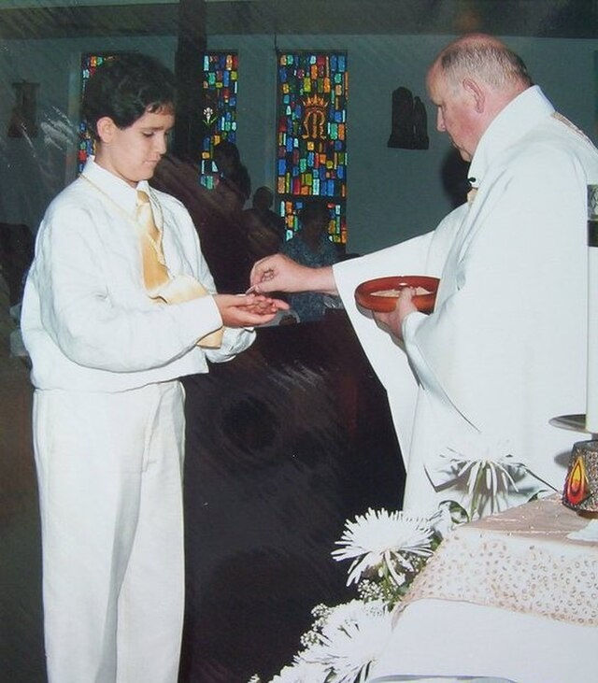
Who May Receive Communion?
All are welcome at Mass, always. However, only baptized Catholics in a state of grace who have already received their First Communion can receive the Eucharist, because receiving the Eucharist is a sign of full unity with the Church. Those who belong to other ecclesial communities, as well as those Catholics who may have fallen into mortal sin
lack this full unity.
Notes:
Photo Credit: Junior1communion.jpg. Photo done in 2006 at S. Mary Magdalen church of North Miami Beach (Florida). 4researchvita. Creative Commons Attribution-Share Alike 3.0. https://commons.wikimedia.org/wiki/File:Junior1communion.jpg
License: https://creativecommons.org/licenses/by-sa/3.0/deed.en
Directions: Have a students copy down information from their slides into their notes.
Teaching Points:
Receiving the Eucharist is a sign of belief in the Real Presence of Jesus in the Eucharist. So even though many Protestant Christians may share a wide range of other beliefs with Catholics, they still may not receive the Eucharist at Mass. If they did receive Communion, they would be making a false statement, since they do not believe Jesus is present in the Eucharist in the same sense that Catholics believe this.
Because of apostolic succession and the priesthood, the consecration of bread and wine into the Body and Blood of Christ possible.
Likewise, it would be a false statement for a Catholic to receive communion at a Protestant worship service, since Catholics believe that Jesus is only present when the bread and wine are consecrated by a validly ordained priest. This division is saddening, but it is hoped that one day it will be a thing of the past: “The more painful the experience of the divisions in the Church which break the common participation in the table of the Lord, the more urgent are our prayers to the Lord that the time of complete unity among all who believe in him may return” (CCC, 1398).
Online Resources: Have students view video Why Non-Catholics Can't Receive Communion. URL here: https://youtu.be/8jxwGIXfoOo
The videos linked in this presentation file may contain copyrighted material. Such material is made available for educational purposes only. This constitutes a “fair use” of any such copyrighted material as provided for in Title 17 U.S.C. section 106A-117 of the US Copyright Law.

Slide 15

Turn and Talk
Describe two ways that you would prepare yourself to receive Holy Communion.
Notes:
Directions: Have students write down the question and their answer in their notes and then share their answer with one person close by.

Slide 16

Effects of the Sacrament of the Eucharist
Reaching the Summit
Notes:
Photo Credit: © Vyacheslav Argenberg / http://www.vascoplanet.com/
License: https://creativecommons.org/licenses/by/4.0/deed.en
Directions: Have students copy the slide information in their notebooks. Then summarize some of the spiritual effects of the Sacrament of Holy Eucharist.
Teaching Points:
Union with Christ
Receiving the Eucharist strengthens our personal union with Jesus Christ, making us more like him.
It allows Jesus to reside in us in a special way, and we to reside in him.
Forgiveness of Sins
The Eucharist forgives venial sins (minor offenses).
It also helps us avoid grave sins (more serious offenses).
Spiritual Nourishment
Just as physical food nourishes the body, the Eucharist nourishes the soul, strengthening our spiritual lives.
It provides grace, spiritual power, and endurance.
Unity within the Church
Receiving the Eucharist strengthens our bond with other Catholics and the Church as a whole.
It reinforces the idea that the Church is the body of Christ, a unified community of believers.
It increases our love for the poor.
Remembrance of Christ's Sacrifice
The Eucharist is a memorial of Christ's Passion and death on the cross, reminding us of his love and sacrifice for us.
Spiritual Protection
It acts as a spiritual defense mechanism, helping us resist temptation and sin.
Closeness to the Trinity
Holy Communion draws us closer to the life of the Holy Trinity.
Increase in Virtue
Receiving the Eucharist helps us grow in virtue, especially in areas where we struggle.
Living the Life of Christ
By receiving the Eucharist, we are called to live out the teachings of Jesus in our daily lives.
Promise of Eternal Life
The Eucharist is a pledge of glory and eternal life with Christ.
Online Resources: Have students view video The Fruits of the Eucharist - Best Lent Ever - Matthew Kelly. URL here: https://youtu.be/raSkrYIn9m4
The videos linked in this presentation file may contain copyrighted material. Such material is made available for educational purposes only. This constitutes a “fair use” of any such copyrighted material as provided for in Title 17 U.S.C. section 106A-117 of the US Copyright Law.

Slide 17
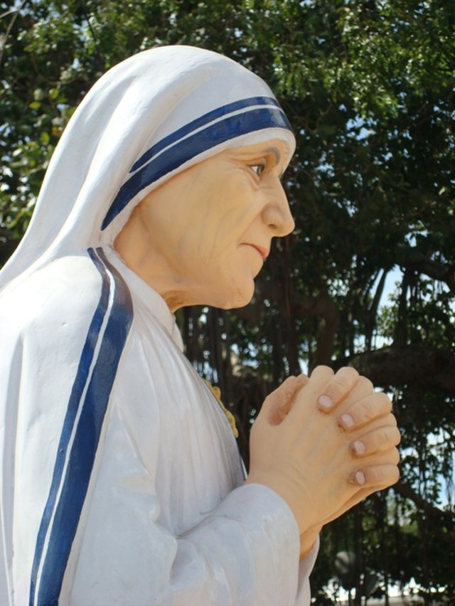
The saints love Jesus in the Eucharist.
“If we have Our Lord in the midst of us, with daily Mass and Holy Communion, I fear nothing for the sisters nor myself. He will look after us. But without him I cannot be. I am helpless.”
—St. Mother Teresa
Notes:
Photo Credit: Mother Teresa Statue, at St. Thomas Mount, Chennai, India. Sa.balamurugan. Creative Commons Attribution-Share Alike 3.0. https://commons.wikimedia.org/wiki/File:StThomasMount_Theresa.JPG.
License: https://creativecommons.org/licenses/by-sa/3.0/deed.en
Directions: Have students copy the information from the slide into their notes.
Teaching Point:
In the twentieth century, St. Mother Teresa of Calcutta was someone who understood the connection between the Eucharist and its relationship with the poor and suffering. “The Eucharist and the poor are inseparable,” she said. “This is not anything new for the Church, for we can clearly see it in the Gospels. The One who said, ‘this is my body’ is the same one who said, ‘I was hungry and you gave me food.’” When Mother Teresa first began her ministry in India with her community, the Missionaries of Charity, she begged the archbishop to arrange for the celebration of the Eucharist on a daily basis for her and her sisters. “If we have Our Lord in the midst of us, with daily Mass and Holy Communion,” she told him, “I fear nothing for the sisters nor myself. He will look after us. But without him I cannot be. I am helpless.”
Online Resources: Assign article, Quotes on the Most Blessed Sacrament 1. URL here: http://www.therealpresence.org/eucharst/tes/a7.html

Slide 18

Memorize It
Key
Verse
“I am the living bread that came down from heaven; whoever eats this bread will live forever; and the bread that I will give is my flesh for the life of the world.” — John 6:51
Notes:
Directions: Have students copy the quote. Add bonus points to the assessment if they can copy it down and demonstrate that they memorized it.

