Slide 1
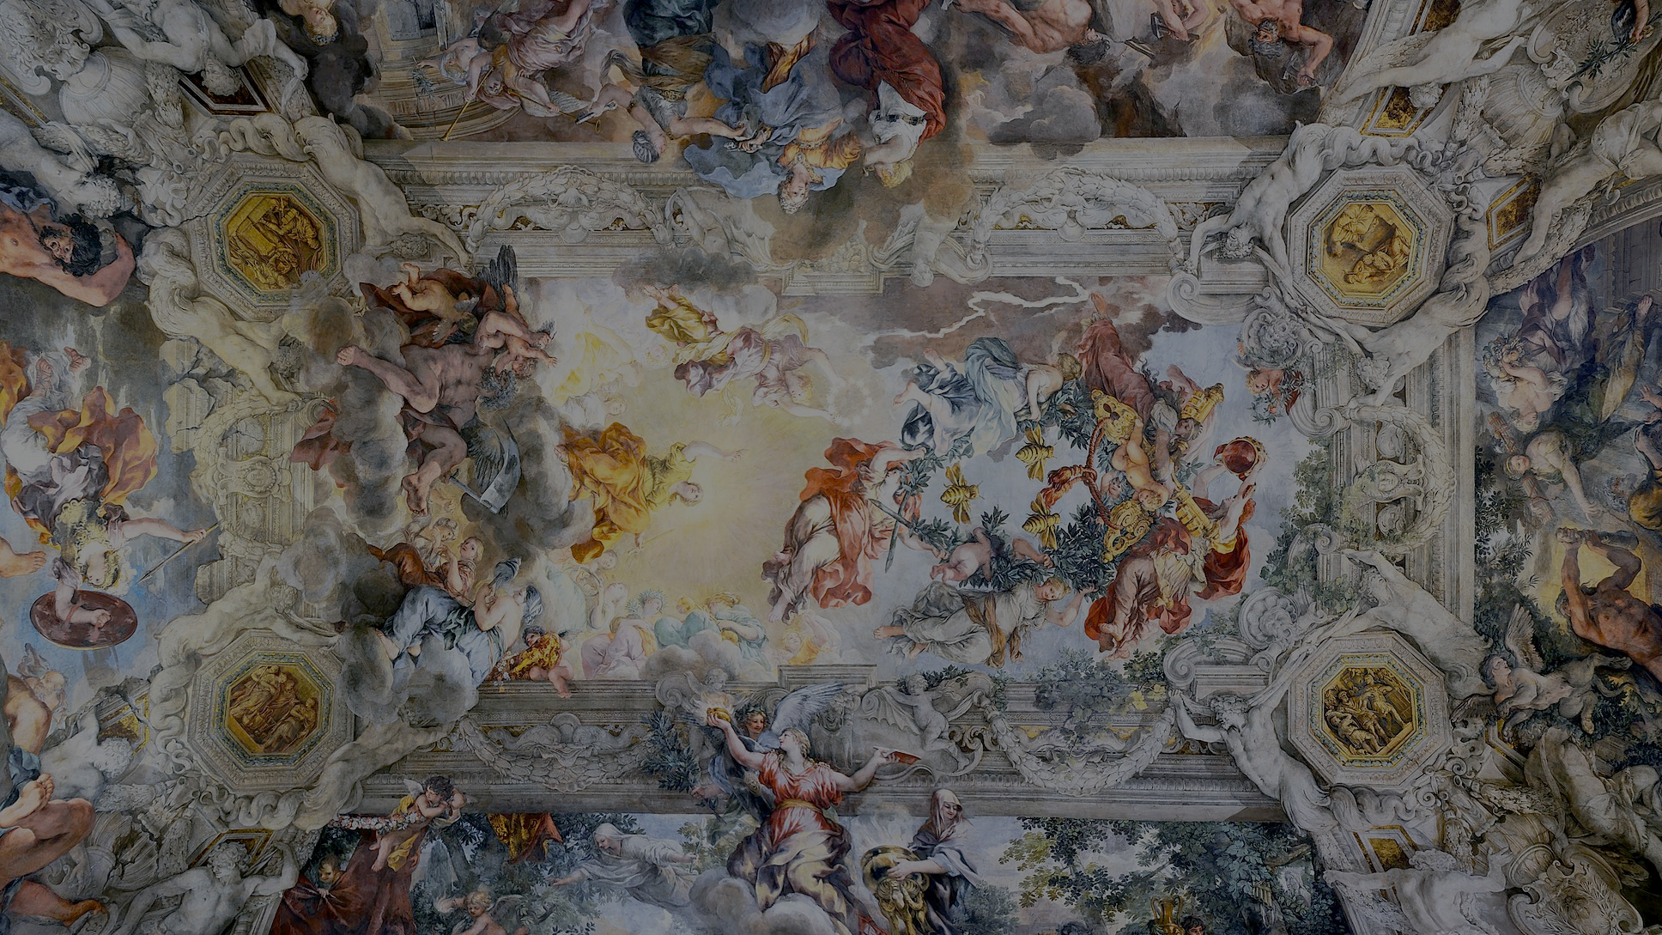
2
Jesus Reveals What
God Is Like
God Loves: Jesus Christ Enters the World
Notes:
Photo Credit: Allegory of Divine Providence and Barberini Power. Pietro da Cortana. Public domain
https://commons.wikimedia.org/wiki/File:Ceiling_of_Palazzo_Barberini.jpg
Suggestions for students’ note taking:
●Require students to use a three ring binder (1/2-1 inches) full of loose leaf paper (college or wide ruled).
●Notes must be taken in pen only and hand written.
●Notebooks should contain information and notes for religion class only.
●Notebooks must have a table of contents with topic of notes, dates and page numbers.
●All notes must have a topic and page number.
●Students will be required to copy each slide unless the teacher directs students to skip certain slides or parts of slides. Notebooks will be graded based on neatness, completeness and organization. Notebooks should have a significant point value representing 20-25% of the overall grade.
The videos linked in this presentation file may contain copyright material. Such material is made available for educational purposes only. This constitutes a “fair use” of any such copyright material as provided for in Title 17 U.S.C. section106A-117 of the US Copyright Law.

Slide 2
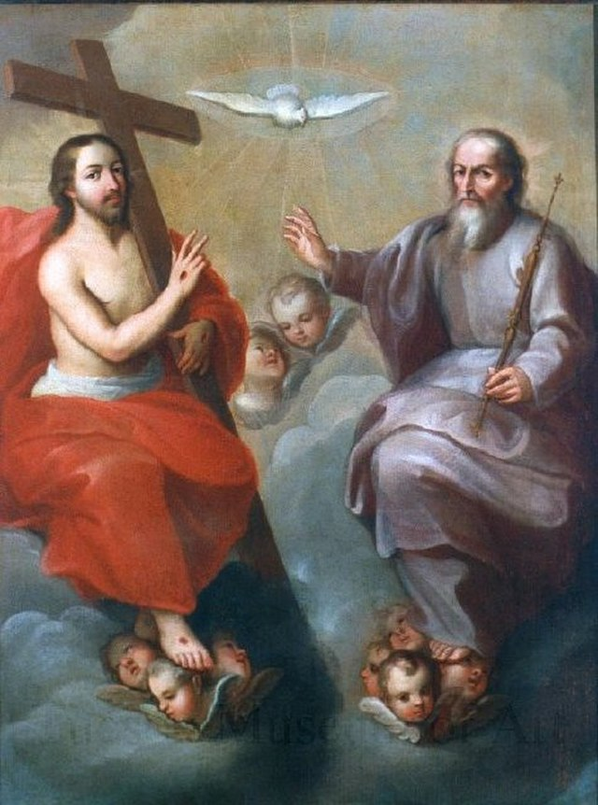
God The Father
Christians believe that God is one God in three separate Persons: Father, Son and Holy Spirit.
Jesus came to be anointed by the Holy Spirit and to reveal the Father who is pure Spirit.
Notes:
Photo Credit: The Holy Trinity by Miguel Cabrera, 1757-1760, in the collection of the Tucson Museum of Art. Miguel Cabrera
Public domain. https://commons.wikimedia.org/wiki/File:The_Holy_Trinity_by_Miguel_Cabrera.jpg
Directions: Have students copy down the information from the slide into their notes. Ask students to identify each Person of the Holy Trinity.
Teaching Points: The Father is pure spirit even though in art He is depicted as a fatherly figure and the Holy Spirit is a Person who is also pure spirit but uses natural signs like wind, fire and a dove to reveal his presence. While they are three separate persons they share one divine nature and are united in their wills.
When Jesus used “Father” to define God, he was doing so in a completely new and unique way: God is Father only in relation to Jesus, his Son. They share an eternal relation. To understand and know God the Father is to understand and know the Son, Jesus. God transcends human fatherhood and motherhood. This means that in order to truly know God as Father, we must believe in Jesus and so, by the power of the Holy Spirit, be transformed into children of God the Father. Only by living in Jesus, the Son, do we share in his knowledge of the Father and so know the Father’s love. Only in Jesus and through the Holy Spirit can we address God as “Abba”—Father.
Even by the time of the Last Supper, Jesus’s closest disciples were still having trouble understanding the relationship between the Son of God and his Father. Jesus told them, “I am the way and the truth and the life” (Jn 14:6), and added, “No one comes to the Father except through me. If you know me, then you will also know my Father. From now on you do know him and have seen him” (Jn 14:6–7)
Online Resources: Assign article, God and the Image of Fatherhood. URL here: https://www.catholic.com/magazine/online-edition/hes-your-father-like-it-or-not
The videos linked in this presentation file may contain copyright material. Such material is made available for educational purposes only. This constitutes a “fair use” of any such copyright material as provided for in Title 17 U.S.C. section106A-117 of the US Copyright Law.

Slide 3
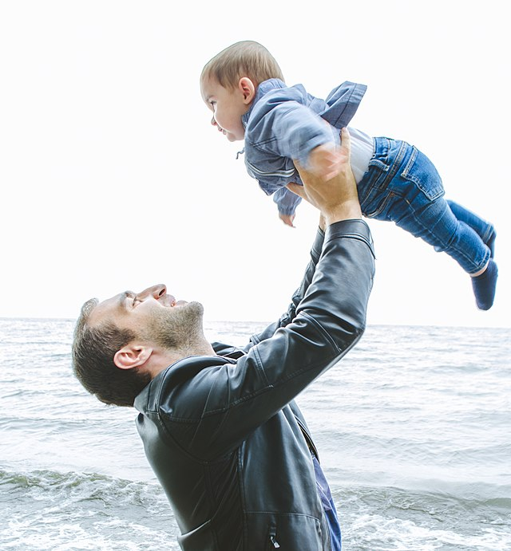
The God the Father is Love
God the Father created the world out of life-giving Love.
He holds everything in existence because of his great love.
He sent his Son to die on the cross for us out of love.
Notes:
Photo Credit: Hripsime Poghosyan. Creative Commons Attribution-Share Alike 4.0.Father's love (cropped).jpg. https://commons.wikimedia.org/wiki/File:Father%27s_love_(cropped).jpg
Directions: Have students copy information from the slide into their notes.
Teaching Points: The Father’s very being is love. Jesus said, “No one has ever seen God. Yet, if we love one another, God remains in us, and his love is brought to perfection in us” (1 Jn 4:12). There is an eternal exchange of love among the Divine Persons of the Blessed Trinity: Father, Son, and Holy Spirit. The Incarnation of Christ allows humans to witness this love in the flesh.
‘For God so loved the world that he gave his only Son, so that everyone who believes in him might not perish but might have eternal life.’ -Jn 3:16
As I have loved you, so you also should love one another”(Jn 13:34). Recall also Jesus’s instruction that we should not only love those who love us back; we must also love our enemies and pray for those who persecute us (see Matthew 5:44).
Online Resources: View video, The Divine Attributes. URL here: https://youtu.be/53wHJiGoBpI Assign article Love (Kreeft). URL here: https://www.peterkreeft.com/topics/love.htm
The videos linked in this presentation file may contain copyright material. Such material is made available for educational purposes only. This constitutes a “fair use” of any such copyright material as provided for in Title 17 U.S.C. section106A-117 of the US Copyright Law.

Slide 4
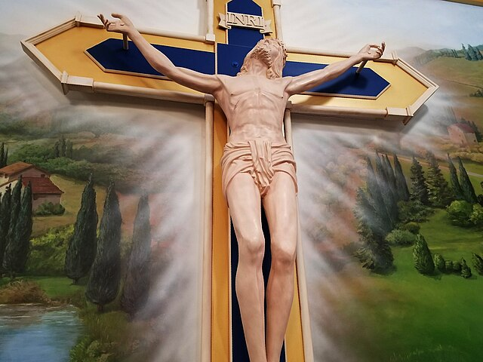
AGAPE
“No one has greater love than this, to lay down one’s life for one’s friends.” -Jn 15:13
Self-Sacrificial Love
Divine Love
Christian Love
Notes:
Photo Credit: Inside Sacred Heart of Mary Catholic Church in Boulder, Colorado. Let Ideas Compete. Public domain. https://commons.wikimedia.org/wiki/File:The_Crucified_Jesus_(26617883608).jpg
Directions: Have students copy information from the slide into their notes.
Teaching Points: To love means to consistently will and choose the good of the other. The natural loves are universal and engaged in by every human person to one degree or another. They are known by all cultures and all people.
Philia love is also known as friendship love. Two people come together side by side and share as the object of their love a third thing, hobby or interest. This brotherly love is reciprocal. Each party only associates and engages in friendship, philia love if he is receiving from the other the same or close to the same level of love.
Storge love is also known as family love. It is what C.S. Lewis calls a need love. Beginning with a parent's love for his or her child and then the child's love for the parents. Sibling love and even relationships with animals or objects can fall into this category. It is the most unconditional of the natural loves. For instance, a mother's love knows no bounds.
Eros love is also known as romantic love. C.S. Lewis describes this as the kind of love which is the least rational. It is feelings based. When someone uses the expression, 'falling in love' this is what they mean. A man and a woman who can't explain the attraction or the obsession not just with each other's physical attributes but with the person. Eros' deep desire is to keep thinking about the other as object of their love. It is a kind of obsession. It is reciprocal and ephemeral. It demands a mutual response from the other and when it doesn't receive Eros love in return, it will fade away. No other type of love is written about in poetry or sung of in music as much as eros love.
Agape love stands apart and above the natural loves because it has a supernatural source. It is also known as Christian love. When we read in John's gospel that God is Love, agape is the word used. Not every person has participated in agape love but every person is loved by God. Jesus demonstrated the meaning of agape love par excellence in the passion and death on the cross. We are given the gift of agape love in baptism. Christians are given the capacity to receive and to give away this higher qualitative love. The secret of the saints is that they grew in their capacity to receive agape love because they desired to give it away. They truly followed the Great Command, the law of love that Jesus gave to the rich young man. To Love God and love neighbor is a summation of the commandments as a whole.
Agape love seeks the best interest of the other. It is not reciprocal because it is self-less rather than selfish. It is unconditional, and undeserved. This is the meaning of Jesus command to love even our enemies. St. Paul gives the most sublime description of agape love in his first letter to the Corinthians. He says, "Love (agape) is patient, love is kind. It does not envy, it does not boast, it is not proud. It does not dishonor others, it is not self-seeking, it is not easily angered, it keeps no record of wrongs. Love does not delight in evil but rejoices with the truth. It always protects, always trusts, always hopes, always perseveres. Love never fails".
Online Resources: Have students view video, Agape. URL here: https://youtu.be/slyevQ1LW7A Have students view video, What Kind of Love Does Jesus Ask of Peter?. URL here: https://youtu.be/hgOpeYxl8uc?list=TLPQMjkwNjIwMjQxvOlfufkARg
The videos linked in this presentation file may contain copyright material. Such material is made available for educational purposes only. This constitutes a “fair use” of any such copyright material as provided for in Title 17 U.S.C. section106A-117 of the US Copyright Law.

Slide 5
Challenge
Question
The Bible uses hyperbole to stress how passionate God’s love for his people that he would want to completely eliminate any evil that separated him from them. He did a zero tolerance approach as a way to show the purity of his love and desire for his people. We should read these stories in the context of the merciful jesus as the fullest revelation of God
How could God the Father be a loving God when he seemed to condone violence?
Notes:
Directions: Use the animation feature to have the yellow answer box appear after you ask the students to respond out loud to the question on the left.
Online Resources: Have students view video, Bishop Barron on Violence in the Bible. URL here: https://youtu.be/1A65Wfr2is0 and here: https://youtu.be/odKNfjPr6hQ
The videos linked in this presentation file may contain copyright material. Such material is made available for educational purposes only. This constitutes a “fair use” of any such copyright material as provided for in Title 17 U.S.C. section106A-117 of the US Copyright Law.

Slide 6
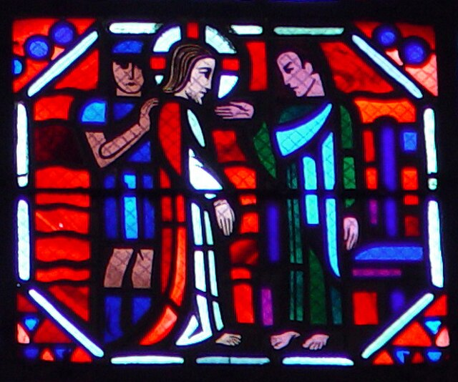
The God the Father is Truth
God the Father is the source of all truth.
Creation conforms to God's intellect and will.
He can neither deceive nor be deceived.
Notes:
Photo Credit: Jesus Before Pilate. Anne C Richardson Jim Womack. Public Domain. https://commons.wikimedia.org/wiki/File:Jesus_Before_Pilate_-_Vanderbilt_ACT_-_Amiens35.jpg
Directions: Have students copy information from the slide into their notes.
Teaching Points: God the Father is truth. As the First Letter of John states, Jesus came to confirm this: “We also know that the Son of God has come and has given us discernment to know the one who is true” (5:20). Every word from the mouth of God is true. Everything God created conforms with the mind of God. His truth is his wisdom, “which commands the whole created order and governs the world” (CCC, 216). Because the Son of God is one with the Father, he too is the truth. Jesus came to reveal the truth.
Ironically, at his trial before Pontius Pilate he was asked ‘What is truth?’. Jesus was brought before Pontius Pilate by Jewish leaders who charged him with a crime that his accusers did not explain (see John 18:28–40). Pilate himself wasn’t sure of the crime, so he questioned Jesus, “Are you the King of the Jews?” As the conversation persisted, Jesus explained to Pilate that he had come into the world to testify to the truth. “Everyone who belongs to the truth listens to my voice,” Jesus said. Pilate was dumbfounded. He responded, “What is truth?” Jesus could have told him, ‘You are looking at it. I AM truth’. In the same Gospel Jesus said, “I am the way and the truth and the life. No one comes to the Father except through me” (Jn 14:6).
The videos linked in this presentation file may contain copyright material. Such material is made available for educational purposes only. This constitutes a “fair use” of any such copyright material as provided for in Title 17 U.S.C. section106A-117 of the US Copyright Law.

Slide 7
Truth
Key
Vocab
We discover truth when our perception of a thing matches up with what the thing actually is. Truth is objective and universal.The word truth signifies something that is real, something that is honest, something that really exists.
Notes:
Photo Credit: Ben Hickey and Mariana Garcia. Creative Commons Zero, Public Domain Dedication. Affiliate spotlight left.svg Copy https://commons.wikimedia.org/wiki/File:Affiliate_spotlight_left.svg
Directions: Have students copy information from the slide in their notes.
Online Resource: Assign article, Dictatorship of Relativism (Objective truth vs. the subjective ‘my truth/your truth’). URL here: https://www.catholiceducation.org/en/culture/catholic-contributions/dictatorship-of-relativism.html
The videos linked in this presentation file may contain copyright material. Such material is made available for educational purposes only. This constitutes a “fair use” of any such copyright material as provided for in Title 17 U.S.C. section106A-117 of the US Copyright Law.

Slide 8
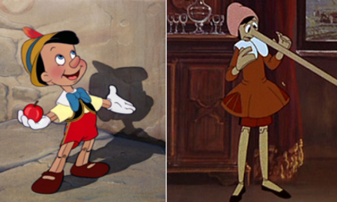
Truthfulness
Key
Vocab
Humans are expected to be truthful, sincere and honest with one another. As disciples of Jesus, truthfulness becomes part of our identity, instead of being untrue or a liar. The closer we get to God the more we become truthful.
Notes:
Photo Credit: Different film depictions of Pinocchio.Walt Disney. Giuliano Cenci. ProtoplasmaKid. Public domain. Pinochio 1940, 197. https://commons.wikimedia.org/wiki/File:Pinochio_1940,_1972_%26_2022.png
Directions: Have students copy information from the slide into their notes.
Online Resources: View video, Let Your Yes Be Yes, URL here: https://youtu.be/GV51ARJ7S5s Assign article Are Oaths Necessary?. URL here: https://www.catholiceducation.org/en/culture/catholic-contributions/are-oaths-necessary.html
The videos linked in this presentation file may contain copyright material. Such material is made available for educational purposes only. This constitutes a “fair use” of any such copyright material as provided for in Title 17 U.S.C. section106A-117 of the US Copyright Law.

Slide 9
God the Father is Almighty
He created the entire universe.
He rules over creation.
He is the Lord of history.
He governs the events of history according to his will.
Notes:
Photo Credit: God the Father with Angels. Pietro Perugino. Public domain
https://commons.wikimedia.org/wiki/File:God_the_Father_and_angels,_Pietro_Perugino,_Stanza_dell%27Incendio_di_Borgo,_medalion,_part_of_the_ceiling,_Vatican_City_1.jpg
Directions: Have students copy information from the slide into their notes.
Teaching Points: We believe God’s power is universal; the “God who created everything also rules everything and can do everything” (CCC, 268). God can do whatever he pleases. Nothing is impossible for God. We believe God is not only a God of love and truth; he is also omnipotent, or all-powerful.
Online Resources: Assign article, The Almighty Father. URL here: https://www.catholiceducation.org/en/culture/catholic-contributions/the-almighty-father.html
View video, The Fear of the Lord. URL here: https://youtu.be/81UAig6ojsE
Assign article, God is Not Nice. URL here: https://www.catholiceducation.org/en/religion-and-philosophy/other-topics/forward-god-is-not-nice.html
Assign article, Why Does an Almighty God Allow Disabilities?. URL here: https://www.catholiceducation.org/en/religion-and-philosophy/other-topics/a-girl-asked-why-does-god-allow-disabilities.html
The videos linked in this presentation file may contain copyright material. Such material is made available for educational purposes only. This constitutes a “fair use” of any such copyright material as provided for in Title 17 U.S.C. section106A-117 of the US Copyright Law.

Slide 10
Turn and Talk
Give an example from your life where God allowed you to suffer to bring about more love and peace to friends, family or teammates.
Notes:
Directions: Have students write down the question and then write down their answer….Then have students share their answers with one person close by. Ask for volunteers to share with their reflection with the class.
Teaching Point: Even though God is all powerful and good he still allows us to suffer. Without suffering there is no opportunity to freely enter into divine love or Agape love.
What do Jesus’s words and actions about suffering teach us about how an Almighty God the Father allows for suffering?
For one, though God doesn’t punish us with illness for our sins, it is important to understand that our sins themselves do cause us to suffer. For example, pride, selfishness, arrogance, lust, and an unwillingness to forgive cause us to suffer and become unhappy. Two consequences of sin are the loss of divine grace and the incurring of a debt of punishment. Mortal sin deprives a person of sanctifying grace and brings about the debt of eternal punishment. Venial sin deprives a person of some of God’s grace and requires temporal punishment. These two kinds of punishment are not the action of a vengeful God but the consequence of a person’s own sin. Also, some suffering is the direct result of the work of Satan. Natural disasters can, in part, be understood as a result of Original Sin: “Harmony with creation is broken: visible creation has become alien and hostile to man” (CCC, 400).
The videos linked in this presentation file may contain copyright material. Such material is made available for educational purposes only. This constitutes a “fair use” of any such copyright material as provided for in Title 17 U.S.C. section106A-117 of the US Copyright Law.

Slide 11
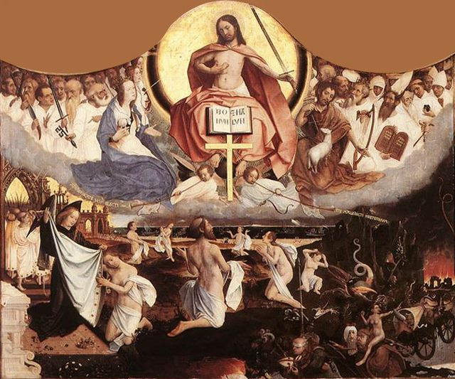
God the Father is Just
God has a perfect balance between Mercy and Justice.
His justice comes to all as either reward or punishment in this life or the next.
Notes:
Photo Credit: Last Judgment. Jan Provoost. Public Domain. https://commons.wikimedia.org/wiki/File:Jan_Provoost_-_Last_Judgement_-_WGA18449.jpg
Directions: Have students copy information from the slide into their notes.
Teaching Points: God’s idea of justice is completely different than ours. The Father values all people and is generous with the gifts he gives. He provides to people not according to their skills or talents or what they produce but according to what they need.
In our human world, mercy and justice are very imperfect. Justice is said to be administering what is reasonable, right, or deserved – reward or punishment. Mercy, on the other hand, is showing leniency or being compassionate, refraining from inflicting some due punishment.
“Each man receives his eternal retribution in his immortal soul at the very moment of his death, in a particular judgment that refers his life to Christ: either entrance into the blessedness of heaven – through a purification or immediately – or immediate and everlasting damnation.” -CCC 1022
Online Resources: View video, The Rich Man and Lazarus (God’s Justice). URL here:https://youtu.be/QwWhTv0ZL44
The videos linked in this presentation file may contain copyright material. Such material is made available for educational purposes only. This constitutes a “fair use” of any such copyright material as provided for in Title 17 U.S.C. section106A-117 of the US Copyright Law.

Slide 12
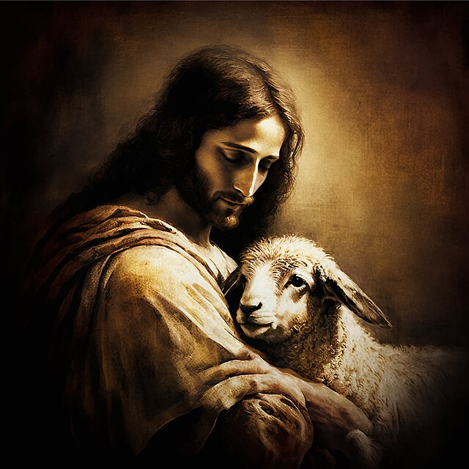
Particular Judgement
Key
Vocab
The individual judgment of every person right after death, when Christ will rule on one’s eternal destiny in heaven (after purification in Purgatory, if needed) or in hell.
Notes:
Photo Credit: Gentle Good Shepherd, help me to follow You faithfully. RosaryTeam. Public domain. https://commons.wikimedia.org/wiki/File:Rosary_Team_-_Gentle_Jesus_Good_Shepherd_-_Public_Domain.jpg
Directions: Have students copy the key vocabulary term from the slide into their notes.
Teaching Points: What we think, say and do matters and we will be judged immediately after death according to how we chose to love or not love both God and others. The best way to be prepared for death is to stay in communion with God in the sacraments especially the regular reception of the sacraments of Reconciliation and the Eucharist.
Online Resources: View video, Particular Judgment. URL here: https://youtu.be/7uo2MF2r_vY
The videos linked in this presentation file may contain copyright material. Such material is made available for educational purposes only. This constitutes a “fair use” of any such copyright material as provided for in Title 17 U.S.C. section106A-117 of the US Copyright Law.

Slide 13
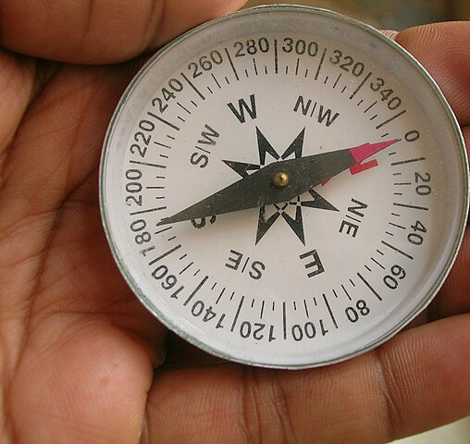
God Has a Plan for Each of Us
He chose us in Him before the foundation of the world…
That we would be holy and blameless before Him…
He predestined us to adoption as sons and daughters through Jesus Christ to Himself, according to the good pleasure of His will.
- Eph 1:4-5
Notes:
Photo Credit: Compass align.jpg. Aligning a compass so that readings of direction can be taken
Shyamal. Creative Commons Attribution-Share Alike 3.0. Compass align.jpg Copy
Directions: Have students copy down information from the slide into their notes.
Teaching Points:
God’s overall plan is for us to become disciples of Christ so that we may attain sanctification and salvation. He wants everyone to be saved but he respects free will.
He also has particular plans for individual lives. Share John Henry Newman Quote: “God has created me to do Him some definite service. He has committed some work to me which He has not committed to another. I have my mission. I may never know it in this life, but I shall be told it in the next. I am a link in a chain, a bond of connection between persons. He has not created me for naught. I shall do good; I shall do His work. I shall be an angel of peace, a preacher of truth in my own place, while not intending it if I do but keep His commandments. Therefore, I will trust Him, whatever I am, I can never be thrown away. If I am in sickness, my sickness may serve Him, in perplexity, my perplexity may serve Him. If I am in sorrow, my sorrow may serve Him. He does nothing in vain. He knows what He is about. He may take away my friends. He may throw me among strangers. He may make me feel desolate, make my spirits sink, hide my future from me. Still, He knows what He is about.” ― John Henry Newman
With God’s providence in our lives we trust that everything happens for a reason. When evil happens it is not God’s will but he can and will turn it into some good. St. Augustine wrote, “Nothing happens that the Almighty does not will should happen, either by permitting it or by himself doing it.” God does not will the evil of war or sickness like cancer, but he is so good, wrote St. Augustine, “that in his hand, even evil brings about good. He would have never permitted evil to occur if he had not, thanks to his perfect goodness, been able to use it.
‘Creation has its own goodness and proper perfection, but it did not spring forth complete from the hands of the Creator. The universe was created "in a state of journeying" (in statu viae) toward an ultimate perfection yet to be attained, to which God has destined it. We call "divine providence" the dispositions by which God guides his creation toward this perfection:
By his providence God protects and governs all things which he has made, "reaching mightily from one end of the earth to the other, and ordering all things well". For "all are open and laid bare to his eyes", even those things which are yet to come into existence through the free action of creatures.’ CCC 302
Online Resources: Have students view video, Navigation (Trusting in God). URL here: https://youtu.be/-M_3lQxfAPk and God Just Be With Me (Trusting in God). URL here: https://youtu.be/ghbV4TfW1N0 Assign article, Everything Happens for a Reason. URL here: https://www.catholic365.com/article/30234/everything-happens-for-a-reason.html
The videos linked in this presentation file may contain copyright material. Such material is made available for educational purposes only. This constitutes a “fair use” of any such copyright material as provided for in Title 17 U.S.C. section106A-117 of the US Copyright Law.

Slide 14
Memorize It
Key
Verse
“Whoever has seen me has seen the Father. . . .The Father who dwells in me is doing
his works.”
-Jn 14:9–10
Notes:
Directions: Have students write down the verse and commit it to memory. Bonus points may be awarded if they can add it to the end of the chapter assessment.
The videos linked in this presentation file may contain copyright material. Such material is made available for educational purposes only. This constitutes a “fair use” of any such copyright material as provided for in Title 17 U.S.C. section106A-117 of the US Copyright Law.

