Slide 1
Chapter 1 PowerPoint

Slide 3
The Pursuit of Happiness

Slide 4
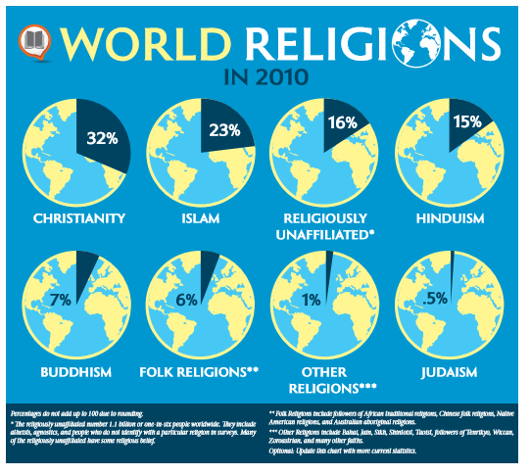
The Pursuit of Happiness

Slide 5
Secularism is an indifference to religion and a belief that religion should be excluded from civil affairs and public education.
The Pursuit of Happiness

Slide 6
Why People Desire God

Slide 7
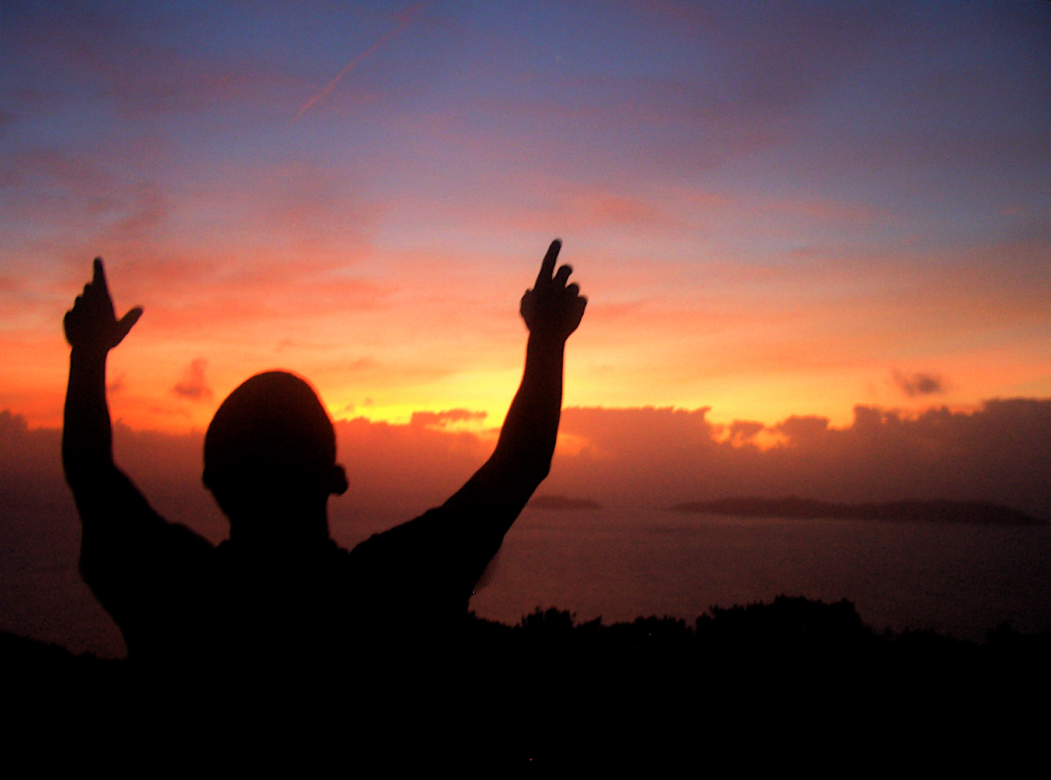
The desire for God is written in the human heart, because man is created by God and for God. CCC, 27
Why People Desire God

Slide 8
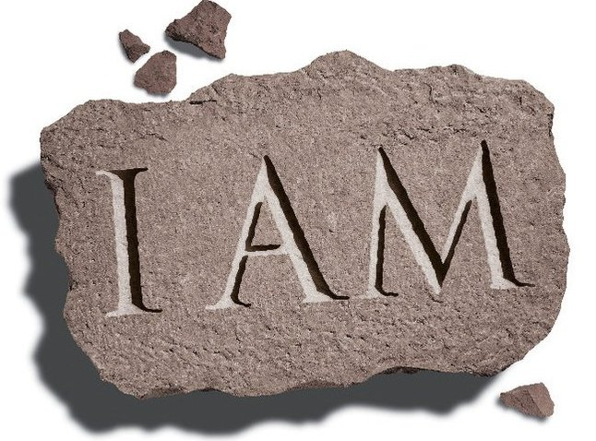
I am the way and the truth and the life. No one comes to the Father except through me.
WAY (Jn. 14:6)
TRUTH (Jn. 14:6)
LIFE (Jn. 14:6)
RESURRECTION (Jn. 11:5)
BREAD OF LIFE (Jn. 6:35)
TRUE VINE (Jn. 15:1)
GOOD SHEPHERD (Jn. 10:11)
LIGHT OF THE WORLD (Jn. 8:12)
DOOR OF THE SHEEP (Jn. 10:7)
FIRST AND THE LAST (Rev. 1:17)
Why People Desire God

Slide 9
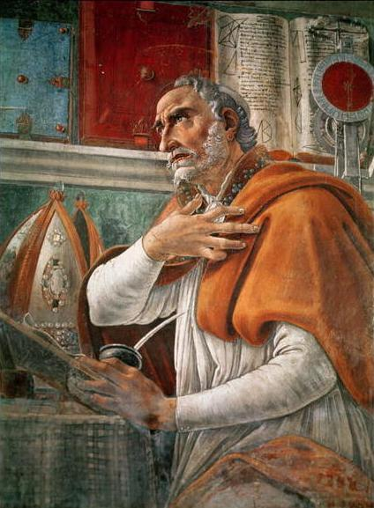
“Our heart is restless
until it rests in you.”
St. Augustine
Confessions
Book 1
Why People Desire God

Slide 10
Forms of atheism:
practical materialism — restricts all a person’s hopes and dreams to the particular time and place of his or her earthly life
atheistic humanism – holds that a person alone determines his or her own fate
the liberation of humanity by social and economic means independent of religion and God
Forms of agnosticism:
May profess no judgment about God’s existence, while at the same time declaring it impossible to prove, affirm, or even deny
Is most often equivalent to practical materialism
Page 8
Why People Desire God

Slide 11
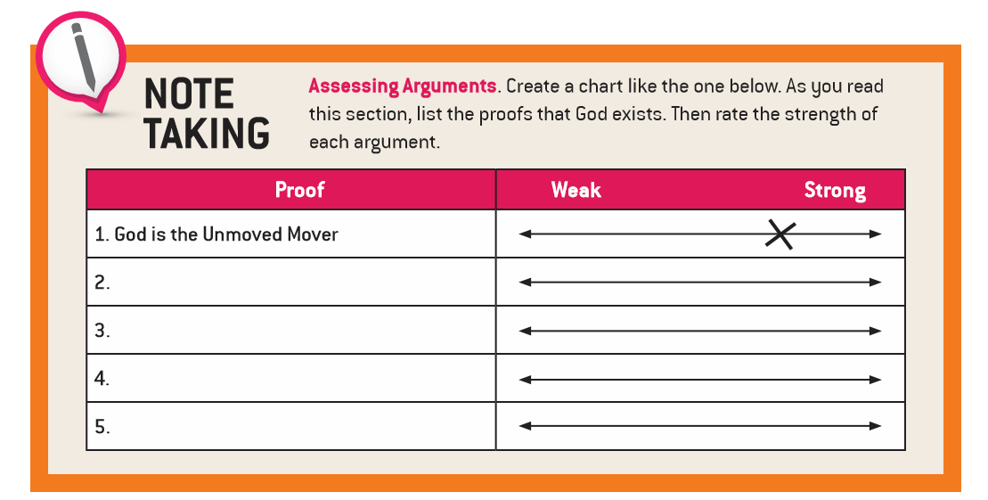
Knowing God Through Natural Revelation

Slide 12
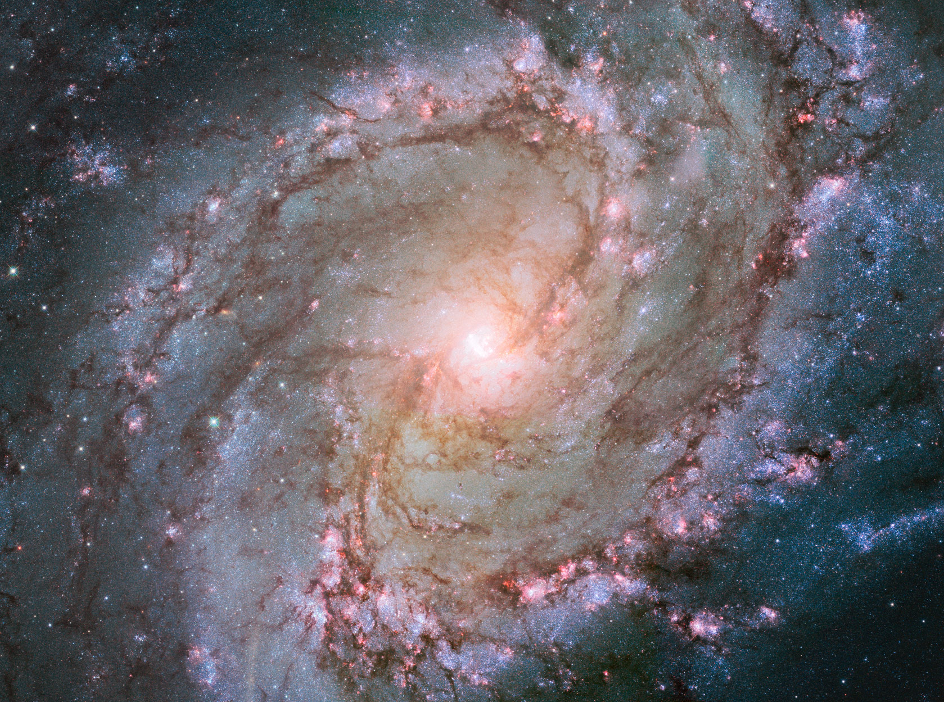
Foolish by nature were all who were in ignorance of God, and who from the good things seen did not succeed in knowing the one who is. Wisdom 13:1
Ever since the creation of the world, his invisible attributes of eternal power and divinity have been able to be understood and perceived
in what he has made.
Romans 1:20
Knowing God Through Natural Revelation

Slide 13
Natural Revelation The knowledge of the existence of God and his basic attributes that can be derived by human reason while reflecting on the created order.
The Pursuit of Happiness

Slide 14
Which of these arguments for God’s existence would you offer to a skeptical friend? Why?
Love and intelligence
God is the Grand Designer
Moral goodness, voice of conscience, and freedom
God is the Unmoved Mover
God is the Supreme Model
Everything comes from something and God is the Something
God is the First Cause
Beauty and truth
Knowing God Through Natural Revelation

Slide 15
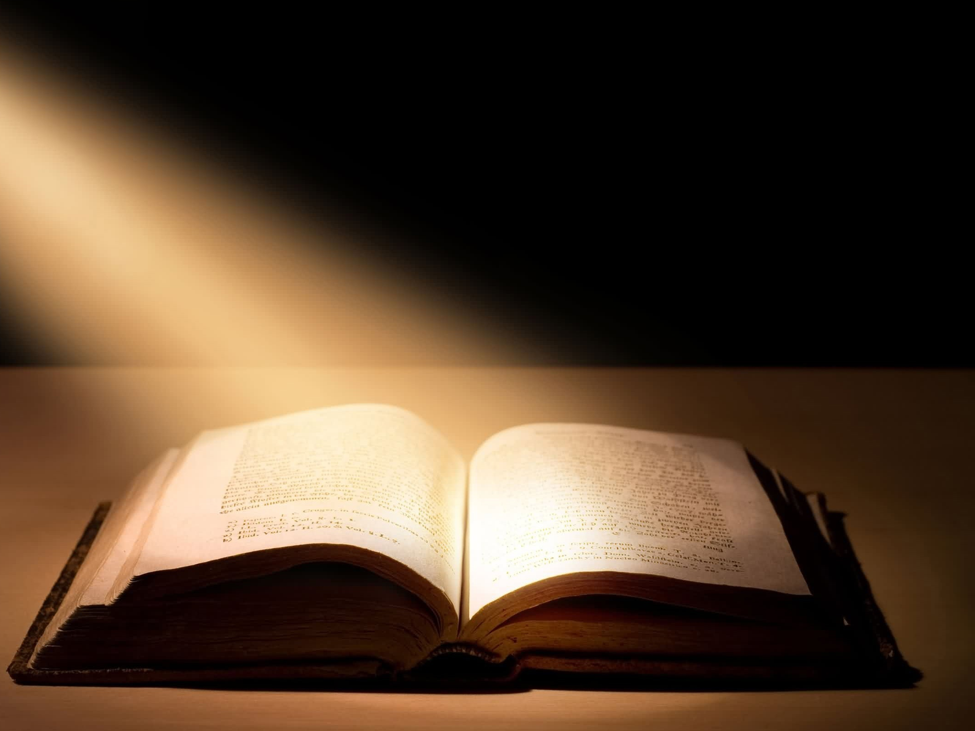
Divine Revelation is the way God communicates knowledge of himself to humankind, a self-communication realized by his actions and words over time, most fully by his sending us his divine Son, Jesus Christ.
The Pursuit of Happiness

Slide 16
Knowing God Through Divine Revelation

Slide 17
GOD
Father
The Holy Trinity
The central mystery of faith
Son
Holy
Spirit
Knowing God Through Divine Revelation

Slide 18
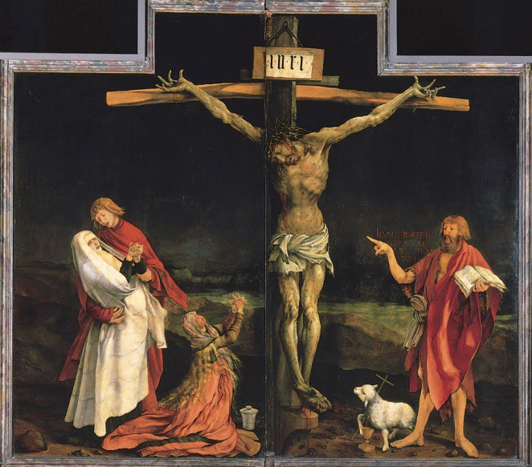
The last and greatest prophet was Jesus’ cousin, John the Baptist. Through his preaching and baptizing of many, and later through his martyrdom, John paved the way for Jesus’ own ministry.
This altarpiece positions St. John the Baptist on Christ’s left side. How does the artist reflect John’s importance in salvation history through the use of symbolism?
Knowing God Through Divine Revelation

Slide 19
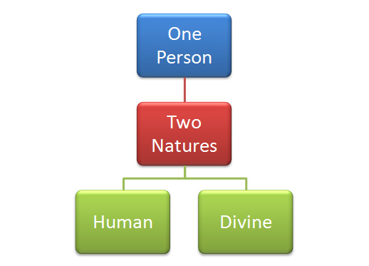
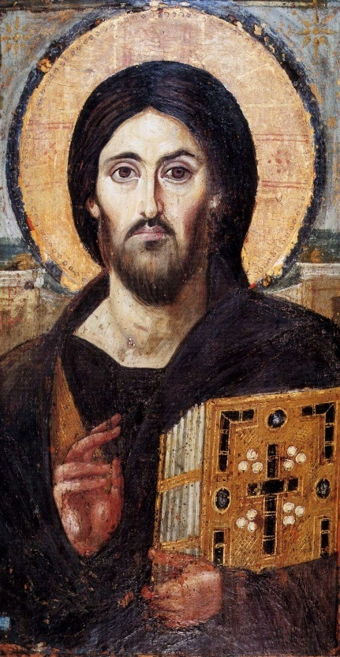
Incarnation is the assumption of a human nature by Jesus Christ, God’s eternal Son, who became man in order to save humankind from sin. The term literally means “being made flesh.”
Knowing God Through Divine Revelation

Slide 20
Prayer to the Blessed Trinity
Glory be to God the Father
Who by His almighty power and love created me,
making me in His own image and likeness.
Glory be to God the Son
Who by His Precious Blood delivered me from hell, and opened for me the gates of heaven.
Glory be to God the Holy Spirit
Who has sanctified me in the Sacrament of Baptism,
and continues to sanctify me by the graces I receive daily from His Bounty.
Glory be to the three adorable Persons of the Holy Trinity, now and forever. Amen.
Knowing God Through Divine Revelation

Slide 21
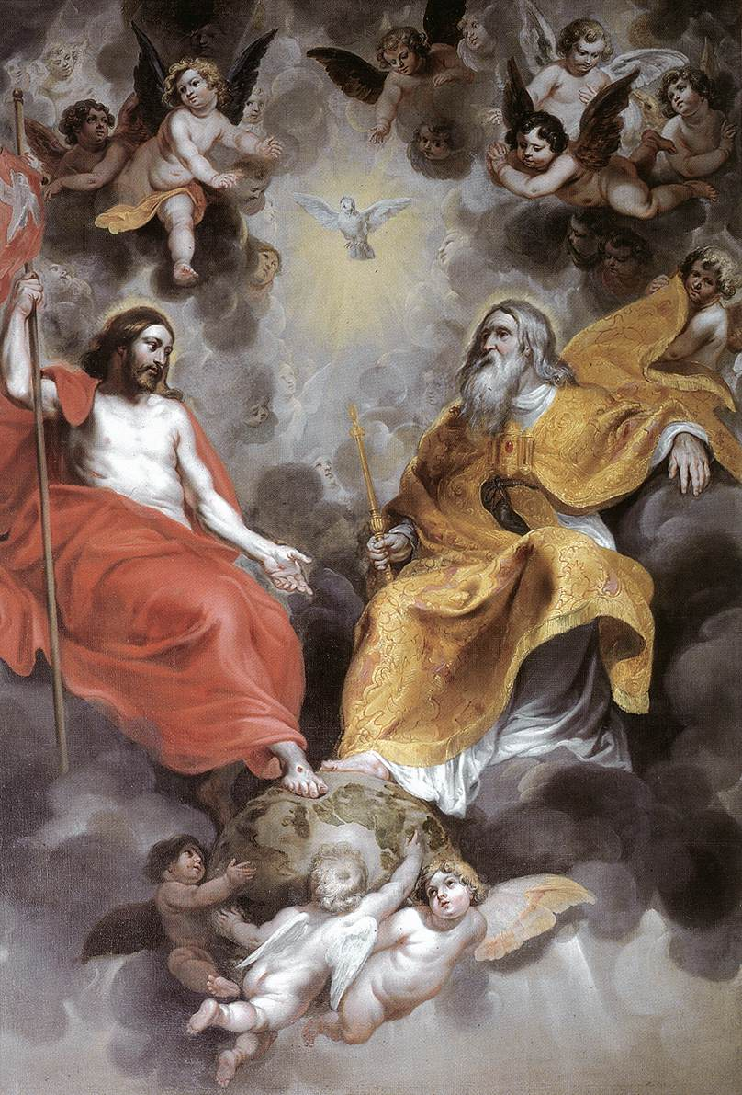
Consecration to the Holy Trinity
O everlasting and Triune God, I consecrate myself wholly to you today. Let all my days offer you ceaseless praise, My hands move to the rhythm of your impulses, My feet be swift in your service, My voice sing constantly of you, My lips proclaim your message, My eyes perceive you everywhere, And my ears be attuned to your inspirations. May my intellect be filled with your wisdom, My will be moved by your beauty, My heart be enraptured with your love, And my soul be flooded with your grace. Grant that every action of mine be done For your greater glory And the advancement of my salvation. Amen.
Knowing God Through Divine Revelation

Slide 22
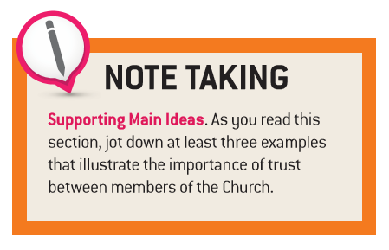
Handing Down Divine Revelation

Slide 23
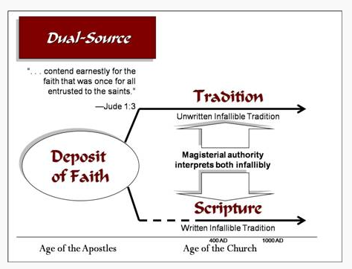
Deposit of Faith
Handing Down Divine Revelation

Slide 24
The History of Salvation: God’s Plan for His People
Covenant Mediator | Adam | Noah | Abraham | Moses | David | Jesus
Covenant Form | Marriage | Household | Tribe | Nation | Kingdom | Church
Covenant Sign | Sabbath | Rainbow | Circum-cision | Passover | Temple & Throne | Eucharist
Handing Down Divine Revelation

Slide 25
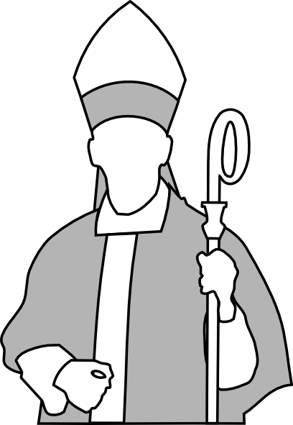
Magisterium “The heritage of faith contained in Sacred Scripture and Sacred Tradition, handed down in the Church from the time of the Apostles, from which the Magisterium draws all that it proposes for belief as being divinely revealed”
(Catechism of the Catholic Church, Glossary).
Handing Down Divine Revelation

Slide 26
Handing Down Divine Revelation

Slide 27
To have faith means that you take a leap of sorts.
Faith: Your Response to Divine Revelation

Slide 28
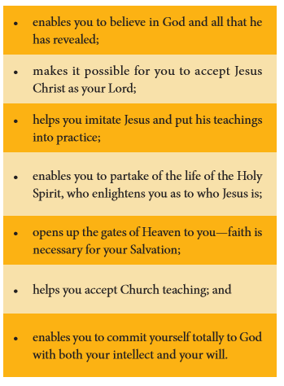
Faith: Your Response to Divine Revelation

Slide 29
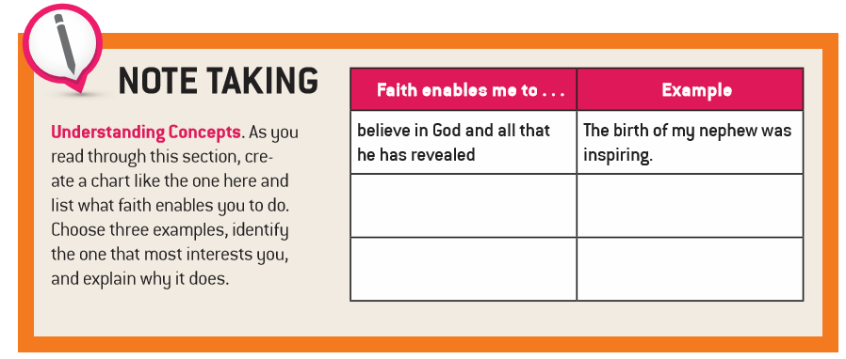
Faith: Your Response to Divine Revelation

Slide 30
Sacred Scripture, Sacred Tradition, and the Church’s Magisterium support one another. With the help of the Holy Spirit, they provide what you need to gain eternal life.
The Catholic Church
Magisterium
Sacred Scripture
Sacred Tradition
Faith: Your Response to Divine Revelation

Slide 31
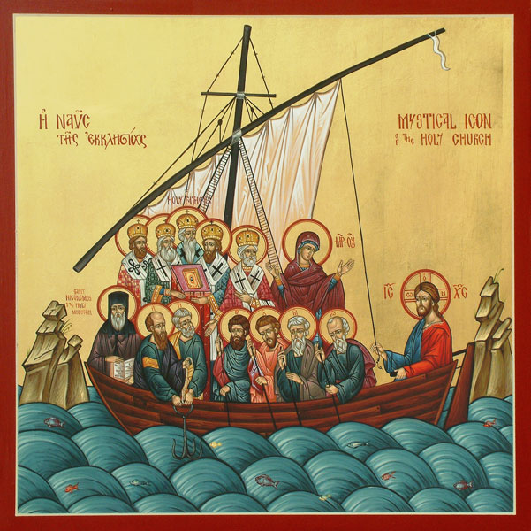
How is the sensus fidei in the life of the Church reflected in this icon?
(cf, p. 26)
Faith: Your Response to Divine Revelation

Slide 32
Endnotes
Quotations from Sacred Scripture come from the New American Bible, Revised Edition (NABRE) http://wwwmigrate.usccb.org/bible/
Quotations from the Catechism of the Catholic Church http://www.vatican.va/archive/ENG0015/_INDEX.HTM
Quotations from Documents of the Second Vatican Council http://www.vatican.va/archive/hist_councils/ii_vatican_council/index.htm

