Slide 1

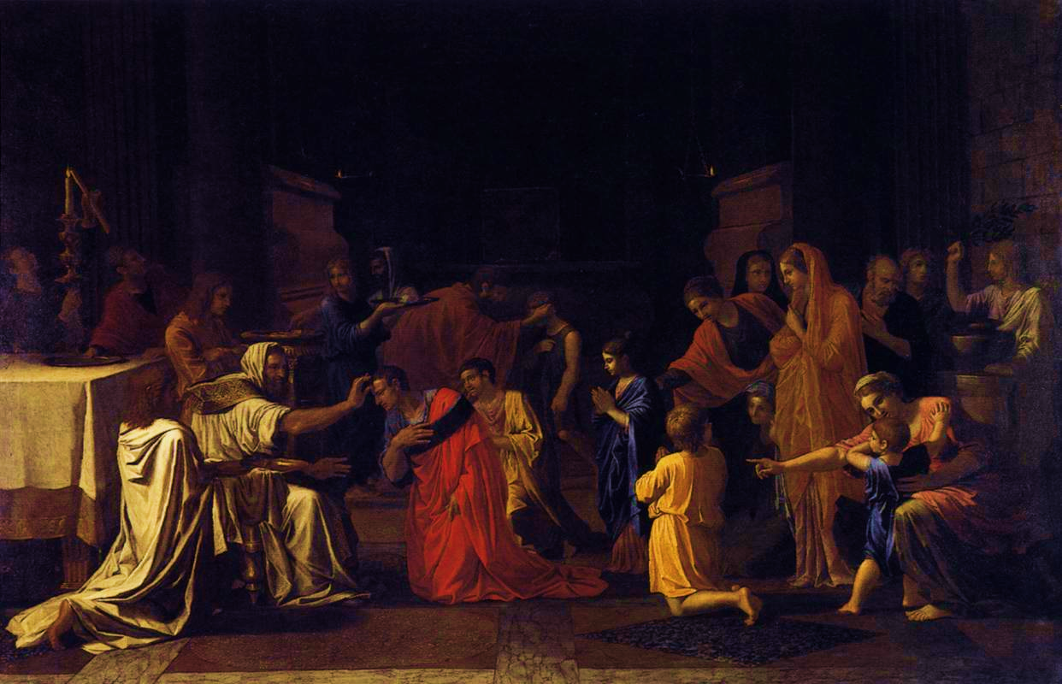
3
3. THE SACRAMENT OF CONFIRMATION
The Sacrament of Confirmation
The Seven Sacraments: Signs of God’s Grace
Notes:
Photo Credit: The Seven Sacraments, Confirmation (Second Series), Nicholas Poussin, 1644–1648 (public domain)
Suggestions for taking notes on the slides:
Require students to use a three ring binder (1/2-1 inches) full of loose leaf paper (college or wide ruled).
Notes must be taken in pen only and handwritten.
Notebook binders should contain information and notes for religion class only.
Notebook binders must have a table of contents with topics of notes, dates, and page numbers.
All notes must have a topic and page number.
Students will be required to copy each slide unless the teacher directs students to skip certain slides or parts of slides. Binder notebooks will be graded based on neatness, completeness and organization.

Slide 2
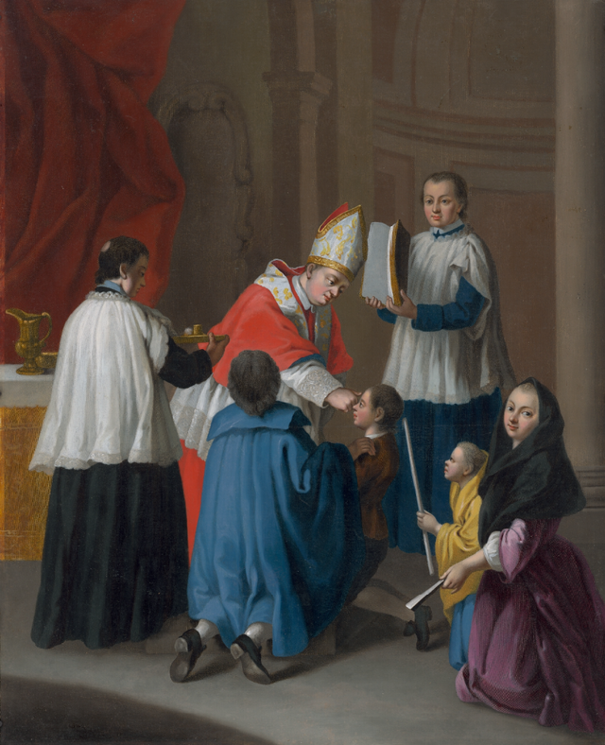
To “confirm” (verb)
To verify as being true
To strengthen or reinforce
Notes:
Photo Credit: Pietro Longhi, “Confirmationis Sacramentum” (public domain), https://commons.wikimedia.org/wiki/File:Pietro_Longhi,_Confirmationis_Sacramentum.png.
Directions: Ask students to define the word “confirm.” Then reveal the two definitions and explain how they relate to the sacrament of Confirmation. Next, read aloud Luke 3:21-22 (the Baptism of Jesus).
Teaching Points:
Perhaps no sacrament is more misunderstood than Confirmation. To begin with, What does the verb confirm even mean? It turns out that there are two definitions. One is that confirm means to verify something as being true. For example, to confirm the story that the defendant is telling. Ex. “Can you confirm that this is true?” The next definition is to make something strong, to edify or to make firm. To confirm is to strengthen. Ex. “Working on the campaign confirmed my desire to enter politics.” Therefore, the verb confirm means both to strengthen and to verify.
The second meaning of the verb confirm is to strengthen and fortify. This strengthening, this confirmation, also happened when the Holy Spirit, in the form of a dove, descended on Jesus. In Luke’s account, immediately after the Baptism, the Holy Spirit leads Jesus into the harsh solitude of the desert for forty days of fasting to finally confront the Enemy. The Spirit would not lead Jesus into a hostile situation without confirming (strengthening, fortifying and equipping) him for the test. The Holy Spirit never left Jesus. This is why Jesus, later in his ministry said, "The Spirit of the Lord is upon me . . .” (Lk 4:18). Though Jesus didn’t need to be baptized or confirmed like we do, it was the will of the Father that he demonstrated these great mysteries in his own life, as the one without sin, who identifies with our sin and our desire for holiness.

Slide 3
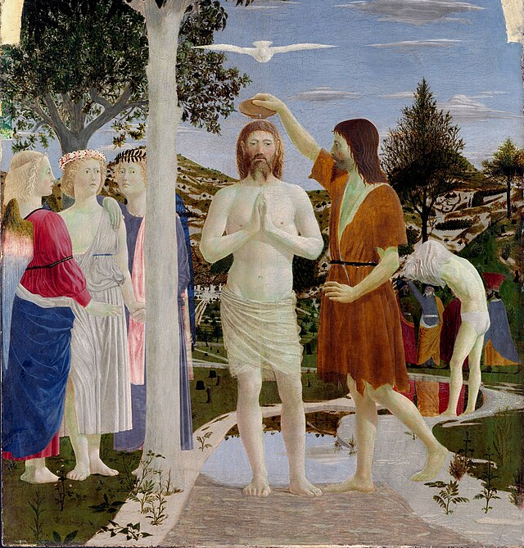
The Holy Spirit and Jesus
“The spirit of the Lord GOD is upon me, because the LORD has
anointed me;
He has sent me to bring
good news to the afflicted,
to bind up the brokenhearted,
To proclaim liberty to the captives,
release to the prisoners.”
— Isaiah 61:1
Notes:
Photo Credit: Piero Della Francesca, “Baptism of Jesus” (public domain), https://commons.wikimedia.org.
Directions:. Have students copy the information from this slide in their notebooks.
Teaching Points:
The Spirit that descended upon Jesus at his own Baptism was communicated to all who heard and accepted his message. This fulfilled the words of the prophet Ezekiel: “I will give you a new heart, and a new spirit I will put within you. I will remove the heart of stone from your flesh and give you a heart of flesh” (Ez 36:26).
Throughout his public ministry, Jesus promised his followers the outpouring of the Holy Spirit:
While preaching to his disciples about their facing persecution, he said: “When they take you before synagogues and before rulers and authorities, do not worry about how or what your defense will be or about what you are to say. For the holy Spirit will teach you at that moment what you should say” (Lk 12:11–12).
In answering the question of the Pharisee Nicodemus about how a person who is grown can be “born again,” Jesus said: “The wind blows where it wills, and you can hear the sound it makes, but you do not know where it comes from or where it goes; so it is with everyone who is born of the Spirit” (Jn 3:8).
At the Last Supper, Jesus promised that after he returned to the Father he would send the Advocate: “For if I do not go, the Advocate will not come to you. But if I go, I will send him to you” (Jn 16:7).
Online Resources: Have students view the video, Understand How the Holy Spirit Works in the Bible. URL here: https://youtu.be/oNNZO9i1Gjc
The videos linked in this presentation file may contain copyrighted material. Such material is made available for educational purposes only. This constitutes a “fair use” of any such copyrighted material as provided for in Title 17 U.S.C. section 106A-117 of the US Copyright Law.

Slide 4
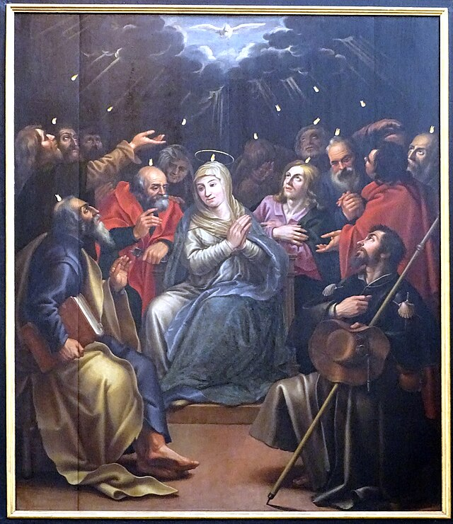
The Holy Spirit and the Church
“You will receive power when the holy Spirit comes upon you, and you will be my witnesses in Jerusalem, throughout Judea and Samaria, and to the ends of the earth.” — Acts 1:8
Notes:
Photo Credit: Ad Meskens, “Mechelen St - Jan Lucas Franchoys Descent of the Holy Spirit 02,” https://commons.wikimedia.org/wiki/File:Mechelen_St_-_Jan_Lucas_Franchoys_Descent_of_the_Holy_Spirit_02.jpg.
Directions: Have students copy the slide information in their notebooks.
Teaching Points:
The Holy Spirit helped the Apostles bear true witness to Jesus, just as he had assured them before his Ascension: “. . . you will receive power when the holy Spirit comes upon you, and you will be my witnesses in Jerusalem, throughout Judea and Samaria, and to the ends of the earth” (Acts 1:8). Today, the Holy Spirit continues to perfect the mission of disciples of Christ—intimately united with him through Baptism—to share the Good News of Christ with all.
Just as the Holy Spirit came upon the Apostles at Pentecost and filled them with the power to witness to Christ—such that some three thousand people believed and were baptized that day (Acts 2:41)—so too Confirmation fills us with that same power of the Holy Spirit to bear witness to Christ. This is one reason why the bishop, as successor of the Apostles, is the ordinary minister of Confirmation.
Online Resources: Have students view the following video: The Holy Spirit in the Life of Catholics – Jeff Cavins. URL here: https://youtu.be/1_l8vGBboV8
The videos linked in this presentation file may contain copyrighted material. Such material is made available for educational purposes only. This constitutes a “fair use” of any such copyrighted material as provided for in Title 17 U.S.C. section 106A-117 of the US Copyright Law.

Slide 5
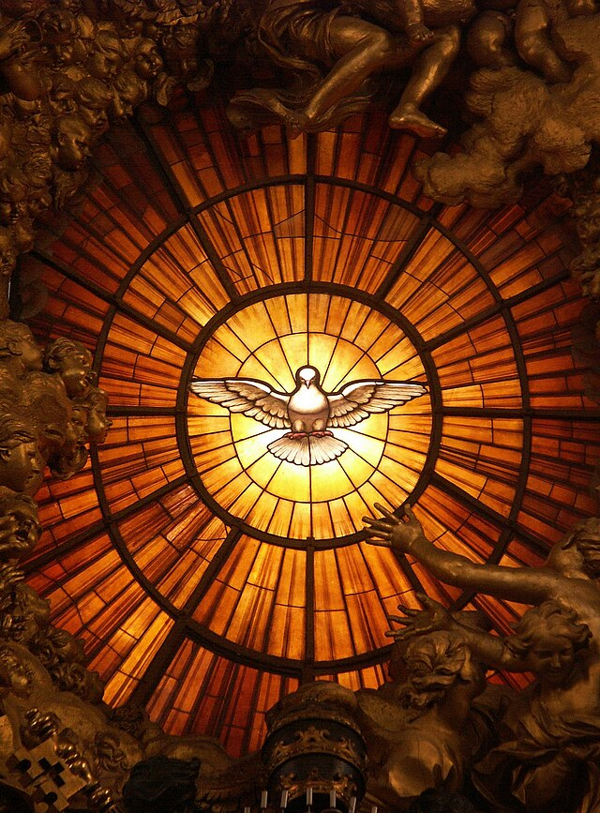
Prayer of the Bishop over the Confirmandi
“Give them the spirit of wisdom and understanding, the spirit of right judgment and courage, the spirit of knowledge and reverence. Fill them with the spirit of wonder and awe in your presence.”
Notes:
Photo Credit: Gian Lorenzo Bernini, “Dove of the Holy Spirit” (alabaster stained glass, Chair of Saint Peter, Saint Peter's Basilica, Vatican City), ca. 1660
Dnalor_01. Creative Commons Attribution-Share Alike 3.0
https://commons.wikimedia.org/wiki/File:Rom,_Vatikan,_Basilika_St._Peter,_Die_Taube_des_Heiligen_Geistes_(Cathedra_Petri,_Bernini).jpg
License: https://creativecommons.org/licenses/by-sa/3.0/at/deed.en
Teaching Points:
The seven gifts of the Holy Spirit enable us to live as disciples of Christ in all aspects of life. These gifts are not magically infused into us. However, if we are open to receiving these gifts, they have several benefits.
The gifts of the Spirit enrich and strengthen our prayer life and our communion with the Blessed Trinity. They give us the courage to always act with moral integrity and to reject choices that wound our holiness and virtue. They give us wisdom to lead others to holiness and virtue by our words and example.
They help us use the talents and gifts that God has given us not only to honor and serve him, but to also spread and defend the Catholic Faith. They help us say yes to God’s will always, to give him greater glory, and to attain for ourselves eternal life with the Blessed Trinity.
Online Resources: Have students view the following video: Sophia SketchPad: Confirmation. URL here: https://youtu.be/Lu3MoT_egFI
The videos linked in this presentation file may contain copyrighted material. Such material is made available for educational purposes only. This constitutes a “fair use” of any such copyrighted material as provided for in Title 17 U.S.C. section 106A-117 of the US Copyright Law.

Slide 6
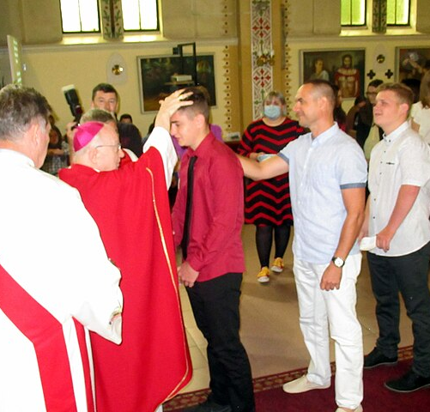
The Laying on of Hands
Key
Vocab
Definition: The imposition of hands completes the graces of Baptism and is rightly recognized by the Catholic tradition as the origin of the Sacrament of Confirmation, which in a certain way perpetuates the grace of Pentecost in the Church.
Protestants who interpret each word or phrase in the
Bible from a literalist point of view.
Notes:
Photo Credit: “Roos Muzlja 33.jpg” (cropped), Bishop confirms young believers, Stebunik, https://commons.wikimedia.org/wiki/File:Roos_Muzlja_33.jpg. Creative Commons Attribution-Share Alike 4.0.
License: https://creativecommons.org/licenses/by-sa/4.0/deed.en
Directions: Have students write down the term and definition as part of a Key Vocab section in their notes.
Online Resources: Have students view video, The Laying on of Hands. URL here: https://youtu.be/Yp7h4wRV2Mo
The videos linked in this presentation file may contain copyrighted material. Such material is made available for educational purposes only. This constitutes a “fair use” of any such copyrighted material as provided for in Title 17 U.S.C. section 106A-117 of the US Copyright Law.

Slide 7
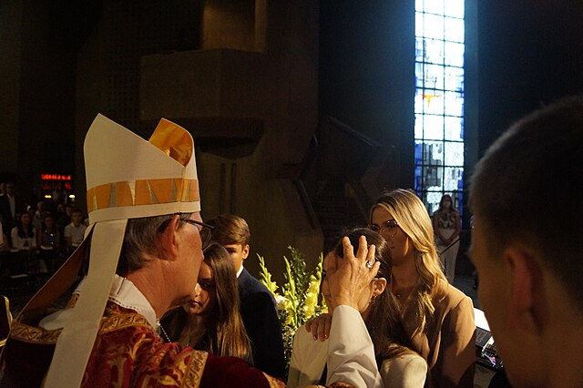
Celebration of Confirmation
Peter and John, who went down and prayed for them, that they might receive the holy Spirit, for it had not yet fallen upon any of them; they had only been baptized in the name of the Lord Jesus. Then they laid hands on them and they received the holy Spirit.
— Acts 8:14-17
Notes:
Photo Credit: “Firmung Neviges 2022.jpg,” Feldbrahi, https://commons.wikimedia.org/wiki/File:Firmung_Neviges_2022.jpg. Creative Commons Attribution-Share Alike 4.0
License: https://creativecommons.org/licenses/by-sa/4.0/deed.en
Directions: Have a student read aloud the quote from the slide. Then explain the the elements in the Rite of Confirmation from the Teaching Points below.
Teaching Points:
The Readings The Sacrament of Confirmation takes place during Mass during the Liturgy of the Word and before the Liturgy of the Eucharist.
The Presentation of the Candidates After the Gospel, a catechist, deacon, or priest presents the candidates for Confirmation to the bishop. If possible, each candidate’s name is read aloud, and the person comes forward individually to meet the bishop.
Homily In the homily that follows, according to some local customs, the bishop may conduct a question-and-answer dialogue with the confirmandi to make sure they understand the meaning of Confirmation.
Renewal of Baptismal Promises After the homily, the candidates publicly renew their baptismal promises, promising to reject Satan and professing their faith in the Blessed Trinity and in the Church. The bishop confirms their profession of faith by proclaiming the faith of the Church with these words: “This is our faith. This is the faith of the Church. We are proud to profess it in Christ Jesus the Lord.” The entire assembly responds: “Amen.”
Invocation of the Outpouring of the Spirit After the Profession of Faith, the bishop extends his hands over the whole group, praying for the outpouring of the Holy Spirit.
The Laying on of Hands and Anointing with Sacred Chrism The laying on of hands by the bishop accompanies the anointing with sacred chrism. The laying on of hands communicates the grace of the Holy Spirit and continues the laying on of hands by the Apostles to those who were newly baptized. From the Church’s origins, the laying on of hands was understood to impart the gift of the Holy Spirit and complete the graces of Baptism. The anointing is the essential rite of Confirmation. It is often a deacon who brings the sacred chrism to the bishop as each candidate comes forward with his or her sponsor. The sponsor gives the candidate’s name to the bishop and places his or her right hand on the candidate’s right shoulder.
General Intercessions After all the candidates have been confirmed, the General Intercessions are prayed. These prayers are for the newly confirmed, their godparents, and their families. The prayers also ask God to help everyone in the Church to be open to the gifts of the Holy Spirit and give witness to the Gospel of Jesus.
Liturgy of the Eucharist The Mass continues.
Online Resources: Have students view the following video: Confirmation | Catholic Central. URL here: https://youtu.be/zUn4e4xmo1k
The videos linked in this presentation file may contain copyrighted material. Such material is made available for educational purposes only. This constitutes a “fair use” of any such copyrighted material as provided for in Title 17 U.S.C. section 106A-117 of the US Copyright Law.

Slide 8
Confirmation Essentials
Minister | Matter | Form
Bishop Priest (with bishop’s permission) | Chrism Oil Anointing Laying on of Hands | “Be sealed with the gift of the Holy Spirit”
Notes:
Directions: Have students copy down the information from the slide into their notes.
Teaching Points:
Minister In the Roman Church, the “ordinary minister” of the Sacrament of Confirmation is the bishop. Bishops are successors of the Apostles. They have received the fullness of the Sacrament of Holy Orders. Their personal administering of Confirmation clearly demonstrates that the effect of the Sacrament is to unite those who receive it more closely to the Church, to the Apostles, and to the mission of bearing witness to Christ. There are circumstances when a priest may confer Confirmation. A priest (using the sacred chrism consecrated by the bishop) is typically the minister of Confirmation for adults who receive all three Sacraments of Christian Initiation at the Easter Vigil. Also, a priest can confer Confirmation if a person is in danger of death. In the Eastern Churches, the priest is the ordinary minister of Confirmation and confers the Sacrament immediately after Baptism. However, recall that in the East, the unity with the bishop is preserved in this sacrament especially through the sacred chrism, which has been consecrated by the bishop or patriarch, thus expressing the apostolic unity of the Church.
Matter Chrism Oil is used in the Sacraments of Baptism, Confirmation, and Holy Orders. The anointing signifies the status of the Christian as “other Christ” and it sets them apart for God’s purpose. Laying on of hands calls to mind what the Apostles did after those who were baptized were waiting for the full outpouring of the Holy Spirit.
Form The words spoken by the minister (form) refer to the biblical seal of those who are counted among the elect in heaven in the Book of Revelation.

Slide 9
Common Misconceptions
Not Important
Graduation from Church
Only for Teens
Christian Bar Mitzvah
Recipient is Confirming God
Notes:
Directions: Have students copy the slide information in their notebooks.
Teaching Points:
Confirmation is not
a “sign of maturity” as if no more growth is necessary;
a Christian Bar Mitzvah-marking the transition into adulthood;
a person’s confirmation to accept God. Instead, it is an openness to receive the grace offered.
Confirmation is
a reception of an increase of God’s help to live a life of holiness in order to spread and defend the faith;
a reception of the Spirit’s special grace to be a servant leader and what used to be known as a (peaceful) “soldier for Christ”;
God confirming us as his “beloved sons and daughters” and equipping us to fight for Good against evil.
Online Resources: Have students view the following video: 5 Things People Get Wrong About Confirmation (Aquinas 101). URL here: https://youtu.be/txKGwEYA-18

Slide 10

The Anointed Ones
Christ means “anointed One.” Christians are the “anointed ones.”
Sacred Chrism: Perfumed oil consecrated by the bishop and used for anointing in the Sacraments of Baptism, Confirmation, and Holy Orders.
Notes:
Photo Credit: "OleaSancta.JPG,” Jonathunder, https://commons.wikimedia.org/wiki/File:OleaSancta.JPG. A jar of consecrated oil for ritual purposes displayed at the Roman Catholic Cathedral of the Sacred Heart in Winona, Minnesota. Etched into the glass are the letters "OS" for Oleum Sanctum, Latin for holy oil.Jonathunder. Creative Commons Attribution-Share Alike 3.0
License: https://creativecommons.org/licenses/by-sa/3.0/deed.en, https://commons.wikimedia.org/wiki/Commons:GNU_Free_Documentation_License,_version_1.2
Directions: Have students copy the information from this slide into their notes.
Teaching Points:
Very early in the development of the Sacrament of Confirmation, an anointing with sacred chrism was added to the laying on of hands. Chrism is a mixture of olive oil (which by its rich and abundant nature symbolizes the Holy Spirit’s overflowing outpouring of grace) and balsam (a fragrant perfume—sometimes referred to as “the balm of Gilead”—used in healing and preservation from corruption).
Oil is a sign of abundance; it cleanses and limbers; it is a sign of healing; and it suffuses those who are anointed with beauty, health, and strength (CCC, 1293). The balsam symbolizes the sweet “odor” of Christianity, found in virtuous living and imitation of Christ (2 Cor 2:15).
Those who are anointed with sacred chrism have a new identity—that of Christians, who share in Christ’s mission and have the special duty of proclaiming his Gospel to the world.
Anointing with sacred chrism has been part of the Rite of Confirmation since the early Church in both the East and West.

Slide 11

Chrism Mass
Key
Vocab
Protestants who interpret each word or phrase in the
Bible from a literalist point of view.
At the Chrism Mass, which occurs during Holy Week, the bishop consecrates the sacred chrism and the other oils used in the diocese throughout the year.
Notes:
Photo Credit: “3HolyOils.jpg,” Jonathunder, https://commons.wikimedia.org/wiki/File:3HolyOils.jpg. Three sacramental oils which were blessed by the bishop at the Chrism mass stored in glass bottles in on a wall of the ambry near the baptistery in the Roman Catholic Church of St. John the Evangelist in Rochester, Minnesota, United States.
GNU Free Documentation License 1.2.
License: https://commons.wikimedia.org/wiki/Commons:GNU_Free_Documentation_License,_version_1.2
Directions: Have students write down the term and definition as part of a Key Vocab section in their notes.
Online Resources: Have students view video, What is the Chrism Mass? URL here: https://youtu.be/hdChDkT_Pv0
The videos linked in this presentation file may contain copyrighted material. Such material is made available for educational purposes only. This constitutes a “fair use” of any such copyrighted material as provided for in Title 17 U.S.C. section 106A-117 of the US Copyright Law.

Slide 12

The Spiritual Effects of Confirmation
Strengthening of baptismal identity
Reception of the Seven Gifts and the full outpouring of the Holy Spirit
Power to spread and defend the faith
Power to never be ashamed of the cross and to be a bold witness for Christ
Strengthening of bond with the Church on earth and with the saints
Imprints on the soul the Seal of the Holy Spirit
Notes:
Photo Credit: “Happiness is wellness.jpg” (cropped and reflected vertically), GiftedLydia, https://commons.wikimedia.org/wiki/File:Happiness_is_wellness.jpg.
Creative Commons Attribution-Share Alike 4.0.
License: https://creativecommons.org/licenses/by-sa/4.0/deed.en
Directions: Have students copy information from the slide into their notes.
Teaching Points:
Some of the spiritual effects of Confirmation include:
Confirmation “unites us more firmly to Christ” (CCC, 1303). It helps us to “more perfectly become the image” of Christ and be attentive to and discerning of God’s call. At Confirmation, the Holy Spirit comes to us and teaches us to pray more consistently as our relationship with Christ is renewed and deepened throughout our life. St. Paul explained that “the Spirit too comes to the aid of our weakness; for we do not know how to pray as we ought, but the Spirit itself intercedes with inexpressible groanings” (Rom 8:26). This effect also helps us remain faithful to Christ when our faith is inevitably challenged or threatened.
We receive the gifts of the Holy Spirit. Confirmation “increases the gifts of the Holy Spirit in us” (CCC, 1303). The Church has traditionally defined these seven gifts as wisdom, understanding, counsel, fortitude, knowledge, piety, and fear of the Lord. The scriptural source of these gifts of the Holy Spirit is Isaiah 11:2–3. The seven gifts of the Holy Spirit work within us and help us grow in holiness, faith, and union with the Blessed Trinity. They help us listen more closely to God’s Word and act on that Word in daily life. Consider the benefits and graces of each gift.
The Sacrament of Confirmation strengthens our bond with the Church. The Catechism of the Catholic Church teaches: “by the sacrament of Confirmation, [the baptized] are more perfectly bound to the Church and are enriched with a special strength of the Holy Spirit. Hence they are, as true witnesses of Christ, more strictly obliged to spead and defend the faith by word and deed” (CCC, 1285). Because of the Holy Spirit’s presence, when we receive this sacrament we are confirmed as a member of the People of God, of the Church.
We receive a new spiritual character. The spiritual character or mark we receive at Confirmation is a different one than we receive at Baptism. It is this indelible character that helps us to spread and defend the faith as a witness of Christ and to never be ashamed of the cross. Those who receive this spiritual character share more completely in the mission of Christ to spread the Gospel message.
Online Resources: Assign article, Confirmation: How to Confront and Smite Smaug. URL here: https://www.catholic365.com/article/30321/confirmation-confronting-smaug.html

Slide 13

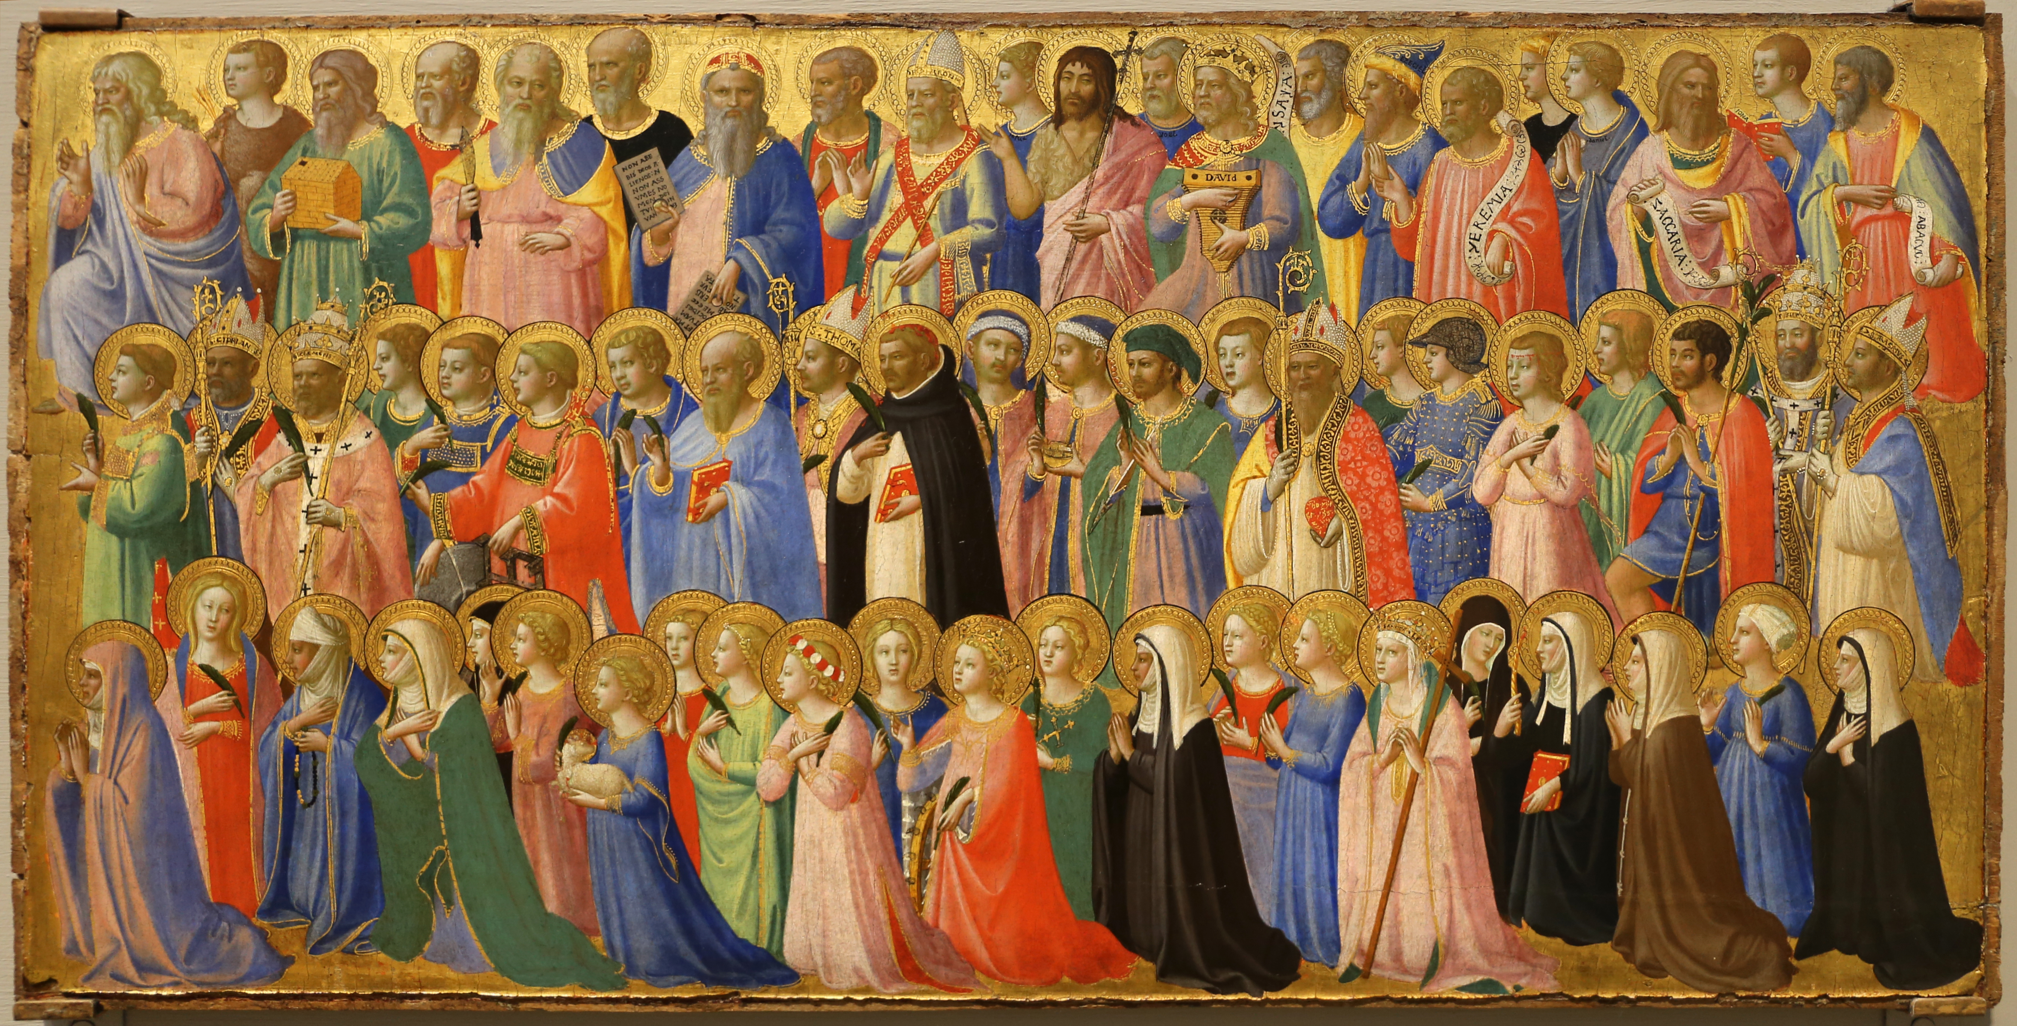
Strengthening the Bond with the Saints
Notes:
Photo Credit: Fra Angelico, The Forerunners of Christ with Saints and Martyrs, “Beato angelico, cristo glorificato nella corte del paradiso, 1423-24, da s. domenico, fiesole 05.jpg," Sailko, https://commons.wikimedia.org/wiki/File:Beato_angelico,_cristo_glorificato_nella_corte_del_paradiso,_1423-24,_da_s._domenico,_fiesole_05.jpg.
License: https://creativecommons.org/licenses/by/3.0/deed.en
Directions: Have a students copy down information from the slide into their notes.
Teaching Points:
The Sacrament of Confirmation in Catholicism strengthens the believer's bond with the Church and, by extension, with the saints, who are also members of the Church. Confirmation is a sacrament that further unites individuals with Christ and the Church, while also pouring out the gifts of the Holy Spirit to empower them to live out their faith. Here's how Confirmation strengthens our bond with the saints:
Deepens connection to the Church. Confirmation renders a believer's bond with the Church, including the communion of saints, more perfect, making them a more active and faithful member of the Body of Christ.
Strengthens faith and witness. By receiving the Holy Spirit, those confirmed are empowered to defend and spread their faith, following the example of the saints who lived their lives in service to God.
Encouragement through examples. Choosing a Confirmation saint to emulate can provide an example of how to live a holy life and can serve as a source of inspiration and intercession.
Incorporation into the Body of Christ. Confirmation makes believers more perfectly members of the Church, the Body of Christ, which includes the saints, both in heaven and on earth.
Increased gifts of the Holy Spirit. Confirmation bestows the gifts of the Holy Spirit, which can be used to grow in holiness and follow the example of the saints.
Online Resources: Have students view video, Bishop Barron on Confirmation Names. URL here: https://youtu.be/Z7bjqldlHl4
The videos linked in this presentation file may contain copyrighted material. Such material is made available for educational purposes only. This constitutes a “fair use” of any such copyrighted material as provided for in Title 17 U.S.C. section 106A-117 of the US Copyright Law.

Slide 14

Turn and Talk
Who would you choose as your Confirmation saint? Explain why.
Notes:
Directions: Have students write down their answer and then share their answers with one person close by. Call on volunteers to share with the whole class.

Slide 15

The Armor of God
“Therefore, put on the armor of God, that you may be able to resist on the evil day and, having done everything, to hold your ground. So stand fast with your loins girded in truth, clothed with righteousness as a breastplate, and your feet shod in readiness for the gospel of peace. In all circumstances, hold faith as a shield, to quench all [the] flaming arrows of the evil one. And take the helmet of salvation and the sword of the Spirit, which is the word of God.” — Ephesians 6:13–17
Notes:
Photo Credit: NROL-47 Knight.png. A drawing of a knight National Reconnaissance Office
Public domain. https://commons.wikimedia.org/
Directions: Have students read aloud the quote from the slide.
Teaching Points:
Many Catholics throughout history have witnessed their faith in Christ despite persecution, imprisonment, and ridicule. Some have given their lives for their faith; they died as martyrs. As times changed and the Church saw herself in a more militaristic way—as an army of God fighting heresy, infidelity, and evil—Confirmation came to be viewed in a militaristic way, too. St. Bonaventure, for example, taught that Confirmation strengthens baptized Catholics so that they might become “soldiers for Christ,” defending the faith against the evil of Satan.
The “soldier for Christ” emphasis at Confirmation was prominent in the rite itself in earlier times. After the confirmandi was anointed on the forehead with chrism, the bishop would give the person a slight blow on the cheek—in reality a light slap. This tradition was at one time connected with a blow to the cheek knights were given in knighting ceremonies in the Middle Ages as a sign of being the last blow a knight would receive before always defending his honor from that point forward. There is evidence that a slap was common at Confirmation as early as the thirteenth century, accompanied by the words of the bishop, somewhat oddly on a peripheral level, “Peace be with you.” The slap on the cheek was also mentioned in the documents of the Council of Trent in the sixteenth century: “The person when anointed and confirmed next receives a gentle slap on the cheek from the hand of the Bishop to make him recollect that, as a valiant combatant, he should be prepared to endure with unconquered spirit all adversities for the name of Christ” (Catechism of the Council of Trent, The Sacrament of Confirmation).
Online Resources: Have students view video, Why the Devil Wants You to Fail | Into the Breach. URL here: https://youtu.be/-fU-nAULL8Y
The videos linked in this presentation file may contain copyrighted material. Such material is made available for educational purposes only. This constitutes a “fair use” of any such copyrighted material as provided for in Title 17 U.S.C. section 106A-117 of the US Copyright Law.

