Slide 1
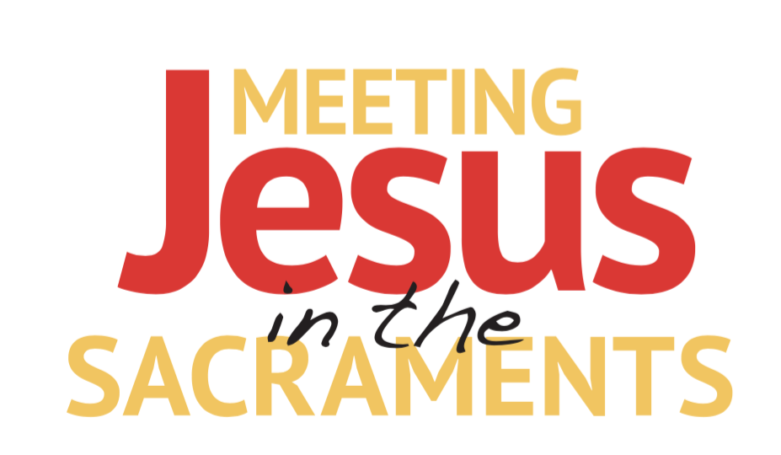
CHAPTER 1

Slide 2
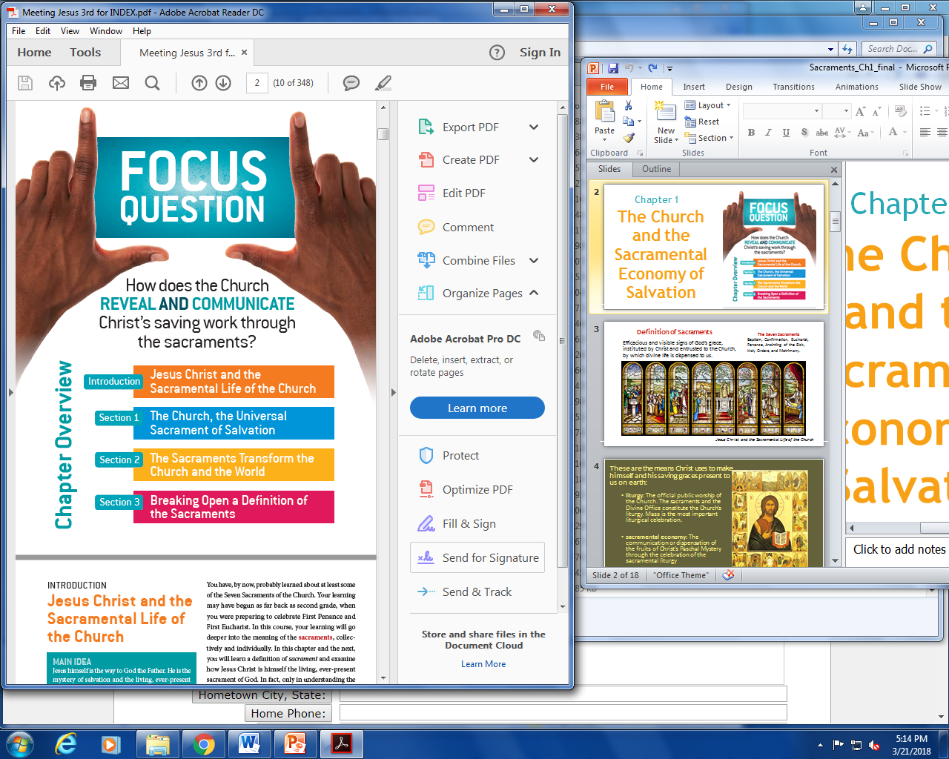
Chapter 1
The Church and the Sacramental Economy of Salvation

Slide 3
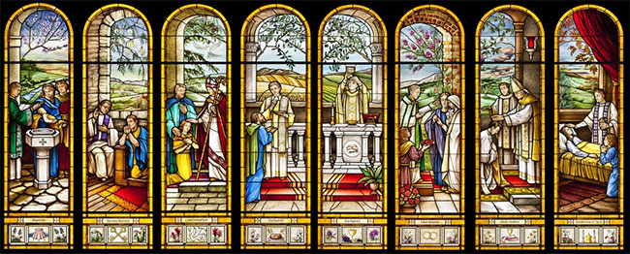
Definition of Sacraments
The Seven Sacraments
Baptism, Confirmation, Eucharist, Penance, Anointing of the Sick, Holy Orders, and Matrimony.
Efficacious and visible signs of God’s grace, instituted by Christ and entrusted to the Church, by which divine life is dispensed to us.
Jesus Christ and the Sacramental Life of the Church

Slide 4
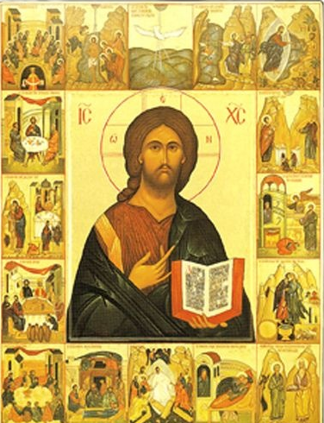
These are the means Christ uses to make himself and his saving graces present to us on earth:
liturgy: The official public worship of the Church. The sacraments and the Divine Office constitute the Church’s liturgy. Mass is the most important liturgical celebration.
sacramental economy: The communication or dispensation of the fruits of Christ’s Paschal Mystery through the celebration of the sacramental liturgy
Jesus Christ and the Sacramental Life of the Church

Slide 5
Hypostatic union
Fully Divine
Divine intellect
Divine will
Never ceased being God
Fully Human
Born into the world as a baby
Grew as a child
Experienced adolescence
Matured to adulthood
Laughed, cried, ate, slept , experienced hunger, sadness, pain at every stage
JESUS
Christ
Jesus Christ and the Sacramental Life of the Church

Slide 6
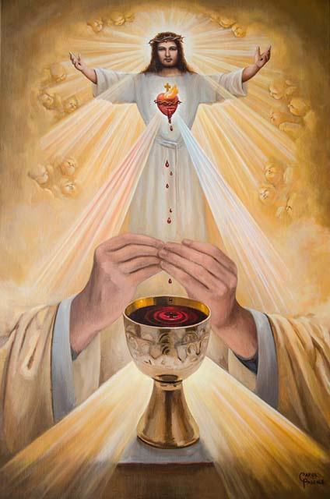
I am the living bread
that came down from heaven; whoever eats this bread will live forever; and the bread that I will give is my flesh for the life of the world (Jn 6:51).
Jesus Christ and the Sacramental Life of the Church

Slide 7
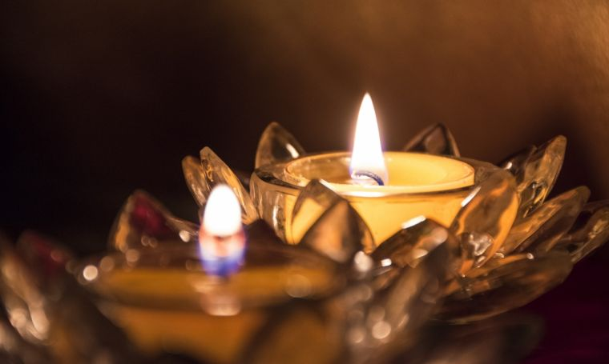
Jesus as light of the earth
“I am the light of the world. Whoever follows me will not walk in darkness, but will have the light of life” (Jn 8:12).
Jesus Christ and the Sacramental Life of the Church

Slide 8

Just as the sun shines and the moon reflects its light the Church shines from the light of Christ.
The Church, the Universal Sacrament of Salvation

Slide 9
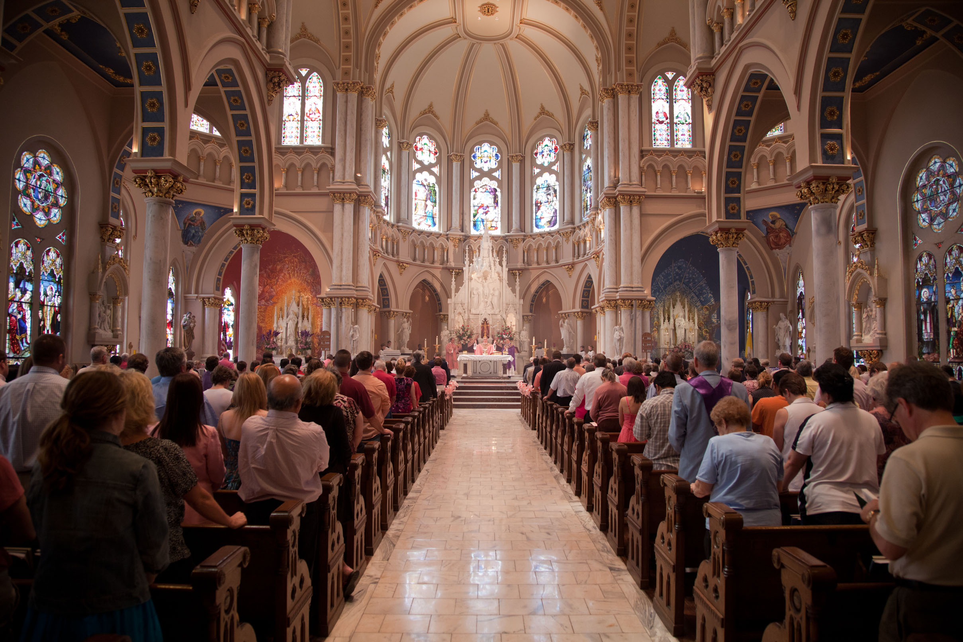
Communion of Saints
The Church, the universal sacrament of salvation, completes the mission of Christ. The Communion of Saints is the unity in Christ of all those he has redeemed: the Church on earth, in heaven, and in Purgatory
The Church, the Universal Sacrament of Salvation

Slide 10
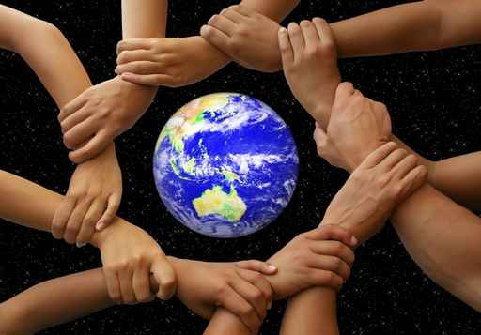
The Church is the Sacrament of Unity
Communion in Faith
Communion of the Sacraments
Communion of Charisms
Communion of Goods
Communion in Charity
The Church, the Universal Sacrament of Salvation

Slide 11
The Human Family
God is the Father of all
Catholics
Orthodox
Church
Jewish People
Other non Christians
The task to make all people disciples of Christ and sharers in the communion of love of the Blessed Trinity is a missionary mandate directed by the Holy Spirit.
The Church, the Universal Sacrament of Salvation

Slide 12
Priest | Prophet | King
All the baptized share in the priesthood of Christ. | A prophet witnesses to the Catholic faith and proclaims God’s truth. | Jesus fulfilled his kingly mission by dying for the sins of all.
You participate in Christ’s priestly mission when you provide spiritual support, such as through your prayers, to another person. | Being a prophet sometimes means you have to go against the tide of public opinion. | You can participate in Christ’s kingly mission when you put the needs of others before your own needs.
The Sacraments Transform the Church and the World

Slide 13
Baptism
Anointing of the Sick
Catholics receive an increase in the theological virtues through reception of the sacraments.
Reconciliation and Penance
Eucharist
Confirmation
Holy Orders
Matrimony
The Sacraments Transform the Church and the World

Slide 14

Characteristics of Grace
Sanctifying Grace
enables you to believe in God, hope in him, and love him
heals your wounded human nature
gives you a share in the divine life
allows you to grow in goodness and virtue with the help of the Holy Spirit
Actual Grace
divine help to perform some good action you wouldn’t be able to perform on your own
gets your will and intellect moving so we can seek out and keep sanctifying grace
acts on the soul from the outside
The Sacraments Transform the Church and the World

Slide 15
Relationship of Sin to Grace
Venial Sin | Mortal Sin
Does not destroy supernatural life or sanctifying grace | Kills off all supernatural life inside of us
Weakens you so that you are more susceptible to mortal sins | Says no to God whereas sanctifying grace is saying yes to God
Breaking Open a Definition of the Sacraments

Slide 16
Four aspects of the sacraments
Sacrament | Memorial | Celebration | Communion | Transformation
Baptism |  | Holy Water, Oil
Confirmation | Holy spirit comes to the Apostles | Holy Chrism | Laying on of hands | Gives the graces to live a Christian life
Eucharist | Last Supper | Holy Eucharist | Priest and people | “go in peace to love and serve the Lord”
Reconciliation & Penance | “You must repent” | Act of Contrition
Anointing of the sick | Jesus as the healer | Holy Oils and Blessing
Matrimony |  | Blessing rings
Holy Orders
Breaking Open a Definition of the Sacraments

Slide 17
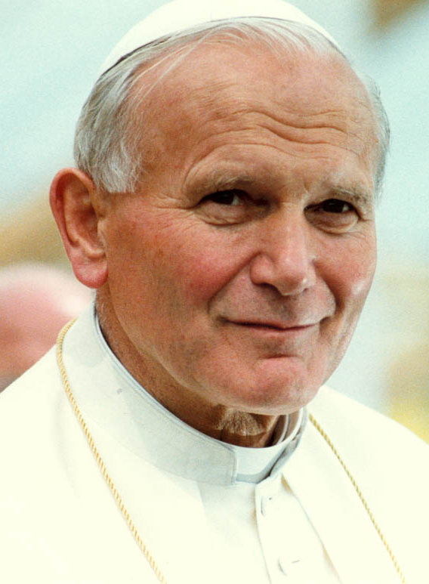
St. John Paul II
Born Karol Wojtyla
Worked in both a quarry and a chemical plant after his university was shut down by the Nazis during World War II
Studied in a secret underground seminary
Named a bishop at age 38
Papal reign lasted 27 years
“What else are the sacraments (all of them!), if not the action of Christ in the Holy Spirit? “
Breaking Open a Definition of the Sacraments

Slide 18
https://www.catholic.com/tract/grace-what-it-is-and-what-it-does

