Slide 1

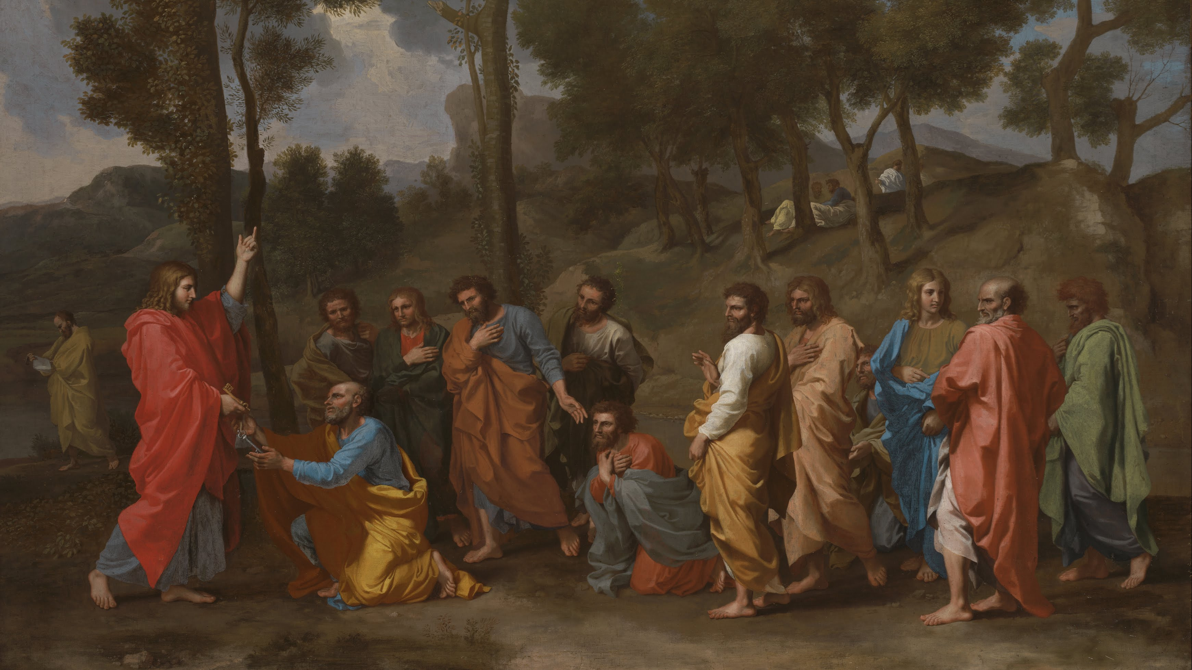
7. THE SACRAMENT OF HOLY ORDERS
7
The Sacrament of Holy Orders
The Seven Sacraments: Signs of God’s Grace
Notes:
Suggestions for taking notes on the slides:
Require students to use a three ring binder (1/2-1 inches) full of loose leaf paper (college or wide ruled).
Notes must be taken in pen only and hand written.
Notebooks should contain information and notes for religion class only.
Notebooks must have a table of contents with topic of notes, dates and page numbers.
All notes must have a topic and page number.
Students will be required to copy each slide unless the teacher directs students to skip certain slides or parts of slides. Notebooks will be graded based on neatness, completeness and organization.

Slide 2

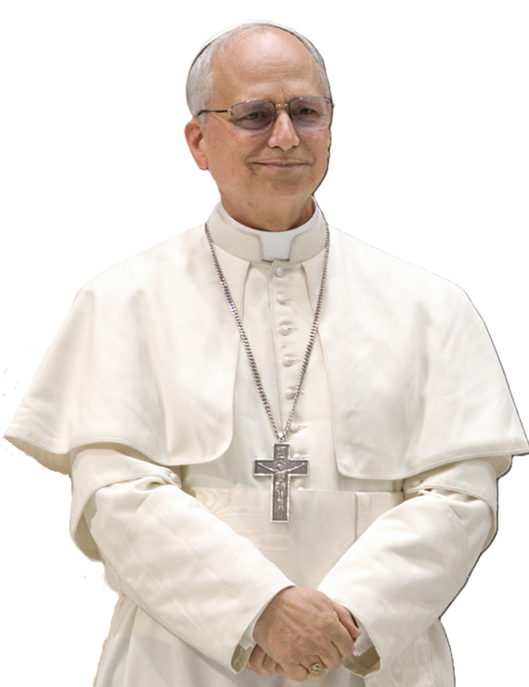
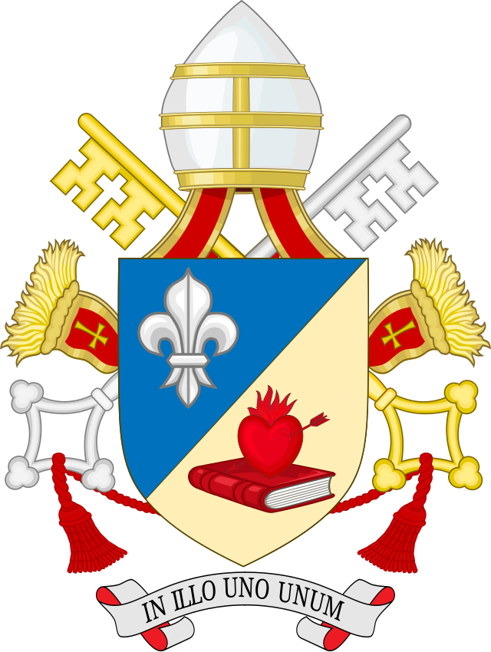
Pope Leo XIV: “I am a son of St. Augustine!”
Pope Leo XIV, the first Augustinian pope, frequently quotes St. Augustine. The pope’s episcopal motto is In Illo uno unum (In the One, [we are] one), a direct quote from St. Augustine.
He also frequently references Augustine’s words "With you I am a Christian, and for you I am a bishop."
Notes:
Photo Credit: Pope Leo XIV during an audience with the media (May 12, 2025). Edgar Beltrán, The Pillar . Creative Commons Attribution-Share Alike 4.0. https://commons.wikimedia.org/wiki/File:Pope_Leo_XIV_3_(3x4_cropped).png Coat of Arms of Popes - Sodacan Style Leo XIV.svg https://commons.wikimedia.org/wiki/File:Coat_of_Arms_of_Popes_-_Sodacan_Style_Leo_XIV.svg
Creative Commons Attribution-Share Alike 4.0. wikicommons.org
Directions: Have students copy the slide information in their notebooks.
Teaching Points:
There are two ways to live out the priesthood: as a diocesan priest, or as a religious priest. Pope Leo XIV was a religious priest who became a bishop in Peru and then was later named as a cardinal by Pope Francis. He was elected as the bishop of Rome. Otherwise known as the pope, on May 8, 2025. His religious order is based on the charism and teachings of St. Augustine. Therefore, he has a devotion to that Saint and models his leadership after St. Augustine. Located inside his pectoral cross are the relics of St. Augustine, the mother of Augustine, St. Monica, and other Augustinian saints.
St. Augustine was always accountable to the people he served. On an anniversary of his ordination as bishop, he said: “I am fearful of what I am for you, but I draw strength from what I am for you. For you, I am a bishop, and with you I am a Christian.”—Sermo de caritate, 340.
Online Resources: Assign article, Pope Leo's Coat of Arms (Symbolism Explained). Article here: https://www.catholic365.com/article/49201/pope-leos-coat-of-arms-symbolism-explained.html

Slide 3

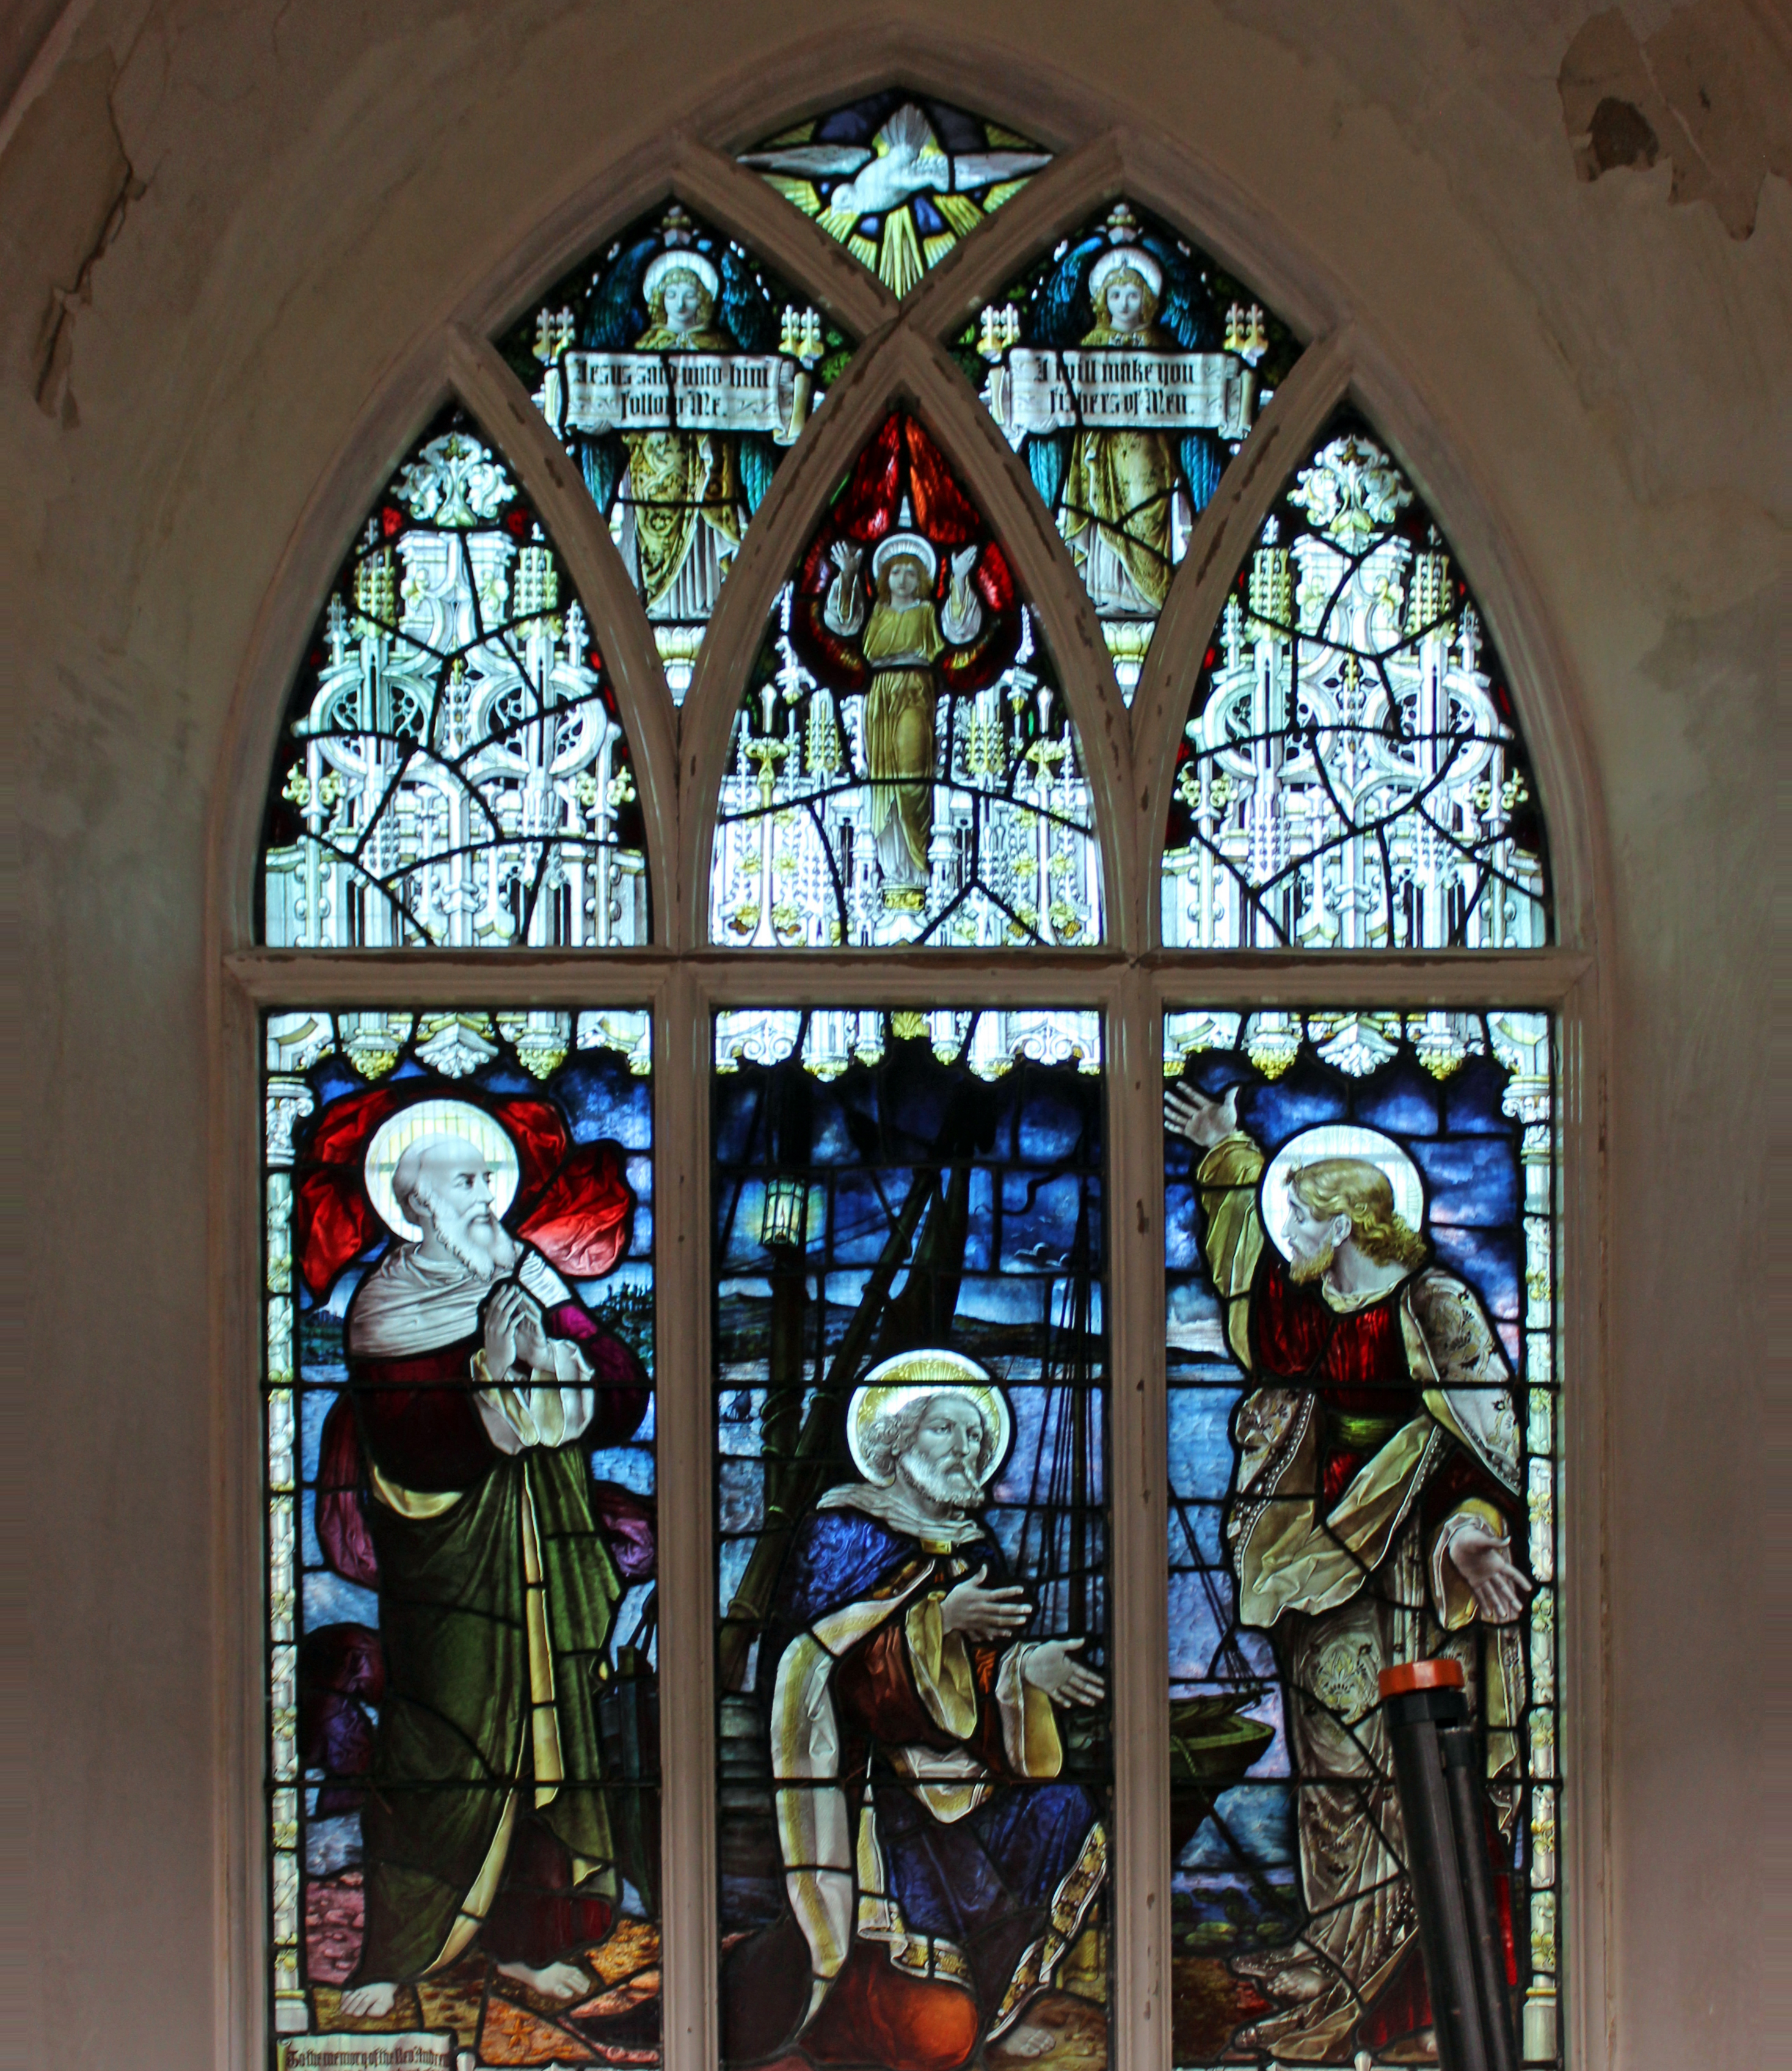
Fishers of Men
“Jesus said to them, ‘Come after me, and I will make you fishers of men.’ Then they abandoned their nets and followed him.”
—Mark 1:17–18
Notes:
Photo Credit: Rodhullandemu, “Fishers of Men window, All Saints, Edge Hill.jpg” (cropped), March 13, 2018, https://commons.wikimedia.org/wiki/File:Fishers_of_Men_window,_All_Saints,_Edge_Hill.jpg.
License: https://creativecommons.org/licenses/by-sa/4.0/deed.en
Directions: Have students read aloud and summarize the side information in their notebooks.
Teaching Point:
The response of men who choose priesthood today parallels the response of the first disciples to Jesus’s call: “Come after me, and I will make you fishers of men” (Mk 1:17). Simon (later called Peter) and his brother Andrew were fishermen. They left their fishing nets to follow Jesus. Likewise, James and his brother John, sons of Zebedee, were on their fishing boat when Jesus approached them. They not only left their nets and boat to follow Jesus—they left their father too. This radical commitment of discipleship is a strong element of the priesthood. Good men today are still listening for, and accepting, God’s call to this vitally necessary ministry.
Online Resources: Have students view video, Catholic Priesthood - Fishers of Men. URL here: https://youtu.be/FVEzWuYlAxM
The videos linked in this presentation file may contain copyrighted material. Such material is made available for educational purposes only. This constitutes a “fair use” of any such copyrighted material as provided for in Title 17 U.S.C. section 106A-117 of the US Copyright Law.

Slide 4
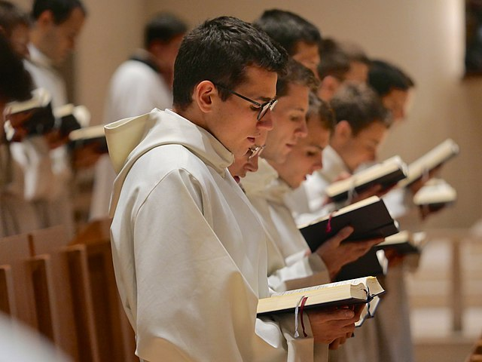
Seminary
Key
Vocab
Definition: A communal environment that prepares men for the priesthood and fosters an important priestly quality: fraternal love and communion among those who will become brother priests.
Notes:
Photo Credit: Communauté Saint-Martin office.jpg. Liturgie des Heures. Octave 444. Creative Commons Attribution-Share Alike 4.0. wikicommons.org https://commons.wikimedia.org/wiki/File:Communaut%C3%A9_Saint-Martin_office.jpg
Directions: Have students copy down this key term in their vocab section of their notes.
Teaching Point:
Together, the seminarians experience formation in four important areas:
Human formation helps the candidate learn to relate well with others.
Spiritual formation cultivates an intimate friendship with Jesus Christ, expressed in a lifelong commitment to personal prayer and devotion.
Intellectual formation involves studies in theology and philosophy, leading to a deeper understanding of what it means to be human and to seek God.
Pastoral formation—the goal of the whole process—makes candidates into shepherds of souls in imitation of Jesus Christ, the Good Shepherd.

Slide 5
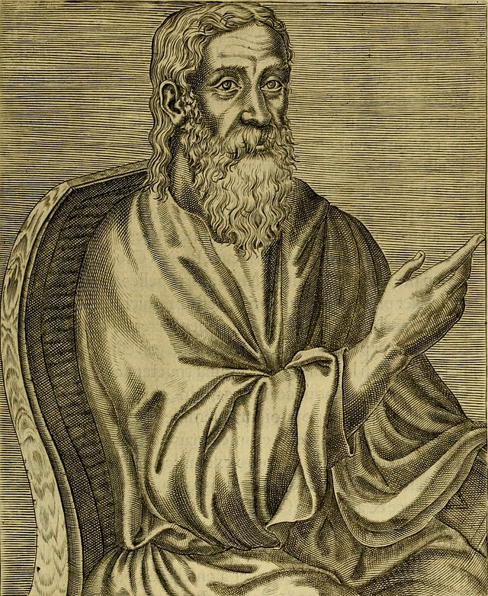
Clement of Alexandria 208 AD
“According to my opinion, the grades here in the church, of bishops, presbyters, deacons, are imitations of the angelic glory, and of that economy which, the Scriptures say, awaits those who, following the footsteps of the apostles, have lived in perfection of righteousness according to the gospel.”
—The Miscellanies: Book 6, Chapter 13
Notes:
Photo Credit: Clement of Alexandria, from book 1, folio 5 recto of Les vrais pourtraits et vies des hommes illustres grecz, latins et payens (1584) by André Thevet.
André Thévet. Public domain. https://commons.wikimedia.org/wiki/File:Clement_alexandrin.jpg.
Directions: Have students read aloud and summarize the slide information in their notebooks.

Slide 6

Apostolic Successsion
Key
Vocab
Definition: The authority of the Apostles to lead and teach has been passed down through a continuous line of bishops, unbroken from the time of the Apostles to the present day. It is essential for maintaining the true faith and the sacraments.
Notes:
Photo Credit: Broad chain closeup.jpg. Broad iron chain. Toni Lozano. Creative Commons Attribution 2.0. https://commons.wikimedia.org/wiki/File:Broad_chain_closeup.jpg.
Directions: Have students copy down this key term in their vocab section of their notes.
Online Resources; View video, Does the Catholic Church Have Unbroken Apostolic Succession? URL here: https://youtu.be/La-EmKSKSPk
The videos linked in this presentation file may contain copyrighted material. Such material is made available for educational purposes only. This constitutes a “fair use” of any such copyrighted material as provided for in Title 17 U.S.C. section 106A-117 of the US Copyright Law.

Slide 7
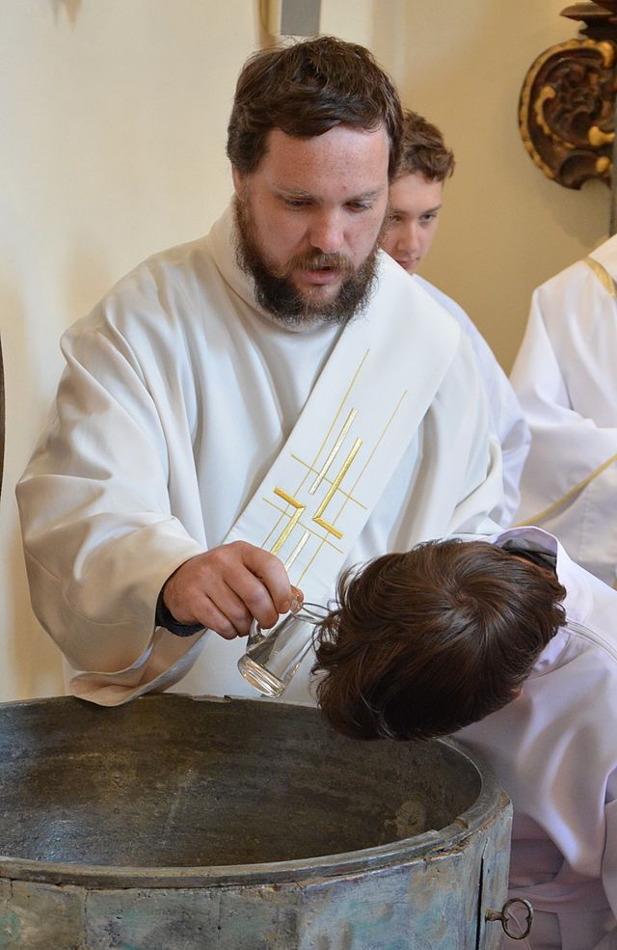
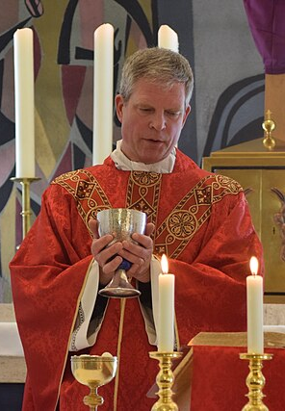
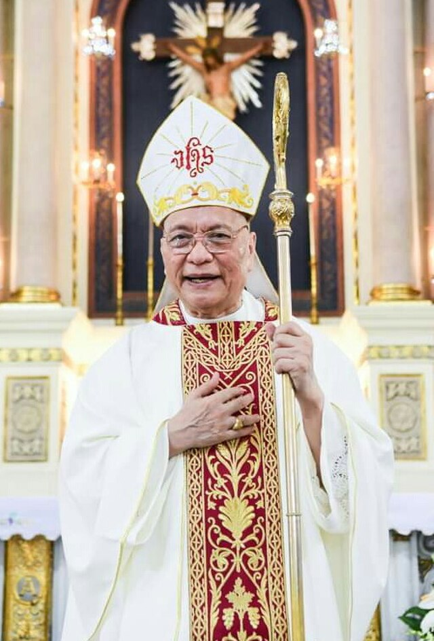
Three Degrees of Ordination
Diaconate
(deacons)
Presbyterate (priests)
Episcopate
(bishops)
Notes:
Photo Credits: Cubao Diocese Media.Creative Commons Attribution 4.0. Bishop Honesto Ongtioco
Palm sunday mass, St. Franciskus Xaverius, Catholic church, Arendal, Norway. Pater Sigurd Markussen.Jan-Erik Løken. Creative Commons Attribution-Share Alike 4.0. Jáhen křtí.jpg Deacon Václav Mikula performs a baptism in the church. v Hrobech.Václav Mikula.Creative Commons Attribution-Share Alike 4.0. https://commons.wikimedia.org/
https://commons.wikimedia.org/wiki/File:Bishop_Honesto_Ongtioco.jpg, https://commons.wikimedia.org/wiki/File:Palmsunday_mass,_St._Franciskus_Xaverius,_Catholic_church,_Arendal,_Norway._Pater_Sigurd_Markussen.jpg, https://commons.wikimedia.org/wiki/File:J%C3%A1hen_k%C5%99t%C3%AD.jpg
Directions: Have students copy down information from the slide into their notes.
Teaching Points:
Since the beginning of the Church, the Sacrament of Holy Orders has been conferred in three degrees: the episcopate, presbyterate, and diaconate. These ordinations lead to the ministries of deacon, priest, and bishop.
The orders of bishop and priest enable the one who is ordained to act in the Person of Christ, the Head of the Body, in celebration of the sacraments. Deacons are ordained to help and serve both priests and bishops in their work. Since priests and bishops are configured to Christ, they can act as the head of Christ’s Body, the Church. Deacons are configured to Christ so that they might serve as he served. Bishops, priests, and deacons are irreplaceable in the structure of the Church; in fact, without them, one cannot speak of the Church.
The Twelve Apostles soon realized they needed others to help them in their rapidly expanding ministry of spreading the Good News and celebrating the Eucharist. They chose seven men—Stephen, Philip, Prochorus, Nicanor, Timon, Parmenas, and Nicholas of Antioch—to serve as deacons, or ministers (see Acts 6:5). Deacons attended to the internal needs of the community—both at the Eucharistic table and elsewhere. They read aloud the Scriptures, administered Communion, taught catechumens, ministered to the sick, and distributed food and clothing to the poor, especially widows and orphans.
The Apostles chose men to be presbyters, or elders, of each local Church: “They appointed presbyters for them in each church and, with prayer and fasting, commended them to the Lord in whom they had put their faith” (Acts 14:23). The Apostles invested these men through a ritual involving prayer and the laying on of hands. Decisions affecting the entire Church were made at general councils by the Apostles acting together with presbyters (Acts 15).
Eventually, the Apostles selected men to be their successors and to continue their work after their deaths. The recorded Greek name for the successors was episcopoi, or bishops in English. Holy Orders preserve the apostolic priesthood for over 2,000 years; it is the key that links the chain of apostolic succession. Our Catholic bishops can link their episcopacy back to the Twelve Apostles.
Online Resources: Have students view video, 3MC - Episode 47 - What are the degrees of the Sacrament of Holy Orders? URL here: https://youtu.be/aq315ppTiOY
The videos linked in this presentation file may contain copyrighted material. Such material is made available for educational purposes only. This constitutes a “fair use” of any such copyrighted material as provided for in Title 17 U.S.C. section 106A-117 of the US Copyright Law.

Slide 8
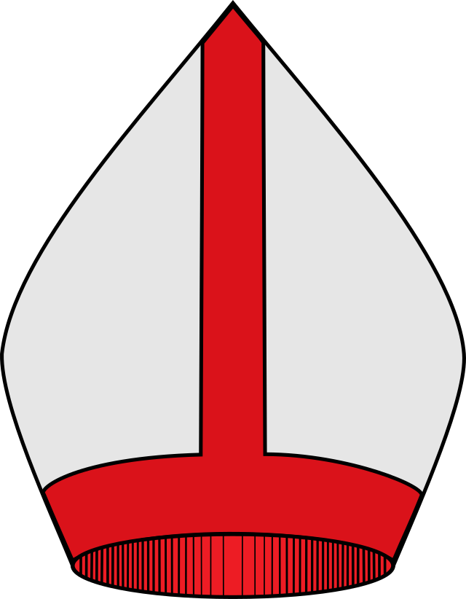
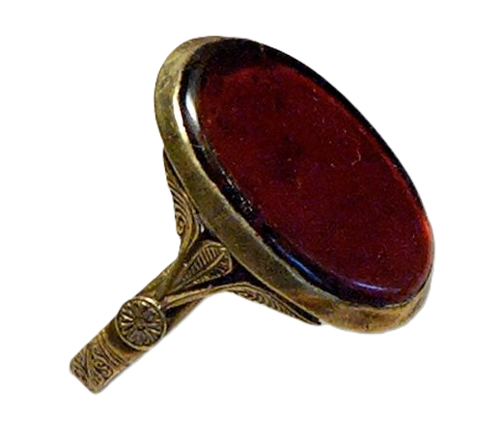
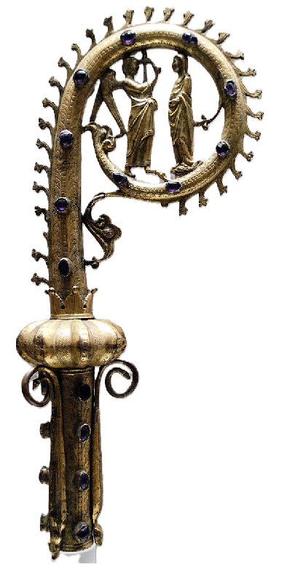
Bishop’s Mitre, Ring & Crosier
The mitre: a distinctive type of tall triangular hat, a sign of the bishop’s authority
The ring: a sign of his lifelong commitment and fidelity to the Church, the Bride of Christ
The crosier: a sign of the bishop’s role as shepherd of the Lord’s flock
Notes:
Photo Credit: Mitre - Cardinal (Heraldry).svg. https://commons.wikimedia.org/wiki/File:Mitre_-_Cardinal_(Heraldry).svg Creative Commons Attribution-Share Alike 2.5. Bishop ring Louvre OA3357.jpg
Marie-Lan Nguyen. Public domain. Crozier with representation of the Annunciation.Unknown artist.Public domain. wikicommons.org
Directions: Have students copy the slide information in their notebooks.

Slide 9
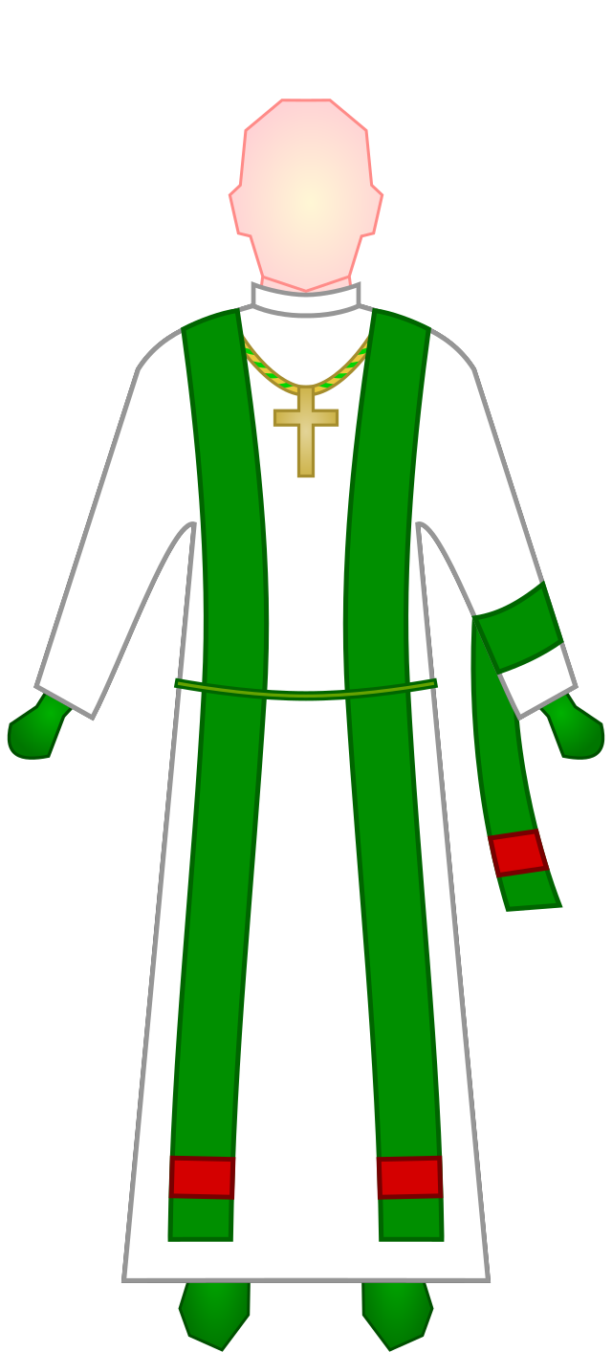
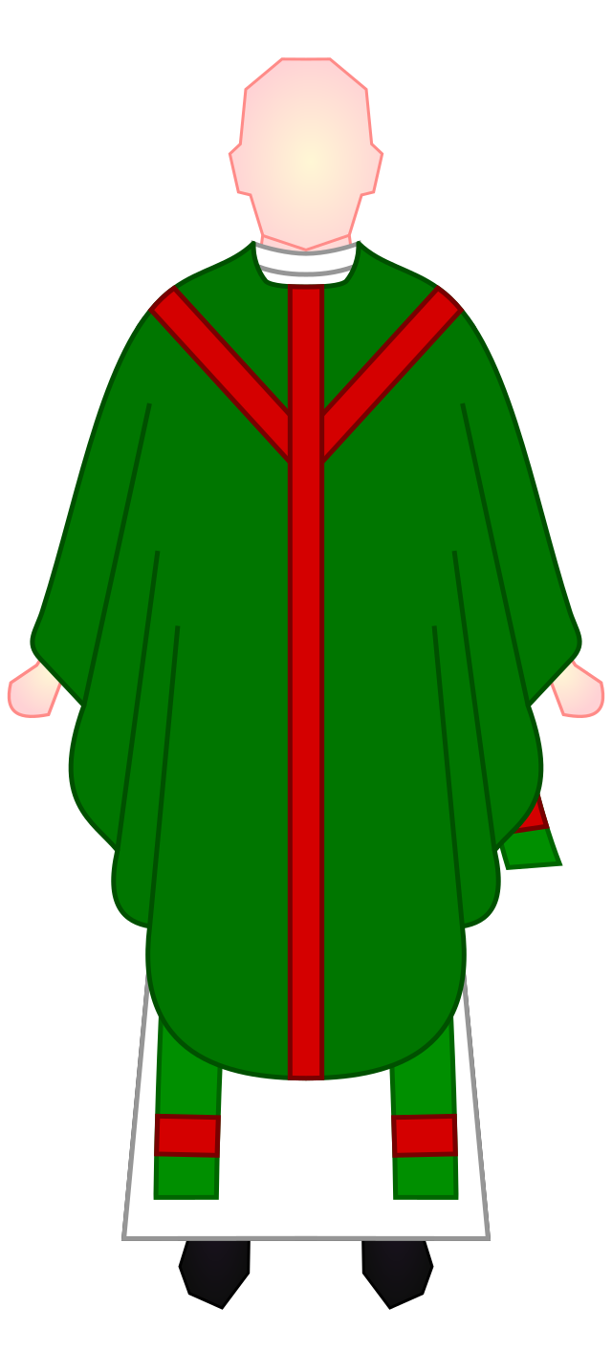
Priest’s Stole & Chasuble
The stole: worn over both shoulders; a sign of the priest’s authority
The chasuble: outer vestment worn at liturgical celebrations
Notes:
Photo Credit: Vestments of a priest dressed for Mass in the Roman Rite, liturgical colour green.Tom-L. Creative Commons Attribution 4.0. https://commons.wikimedia.org/wiki/File:Roman_Rite_Mass_Vestments_-_Priest.svg Showing the difference in how the stole is worn, and also pectoral crosses, subcinctorium and falda.Tom-L/ Creative Commons Attribution 4.0. wikicommons.org https://commons.wikimedia.org/wiki/File:Roman_Rite_Mass_Stole_and_Maniple_-_Bishop.svg
Directions: Have students copy the slide information in their notebooks.

Slide 10
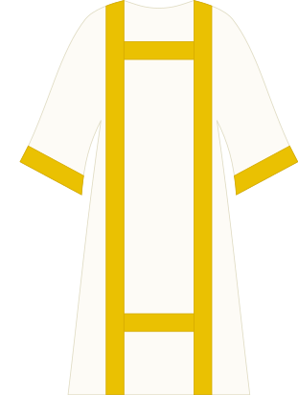
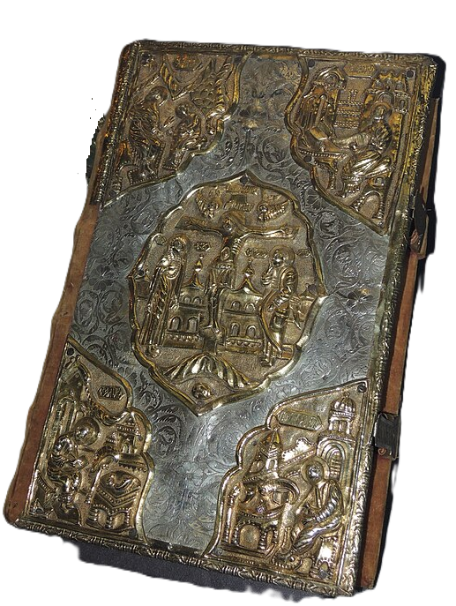
Deacon’s Dalmatic & Book of Gospels
The dalmatic: unlike a chasuble, a dalmatic (from the root word for tunic) has sleeves
Book of Gospels: a sign of Christ’s presence in the liturgy
Notes:
Photo Credit: Dalmática elaborada y simple.svg.Dalmática elaborada y simple. Zelui05. Creative Commons Attribution-Share Alike 4.0. https://commons.wikimedia.org/wiki/File:Dalm%C3%A1tica_elaborada_y_simple.svg Евангелие Дм. Пожарского. Москва, 1605-6. Оклад - Россия, 1606, 42. Надпись по листам: "Евангелие кнзя Дмитрея Михайловича Пожарского". ГИМ
Shakko. Creative Commons Attribution-Share Alike 3.0. wikicommons.org https://commons.wikimedia.org/wiki/File:Dm._Pozharskiy%27s_gospel_book_(1605-6,_GIM)_by_shakko.jpg
Directions: Have students copy the slide information in their notebooks.

Slide 11
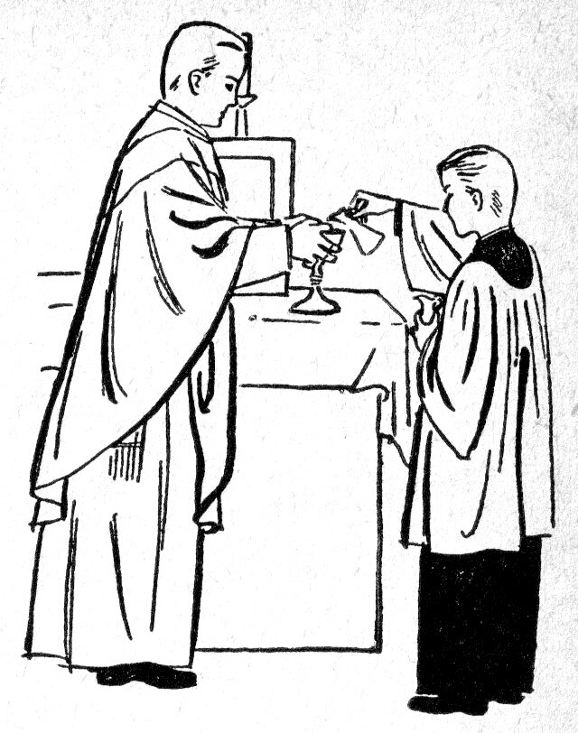
Priest
Key
Vocab
In Scripture, someone who administers religious rituals especially the offering of sacrifice as a mediator between the people and God.
In the Church, a man ordained through the sacrament of Holy Orders entrusted with specific roles and responsibilities, including preaching the Gospel, administering the sacraments, and leading the faithful.
Notes:
Photo Credit: That part of the Mass during which the priest cleans the chalice. K. Wood. Public domain. wikicommons.org
Catholic Picture Dictionary
Directions: Have students copy down this key term in their vocab section of their notes.
Online Resources: View video, Priesthood. URL here: https://youtu.be/aP1oxGv8nps
The videos linked in this presentation file may contain copyrighted material. Such material is made available for educational purposes only. This constitutes a “fair use” of any such copyrighted material as provided for in Title 17 U.S.C. section 106A-117 of the US Copyright Law.

Slide 12
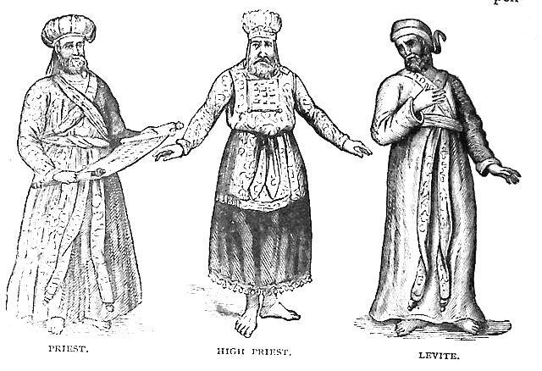
Old Testament Priesthood
Patriarchs offered sacrifices as priests and mediators
Eventually, Levites were designated as the only priestly tribe
Levitical priests served at the Temple liturgy
The High Priest alone entered the Holy of Holies once a year to offer sacrifice
Notes:
Photo Credit: Priest, High Priest, and Levite, illustration from the 1890 Holman Bible. publishers of the 1890 Holman Bible. Public domain. wikicommons.org
Directions: Have students copy the side information in their notebooks.
Teaching Point:
There was no ordained priesthood in early Israel. The father (patriarch) of a family, or the head of a clan, acted as the group’s priest. He performed spiritual duties and taught his children about God. Around the time of the Exodus, the clan of Aaron and the tribe of Levi were set aside as priests (see Ex 28–29; 32:25–29). Sometimes the men were anointed with oil before they assumed their sacred duties (Lev 8–9). Most of these priests were married, and they passed the priesthood on to their sons.
Online Resources: Have students view video, Priesthood - How the old points to the new. URL here: https://youtu.be/kucdd4NhPpY

Slide 13
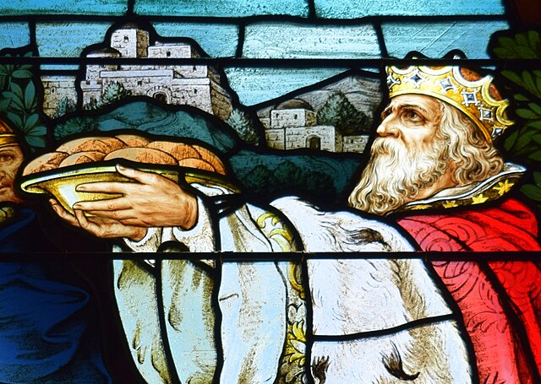
Melchizedek (Mahl-kee-SEDD-eck)
The first priest mentioned in the Bible; “Priest of God Most High”
Priesthood greater than (preceded) Levites
King of Salem (King of Peace)
Offered Bread and Wine
Abraham gave him a Tenth (tithe)
No Ancestry, Mysterious (timeless)
Foreshadowed Jesus as Priest
“You are a priest forever according to the order of Melchizedek.” —Hebrews 7:17
Notes:
Photo Credit: Saint Mary of the Assumption Parish (Springboro, Ohio) - stained-glass, Melchizedek detail. Nheyob. Creative Commons Attribution 4.0. https://commons.wikimedia.org/wiki/File:Saint_Mary_of_the_Assumption_Parish_(Springboro,_Ohio)_-_stained-glass,_Melchizedek_detail.jpg.
Directions: Have students copy the slide information in their notebooks.
Teaching Points:
Jesus’s priesthood is traced to Melchizedek, identified as the “king of Salem” in Genesis 14, who brought out bread and wine and blessed Abram early in his journey to Canaan. Melchizedek’s priesthood is not tied to a tribe, but extends back to the first man.
The author of Hebrews uses Melchizedek's priesthood as a type or foreshadowing of Jesus’s eternal, heavenly priesthood. Psalm 110:4 declares, "You are a priest forever in the manner of Melchizedek".
Online Resources: Have students view video, Melchizedek Priesthood. URL here: https://youtu.be/Zih9pv74hpM
The videos linked in this presentation file may contain copyrighted material. Such material is made available for educational purposes only. This constitutes a “fair use” of any such copyrighted material as provided for in Title 17 U.S.C. section 106A-117 of the US Copyright Law.

Slide 14

Memorize It
Key
Verse
“You are a priest forever according to the order of Melchizedek.”
—Hebrews 7:17
Notes:
Directions: Have students copy the quote. Add bonus points to the assessment if they can copy it down and demonstrate that they memorized it.

Slide 15
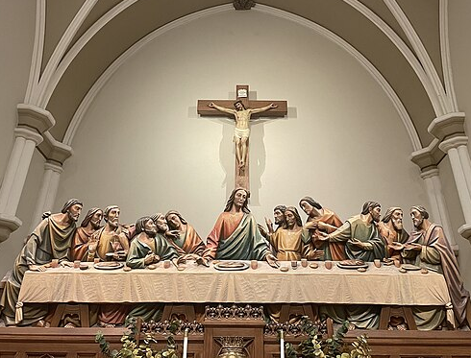
The Priesthood of Jesus Christ
Jesus is the High Priest of the New Covenant, acting as both priest and victim in his sacrifice on the Cross to the Father.
He passed his priesthood on to the Apostles when he said, “Do this in memory of me.”
Catholic priests act in the person of Christ to offer the eternal sacrifice of Jesus in the Eucharist.
Notes:
Photo Credit: Wood carvings of the Crucifixion and Last Supper above the altar of reservation at St. Rose Priory in Springfield, Kentucky. Maximilian775. Creative Commons Attribution-Share Alike 4.0. https://commons.wikimedia.org/wiki/File:St._Rose_Priory_Last_Supper_and_Crucifix_Carving.jpg.
Directions: Have students copy the slide information in their notebooks.
Teaching Point:
Because Jesus himself is present to the Church in the ordained minister as “Head of his Body, Shepherd of his flock, high priest of the redemptive sacrifice” (CCC, 1548), Jesus is the perfect Mediator between God and humanity. He called the Twelve Apostles to continue his work (see Mt 10:1–42; Mk 1:17, 3:13–19), consecrating them at the Last Supper (Jn 17). He made of these Apostles a Church—a permanent assembly—with Peter as their head (see Mt 16:18–19; Jn 21:15–17). Their mission was to be his witnesses to the ends of the earth and, through the power of the Holy Spirit, to make all people his disciples (see Mt 28:16–20; Mk 16:15; Lk 24:45–48; Acts 1:8, 2:1–36).
Online Resources: Have students view video, Day 211: The One Priesthood of Christ — The Catechism in a Year (with Fr. Mike Schmitz). URL here: https://youtu.be/pwd8sGhc6fE
The videos linked in this presentation file may contain copyrighted material. Such material is made available for educational purposes only. This constitutes a “fair use” of any such copyrighted material as provided for in Title 17 U.S.C. section 106A-117 of the US Copyright Law.

Slide 16
Holy Orders Essentials
Minister | Matter | Form
Bishop | Laying on of Hands Chrism Oil Anointing | Consecratory Prayer
Notes:
Directions: Have students draw a rough sketch of the information mapped on the slide. Have students copy down the information from the slide into their notes.

Slide 17

Turn and Talk
Recall a time in your life when you experienced the presence or power of Christ through your interaction with a priest or bishop. What happened? Explain.
Notes:
Directions: Have students write the question and answer and then share their answer with one person close by.

