Slide 1

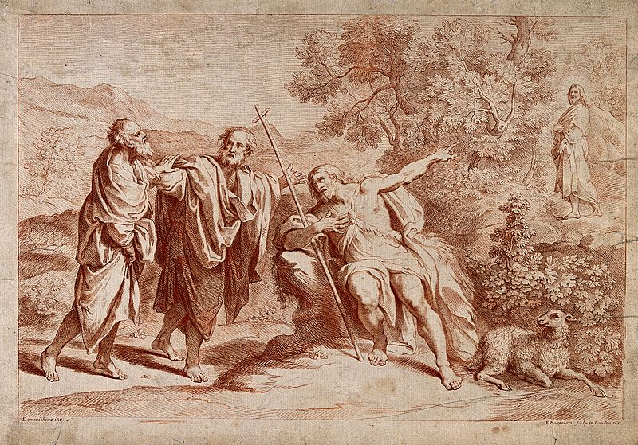
2
The Promise of a Messiah
God Saves: We Are Redeemed through the Paschal Mystery
Notes:
Image Source: https://commons.wikimedia.org/wiki/File:John_the_Baptist_recognises_Jesus_as_the_messiah._Stipple_en_Wellcome_V0034696.jpg
Suggestions for students’ note taking:
●Require students to use a three ring binder (1/2-1 inches) full of loose leaf paper (college or wide ruled).
●Notes must be taken in pen only and hand written.
●Notebooks should contain information and notes for religion class only.
●Notebooks must have a table of contents with topic of notes, dates and page numbers.
●All notes must have a topic and page number.
●Students will be required to copy each slide unless the teacher directs students to skip certain slides or parts of slides. Notebooks will be graded based on neatness, completeness and organization. Notebooks should have a significant point value representing 20-25% of the overall grade.
The videos linked in this presentation file may contain copyright material. Such material is made available for educational purposes only. This constitutes a “fair use” of any such copyright material as provided for in Title 17 U.S.C. section106A-117 of the US Copyright Law.

Slide 2
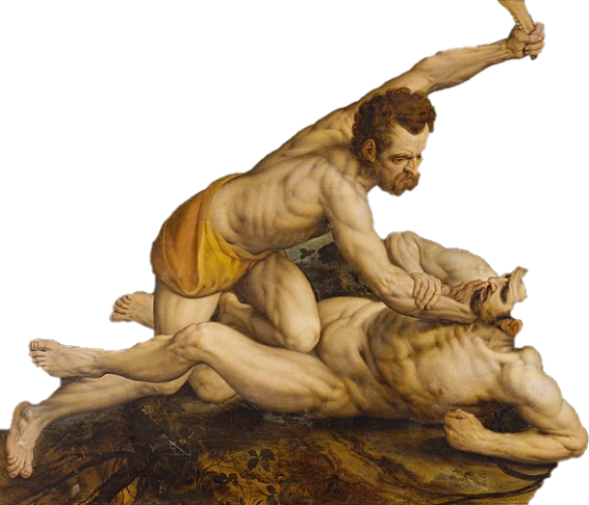
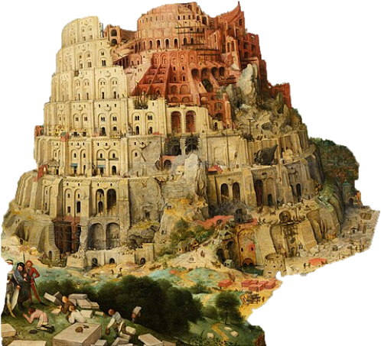
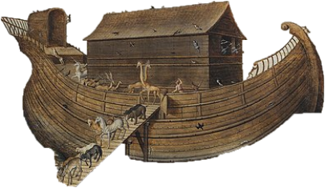
The Spread of Sin
Notes:
Photo Credit: Pieter Brueghel the Elder,Public domain. https://commons.wikimedia.org/wiki/File:Pieter_Bruegel_the_Elder_-_The_Tower_of_Babel_(Vienna)_-_Google_Art_Project_-_edited.jpg
Simon de Myle,Public domain. https://commons.wikimedia.org/wiki/File:Noah%27s_Ark_on_Mount_Ararat_by_Simon_de_Myle.jpg Frans Floris I, Public domain. https://commons.wikimedia.org/wiki/File:Frans_Floris_-_Cain_and_Abel_-_KMSsp337_-_Statens_Museum_for_Kunst.jpg
Directions: Begin by asking what each picture represents in the Book of Genesis.
CAIN AND ABEL in Gen 4: The depth of humanity's fall is revealed in the heinous murder between two brothers.
NOAH and the FLOOD in Gen 6: Judgment and graciousness are found in the flood.
TOWER OF BABEL in Gen 11: Humanity's pride is relentless in seeking praise for itself; but God's glory will never be dethroned.
The stories of Cain and Abel, Noah and the Flood, and the Tower of Babel teach us that sin spreads and that without God’s help, sin leads to death and destruction. Explain that the Book of Genesis teaches the same lesson over and over: going it alone apart from God ultimately leads to sorrow and evil.
Online Resources: View video, How God Deals With Evil Without Destroying Humanity. URL here: https://youtu.be/G_OlRWGLdnw
Assign for reading, Spiderman 3: 5 Lessons on Sin. URL here: https://www.catholic365.com/article/30013/spiderman-3-five-lessons-on-sin.html
View video Genesis 1-11. URL here: https://youtu.be/GQI72THyO5I
The videos linked in this presentation file may contain copyright material. Such material is made available for educational purposes only. This constitutes a “fair use” of any such copyright material as provided for in Title 17 U.S.C. section106A-117 of the US Copyright Law.

Slide 3

The First Promise of Salvation
In spite of a world overrun by sinfulness, there was no time that God intended for people to be alone and without him. God is always with us, is always for us, and will always work things out.
He promised!
Genesis 3:15
Notes:
Directions: Have students write down the information on the slide into their notes. With their Bibles have them look up Genesis 3:15. Have a student read it aloud. Then share the CCC quote here, “ After his fall, man was not abandoned by God. On the contrary, God calls him and in a mysterious way heralds the coming victory over evil and his restoration from his fall. This passage in Genesis is called the Protoevangelium ("first gospel"): the first announcement of the Messiah and Redeemer, of a battle between the serpent and the Woman, and of the final victory of a descendant of hers.” -CCC 410.
The videos linked in this presentation file may contain copyright material. Such material is made available for educational purposes only. This constitutes a “fair use” of any such copyright material as provided for in Title 17 U.S.C. section106A-117 of the US Copyright Law.

Slide 4
Protoevangelium
Key
Vocab!
I will put enmity between you and the woman,
and between your offspring and hers;
They will strike at your head, while you strike at their heel.
- Genesis 3:15
A messianic interpretation of Genesis 3:15 which promises the ultimate triumph over sin through a coming Savior. It is the ‘first Gospel message’ in the Bible.
Notes:
Directions: Have students copy down key vocabulary in their notes.
Explain that God told Adam and Eve to not eat of the fruit of the tree in the middle of the garden. It was Eve, the first woman, who was tempted by the serpent (the devil) to eat the fruit and disobey God. She ate the fruit and gave the fruit to Adam. As a result they both fell out of union with God. This affected us because we inherited this sin called Original Sin. God responded with a curse and a promise against the devil. He said, “I will put enmity between you and the woman, between your offspring and hers. He will strike at your head, while you strike at his heel”(Gn 3:15). In other words, the devil would be crushed and defeated by Jesus. Jesus is the offspring of Mary therefore, this woman, this new Eve, is Mary, the mother of Jesus. There is total enmity (opposition) between Mary and Satan because she is the one immaculate creature that he could not bring down in sin.
Online Resources: For an apologetic approach to Genesis 3;15 see website catholic.com. URL here: https://www.catholic.com/bible-navigator/mary%E2%80%99s-immaculate-conception/genesis315
For more about Mary as the ‘Woman’ of Genesis 3:15 assign reading of article, Teaching Mary the Woman to a Doubting Thomas
. URL here: https://www.catholic365.com/article/30167/the-woman-of-distinction-introducing-mary-in-four-biblical-steps.html
The videos linked in this presentation file may contain copyright material. Such material is made available for educational purposes only. This constitutes a “fair use” of any such copyright material as provided for in Title 17 U.S.C. section106A-117 of the US Copyright Law.

Slide 5
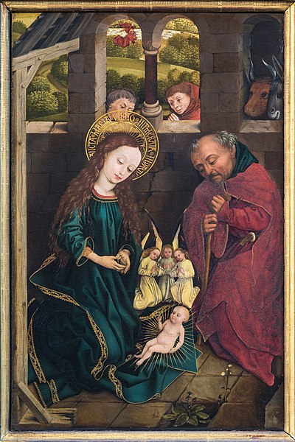
Mary as the New Eve
“Comparing her with Eve, they call Mary 'the Mother of all living' and frequently claim: 'Death through Eve, life through Mary.” -CCC 494
“The Virgin Mary 'cooperated through free faith and obedience in human salvation. … By her obedience she became the new Eve, mother of the living.”
-CCC 511
Notes:
Photo Credit: https://commons.wikimedia.org/wiki/File:N%C3%BCrnberg_St._Lorenz_Dreik%C3%B6nigsaltar_Geburt_01.jpg
Directions: Have students write down the information on the slide into their notes. Ask students the following questions about the image on the slide and have them write down their answers to share later.
What three things stand out to you in this image?
Who is in the image?
What inb the image represents life?
What in the image represents death?
What are the women handing out?
How does the fruit compare to the Eucharist in what they bring about?
Have students share their answers with the person next to them. Choose a student to share their answer with the whole class for each of the six questions.
Online Resources: Have students view, MARY AS THE NEW EVE . URL here: : https://youtu.be/xRGlX1wIMI8
The videos linked in this presentation file may contain copyright material. Such material is made available for educational purposes only. This constitutes a “fair use” of any such copyright material as provided for in Title 17 U.S.C. section106A-117 of the US Copyright Law.

Slide 6
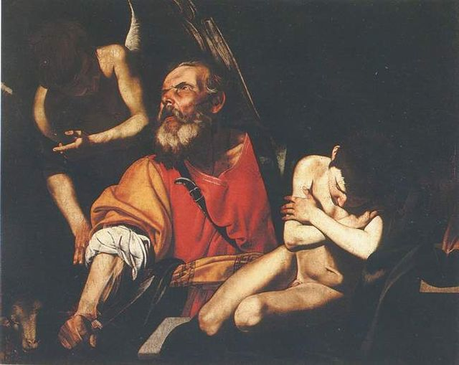
Abraham Model of Faith
“By faith, we completely submit our intellect and will to God.” -CCC 144 This is what Abraham did. Abraham is called the “father of all who believe.” -CCC 146
Notes:
Photo Credit: Filippo Vitale,Public domain. https://commons.wikimedia.org/wiki/File:F_Vitale_Sacrificio_de_Isaac_Capodimonte.jpg
Directions: Have students write down the information on the slide into their notes. Explain that God began a series of covenants with Abraham. His descendants would be his chosen people. Jesus is one of his descendants. We too are children of Abraham when we are baptized into Jesus Christ. Abraham gives us a model of how to have faith in God.
What is happening in the image? Have students look up Genesis chapter 22 and read about the binding of Isaac.
Ask students to list the ways Abraham had faith in God…Start with these two…
He obeyed God and set out for a place where he was promised an inheritance—a large family and land—even though his wife, Sarah, was old and barren, and he did not know where he was going.
He offered his only son Isaac to God as a sacrifice.
Abraham’s willingness to offer his own son out of love for God is an example of what we are all to undertake for the Father. What great sacrifice can you imagine offering to God in your life?
Online Resources: Have students view, Genesis 12-50. URL here: https://youtu.be/F4isSyennFo
Have students view The Faith of Abraham and the Spiritual Life. URL here: https://youtu.be/O0DvKubL4uw
The videos linked in this presentation file may contain copyright material. Such material is made available for educational purposes only. This constitutes a “fair use” of any such copyright material as provided for in Title 17 U.S.C. section106A-117 of the US Copyright Law.

Slide 7
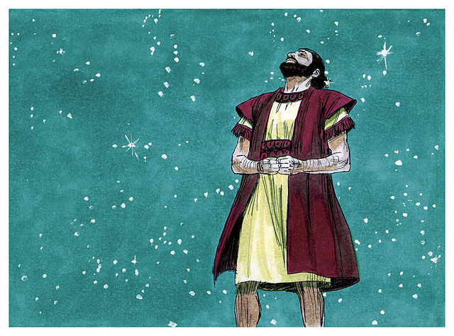
Abraham’s Descendants
“Look at the sky and count the stars, if you can. Just so will your descendants be”
-Genesis 15:5
Notes:
Photo Credit: Jim Padgett,Creative Commons Attribution-Share Alike 3.0. https://commons.wikimedia.org/wiki/File:Book_of_Genesis_Chapter_15-3_(Bible_Illustrations_by_Sweet_Media).jpg
Directions: Have students write down the information on the slide into their notes. Ask students why this promise of a countless multitude of descendants so amazing? (His wife Sarah was too old to have children).
Online Resources: Have students view, Understanding genesis: Abraham and Isaac. URL here: https://youtu.be/4iO_UCOI9Q0
The videos linked in this presentation file may contain copyright material. Such material is made available for educational purposes only. This constitutes a “fair use” of any such copyright material as provided for in Title 17 U.S.C. section106A-117 of the US Copyright Law.

Slide 8
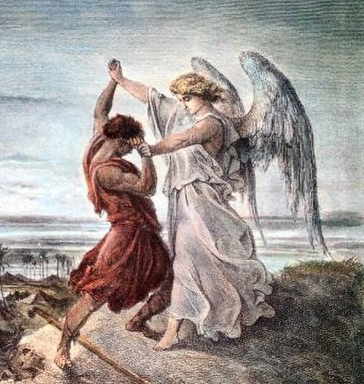
Israelites
Key
Vocab!
A name used interchangeably with Hebrews and Jews in the Old Testament to describe God’s Chosen People. The name comes from Jacob whose name was changed to Israel.
Notes:
Photo Credit: Gustave Doré, Public domain. https://commons.wikimedia.org/wiki/File:La_lucha_de_Jacob_contra_el_%C3%81ngel_Mayor.jpg
Directions: Have students copy down key vocabulary in their notes.
Remind students that Jacob was given the name Israel after he wrestled with a man (often thought to be an angel…see Genesis 32:28–29). Israel means one who wrestles with God. The Israelites were a collection of 12 tribes which originated in the patriarchy of the 12 sons of Israel.
Online Resources: For more about the 12 Tribes which descended from Israel (Jacob) see URL here: https://catholic-resources.org/Bible/History-12Tribes.htm
The videos linked in this presentation file may contain copyright material. Such material is made available for educational purposes only. This constitutes a “fair use” of any such copyright material as provided for in Title 17 U.S.C. section106A-117 of the US Copyright Law.

Slide 9


Turn and Talk
Jacob was blessed after he wrestled with God. In what ways can we too wrestle with God?
Notes:
Directions: Have students write down the question and then write down their answer….Then have students share their answers with one person close by.
The videos linked in this presentation file may contain copyright material. Such material is made available for educational purposes only. This constitutes a “fair use” of any such copyright material as provided for in Title 17 U.S.C. section106A-117 of the US Copyright Law.

Slide 10
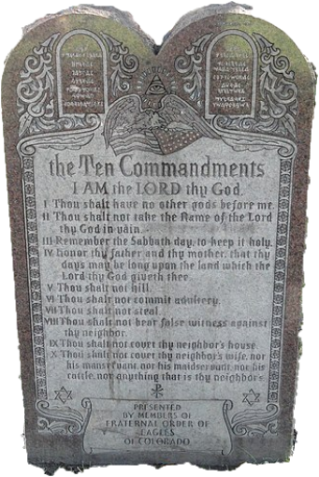
Mosaic Covenant
Key
Vocab!
A sacred pact or agreement between God and the Hebrews. Moses as mediator received the Ten Commandments and then ratified it through the blood of a sacrificial offering.
Notes:
Photo Credit: Daderot,Creative Commons Zero, Public Domain Dedication. https://commons.wikimedia.org/wiki/File:Ten_Commandments_-_Civic_Center_Park_-_DSC01371.jpg
Directions: Have students copy down key vocabulary while you read the quote below.
“A covenant is more than a mere impersonal contract, in which two parties agree to an exchange of goods and services. A covenant binds persons together beyond the mere contractual agreement. Marriage is a prime example. While Holy Matrimony has “contractual” elements and promises, it is a covenant that binds two persons together. Marriage obviously binds two persons in a unique way, but all covenants bind persons together in some way.” - CE Editors, https://catholicexchange.com/what-does-covenant-mean/
The videos linked in this presentation file may contain copyright material. Such material is made available for educational purposes only. This constitutes a “fair use” of any such copyright material as provided for in Title 17 U.S.C. section106A-117 of the US Copyright Law.

Slide 11
The Ten Commandments and Jesus’s Law of Love
Ten Commandments - Ex 20:1-17
I am the Lord your God: You shall not have strange Gods before me.
You shall not take the name of the Lord your God in vain.
Remember to keep holy the Lord’s Day.
Honor your father and mother.
You shall not kill.
You shall not commit adultery.
You shall not steal.
You shall not bear false witness against your neighbor.
You shall not covet your neighbor’s wife.
You shall not covet your neighbor’s goods.
Law of Love - Mk 12:30-31
“And thou shalt love the Lord thy God with all thy heart, and with all thy soul, and with all thy mind, and with all thy strength: this is the first commandment.
And the second is like, namely this, Thou shalt love thy neighbour as thyself. There is none other commandment greater than these.”
Notes:
Directions: Have students write down the information on the slide into their notes.
Point out that the Ten Commandments can be broken into two groups. The first three relate to our duty toward God. The second group relates to our duty towards neighbor. The Law of Love tells us that we must serve and be selfless toward God and other people. The two parts fulfills the two groups of commandments. This is one example of how the Mosaic law points to Jesus and how Jesus fulfills the Mosaic/Sinai covenant.
.
Teaching Points: Compare and contrast the Old Covenant with the New…
OLD
God formed Israel into his Chosen People
Moses as mediator between the people and God the Law on Mount Sinai.
The Law was given to Israel by Moses so that they would be able to recognize God clearly, receive his blessing and know his expectations for them.
At the heart of the Mosaic Law is the Ten Commandments.
Jesus accepted the Ten Commandments and he summarized them by giving the Church the Law of Love.
NEW
The New Law is a law of love. Love is the fulfillment of the Old Law. The New Law doesn’t offer any new precepts to follow; rather, it focuses on the attitudes and motivations we have when we act. It finds expression above all in the Beatitudes preached by Jesus in the Sermon on the Mount (see Matthew 5:3–12) and uses the sacraments 76 God Saves to communicate this grace to us. In fulfilling the Mosaic Law, the New Law focuses on bettering all relationships within the community, especially with the poor.
The Catechism of the Catholic Church explains: The Lord’s Sermon on the Mount, far from abolishing or devaluing the moral prescriptions of the Old Law, releases their hidden potential and has new demands arise from them: it reveals their entire divine and human truth. It does not add new external precepts, but proceeds to reform the heart, the root of human acts, where man chooses between the pure and the impure, where faith, hope, and charity are formed and with them the other virtues. (CCC, 1968)
The videos linked in this presentation file may contain copyright material. Such material is made available for educational purposes only. This constitutes a “fair use” of any such copyright material as provided for in Title 17 U.S.C. section106A-117 of the US Copyright Law.

Slide 12

Memorize It
Key
Verse!
“I am the Lord your God, who brought you out of the land of Egypt, out of the house of slavery. You shall not have other gods beside me.”
(Exodus 20:2-3)
Notes:
Directions: Have students write down the verse and commit it to memory. Bonus points may be awarded if they can add it to the end of the chaptert assessment.
The videos linked in this presentation file may contain copyright material. Such material is made available for educational purposes only. This constitutes a “fair use” of any such copyright material as provided for in Title 17 U.S.C. section106A-117 of the US Copyright Law.

Slide 13
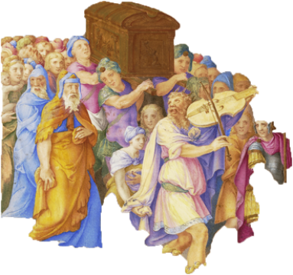
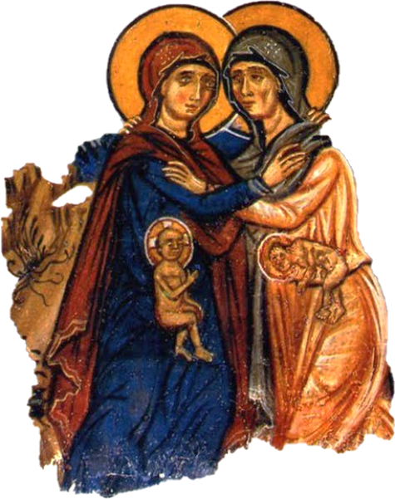
The Ark of Moses and Mary as Ark of New Covenant
“Mary, in whom the Lord himself had made his dwelling is the ark of the covenant, the place where the glory of God dwells.” -CCC 2676‏
Notes:
Photo Credit: Wyatt Archaeological Research,Creative Commons Attribution-Share Alike 4.0. https://commons.wikimedia.org/wiki/File:Ark_of_the_Covenant.jpg Giulio Clovio, Creative Commons Public Domain Mark Owner. https://commons.wikimedia.org/wiki/File:King_David_Dancing_before_the_Ark_of_the_Covenant,_in_a_Decorative_Frame_(SM_468z).png
Directions: Have students write down the information on the slide into their notes. Go over the following typology…
Teaching Points:
In the Old Testament it mentions the three items that were placed in the Ark:
1. The 10 Commandments ~ which represents the word;
2 The manna that fell from Heaven, which represents the bread; and
3. The rod of Aaron (who represented the high priest)
In the New Testament, Mary carried in her womb the following three:
1. Jesus, who is the Word of God in flesh.
2. Jesus – the true bread from Heaven
3. Jesus – the true High Priest
In the image above, King David danced before the ark. In the other image Saint John the Baptist dances in the womb of Elizabeth as he meets the Ark of the New Covenant, Mary.
Moses was ordered by God to build an Ark to store the tablets of the commandments. It was to be made of acacia wood, covered inside and out with gold. On the top were two angels facing each other with an open space between them. This space was known as the “mercy seat”, the place from which God spoke and the priests sprinkled it with the blood of a sacrificial lamb to atone for sin. Within the ark were not only the tablets of the law but a jar of manna (the bread from Heaven) and the rod of Aaron which symbolized the leadership of the priesthood.
Mary, the Mother of Jesus, is often referred to as the Ark of the Covenant. The original ark has been lost for thousands of years, but Mary is the New Ark. From within her being was born the Messiah, son of God, descendent of David, who speaks with the physical body that she gave Him. His blood, from her blood was sprinkled on her as she stood at the foot of the cross and received his broken body into her arms. He is the sacrificial lamb who atones for our sins and saves the righteous. In the Eucharist, her son is manna to all who are prepared to receive him. He is our eternal high priest who continues in every Mass to be offered again and again in atonement for sin. In every way she reflects the original Ark.
No more worthy vessel could be created to contain the sacrificial Lamb of God. The first ark was made by human hands. Mary was created by the hand of God. At her conception she was preserved from all stain of sin in order to the receive the Holy One into her womb. She is a living tabernacle containing God Himself. Often the Father allows this pure Ark to speak on His behalf to draw souls to her Son that they may access his mercy through repentance. Mary, the Ark, is the Mercy Seat through which God can dispense his mercy to all who seek it.
Jesus gave his sinless mother to us on calvary. Always thinking of us, he gave us into her care that she might guide us to God’s mercy seat. For the Divine Trinity has no greater desire than to draw all his children into his heart.
Mary, Ark of the Covenant, still brings to us her Jesus and his mercy. Well does she merit being drawn into the bosom of the Trinity on the day of her Assumption.
Online Resources: Have students view video, ‘Mary, Ark of the New Covenant’. URL here: https://youtu.be/jmNWqLSJcJI
The videos linked in this presentation file may contain copyright material. Such material is made available for educational purposes only. This constitutes a “fair use” of any such copyright material as provided for in Title 17 U.S.C. section106A-117 of the US Copyright Law.

Slide 14
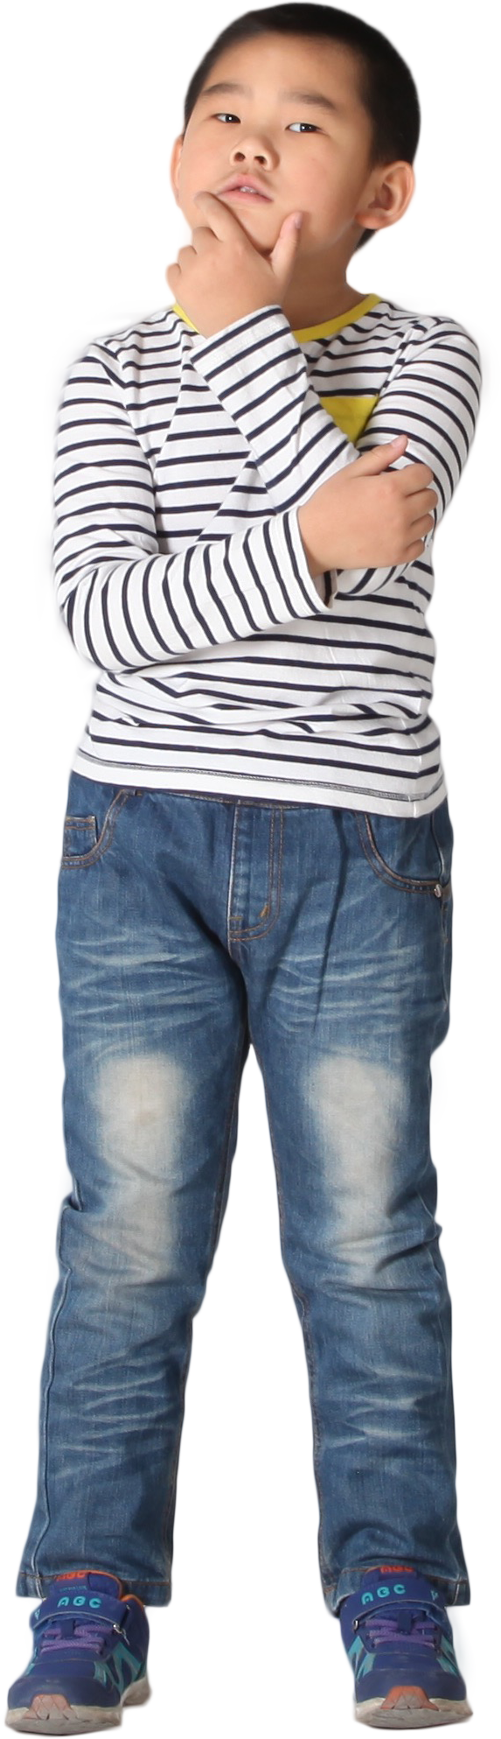
Challenge
Question!
Isn’t the Bible just another piece of literature?
No! While Scripture contains various types of literary forms and genres, it is more than just literature. It is the inspired Word of God.
- CCC 135
Notes:
Directions: Use the animation feature to have the yellow answer box appear after you ask the students to respond out loud to the question on the left.
The videos linked in this presentation file may contain copyright material. Such material is made available for educational purposes only. This constitutes a “fair use” of any such copyright material as provided for in Title 17 U.S.C. section106A-117 of the US Copyright Law.

