Slide 1

THE CHURCH GIVES LIFE
Notes:
Suggestions for students’ note taking:
●Require students to use a three ring binder (1/2-1 inches) full of loose leaf paper (college or wide ruled).
●Notes must be taken in pen only and hand written.
●Notebooks should contain information and notes for religion class only.
●Notebooks must have a table of contents with topic of notes, dates and page numbers.
●All notes must have a topic and page number.
●Students will be required to copy each slide unless the teacher directs students to skip certain slides or parts of slides. Notebooks will be graded based on neatness, completeness and organization. Notebooks should have a significant point value representing 20-25% of the overall grade.
The resources linked in this presentation file may contain copyright material. Such material is made available for educational purposes only. This constitutes a “fair use” of any such copyright material as provided for in Title 17 U.S.C. section106A-117 of the US Copyright Law.

Slide 2

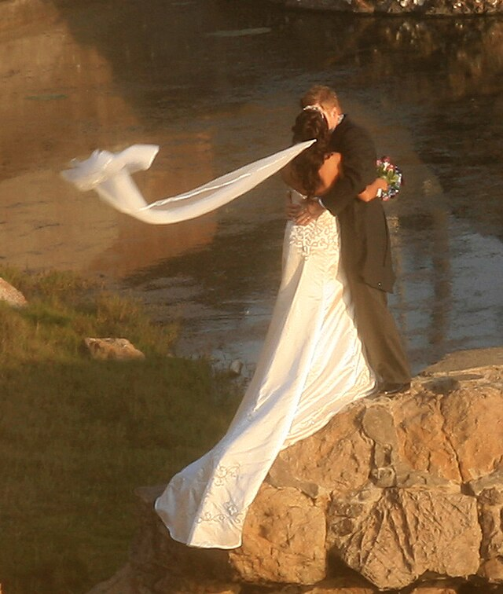
The Church is the Bride of Christ
‘Husbands, love your wives, just as Christ loved the church and gave himself up for her… the two will become one flesh.” This is a profound mystery—but I am talking about Christ and the church.’ Eph 5:21-32
Notes:
Photo Credit: Brocken Inaglory. Creative Commons Attribution-Share Alike 3.0. Bride and groom cropped. https://commons.wikimedia.org/wiki/File:Bride_and_groom_cropped.jpg
Directions: Have students copy information from the slide into their notes.
Teaching Points: In his Letter to the Ephesians, St. Paul compared the love husbands and wives share with how Christ loves the Church. Paul went on to describe the Church as Christ’s beloved Bride for whom he gave himself up so that she would be holy.
See Ephesians 5:25–32: Husbands, love your wives, just as Christ loved the church and gave himself up for her to make her holy, cleansing her by the washing with water through the word, and to present her to himself as a radiant church, without stain or wrinkle or any other blemish, but holy and blameless. In this same way, husbands ought to love their wives as their own bodies. He who loves his wife loves himself. After all, no one ever hated their own body, but they feed and care for their body, just as Christ does the church— for we are members of his body. “For this reason a man will leave his father and mother and be united to his wife, and the two will become one flesh.” This is a profound mystery—but I am talking about Christ and the church.
This image of the Church as bride highlights a deep physical, emotional, intellectual, and spiritual union God desires to have with the baptized Catholic. .
Online Resources: Have students view video, Bride of Christ. URL here: https://youtu.be/U_mr1YTf5SM
The resources linked in this presentation file may contain copyright material. Such material is made available for educational purposes only. This constitutes a “fair use” of any such copyright material as provided for in Title 17 U.S.C. section106A-117 of the US Copyright Law.

Slide 3
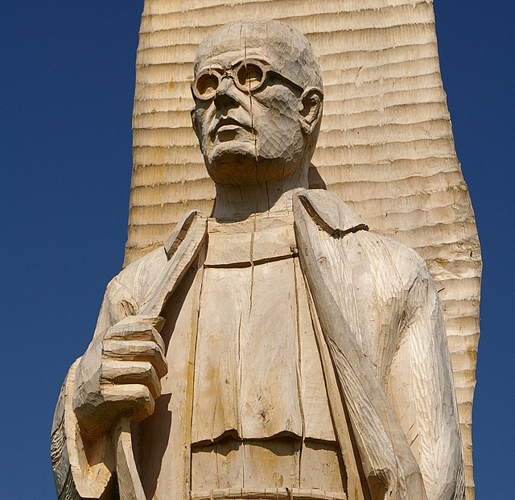
Self-Giving Love
Just like marriage requires self-giving love, our relationship with God also requires that we reciprocate this kind of selfless love toward God and Neighbor.
Notes:
Photo Credit: The wooden sculpture of Saint Maximilian Mary Kolbe in Wiślica. Jakub Hałun. Creative Commons Attribution-Share Alike 3.0. https://commons.wikimedia.org/wiki/File:Wislica_Kolbe_20070825_1048.jpg
Directions: Have students copy information from the slide into their notes.
Teaching Points:
‘Small’- Examples of a small way to enter into self-giving love: a wife getting ready for work a few minutes before her husband uses the light of her phone to find her clothes in the closet so as not to disturb him by turning on the bedside lamp. Then, upon rising himself, the husband gets the coffee brewing for his wife and goes out to the garage to warm up her car.
‘Medium’- Example of a slightly bigger way to enter into self-giving love: Imagine the wife who orchestrates several family moves from place to place to support her husband’s career, or the husband who passes up a new job because it would leave less time for him to spend with his wife and children. We have been created by an unselfish God who gave of himself in becoming not only human, but a poor human who ultimately gave up his life for the benefit of sinners.
‘Large’-Example to total self-giving in the act of laying down one’s life for others. Saint Maximilian Kolbe and St. Gianna Molla are two of many examples in the history of the Church which imitate Jesus on the cross.
Online Resources: Have students view video, Maximilian Kolbe. URL here: https://youtu.be/KsHiBTLo3aw
The resources linked in this presentation file may contain copyright material. Such material is made available for educational purposes only. This constitutes a “fair use” of any such copyright material as provided for in Title 17 U.S.C. section106A-117 of the US Copyright Law.

Slide 4

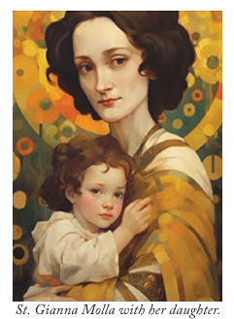
No Greater Love
Key
Vocab
Jesus said that there is no greater love than to give your life for another person. Saints like Gianna Molla and Maximilian Kolbe show that this kind of radical love is possible.
Notes:
Photo Credit: AMP Textbook p. 8.
Directions: Have students write down the term and definition as part of a Key Vocab section in their notes.
Online Resources: Have students view video, The Saint Gianna Beretta Molla Story. URL here: https://youtu.be/NxD8Gf8itVE
The resources linked in this presentation file may contain copyright material. Such material is made available for educational purposes only. This constitutes a “fair use” of any such copyright material as provided for in Title 17 U.S.C. section106A-117 of the US Copyright Law.

Slide 5
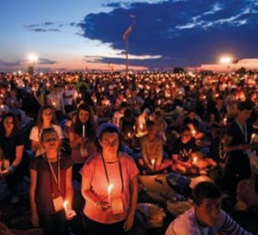
Ekklesia
Key
Vocab
The Greek word ekklesia literally means, “people called together”. It also means ‘church’, people called together in love. The study of the church is called ecclesiology.
Notes:
Photo Credit: AMP Textbook p. 9.
Directions: Have students write down the term and definition as part of a Key Vocab section in their notes.
Teaching points: From CCC 751-752, “The word "Church" (Latin ecclesia, from the Greek ek-ka-lein, to "call out of") means a convocation or an assembly. It designates the assemblies of the people, usually for a religious purpose. Ekklesia is used frequently in the Greek Old Testament for the assembly of the Chosen People before God, above all for their assembly on Mount Sinai where Israel received the Law and was established by God as his holy people. By calling itself "Church," the first community of Christian believers recognized itself as heir to that assembly. In the Church, God is "calling together" his people from all the ends of the earth. The equivalent Greek term Kyriake, from which the English word Church and the German Kirche are derived, means "what belongs to the Lord."
In Christian usage, the word "church" designates the liturgical assembly, but also the local community or the whole universal community of believers. These three meanings are inseparable. "The Church" is the People that God gathers in the whole world. She exists in local communities and is made real as a liturgical, above all a Eucharistic, assembly. She draws her life from the word and the Body of Christ and so herself becomes Christ's Body.
The resources linked in this presentation file may contain copyright material. Such material is made available for educational purposes only. This constitutes a “fair use” of any such copyright material as provided for in Title 17 U.S.C. section106A-117 of the US Copyright Law.

Slide 6

We are the Church
Those who are baptized as Catholic and practice their faith are members of the “visible” Church.
The ‘church’ is also a reference to all Christians who are baptized.
The Church in some way is also a spiritual reality that extends her reach into all hearts who long for God.
Notes:
Photo Credit: AMP Textbook p. 14.
Directions: Have students copy information from the slide into their notes.
Teaching Points: The reality of the Church is therefore relevant to all. Catholics, non-Catholic Christians, and others are all called to embrace the truth about God and his relationship with us.
We are all called to knowledge of the Church, which can lead us to understand how the Church facilitates our growth in wisdom, grace, and unity with God and others and brings about the salvation of our souls and a path to eternal life.
This does not mean that the Catholic Church is not the one true Church but it means that the desire for salvation is for all people and the invitation to all goes out from the visible Church, as a light to the nations, to all people of good will.
Online Resources: Assign article, Small ’c’ Catholic. URL here:https://www.thecatholicthing.org/2017/07/30/small-c-catholic/
The resources linked in this presentation file may contain copyright material. Such material is made available for educational purposes only. This constitutes a “fair use” of any such copyright material as provided for in Title 17 U.S.C. section106A-117 of the US Copyright Law.

Slide 7
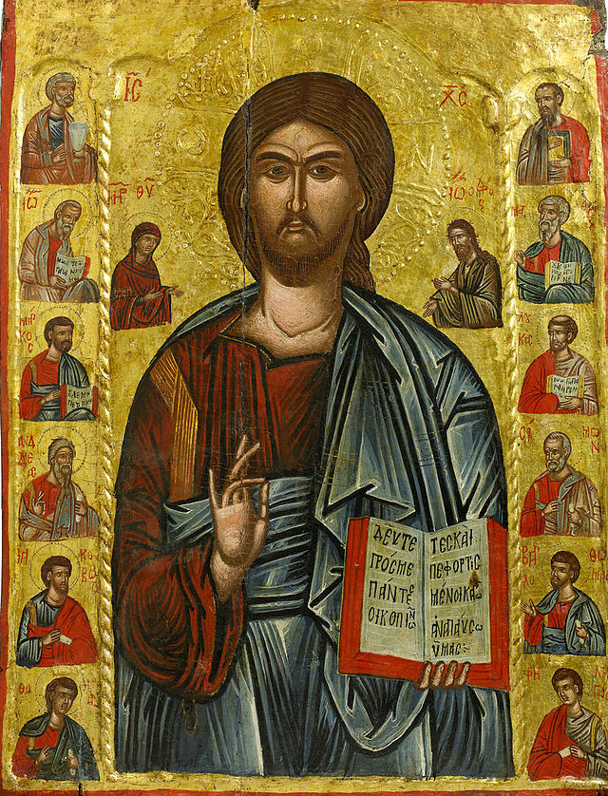
New Covenant
Key
Vocab
The climax of salvation history; the coming of Jesus Christ, who is the fullness of God’s revelation. The sacred promise of salvation between God and his people, the Church, in Jesus Christ.
Notes:
Photo Credit: 12 Apostels from Macedonia.jpeg
Icon of Christ and the 12 Apostels, Macedonia.Unknown author.Public domain. https://commons.wikimedia.org/wiki/File:12_Apostels_from_Macedonia.jpeg
Directions: Have students write down the term and definition as part of a Key Vocab section in their notes.
The resources linked in this presentation file may contain copyright material. Such material is made available for educational purposes only. This constitutes a “fair use” of any such copyright material as provided for in Title 17 U.S.C. section106A-117 of the US Copyright Law.

Slide 8

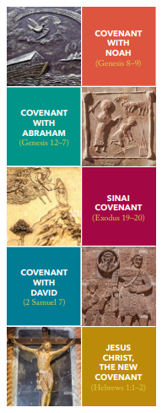
The Church and the New Covenant
Step by step God taught and prepared this people, making known in its history both Himself and His will and plan.
All these things, however, were done by way of preparation and as a figure of that new and perfect covenant…
In the Church and Eucharist, He calls a people together made up of Jews and Gentiles, which would be one, not according to the flesh, but in the Spirit, and it would be the new people of God.
Notes:
Photo Credit: AMP Textbook pg. 8
Directions: Have students copy information from the slide into their notes.
Teaching Points: God announced through the prophets a new and eternal covenant. He was committed to the Jewish people as a faith community from which his own Son, Jesus, would be born. When the proper time came, God himself became a member of that community. The only Son of God was entrusted not only to this Chosen People, but to humanity itself. In the Incarnation, the Second Person of the Blessed Trinity came down from heaven and assumed human nature. It was through this event that God instituted the New Covenant through Christ and specifically through his Paschal Mystery: “He called a people together made up of Jews and Gentiles, which would be one, not according to the flesh, but in the Spirit, and it would be the new people of God” (Lumen Gentium, 9).
Online Resources: Assign article, ‘Jesus Explicitly Ratified the New Covenant by Instituting the Eucharist’. URL here: https://www.ncregister.com/blog/jesus-explicitly-ratified-the-new-covenant-by-instituting-the-eucharist
The resources linked in this presentation file may contain copyright material. Such material is made available for educational purposes only. This constitutes a “fair use” of any such copyright material as provided for in Title 17 U.S.C. section106A-117 of the US Copyright Law.

Slide 9
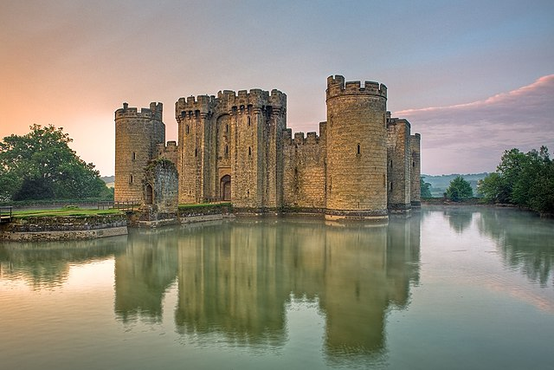
The Kingdom of God
Key
Vocab
The world as God would have it be. A state of “already, but not yet.” God’s Kingdom has been established in the Church but it has not yet transformed all creation; that will not take place until the end of history.
Notes:
Photo Credit: .Bodiam Castle East Sussex England UK. Antony McCallum. Creative Commons Attribution-Share. Alike 3.0. https://commons.wikimedia.org/wiki/File:Bodiam-castle-10My8-1197.jpg
Directions: Have students write down the term and definition as part of a Key Vocab section in their notes.
Online Resources: Assign article, What is the Kingdom of God?. URL here: https://www.catholic.com/magazine/online-edition/what-is-the-kingdom-of-god
The resources linked in this presentation file may contain copyright material. Such material is made available for educational purposes only. This constitutes a “fair use” of any such copyright material as provided for in Title 17 U.S.C. section106A-117 of the US Copyright Law.

Slide 10

Turn and Talk
Explain the “already, not yet” dimension of the Kingdom of God in your own words.
Notes:
Directions: Have students write down the question and then write down their answer….Then have students share their answers with one person close by.
The resources linked in this presentation file may contain copyright material. Such material is made available for educational purposes only. This constitutes a “fair use” of any such copyright material as provided for in Title 17 U.S.C. section106A-117 of the US Copyright Law.

Slide 11
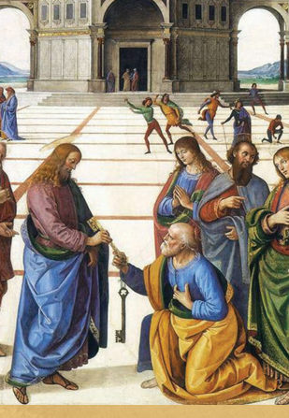
The Keys of the Kingdom
“And so I say to you, you are Peter, and upon this rock I will build my church… I will give you the keys to the kingdom of heaven. Whatever you bind on earth shall be bound in heaven; and whatever you loose on earth shall be loosed in heaven.”
-Mt 16:18-19
Notes:
Photo Credit: AMP Textbook p. 3.
Directions: Have students copy information from the slide into their notes.
Teaching Points: The Church is not founded on an idea or a myth or a legend but on a real, historical person. Jesus founded the Church, and by his words and actions shaped her form and structure. For example, even as the twelve tribes of Israel were the backbone of the Jewish faith and nation, so the Twelve Apostles chosen by Jesus were the “foundation stones of the new Jerusalem,” the Church (Catechism of the Catholic Church, 765). In instituting his Church, Jesus ushered in the Kingdom of God on earth. He chose Peter as the head of his Church (first Pope). By giving Peter and his successors the proverbial keys to the Kingdom he is entrusting him with the supreme authority to govern and teach along with the other apostles and their successors.
Online Resources: View video, Peter, the Rock, the Keys and the Chair. URL here: https://youtu.be/faIB-sOBDKk
The resources linked in this presentation file may contain copyright material. Such material is made available for educational purposes only. This constitutes a “fair use” of any such copyright material as provided for in Title 17 U.S.C. section106A-117 of the US Copyright Law.

Slide 12
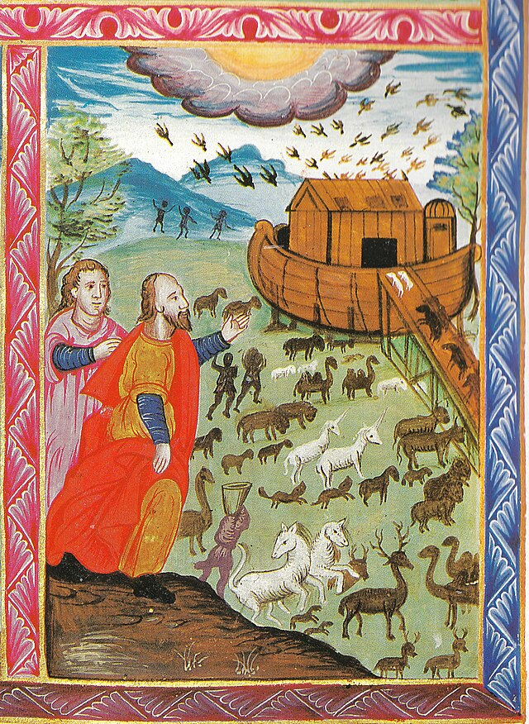
The Church is Necessary for Salvation
“Outside the Church there is no salvation” (CCC, 846, quoting St. Cyprian).
This is so because Jesus is necessary for salvation.
Without Jesus, who has made the Church his Body, there is no salvation.
All who recognize that the Church is the Body of Christ are called to be part of that Church.
Notes:
Photo Credit: Armenian icon 32, The ark of Noah, 1643-1646.jpg. صعود نوح والحيوانات للسفينة. منمنمة أرمنية من إنجيل دي براي. Unknown author. Public domain. https://commons.wikimedia.org/wiki/File:Armenian_icon_32,_The_ark_of_Noah,_1643-1646.jpg
Directions: Have students copy the information from the slide into their notes.
Teaching Points: Salvation is the end goal of creation. It refers to the forgiveness of sins and the restoration of our permanent unity with God and one another. Salvation is made possible through the life, Death, and Resurrection of Christ. The Church is necessary for salvation because Jesus is necessary for salvation and Jesus is the head of the Church. This statement applies to people in different ways based on their knowledge of Jesus and their instruction in the Church. Achieving our salvation is not a one-time event; it is a lifelong process that we can measure by our participation in the life of the Church.
In comparing the Church to Noah’s Ark Saint Cyprian was saying that unless your in the ark you will perish in the flood and unless you enter the Church you will not be saved.
“And as the Ark of Noah was nothing else than the sacrament of the Church of Christ, which then, when all without were perishing, kept those only safe who were within the ark, we are manifestly instructed to look to the unity of the Church. Even as also the Apostle Peter laid down, saying, Thus also shall baptism in like manner make you safe; 1 Peter 3:21 showing that as they who were not in the ark with Noah not only were not purged and saved by water, but at once perished in that deluge; so now also, whoever are not in the Church with Christ will perish outside, unless they are converted by penitence to the only and saving lava of the Church”. (Saint Firmilian quoted in Cyprian, Epistle 74:15)
Online Resources: View video, Do You Have to be Catholic to be Saved? W/ Trent Horn
URL here: https://youtu.be/YQMERQlSlLg
The resources linked in this presentation file may contain copyright material. Such material is made available for educational purposes only. This constitutes a “fair use” of any such copyright material as provided for in Title 17 U.S.C. section106A-117 of the US Copyright Law.

Slide 13
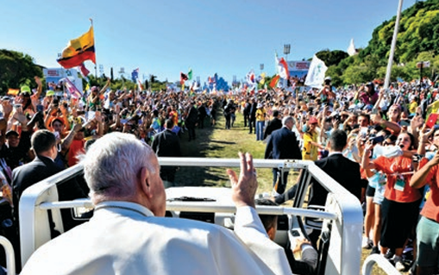
The Church is Human
The Church on earth is made up of imperfect human beings.
The Church is a hospital for sinners.
It’s composed of weeds and wheat.
Everyone, including Church leaders, has a sin problem.
Notes:
Photo Credit: AMP Textbook p. 34.
Directions: Have students copy information from the slide into their notes.
Teaching Points: The Church is a different kind of institution because she has both a divine dimension and a human dimension.
Hospital for sinners: “On hearing this, Jesus said to them, “It is not the healthy who need a doctor, but the sick. I have not come to call the righteous, but sinners.” Mk 2:17
Weeds and Wheat in the Church: “The kingdom of heaven,” he tells us, “may be likened to a man who sowed good seed in his field. While everyone was asleep his enemy came and sowed weeds all through the wheat, and then went off. When the crop grew and bore fruit, the weeds appeared as well” (Matthew 13:24-30).
The messiness of the Church stems from its human dimension. “I love that Church which plunges into the thickets of human history and is not afraid of compromising itself by getting mixed up with men’s affairs … because it loves men and therefore goes out to look for them wherever they are. And I love best of all that Church which is mud-splashed from history because it has played its part in history, that Church of the poor which is denounced by pharisees whose hands are clean but who can point to no single person they have saved.” —Jean Daniélou, Prayer as a Political Problem
That the Church is human is all too apparent. Of course, when most people talk about the Church being “human” they are referring to her failures (as if that is all it means to be human). But the human dimension of the Church continues in heaven, where there will be no failures. That the Church is human means primarily that she is built out of the living stones of individual human persons. She exists in the world in a human manner and through human means. She continues the presence of Christ by human words, actions and relationships.
The resources linked in this presentation file may contain copyright material. Such material is made available for educational purposes only. This constitutes a “fair use” of any such copyright material as provided for in Title 17 U.S.C. section106A-117 of the US Copyright Law.

Slide 14
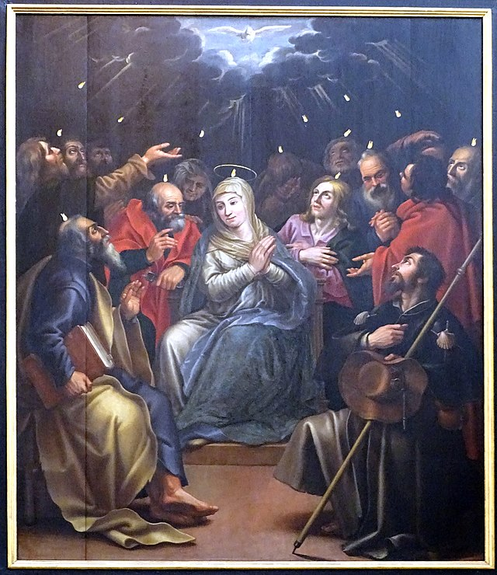
The Church is Divine
God the Father planned the Church.
Jesus Christ is the head of his bride, the Church.
The Holy Spirit dwells within the Church, as a soul to a body, giving it supernatural life and sanctifying it with grace.
Notes:
Photo Credit: Ad Meskens. Creative Commons Attribution-Share Alike 4.0
Mechelen St - Jan Lucas Franchoys Descent of the Holy Spirit 02.jpg. https://commons.wikimedia.org/wiki/File:Mechelen_St_-_Jan_Lucas_Franchoys_Descent_of_the_Holy_Spirit_02.jpg
Directions: Have students copy information from the slide into their notes.
Teaching Points: The Church is not merely human, as many people think. She is also divine: established by God the Son, mandated by his Father, and maintained and guarded by the Holy Spirit. She is not just an assembly of believers gathered around the Pope; she is a body whose head is Christ and whose soul is the Holy Spirit.
The Holy Spirit animates all the parts of Christ’s mystical body, joining them together with their head. He is “the source” of the body’s life, “of its unity in diversity, and of the riches of its gifts.”
“The Spirit dwells in the Church and in the hearts of the faithful as in a temple,” Pope St. John Paul II said in his encyclical on the Holy Spirit, Dominum et Vivificantem (“Lord and Giver of Life”).
“The Spirit guides the Church into the fullness of truth and gives her a unity of fellowship and service,”
“He furnishes and directs her with various gifts, both hierarchical and charismatic.”
These gifts include the sacraments, God’s word, the virtues of the body’s members, special favours (“charisms”), and the authority of the apostles –
Online Resources: View video, How the Holy Spirit Guides the Church. URL here: https://youtu.be/j96dw_Ywogg
The resources linked in this presentation file may contain copyright material. Such material is made available for educational purposes only. This constitutes a “fair use” of any such copyright material as provided for in Title 17 U.S.C. section106A-117 of the US Copyright Law.

Slide 15

Memorize It
Key
Verse
“I will give you the keys to the kingdom of heaven. Whatever you bind on earth shall be bound in heaven; and whatever you loose on earth shall be loosed in heaven.”
-Mt 16: 19
Notes:
Directions: Have students write down the verse and commit it to memory. Bonus points may be awarded if they can add it to the end of the chapter assessment.
The resources linked in this presentation file may contain copyright material. Such material is made available for educational purposes only. This constitutes a “fair use” of any such copyright material as provided for in Title 17 U.S.C. section106A-117 of the US Copyright Law.

Slide 16

Challenge
Question
Wasn’t the Catholic Church created by the Emperor Constantine when he made Christianity the official religion of the Roman Empire?
“No. The Catholic Church can trace its unbroken chain of apostolic leadership all the way back to Peter and the Apostles. Once the church began to grow worldwide, the word ‘Catholic’ was used to describe it as being universal but it is the same Church that Jesus himself instituted.”
Notes:
Directions: Use the animation feature to have the yellow answer box appear after you ask the students to respond out loud to the question on the left.
Online Resources: Have students view video, Did Constantine start the Catholic Church?. URL here: https://youtu.be/XeK1tbMXeNk
The resources linked in this presentation file may contain copyright material. Such material is made available for educational purposes only. This constitutes a “fair use” of any such copyright material as provided for in Title 17 U.S.C. section106A-117 of the US Copyright Law.

