Slide 1
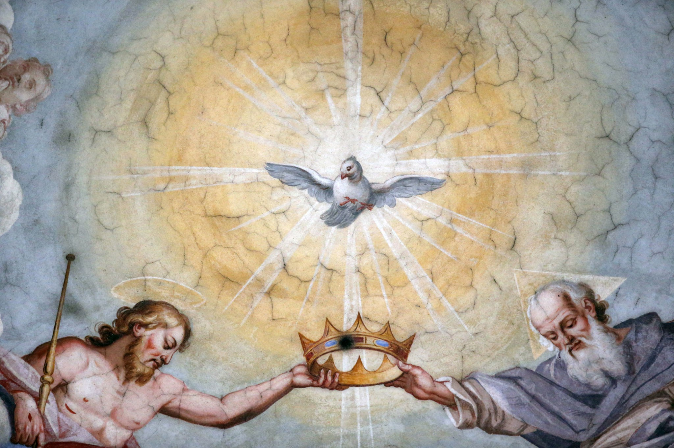
The Trinity: Explained
Sue, John, Linda, Kevin, Louise
4th Block
Intro to the Catechism

Slide 2
Table of Contents
The Trinity in Scripture…………………………………………………....................
The Trinity according to Saints and Church Fathers…………………...
The Trinity according to Papal Teachings……………………………………..
The Trinity according to the Church Documents…………………………
References………………………………………………………………………………………
Appendix....................................................................................................
i

Slide 3
1
The Trinity in Scripture
Topic Introduction
  What does Scripture teach about the Trinity?
Topic Details
  The Trinity in the OT
  The Trinity in the Gospels
  The Trinity in the Epistles
Topic Conclusion
  What did Scripture teach about the Trinity?
Topic Reflection
  What new insights about the Trinity have I gained? How might these insights shape how I live my spiritual life?
1

Slide 4

Put text here
2

Slide 5
2
The Trinity according to Saints and Church Fathers
Topic Introduction
  What do the Saints and Church Fathers teach about the Trinity?
Topic Details (add as many as you need)
  The Trinity in the Councils
  The Trinity according to the Saints
  The Trinity according to Church Fathers
Topic Conclusion
  What did the Saints and Church Fathers teach about the Trinity?
Topic Reflection
  What new insights about the Trinity have I gained? How might these insights shape how I live my spiritual life?
3

Slide 6
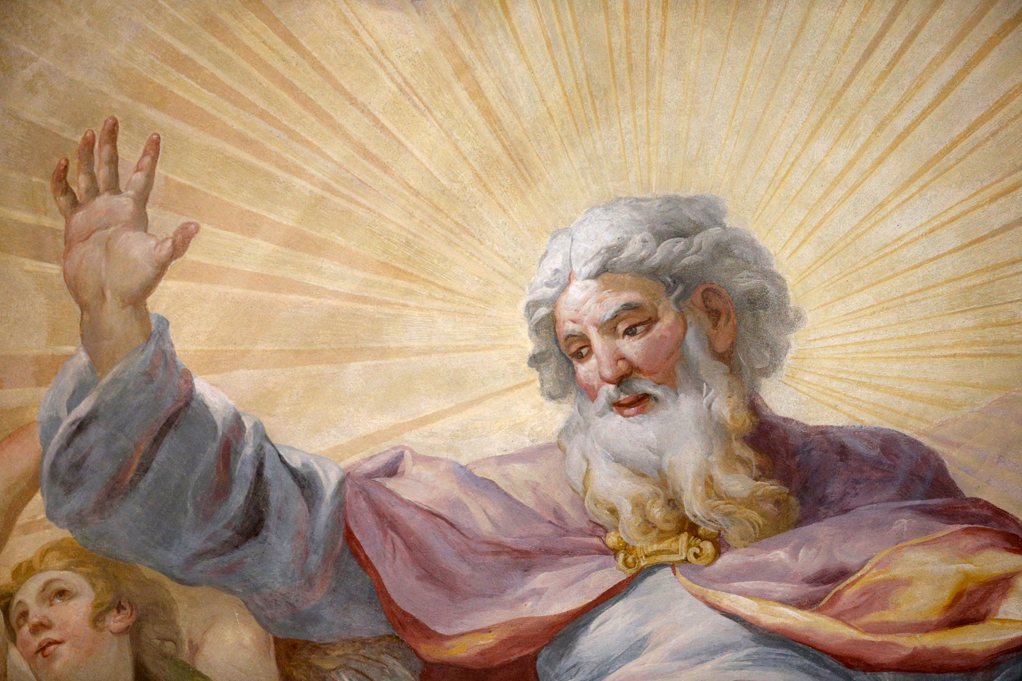
Put text here
4

Slide 7
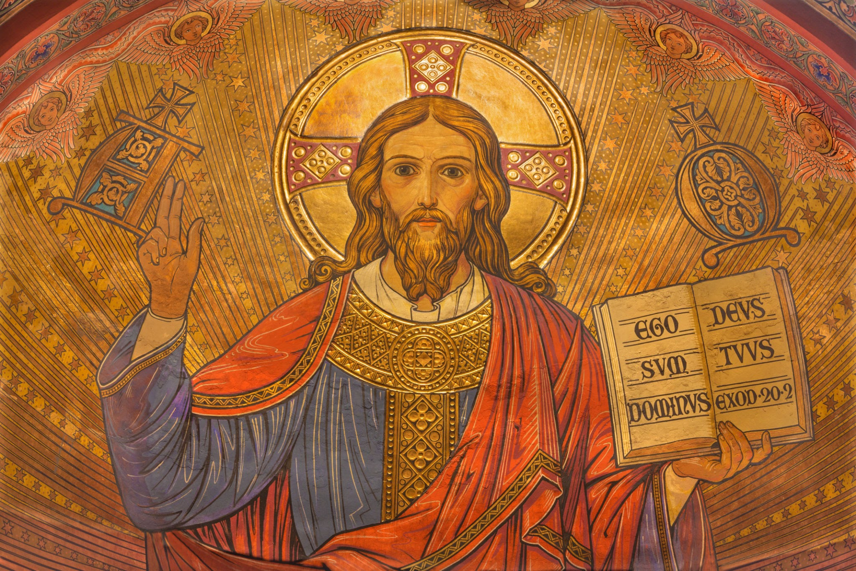
3
The Trinity according to Papal Teachings
Topic Introduction
  What do the Papal Teachings teach about the Trinity?
Topic Details (add as many as you need)
  The Trinity according to the Pope(s)
  The Trinity in Papal Encyclicals
  The Trinity in Papal Addresses
Topic Conclusion
  What did the Papal Teachings teach about the Trinity?
Topic Reflection
  What new insights about the Trinity have I gained? How might these insights shape how I live my spiritual life?
5

Slide 8
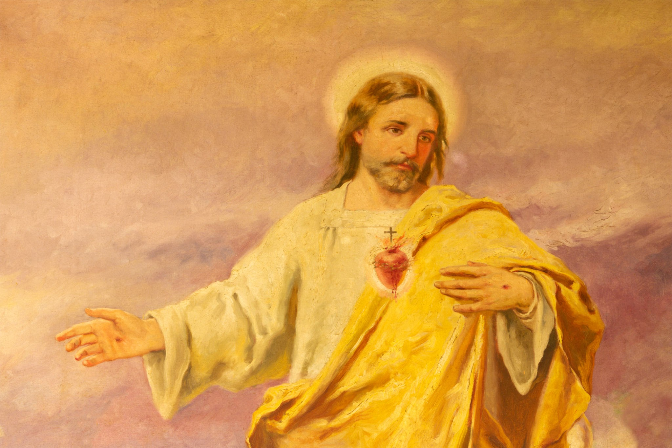
Put text here
6

Slide 9
4
The Trinity according to Church Documents
Topic Introduction
  What do Church Documents teach about the Trinity?
Topic Details (add as many as you need)
  The Trinity in the Catechism
  The Trinity in Apostolic Constitutions
  The Trinity in Apostolic Exhortations
Topic Conclusion
  What did the Church Documents teach about the Trinity?
Topic Reflection
  What new insights about the Trinity have I gained? How might these insights shape how I live my spiritual life?
7

Slide 10

Put text here
8

Slide 11
References
Click HERE for how to write your reference list in APA format. Your main references should be:
The textbook
The CCC
The Bible
Example:
Catholic Church. (2000). Catechism of the Catholic Church: revised in accordance with the official Latin text promulgated by Pope John Paul II. United States Catholic Conference.
11

Slide 12
12

Slide 13
Appendix
This is where you will put your reflections from this project. Remember they may be in the form of a prayer, reflections, songs, quotes, or art. Make sure to attribute any artist, author, etc.. With the title, be sure to write the team members name who wanted it shared in the appendix.
13

Slide 14
Holy Spirit Reflection
By Sue
WRITE TEXT TO REFLECTION HERE
14

